Slide 1
TAKE OFF & TAKE FLIGHT with BOTTLE ROCKETS

Slide 2
Bottle Rocket Review
When the baking soda came into contact with the vinegar, already in the bottle, a chemical reaction was initiated that created pressure inside the bottle. The bottle could not contain all of the built up pressure and energy, so it released the energy by forcing the bottle upwards, like a space rocket.

Slide 3
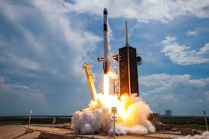
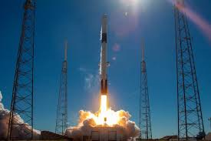
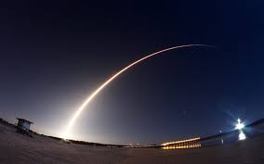
ROCKET LAUNCH IMAGES

Slide 4
Newton’s Laws of Motion
An object at rest remains at rest, and an object in motion remains in motion at constant speed and in a straight line unless acted on by an unbalanced force
Force is equal to mass times acceleration (F = ma)
For every action there is an equal and opposite reaction

Slide 5
1st Law Application
At Rest: Forces are balanced. The force of gravity on the rocket balances with that of the launch pad holding it up.
In Motion: Thrust from the rocket unbalances the forces. As a result, the rocket travels until it runs out of fuel.

Slide 6
2nd Law Application
Acceleration Depends on Mass
Smaller the mass the smaller force needed to accelerate.
Your rocket will go faster and higher with:
Minimize weight
Acceleration Depends on Force
An object’s acceleration increases as force on the object increases
Your rocket will go faster and higher with:
Faster fluid release
Increased pressure inside the bottle

Slide 7
3rd Law Application
When fluid escapes the bottle, providing a downwards action force that is accompanied by an equal and opposite reaction force that results in the movement of the rocket in the opposite direction.

Slide 8
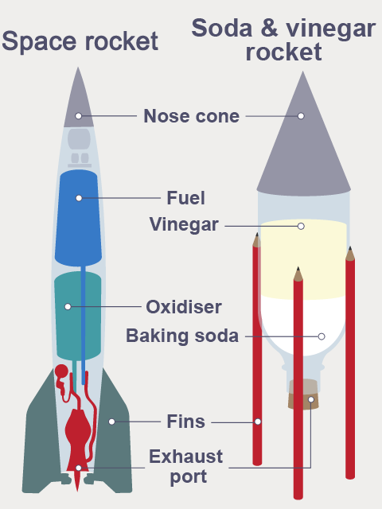
Bottle Rocket vs. Space Rocket

Slide 9
CHEMICAL REACTION
When baking soda and vinegar react, it creates carbon dioxide gas. The gas is what causes bubbles and foam when the two ingredients are mixed. This gas builds pressure within the bottle. Once enough gas builds up, the bottle's opening releases, propelling the rocket forward.

Slide 10
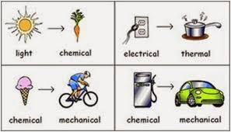
ENERGY CONVERSION

Slide 11
Link to Survey with Do and Snap Picture Challenge!

