Slide 1
ASABE Water Use Standards - Simplified Landscape Irrigation Demand Estimation (SLIDE)
Roger Kjelgren
Dept. Climate-Plants-Soils
Utah State University

Slide 2
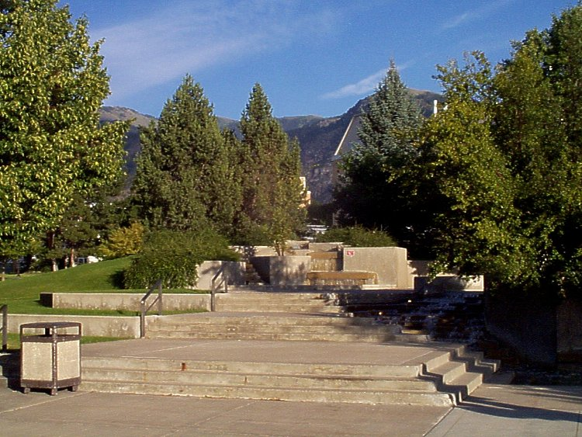
Urban Landscape Value
Urban landscapes have value
Turfgrass - economic impact ~$100M
Trees – 3.8 Billion standing urban trees, appraised value $2.4 Trillion
Ecosystem services value
Shading/cooling
Erosion control
Biodiversity

Slide 3
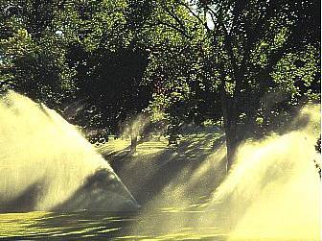
Urban Landscape Water
Irrigation required to maintain value
Low rainfall climates, limited rooting volume
Water for urban irrigation increasingly limited
2013 California drought
2011 Texas drought, >5 trees million dead
Efficiency urgent: Get most landscape for least water

Slide 4
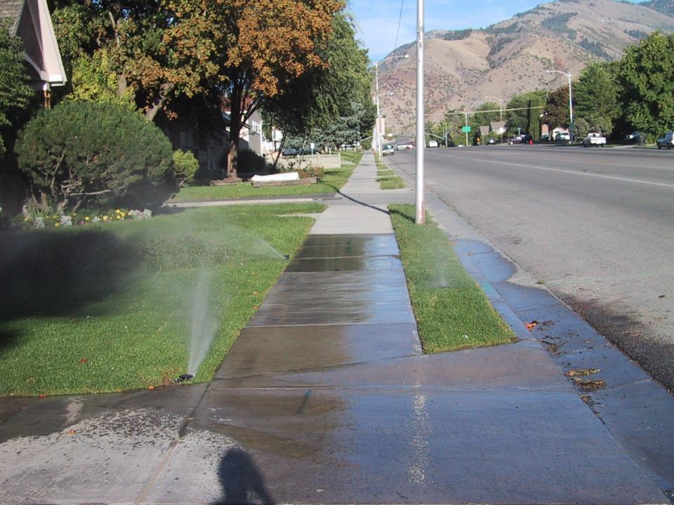
Urban Landscape Water Efficiency
Stakeholders in water efficient landscapes
Landscape architects, designers
Regulators
Landscape contractors, maintenance firms
Everybody here
Satisfy landscape water demand with irrigation
Water lost to plant evapotranspiration replaced by irrigation
Irrigate long enough to fill root zone
Time irrigation when plant depletes root zone water to threshold of visible water stress signs

Slide 5



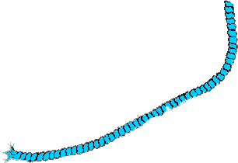

Soil-plant-air continuum
Stomata
Cell expansion,
Biochemical processes
Transpiration
CO
2
Nutrients
Rooting
Root Hair
Depth

Slide 6

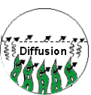
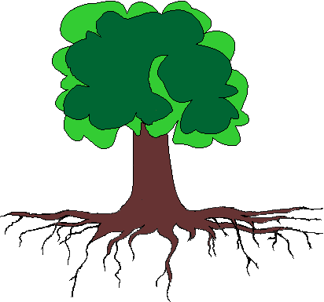
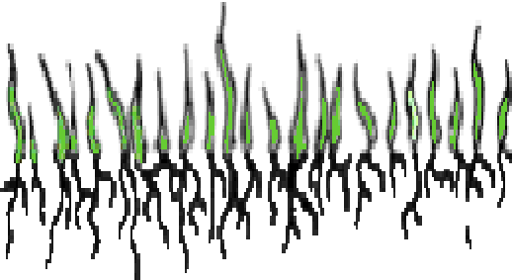
Plant Water Demand
When: Evapotranspiration use that depletes soil water to threshold of plant performance degrading
How much: amount needed to refill root zone
6

Slide 7



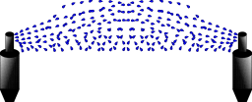
Tree Water Use Basics
Weather factors that govern tree transpiration (water use)
Sun: energy to evaporate water
Temperature: air space evaporation potential
Humidity: actual air space available for evaporation
Wind: how fast evaporate water moves into actual available air space
Trees respond to wind, humidity different from other plants

Slide 8
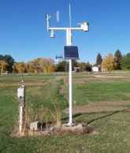
Landscape Plant Water Demand
Plant water use key component of water demand
Necessary for regulation, irrigation scheduling
For landscapes, ag model of ET used: measure weather variables (solar radiation, wind, air temp, humidity) to calculate water use of hypothetical turfgrass: ETo
ETo x adjustment factor = estimated plant water use

Slide 9
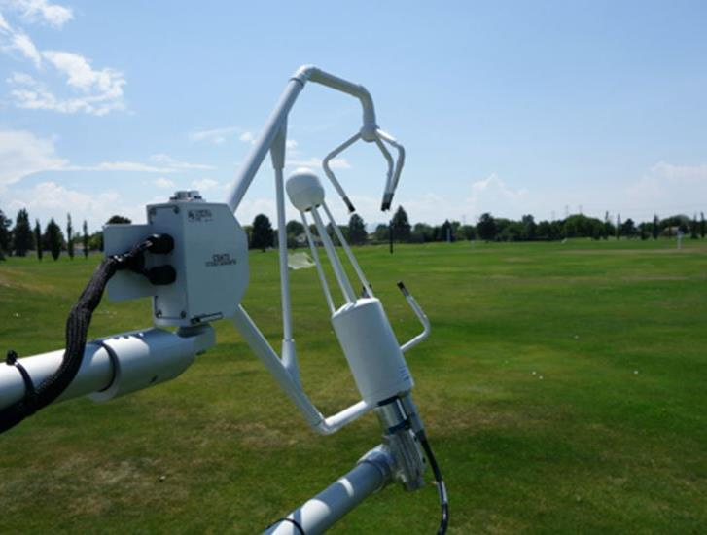
Reference Evapotranspiration: ETo
ETo x adjustment factor = estimated water use
Urban ETo—oasis water use of large turf area
Not same for mosaic of smaller landscapes

Slide 10
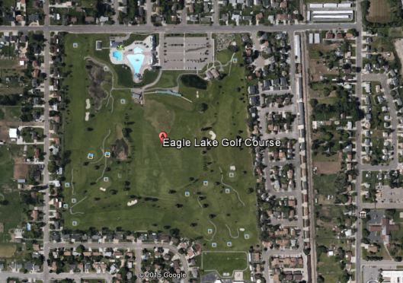
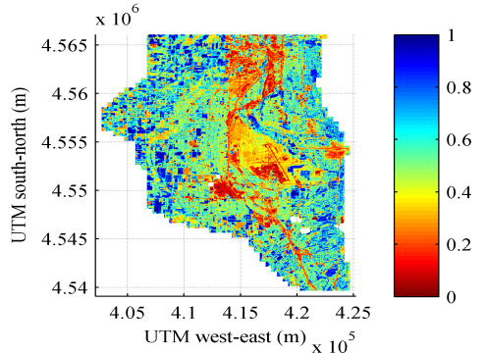
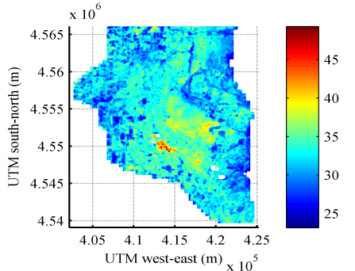
Urban Mosaic
Temper
-ature
Plant cover

Slide 11
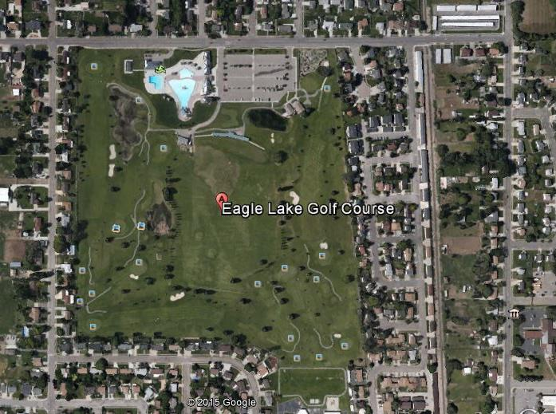
Urban Landscape Mosaic
Biological diversity
Structural diversity (non uniform sizes, plant cover)
Micro climate diversity
How to quantify water demand of urban mosaic

Slide 12
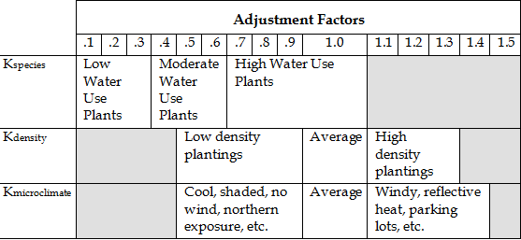
Current Approach from California
ET = K_{L} x ET_{O}
K_{L} = Kspecies x Kdensity x Kmicroclimate
X
X
Notes:
Class Five: Plants, Plant Maintenance and IPM
Determining Water Needs of Plants
Determining K_{L}
The landscape coefficient (K_{L}) is the other part of the ET equation. How do we determine K_{L}? It depends on plant species, planting density, and microclimate.

Slide 13
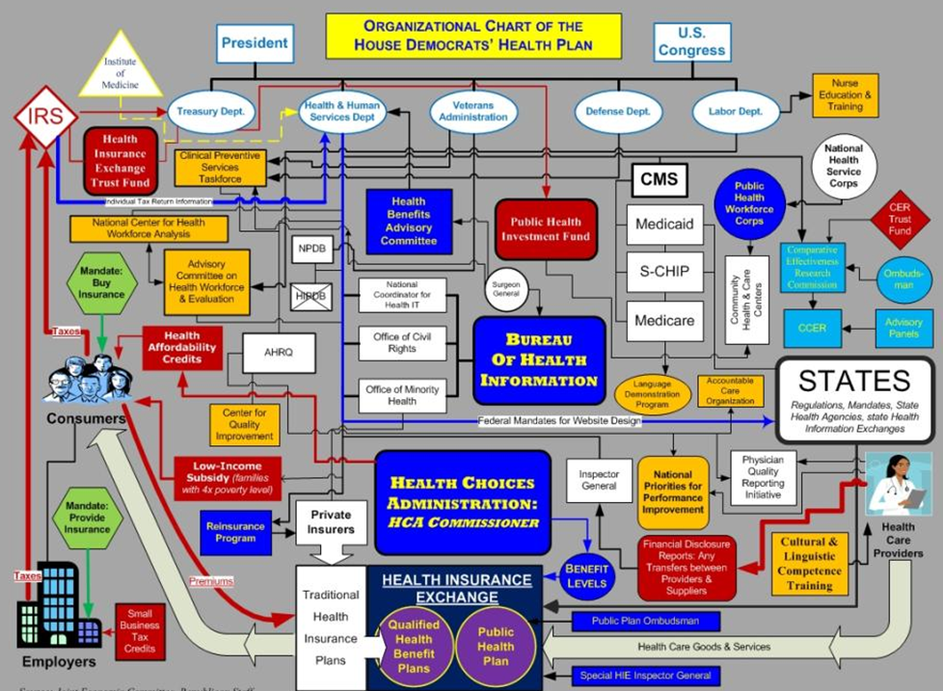

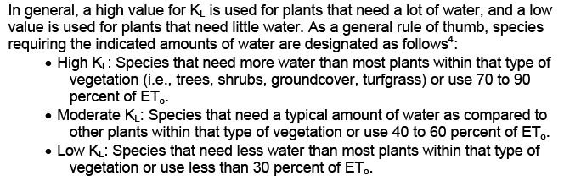
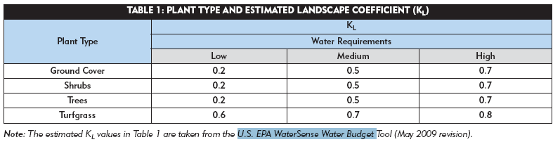
What we have now
COMPLEXITY

Slide 14
New Approach: SLIDE (Simplified Landscape Irrigation Demand Estimation) Rules
SLIDE Rule #1: Reference ETo-basis for estimating water use; useful for uniform plant surfaces, less useful for non-uniform plant surfaces
SLIDE Rule #2: Plant factors (PF)--simple downward adjustments to ETo to estimate water use of turf, non-turf, and desert plants
SLIDE Rule #3: Hydrozone—the species with highest water demand in a zone controlled by an irrigation valve dictates water demand for that zone
SLIDE Rule #4: Density—within a zone, plant density >80%- water use=ETo x PF ; for plant density <80%, water use=ETo x PF x leaf area of individual plants

Slide 15

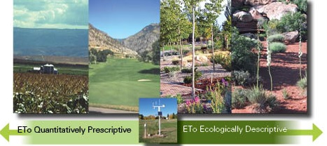
SLIDE Rule #1: Reference ETo-basis for estimating water use; useful for uniform plant surfaces, less useful for non-uniform plant surfaces

Slide 16
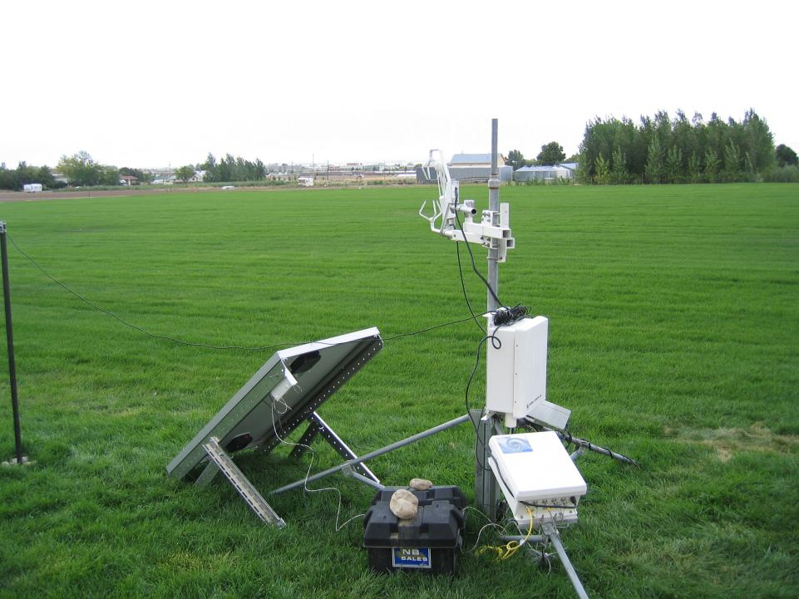
SLIDE Rule #1: Reference ETo-basis for estimating water use; useful for uniform plant surfaces, less useful for non-uniform plant surfaces
ETo useful for estimating water use over a season for all plant types, even desert species
ETo for season in Logan ≈ 25 inches; seasonal water use = 25 inches x Plant Factor (0.8)
ETo approximates water use for woody plants in arid climates, somewhat useful for irrigation scheduling
ETo not useful for irrigation scheduling of desert plants

Slide 17
SLIDE Rule #2: Plant factors (PF)--simple downward adjustments to ETo to estimate water use of turf, non-turf, and desert plants
SLIDE Rule #2 is the American Society of Agriculture and Biological Engineers imminent national standard
Defines Plant Factors (PF) to adjust ETo downward for major plant types: turf, non-turf, desert plants, with subdivisions based on physiological responses to temperature
Turf separated by warm and cool season types
Non turf (especially woody plants) separate by response in arid versus humid climates

Slide 18
ASABE Standard S623, SLIDE Rule #2
Fraction of ET_{o} (Plant Factor) to estimate water use yet maintain acceptable appearance of established landscape plants
 | Recommended Plant Factor
Turf-Cool Season | 0.8
Turf-Warm Season | 0.6
Woody plants-Humid | 0.7
Woody plants-Arid | 0.5
Desert plants | 0.3

Slide 19
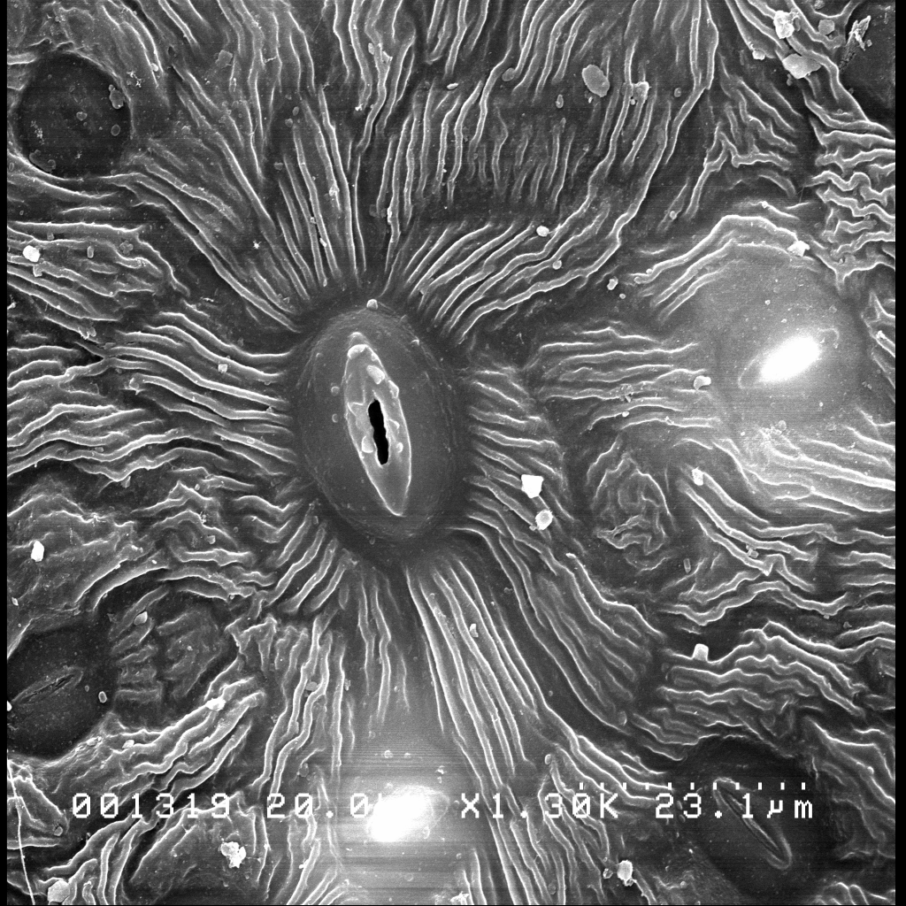
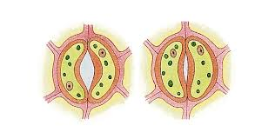

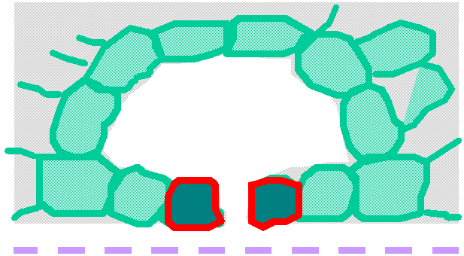
SLIDE Rule #2: Tree stomate response to dry air (low humidity, high vapor deficit)
Cool temperatures, low vapor pressure deficit: high humidity
High temps, high VPD: – low humdity
H⁺
H⁺
H⁺
H⁺
H⁺
H⁺
O⁻
H⁺
H⁺
O⁻
H⁺
H⁺
O⁻
O⁻
O⁻
H⁺
H⁺
H⁺
H⁺
H⁺
H⁺
O⁻
O⁻
H⁺
H⁺
O⁻
O⁻
H⁺
H⁺
H⁺
H⁺
H⁺
H⁺
H⁺
H⁺
H⁺
H⁺
O⁻
O⁻
O⁻
O⁻
O⁻
H⁺
H⁺
H⁺
H⁺
H⁺
H⁺
O⁻
O⁻
O⁻

Slide 20
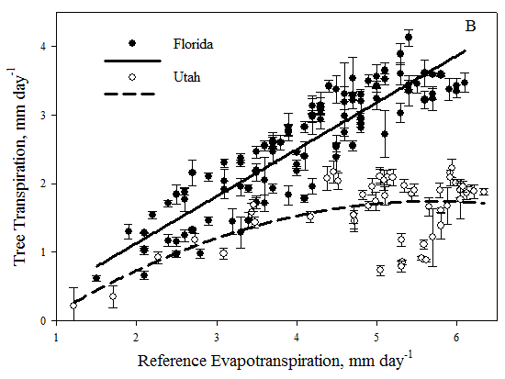
SLIDE Rule #2: Plant factors (PF)--simple downward adjustments to ETo to estimate water use of turf, non-turf, and desert plants
Woody plant response to dry air (low humidity, high vapor deficit: close stomates, moderate water use different from ETo
Study in Utah and Florida on Sweetgum cultivar ‘Moraine’
Sweetgum in Utah moderated water use at ETo levels above 4 mm (~0.1 inch) per day

Slide 21
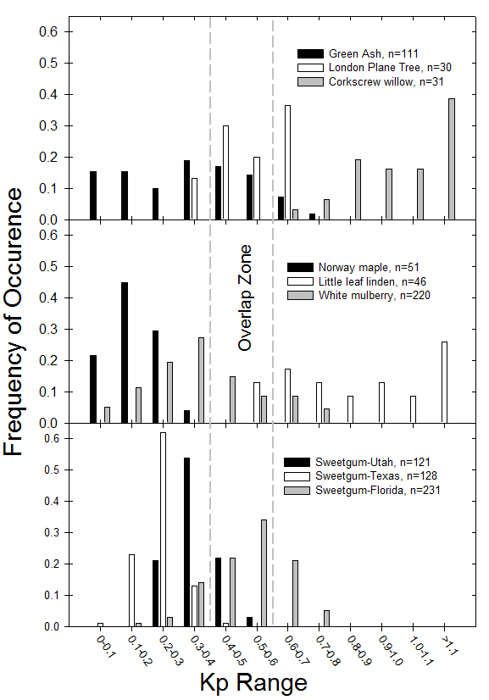
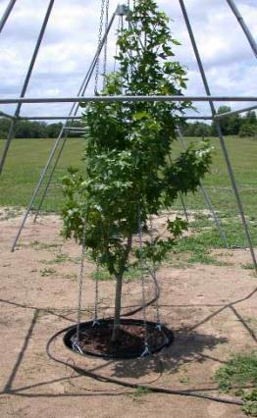
Compiled tree water use from several studies as % of ETo
Water use variation within species = variation among species
Overlap at 50% of ETo; hence Plant Factor in West of 0.5
PLANT FACTOR RANGE

Slide 22
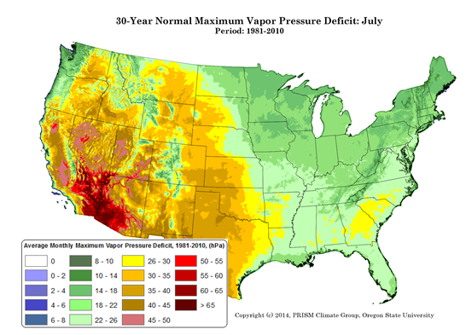
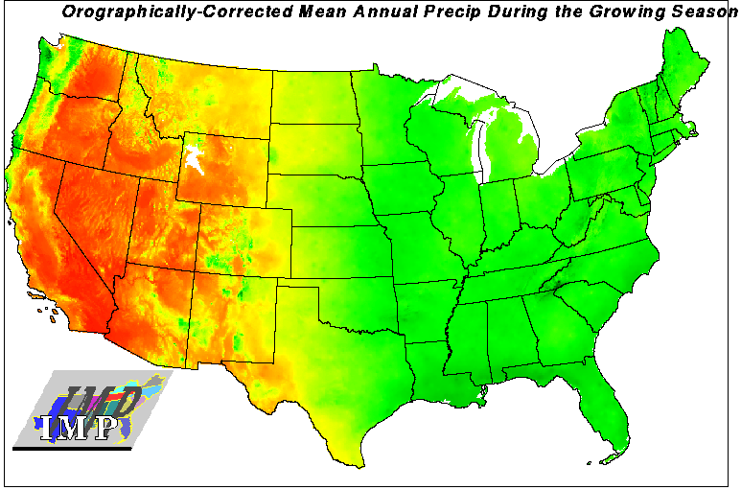
Where woody plant PF = 0.5 applies
Map of July average daily high vapor deficit (low humidity)

Slide 23
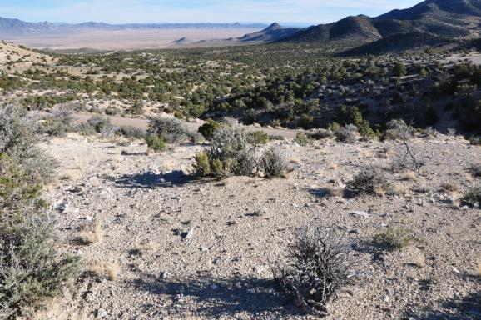
SLIDE Rule #2: Plant factors (PF)--simple downward adjustments to ETo to estimate water use of turf, non-turf, and desert plants
Desert plants survive because BY NOT INCREASING WATER USE WITH ETo; Performance, water use mostly untethered from ET_{o}
Fewer, cooler leaves = less water loss
Wider spacing = more water per plant
PF=0.3; coarse approximation
Mostly herbaceous perennials, shrubs

Slide 24
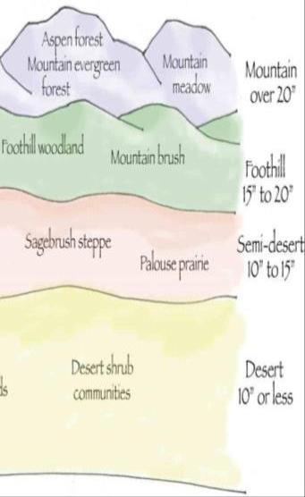
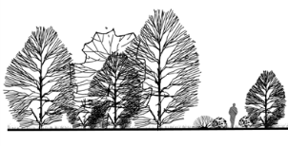
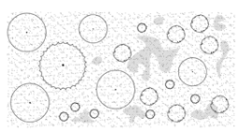
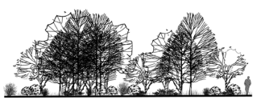
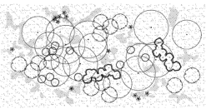




Plant Size, Density Decreases with Elevation

Slide 25
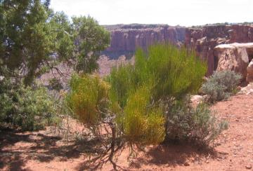
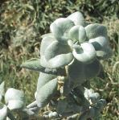
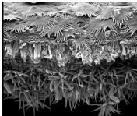
Leaf Traits That Aid in Avoiding, Tolerating Drought
Ephedra viridis
Leaf temperature
Smaller, less leaf area
Vertical leaf orientation , curled
Leaf color (blue reflects light)
Transpiration
Trichomes increasing boundary, reducing water loss
Sunken stomata
Dense, thick, evergreen (desiccation tolerant)
Visual cues tells story of plant water demand
Shepherdia rotundifolia

Slide 26
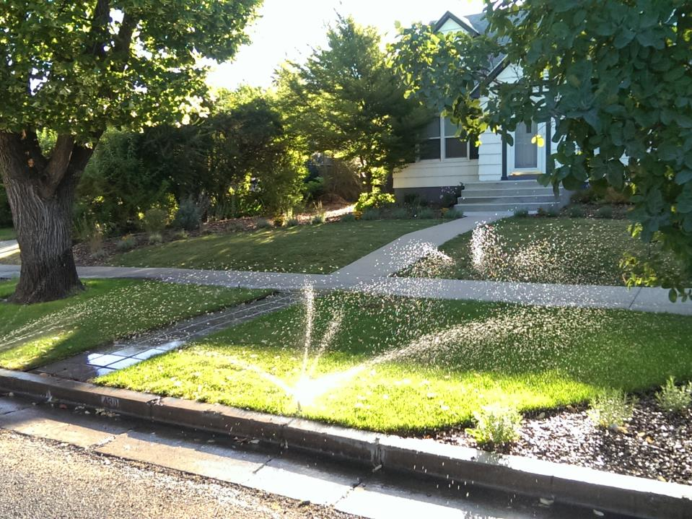
SLIDE Rule #3: Hydrozone—within a zone controlled by an irrigation valve the species with highest water use dictates irrigation schedule
Highest water use plants within a zone dictate when to irrigate, how long to irrigate
Higher PF species, such as turfgrass with imbedded trees; turf dictates schedule
Zone with sun and shade; sunlit area uses more water, dictates schedule

Slide 27
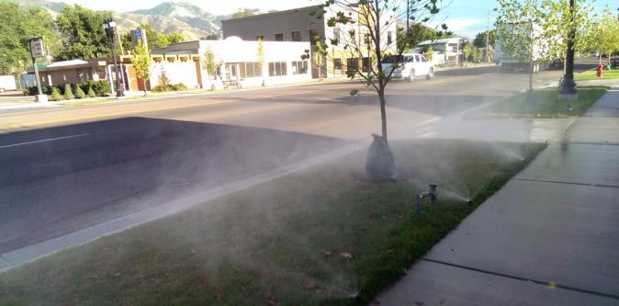
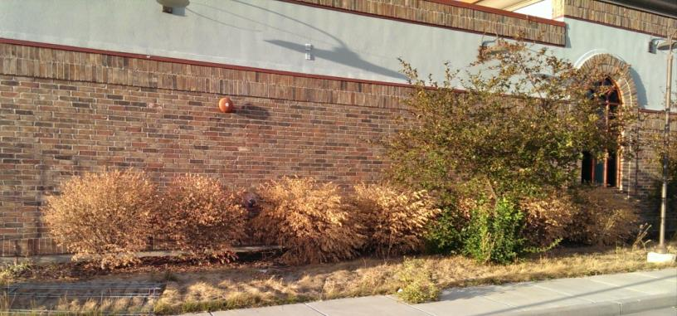
Tree in turf parking lot; turf dictates irrigation
Abandoned landscape; tree survived, but turf and burning bush did not

Slide 28
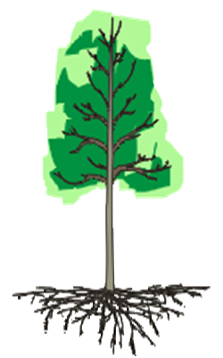

SLIDE Rule #3: Hydrozone
Within Plant Factor plant type, may be differences in rooting depth
Irrigate for shallowest root zone
Deeper rooted will access to irrigation and soil water
An irrigation zone controlled by a valve
Notes:
Key take home point from this slide is that the estimated amount to apply to root zone is decided by the designer based on plant type and soil properties (texture/available water and rooting (or soil) depth) from site analysis; for turf grass, 0.5 to 1 inch (12-25 mm) and woody plants from 1 inch/25 mm (for very drought intolerant species like burning bush [Euonymus alatus], but more often 2 inches/50 mm for most woody plants and many ground covers and perennial wildflowers. The graphic shows that if the plants actually have a deeper root system and access to more water than you estimate, it probably is not a problem if the root zone is continuously refilled with irrigation. The right side of the graphic shows the problem with the opposite, that the plant has less water witin the root zone than you estimate, so the plant may actually run out of water sooner than what you estimate.

Slide 29
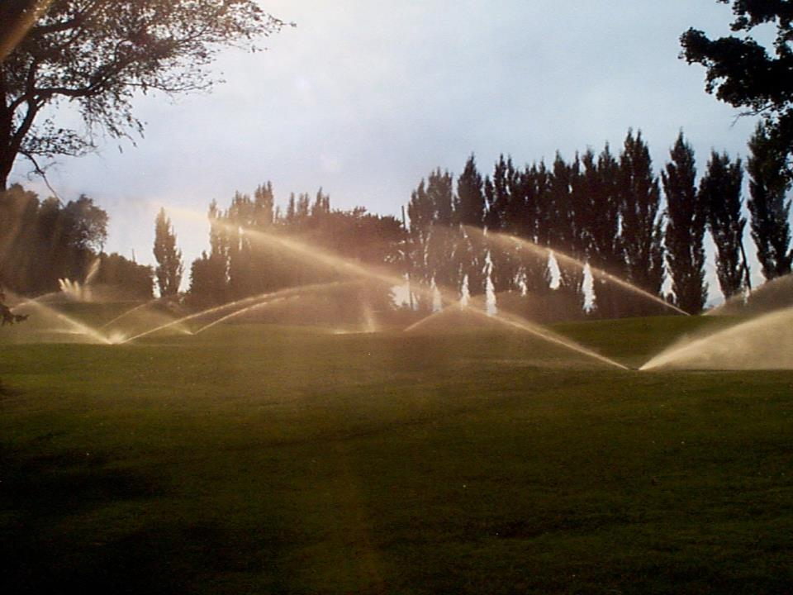
SLIDE Rule #4: Density—within a zone, plant density >80% ‘big leaf’ water use ; <80%, of individual plant water use
Above 80% plant cover within a hydrozone, ‘big leaf’ water use
Water use estimated as ETo x Plant Factor (highest water use plant)
Root zones intermingled, irrigate entire surface
Below 80% plant cover within a hydrozone, individual plant
Water use estimated ETo x Plant Factor x leaf area
Leaf area approximately crown drip line (projected crown) area
Irrigate within drip line area

Slide 30
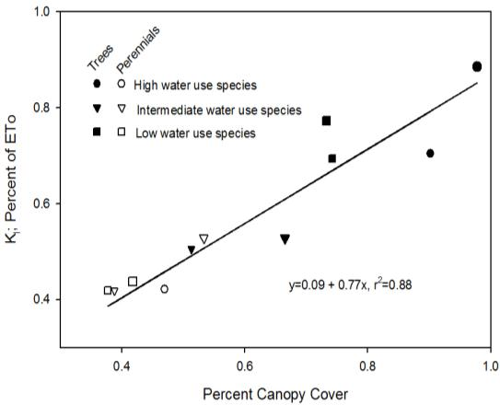
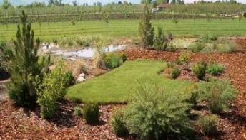
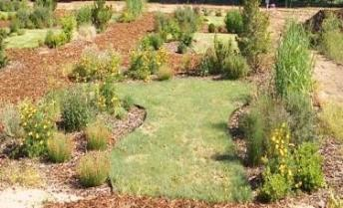
USU Botanical Center Landscape Lysimeter Study: Measure water use of woody plants and perennials at different densities

Slide 31
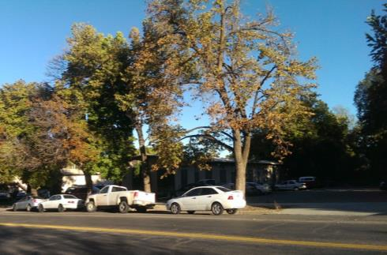
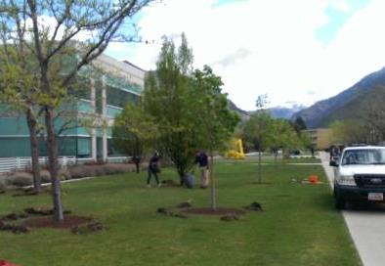
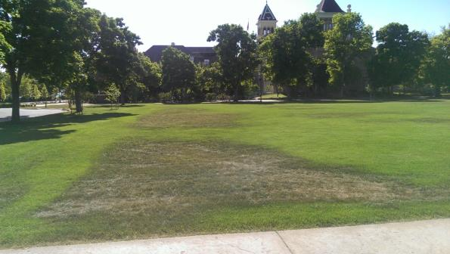
>80% plant cover, trees in turf: turfs get water from turf irrigation; if turf stressed, trees may be stressed If trees isolated, like in parking strip, they can be watered individually

Slide 32
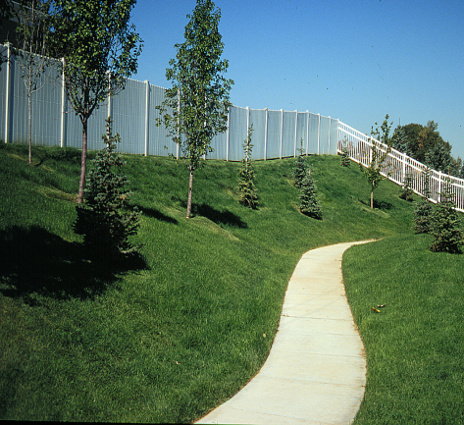
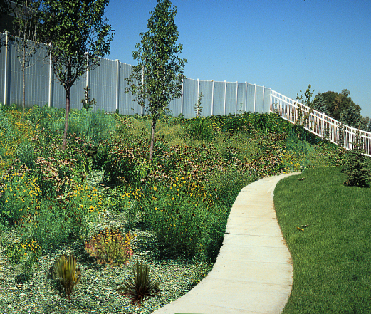
>80% plant cover, leaf area, water use intermingles
80% of ETo
50% of ETo

Slide 33



Incomplete plant cover

Slide 34


Oasis incomplete plant cover; high density (>80%) areas imbedded in hardscape

Slide 35

Individual plant crowns, several layers; non sunlit layers transpire little
Shaded area approximates projected crown area

Slide 36



Incomplete plant cover; estimate water demand of individual plants
Estimate water use of individual plants; projected crown area x depth of water
Assume 2 inches to apply; volume needed depends on crown size
Radius² x 3.14 x 2 x 0.623 = gallons to apply 2 inches of water
Simplified: diameter² =gallons needed to apply 2 inches
White fir: 20 ‘ diameter=400 gal
Bigtooth maple: 10 ‘ diameter=100 gal
Mountain lover: 3 ‘ diameter=9 gal
Notes:
More detail on calculating the volume of water requirmement for an individual plant based on plant diameter, and one possible configuration of drip emitters to meet that estimated water requirement

Slide 37




Slash Pine
Live oak
Red Maple

Slide 38
Estimating water demand of single, isolated tree
GALLONS OF WATER BY CROWN DIAMETER AND DEPTH OF WATER
Crown diam., feet | 0.05 | 0.1 | 0.15 | 0.2 | 0.3 | 0.5 | 1 | 2
 | depth of water to apply, inches
1 | 0.0 | 0.0 | 0.1 | 0.1 | 0.1 | 0.2 | 0.5 | 1.0
2 | 0.1 | 0.2 | 0.3 | 0.4 | 0.6 | 1.0 | 2.0 | 3.9
4 | 0.4 | 0.8 | 1.2 | 1.6 | 2.3 | 3.9 | 7.8 | 15.6
8 | 2 | 3 | 5 | 6 | 9 | 16 | 31 | 63
12 | 4 | 7 | 11 | 14 | 21 | 35 | 70 | 141
20 | 10 | 20 | 29 | 39 | 59 | 98 | 196 | 391
 | Range, daily turf water demand |  |  |  |  | Extended | Extended trees
 | Range, daily tree water demand |  |  |  |  | turf | Sandy soil | Loam soil
Irrigating isolated tree; water application does not need to be perfectly uniform; just need to close

Slide 39

Irrigating isolated plant: just get close; hydraulic transfer from deeper, wet soil to surface soil

Slide 40

Irrigating isolated plant: just get close; hydraulic transfer laterally from wet to dry zone

Slide 41

Rooting depth
Roots in dry zone are kept alive by hydraulic transfer
May not contribute as much water to transpiration as wetted zone

Slide 42

SLIDE Rule #5: Irrigated to a fixed depth based on plant type
Rooting depth, soil type determines the amount of water to apply per irrigations
Generalized assumptions about plant type rooting depth
Rooting depth proportional to plant size: turf least, trees most
Desert species across plant types (shrub, herbaceous perennials) have deep roots

Slide 43





Rooting Depth
Turfgrass: shallowest
Shallow: most, but not all, common non-turf species
Deep: drought adapted non-turf species
Rooting depth is genetic; turfgrass shallow, woody plants deeper, drought adapted plants deepest
Rooting depth x available soil water = water available to plant
Notes:
This slide brings in the importance of rooting depth. Rooting adepth is governed by plant genetics, where turfgrass is shallower and drought adapted species are generally deeper

Slide 44

Rooting Depth
Mahonia fremontii
Dry, desert/ steppe
Genetic Rooting depth deeper as rainfall is less
Ribies aureum
Very wet
riparian
Cercocarpus ledifolius
Foothills, dry
rocky soils
Notes:
Key point here is the M. fremontii, a desert plant, even as a first-year seedling is putting most of its carbon into a deep root system. By contrast, the R. aureum, a riparian species, as a first-year seedling puts much more carbon into stem growth and relative little into root growth, so is less tolerant of drought because it cannot explore as large a volume of soil as M. fremontii.

Slide 45

Rooting Depth and Irrigating
Difficult to know rooting depth
Simplest to assume a depth of water to be applied at each irrigation

Slide 46


Rooting depth
Cool season turf generally shallow rooted
Poor soil, frequent irrigation = more shallow
When turf sodded over subsoil, turf rooting depth visible

Slide 47



Soil water holding capacity
When all pore spaces filled (unusable by plants)=saturation, function of soil properties
When macropores have drained= field capacity, function of soil properties
When plant cannot extract any more water from soil=wilting point, function of plant and soil properties

Slide 48






Saturation:
Pore space =50%, all water filled
Field capacity(FC):
Pore space=25% water, 25% air
Wilting point(WP):
Pore space=10% water, 40% air

Slide 49

Soil Texture and Water
Sand holds less water, so applied water moves deeper but not sideways
Sand irrigate less water, more frequently
Sandy soil
Loam soil
1 HOUR
2 HOURs
3 HOURs
4 HOURS

Slide 50


Soil Texture and Water
Sand holds less total water than loam soils
Sand at field capacity
Loam at field capacity
Sand at wilting point
Loam at wilting point

Slide 51
Depth of water to apply for different plant types
Plant Traits |  | Depth of Water to Apply, cm (inches)
Plant Type | General rooting depth | 1.3 (0.5 ) | 2.5 (1.0) | 5.0 (2.0) | 7.5 (3)
Annuals | 15-30 cm (6-12 in) | X | x | -- | --
Turfgrass | 15-60 cm (6-12 in) | x | X | -- | --
Herb. Perennials | 30-60 cm (6-12 in) | x | X | -- | --
Woody Plants | 60-120 cm (24-48 in) | -- | x | X | --
Desert Plants | 30-300 cm (12-144 in) | x | -- | -- | X
Soil Traits
Depth of applied (or rain) water pene-tration into the soil | Silt Loam | 14 (6) | 28 (11) | 55 (22) | 83 (33)
 | Loamy Sand | 32 (12) | 62 (25) | 125 (50) | 187 (75)

Slide 52


Day 1: full root zone, 0.25” ET , 1.87” remaining
Day 2: full root zone, 0.28” ET , 1.73” remaining
2” water
1.87 water
Midsummer, conventional species, 0.5% of ET
After 17 days, average ET 0.2”day, 1.7” of water used…
At end of 19 days, estimated water to refill root zone depleted
-Apply 9 gallons to shrub
-Apply 50 gallons to tree
NOTE: these are best guess estimates; need to be tempered by good judgment
Day 2: full root zone, 0.28” ET , 0.03” remaining
0.03” water
Notes:
This slide shows a sample irrigation schedule for a random-spacing drip irrigation for a tree and a shrub

Slide 53
Assuming a depth of water to apply
Can assume 2” water to apply for loam soils, most woody plants
1” for sandy soils and drought sensitive plants
1” water
An irrigation zone controlled by a valve
Notes:
Key take home point from this slide is that the estimated amount to apply to root zone is decided by the designer based on plant type and soil properties (texture/available water and rooting (or soil) depth) from site analysis; for turf grass, 0.5 to 1 inch (12-25 mm) and woody plants from 1 inch/25 mm (for very drought intolerant species like burning bush [Euonymus alatus], but more often 2 inches/50 mm for most woody plants and many ground covers and perennial wildflowers. The graphic shows that if the plants actually have a deeper root system and access to more water than you estimate, it probably is not a problem if the root zone is continuously refilled with irrigation. The right side of the graphic shows the problem with the opposite, that the plant has less water witin the root zone than you estimate, so the plant may actually run out of water sooner than what you estimate.

Slide 54


Day 1:ET=0.26”; 0.13”use, 0.87” remains
Day 2:ET=0.20”; 0.10”use, 0.77” remains
Day 3:ET=0.28”; 0.14”use, 0.63” remains
Assume 1” water in root zone, PF=50% of ET
Conventional non turf plants: PF=50% ET, midsummer
Assume 4 days passed, ET=0.24”/day, 0.24” remaining
Day 8:ET=0.20”; 0.10”use, 0.14” remains
Day 9:ET=0.26”; 0.13”use, 0.01” remains
Day 10: soil water in root zone depleted: irrigate
Notes:
This slide shows an example of the replacement method for an inline-gridded drip irrigation layout assuming the landscape is composed of conventional plants but with a shallow root zone where you assume there is safely only 1 inch (25 mm) of water

Slide 55

Application of SLIDE Rules
Regulation: seasonal water use
Designing landscape to meet target allocation of water water
Regulators check actual water use (WaterMAPS to mine water billing data) against estimated landscape water use estimated from design
Irrigation scheduling within season: ET controllers
Design: major audience for SLIDE Rules; save water by either using low PF plants, plant cover below 80%:

Slide 56
Conclusion
SLIDE Rules make landscape irrigation water use estimation more accessible
#1. Reference ET basis for estimating landscape water use; useful for turf, less so for non turf
#2. Plant Factors estimate water use as fraction of ETo for turf, non turf, and desert plants
#3. Hydrozone goal; use plants of same PF in zone
#4. Density; > 80% ‘big leaf’ water use; <80% single plant water use
Ultimately, satellites will measure actual water use of large, oasis turf; eliminate need for weather station ETo

