Slide 1
Simplified Landscape Irrigation Demand Estimation: SLIDE Rules for Landscape Water Budgets and Allocations
Roger Kjelgren
Utah State University
Dept. Plants, Soils, & Climate

Slide 2
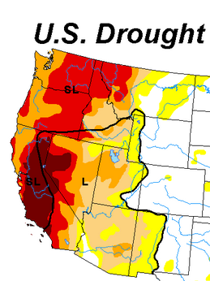
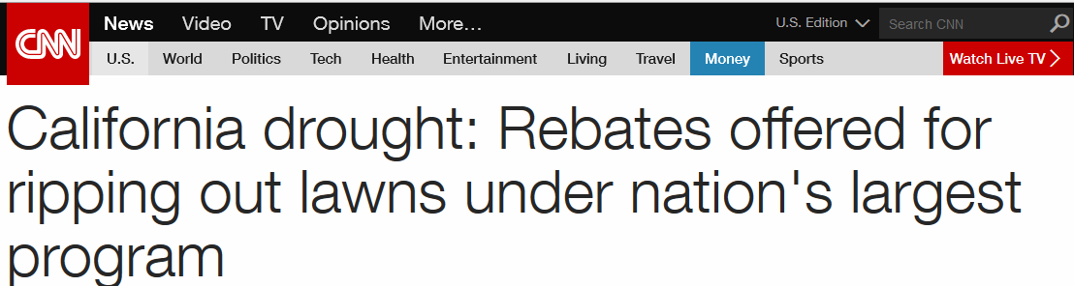
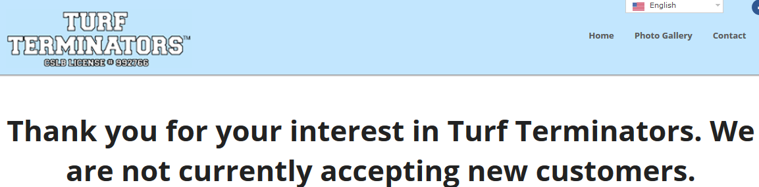
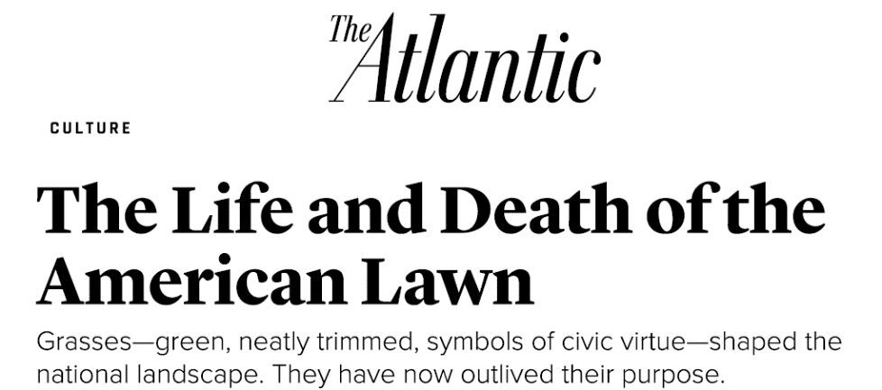
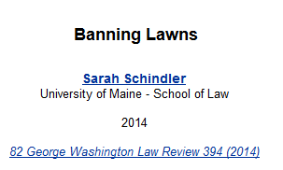
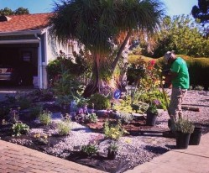
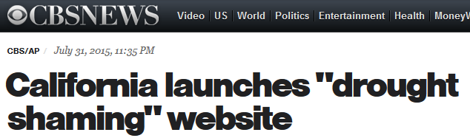
Urban Landscape Water is a “Hot” Topic

Slide 3
Collaborators
Trans-institutional colleagues
Dennis Pittenger, University California Cooperative Extension
Richard Beeson, University Florida Research & Extension Ctr.
Thayne Montague, Texas Tech University
Center for Water Efficient Landscaping, USU
Kelly Kopp, Professor
Larry Rupp, Professor
Paul Johnson, Professor
Joanna Endter-Wada, Professor
Diana Glenn, Research Associate
Adrea Wheaton, Research Associate

Slide 4
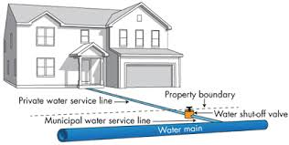
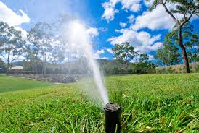
Background
Drought, climate change → managing landscape water is a major policy and program management challenge for water agencies
California “social engineering” - how people relate to water via urban, irrigated landscape
Per capita (people) water demand
Per parcel/lot
landscape water demand

Slide 5




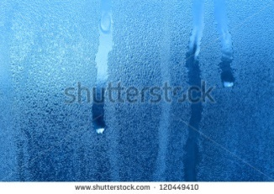


Plant Water Demand
transpiration
When soil water is not limited, water demand is a function of atmospheric conditions

Slide 6
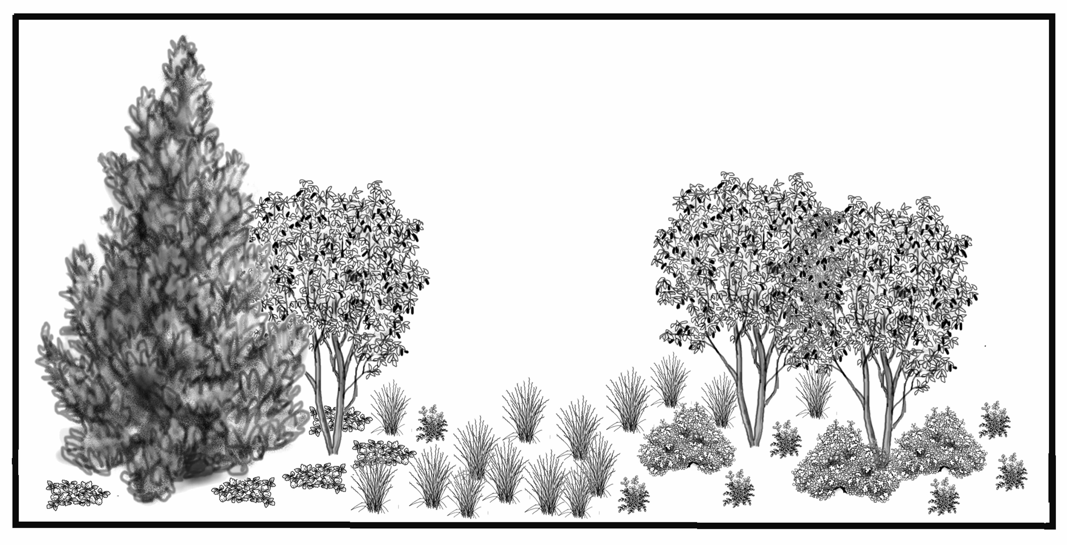


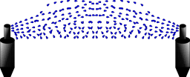
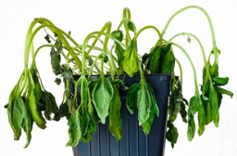
Water use
Water use
Water agency stake: water supply
Water use
Irrigate to refill root zone
Root depth: irrigate before plant performance is affected; desiccation tolerance
Notes:
This slide shows an example of the replacement method for an inline-gridded drip irrigation layout assuming the landscape is composed of conventional plants but with a shallow root zone where you assume there is safely only 1 inch (25 mm) of water

Slide 7
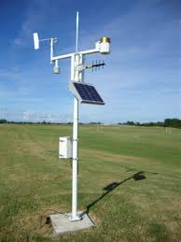
Urban Plant Water Demand
Demand = plant water use in response to atmosphere
We can easily measure atmospheric demand —solar radiation, humidity, wind, temperature
But measuring plant response to atmospheric demand is not easy
Instead, we measure atmospheric demand over standardized plant surface: cool season turfgrass
Atmospheric demand measured over a standardized surface = Reference evapotranspiration, or ETo
ETo is information about atmosphere, not about plant response

Slide 8
Urban Plant Water Demand
ETo link to plant water demand: Plant Factor (PF), not crop coefficient, that adjusts ETo downward
ETo x PF = estimated plant water demand for a given plant type
Example, Salt Lake City
Yearly ETo =40 inches
PF cool season turf =0.8
Plant water demand = 40 inches x 0.8 = 32 inches
Until now, no PF’s for non-turf landscape plants

Slide 9
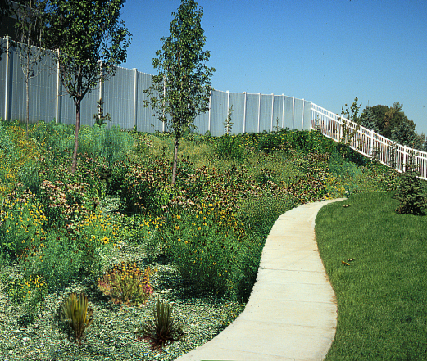
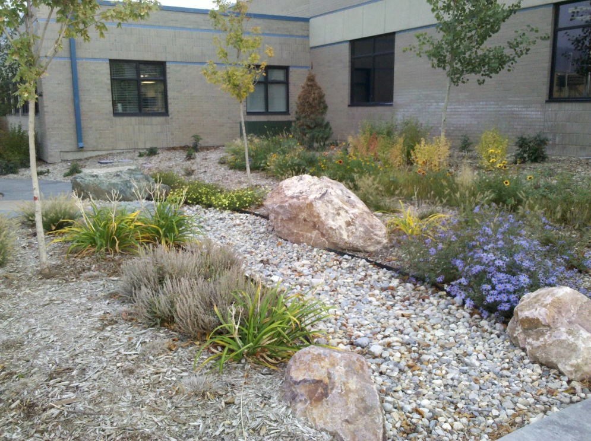
ETo and potential water demand for different plant types
Non-turf
Turf
But how much?
Desert

Slide 10
SLIDE – Simplified Landscape Irrigation Demand Estimation, based on ASABE S623
Fraction of ET_{o} (Plant Factor) to estimate water use yet maintain acceptable appearance of established landscape plants
 | Recommended Plant Factor
Turf-Cool Season | 0.8
Turf-Warm Season | 0.6
Non-turf/woody plants-Humid | 0.7
Non-turf/woody plants-Arid | 0.5
Desert plants | 0.3

Slide 11
ETo x PF = water demand for different plant types
X 0.5 PF non-turf = 20 inches
X 0.8 PF turf = 32 inches
X 0.3 PF desert plants = 12 inches
Salt Lake City Seasonal ETo = 40 inches

Slide 12
SLIDE Rules – Three Applications
WaterMAPS™ - tool for direct use by water agencies
Identify customers with high capacity to conserve: applying water to landscapes in excess of plant water demand
Educate customers about their landscape irrigation practices compared to actual plant water demand
Assess water conservation customer and program performance
Aid landscape design community to design low water landscapes to meet specific water allocations/budgets
Provide minimum irrigation guidelines to keep high value landscape elements (e.g., trees) alive during drought

Slide 13

SLIDE Rules –Application #1

Slide 14
WaterMAPS™ Water Management Analysis and Planning Software
Integrates various databases to compare actual landscape water use (derived from meter data) to estimated demand (needs) based on ETo x PF
First studied in Wasatch Front suburbs (Layton, West Jordan) then expanded to three other entities in metropolitan region (Logan, Weber Basin, Salt Lake City)
Difference between actual landscape water use and estimated demand (needs) = capacity to conserve
WaterMAPS™ automates calculation of capacity to conserve for all parcels in a water providers’ service area

Slide 15
West Jordan, Utah Residential Potable Water Use, 2000; n=2,090 homes
31 inches turf water demand (uniform irrigation)
19 inches trees
12 inches desert plants

Slide 16
Weber Basin WCD, Utah, Residential Secondary Water Use, 2012; n=859 homes
ETo = 40 inches
32 inches turf water demand
(uniform irrigation)
20 inches trees,
12 inches desert plants

Slide 17
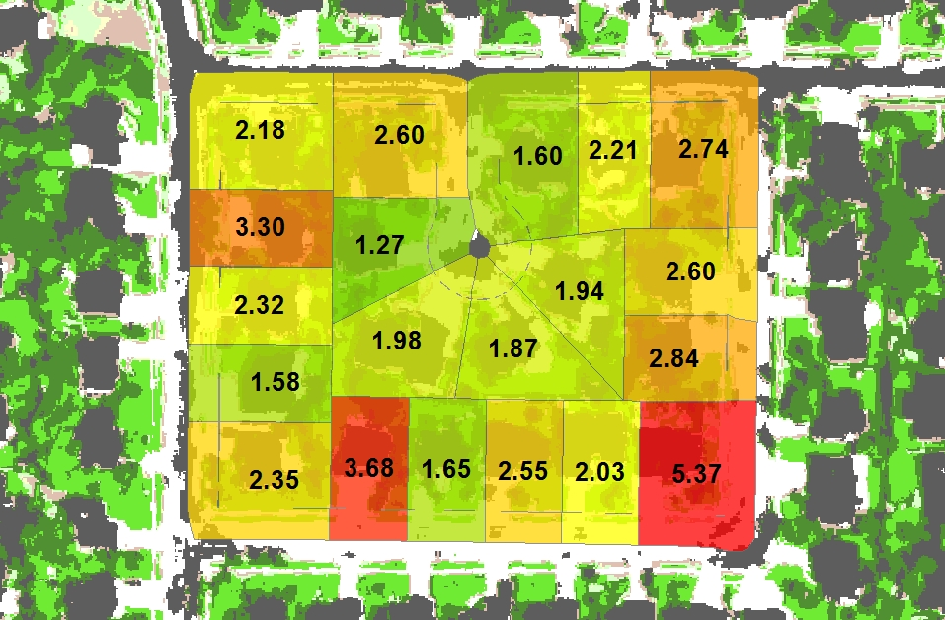
Identifying Capacity to Conserve through “LIR”
Landscape Irrigation Ratio (LIR)
at the parcel scale
LIR less than 1 = Efficient
Between 1 and 2 = Acceptable
Between 2 and 3 = Inefficient
Greater than 3 = Excessive
Landscape Water Use
_________________
Landscape Water Need
(estimated from analysis of meter data)
________________________________________________
(estimated from classified airborne multispectral imagery and localized ETo rates modified by relevant landscape plant factors)
LIR =
(per unit of landscaped area)
Notes:
Or use this one instead of previous one

Slide 18
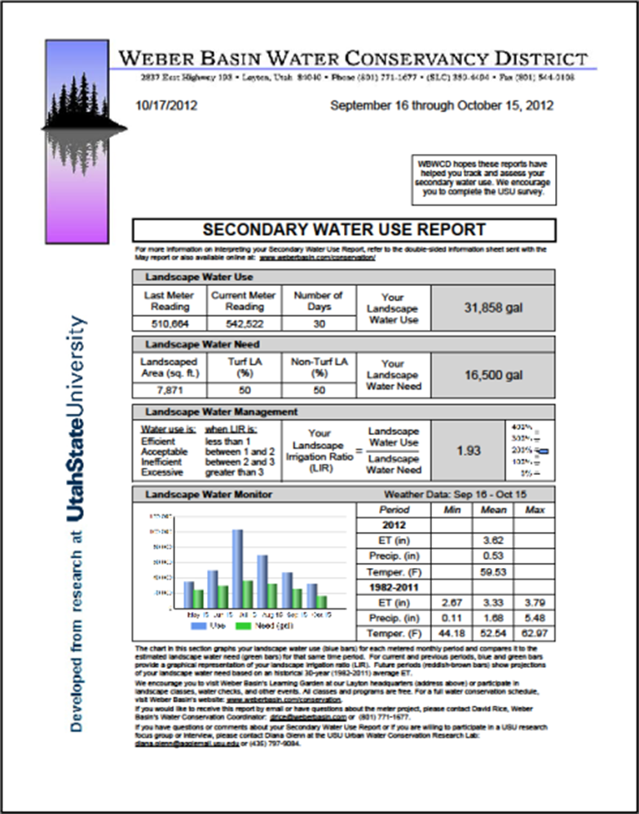
Customer Education – Secondary Users
Three neighborhoods with secondary water in Weber Basin WCD service district
Smart meters installed winter 2011/2012
Received reports on LIR/Capacity to Conserve since 2012 – seen significant water savings

Slide 19
Water Conservation Evaluation: Participants
Did people save water?
Logan City Residential customers
Received free irrigation system evaluation (Water Check)
Calculated LIR/Capacity to conserve before and after the Water Check

Slide 20
Water Conservation Evaluation: Program
How can the program respond to customer performance?
Free Water Checks only worked with small number of customers
Customers who increased use, or had high LIR and no change, need different approach

Slide 21
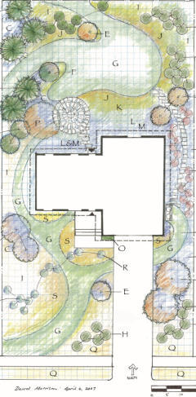
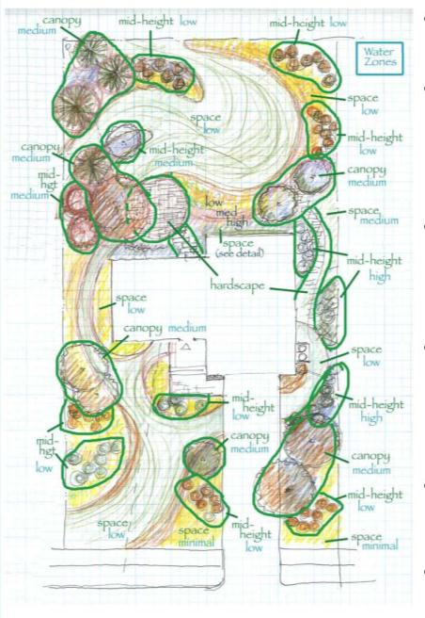
SLIDE Rules –Application #2
Tool for the Landscape Design Community: Hydrozones based on Water Demand

Slide 22
Tool for Landscape Design Community
Landscape architects/designers key to creating low water landscapes with identifiable water savings
SLIDE/ASABE S623 standardizes two key processes
Hydrozones as smallest landscape area managed by irrigation zone
Plant cover <80%, water demand that of isolated plants
Water demand for isolated plants based on cross-section crown area
To meet water allocation/budget, designers now have two standardized tools: species with lower PF, using fewer plants (<80% cover)

Slide 23
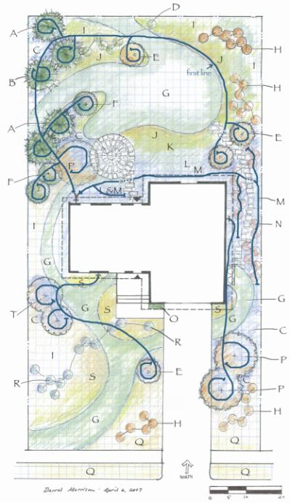
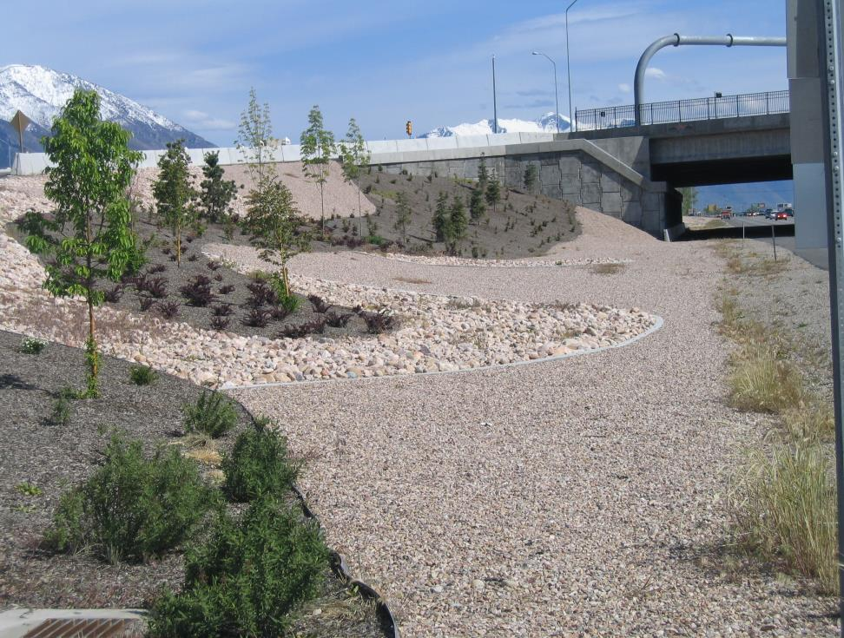
Design Tools: Hydrozoning
Hydrozone controlled by a
single irrigation valve
Plant species with highest Plant Factor dictates the overall zone PF (don’t mix turf and desert plants)
Low plant cover by widely spaced plants, or by creating dense plant oases within larger non- plant area

Slide 24
Design Tools: Hydrozoning
Dense planting water demand: area x 0.5 PF
Low density planting water demand of either isolated plants or plant cluster
Oasis incomplete plant cover; high density (>80%) areas imbedded in hardscape
Isolated plant water demand:
Circle area x
0.5 PF

Slide 25
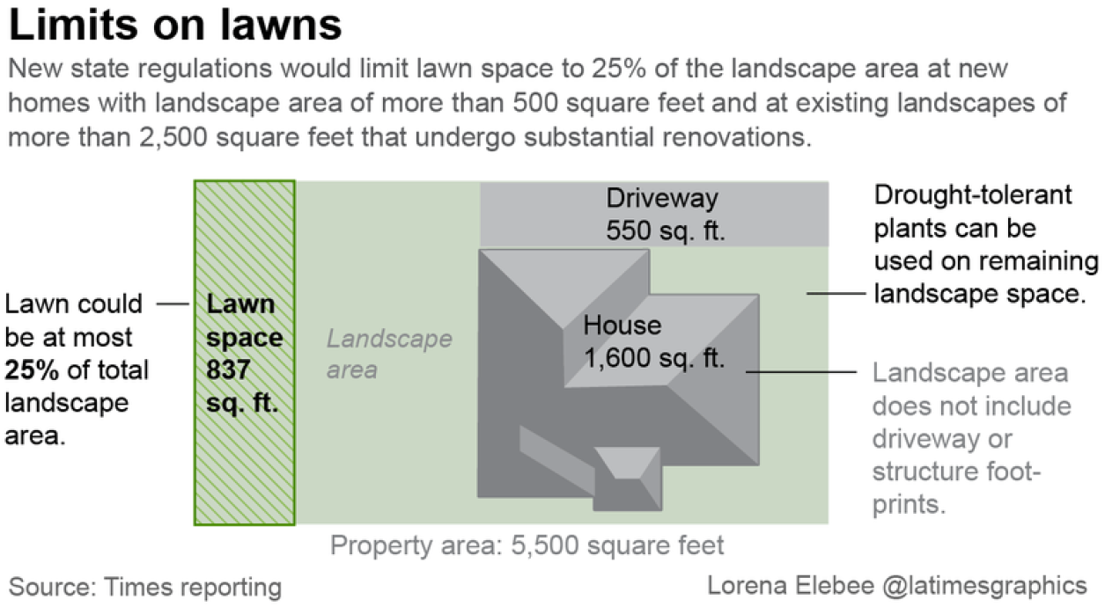
Design of Things to Come: CA Regulations for New Landscapes

Slide 26
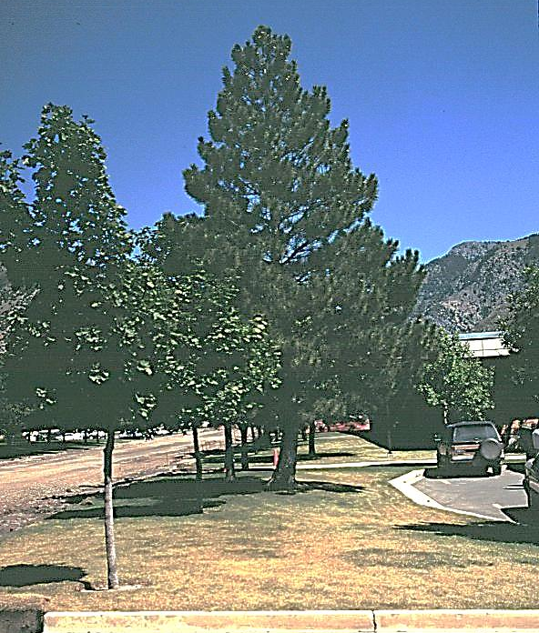
SLIDE Rules –Application #3
Keeping
High-Value Landscapes Alive During Drought

Slide 27

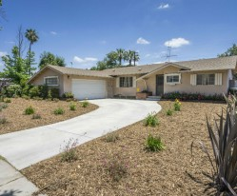
Responding to Drought
During drought, turf can be sacrificed (or removed)
What happens to trees important – 5-10 times more valuable per ft² than turf
Special attention needed for trees previously imbedded in and irrigated with turf
Again, estimate water demand of isolated trees

Slide 28
Keeping Urban Trees Alive During Drought
During drought, customers will likely focus on keeping trees alive
Estimate water demand of isolated tree based on 2-dimensional shape (mostly circle, but also triangle and rectangle)
Web site for calculating water demand of isolated tree and irrigation schedule: http://files.radiantm.com/tree-irrigation/

Slide 29
Summary
SLIDE simplifies how to estimate landscape water demand for three general plant types: turf, non turf, desert plants
SLIDE does not include species-specific drought tolerance traits (root depth, leaf tolerance of desiccation)
Key tool in estimating potential water demand to:
Design landscapes within a targeted budget/allocation
Track customers’ performance relative to water demand of their own landscape configuration
Keep high value plants alive during drought

