Slide 1
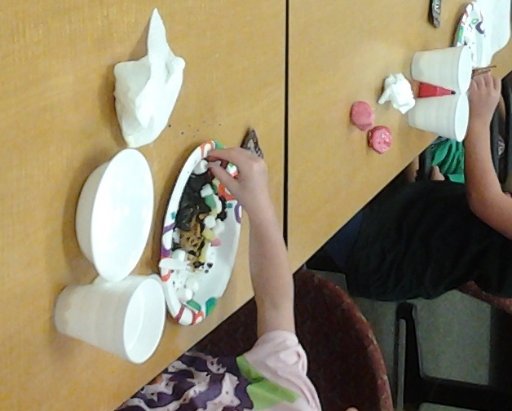
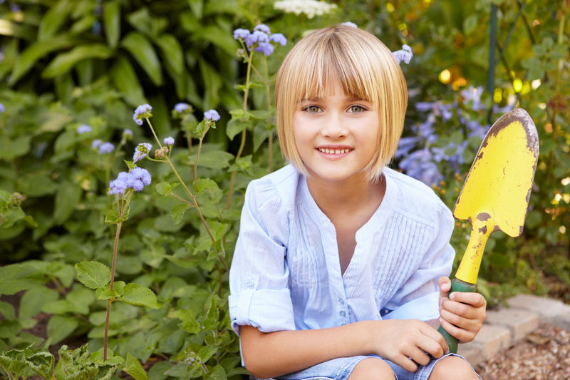
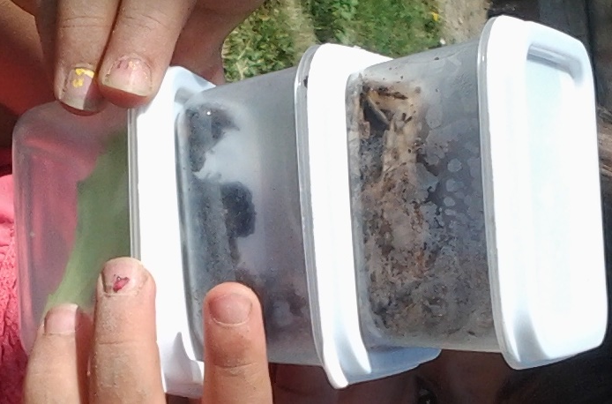
Cache County Junior Master Gardeners
Summer 2016
June 7 – 30
Tuesdays 10:00 am – 11:00 am
Cache County Administration Building
179 North Main Room 109
Thursdays 10:00 am – 11:00 am
Logan Community Garden
1200 North 400 West,
just west of Bridger Elementary
Cache County Extension is offering a Junior Master Gardener Club for 4-H members. 4-Hers will learn gardening skills in the classroom, and plant their own garden at the Logan Community Garden at Bridger Park. Activities will take place on Tuesdays and Thursdays from 10am-11am during the Month of June, plus an end of season harvest party with pizza and ice cream.
To register go online to ut.4honline.com and register for 4-H, then mail in or bring in the $5.00 4-H fee. Cloverbuds are welcome in this club. Everyone must register to participate. For any questions call: (435) 752-6263
Utah State University is an affirmative action/equal opportunity institution.
EXTENSION.USU.EDU

