Slide 1
Introduction to OU Campus
Extension Web, 2.0
extension.usu.edu/ou-campus

Slide 2
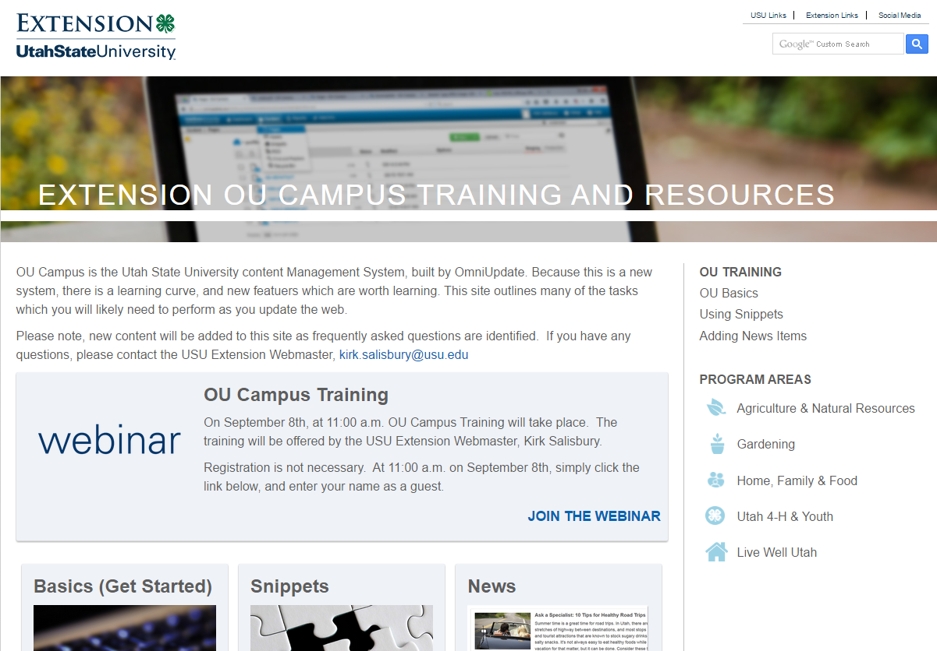
OU Campus Resources
extension.usu.edu/ou-campus

Slide 3
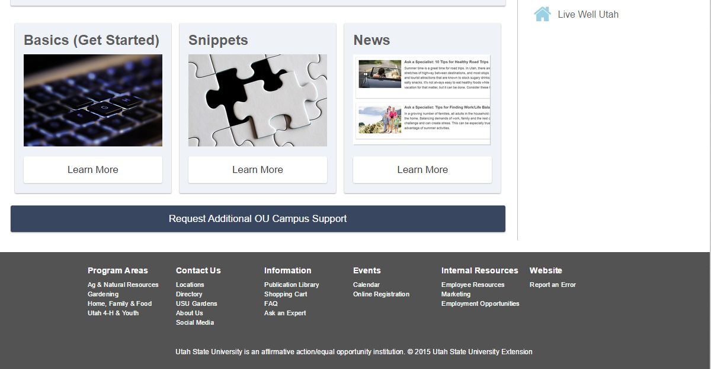
OU Campus Resources
extension.usu.edu/ou-campus

Slide 4
OU Campus Resources
extension.usu.edu/ou-campus

Slide 5
New website features
Fully Responsive. Same website renders on:
Desktop
Tablet
Mobile
Calendar System
Same event can be published to all relevant calendars
Better Management
The days of requesting PAD add users are over
More Powerful

Slide 6

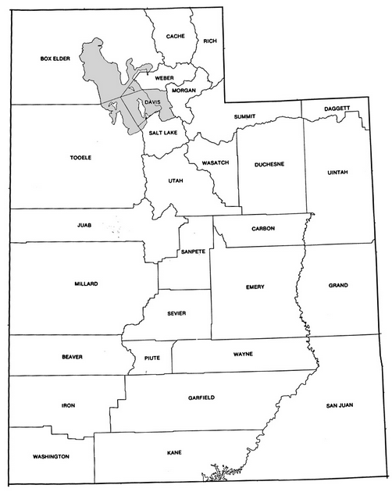

Web Philosophy
Two types of websites
Topic-based County
extension.usu.edu/ou-campus

Slide 7
What belongs where?
Topic Based Website Type Content | County Website
General Information: Useful everywhere To be referenced from anywhere Reference publications which live in Digital Commons | County Specific Information: Location specific Demonstrates what your county is able to offer your consumers May also reference Digital Commons
Food $ense (SNAP-Ed): What is Food $ense (SNAP-Ed) How to make egg-omelets | Food $ense (SNAP-Ed): Class Schedule Contact Information Link to Food $ense (SNAP-Ed) for more information about the program
Fruit Diseases How to find diseases How to treat diseases … etc… | Fruit Diseases Link to the publication
extension.usu.edu/ou-campus

Slide 8
OU Campus Basics
Today’s Training Items:
Logging In
OU Campus Directory System
Adding Files
Adding Images
Adding New Pages
Adding New Sections
Checking Files In/Out
Using Snippets
Using/Rewinding Versions
extension.usu.edu/ou-campus

