Slide 1
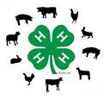
Show Lamb and Goat Nutrition Meeting

Slide 2
Animal Selection

Slide 3
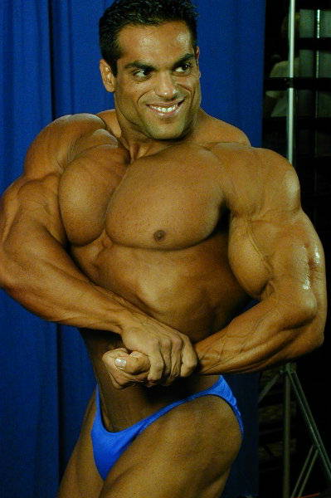
It all starts with genetics!

Slide 4
Animal Selection
Criteria to Consider – In Order of Importance
1. Structural Soundness and Skeletal Correctness
Muscle and Volume
Balance and Correctness
Style and Eye appeal
Notes:
All of these are important and necessary. However, style and eye appeal (for example) do not matter if your animal is not structurally sound.
Keep in mind, what are your end goals? Is your heifer going to retire into the herd to be a cow? She needs to be sound to be able to walk in the pasture and raise a calf, right? She needs to have adequate muscling and balance (desirable traits) to pass onto the next generation.
The purpose of showing (besides youth development) is to continually improve the quality of our livestock. We do that by selecting only the best of the best to continue to pass on their genes from generation from generation. Cattle, pigs, goats, sheep or otherwise.

Slide 5
Sheep
Selecting the Right One – The Ideal Market Lamb
Shop for a “Complete” Lamb
Muscling
Hindsaddle (last rib and back) – highest priced cut
Depth and width through the loin
Fullness and length through the rump
Full leg and stifle
Frame Size
Predicts growth and potential size.
Avoid extremes. Moderate – large is desired (depending on breed).
Includes: Height, length and capacity
Structural Correctness
Sound mouths and normal eyes
Square feet and leg placement
Be weary of limps and other feet and leg issues

Slide 6
Sheep
Selecting the Right One – The Ideal Market Lamb
Balance and Eye Appeal
Level topped
Strait and square over rump
Smooth shoulders that tie into the neck/brisket
Neck ties into the top of the shoulder
Even in it’s thirds
Slightly uphill

Slide 7
Nutrition 101

Slide 8
What is Nutrition?
“the science of transforming food into body tissues and activities”

Slide 9
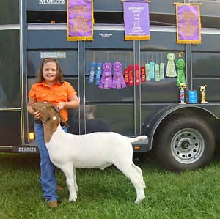
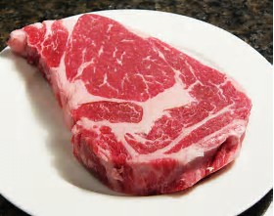
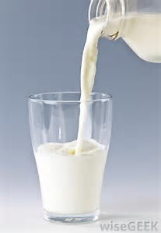
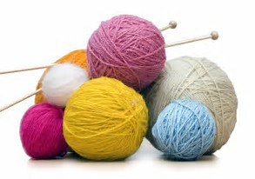
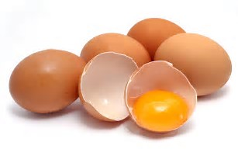
Why is Nutrition Important?
Without proper nutrition animals are NOT healthy and CANNOT produce:
Meat Eggs Milk Fiber Banners

Slide 10
6 Key Nutrients
Water
Protein
Carbohydrates
Fats
Vitamins
Minerals

Slide 11
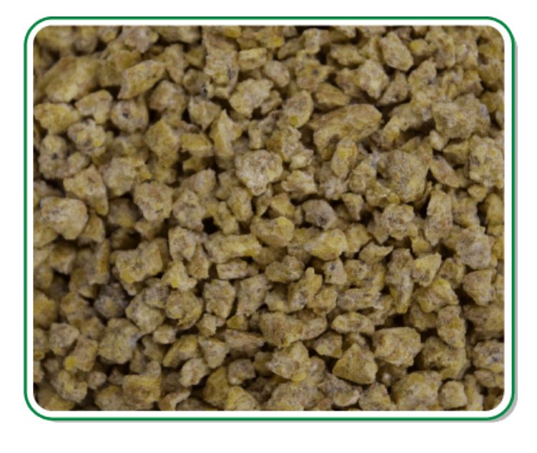
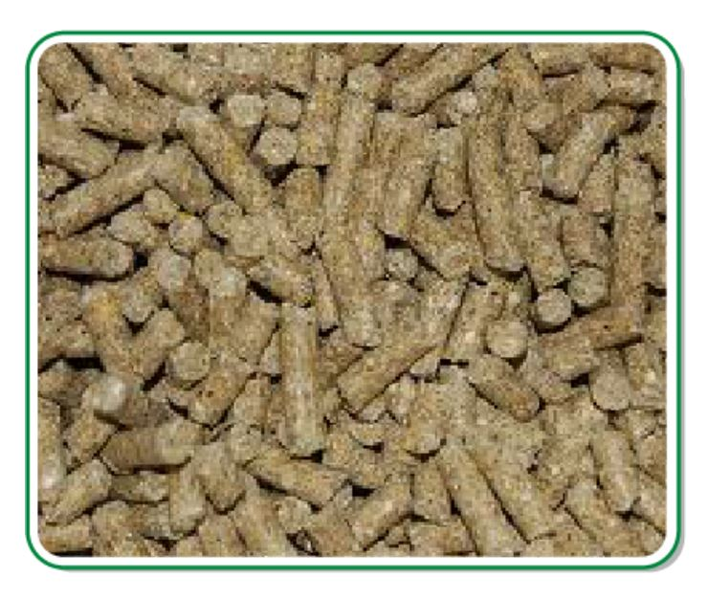
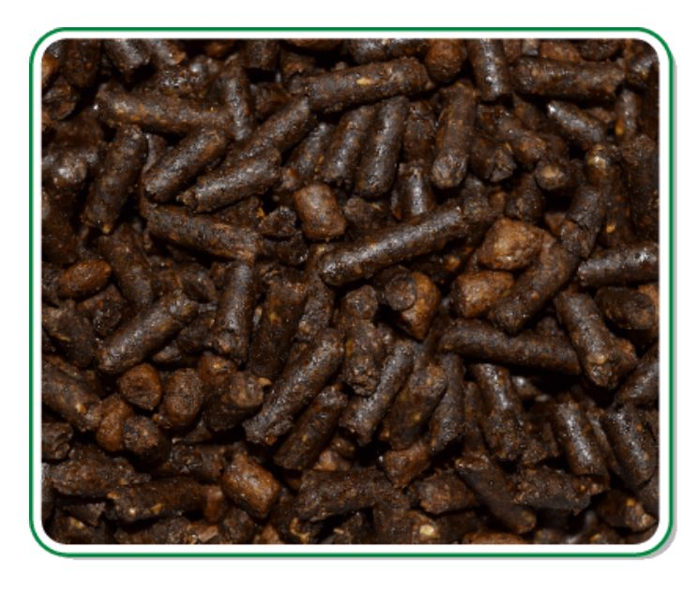
Feed Forms
Notes:
Different types of feed are palatable to different animals. Some show animals, especially, are pickier than others.
Power phat – Extruded
Base feeds – pellet
Mineral – sheep/goat/cattle
Textured/multiform – show edge calf and sheep
Train kids on feed freshness. This stuff does in fact expire at some point. So be sure to check for mold, etc

Slide 12
Nutrena Show Edge
Simply successful.
It’s all about that moment, standing at the backdrop, posing with your prize-wining animal. As your family and friends beam with pride for success, you know all the early mornings, late nights and hard work was worth it.
At Nutrena, we know exactly how good nutrition works and how important it is. We are behind you every step of the way with a simple program that gives you the edge in the show ring. We’ve got your animal’s nutrition covered so you can focus on what it takes to be a winner.

Slide 13
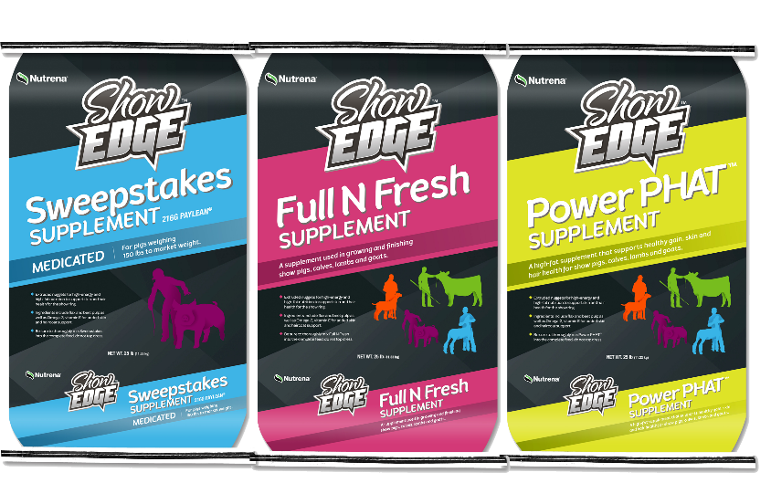
What Does Show Edge Offer?
40lb bags: Complete Feeds
Show Calf Feed
Show Pig Feed
Show Lamb Feed
Show Goat Feed
20lb bags: Supplements (special order)
Sweepstakes Pig Supplement (bag with handles)
Full N Fresh Supplement (all species, bag with handles)
Power Phat Supplement (all species)

Slide 14
All Species Feeding Tips
Fresh Feed Daily
Ample Supply of Fresh Water
Essential for maximizing weight gains
If water isn’t available, they wont eat.
Feed Show Animals Individually.
Mix the feed so they don’t have the opportunity to be picky
Simulate feeding and watering as if you were at a show so you can ensure they will eat once at the show.
Weigh your animals!
Notes:
These animals do not have the same nutritional requirements their whole lives. Change is necessary to achieve the desired show day look.

Slide 15
Power PHAT Supplement
Suitable for Calf, Pig, Sheep and Goat
A fat supplement designed to promote consumption and support bloom, skin and hair health. Provides additional energy and added finish.
Key Points:
Extruded nuggets for high-energy and high-fat nutrition to support skin and hair health for the show ring
Ingredients include flax and beet pulp as well as Omega-3, vitamin E for added skin and haircoat support
12.0%
8.0%
25.0%
Crude Protein
Crude Fiber
Crude Fat
Notes:
Review now, as you will talk about with all species here in a moment.

Slide 16
Full N Fresh Supplement
Suitable for Calf, Pig, Sheep and Goat
A supplement that uniquely combines high-fiber roughage ingredients to achieve the desired look for today’s show ring or be used during a holding period for extra fill and fresh look.
Key Points:
Supports healthy body condition when feed intake is limited.
High fiber roughage supports gut fill
12.0%
20.0%
4.0%
Crude Protein
Crude Fiber
Crude Fat
Notes:
Review now, as you will talk about with all species here in a moment.

Slide 17
Lambs
Feeding Lambs
Grower Stage
Full feeding (2-3 meals per day) until lamb is 75-80 lbs. You want some crumbs to be left after each feeding. If not, you’re not feeding enough.
Give two softball sized amounts of hay per day. Lambs are ruminants and need that roughage in their diet.
Finishing Stage
Continue same hay feeding routine
When lambs reach 120 lbs, feed intake may need to be limited to maintain proper finish and condition.
Notes:
Lambs will eat themselves to death if you let them eat 24/7. Restrict their food.
Too much hay will give they hay belly.
Avoid letting them have pasture grass or yard grass. Can also result in hay belly.
Weigh lambs every 2 weeks. Same day of the week. Same time of day. Record results.
Lambs will gain 4-7 lbs/week on average.

Slide 18
Goat Nutrition
Each animal will eat about 4 pounds a day, or close to 1,500 pounds per year
Hay should always be available
Because goats are ruminants, water should be available at all times
Grain or a commercially prepared ration (concentrate) should be used as a dietary supplement
Needed by pregnant or nursing does, milk goats, or all goats if hay supply is low
One or two pounds of concentrate/day should be sufficient
Dietary needs can vary from season to season

Slide 19
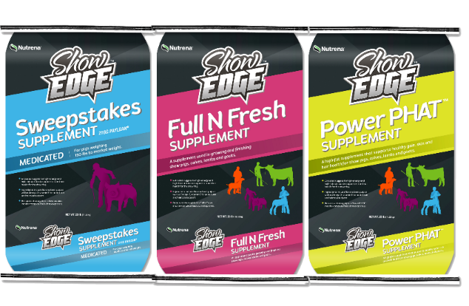
What Does Show Edge Offer?
40lb bags: Complete Feeds
Show Calf Feed
Show Pig Feed
Show Lamb Feed
Show Goat Feed
20lb bags: Supplements (special order)
Sweepstakes Pig Supplement (bag with handles)
Full N Fresh Supplement (all species, bag with handles)
Power Phat Supplement (all species)

Slide 20
Show Lamb Feed
Balanced nutrition to support proper growth, health and performance
Compatible with Show Edge™ premium supplements for a competitive advantage
Helps maintain urinary tract health
17.0%
12.0%
3.0%
Crude Protein
Crude Fiber
Crude Fat
Notes:
Cannot self feed. They will eat themselves to death.
Watch hay consumption to avoid hay belly – if showing the sheep.
For the most part, as long as they are monitored, lambs are pretty self sufficient in their feeding programs.
Lambs, basically, like to die. Safety needs to be top of mind in their pens and in daily routines.

Slide 21
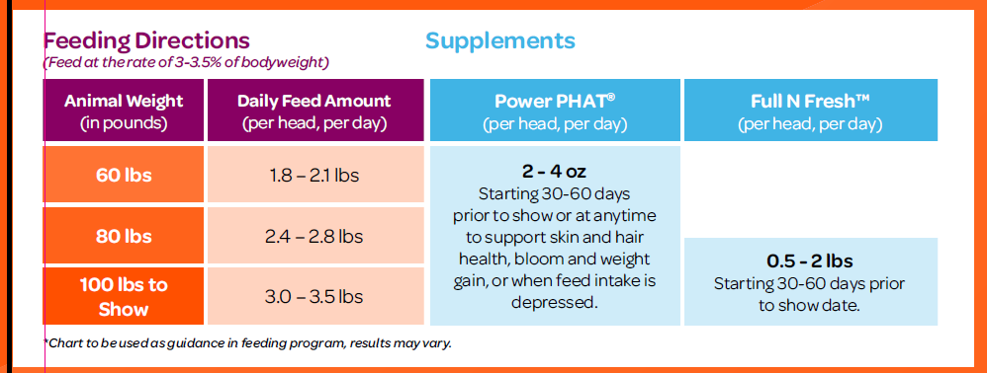
Show Lamb Feed

Slide 22
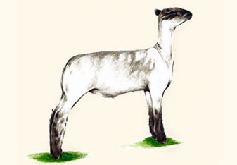
Feeding Rates
Target Weight
3% BW
0.5#/day
5:1
135-150#
Consumption
ADG
Conversion
Bag Count
9

Slide 23
Daily Care & Grooming

Slide 24
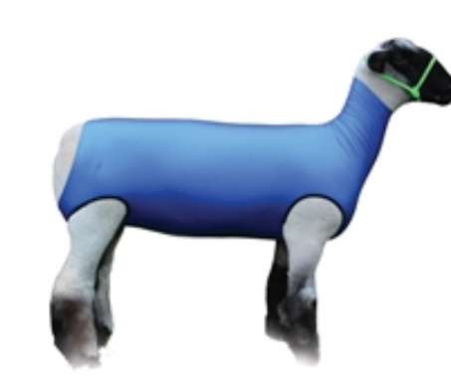
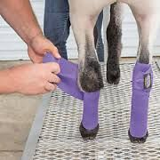
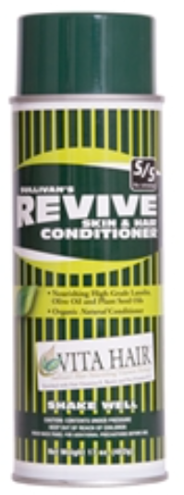
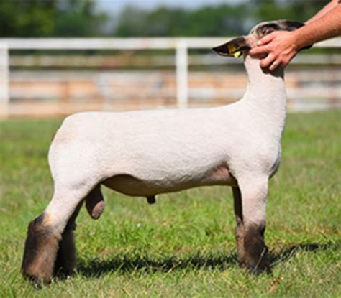
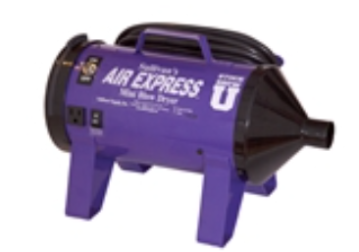
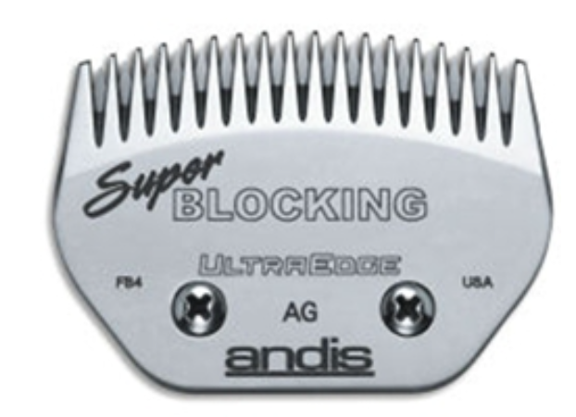
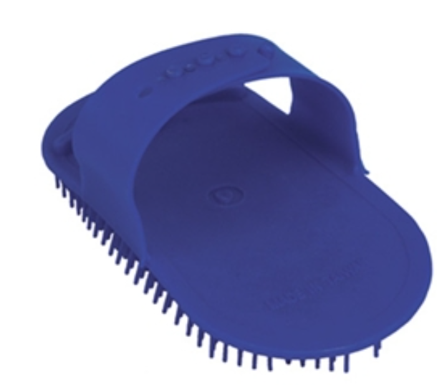
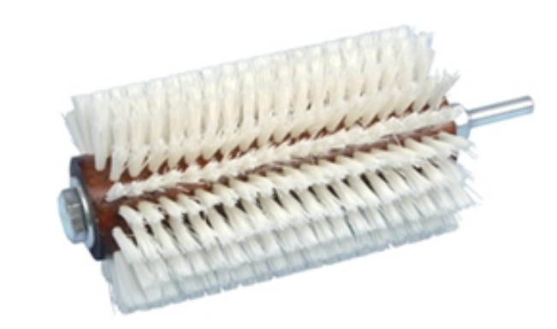
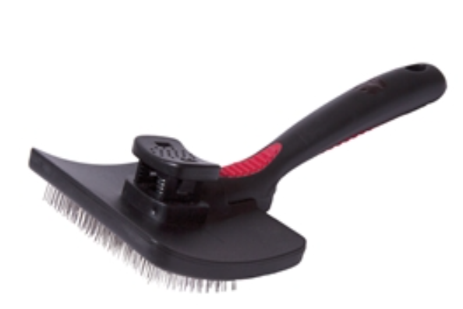
Lambs
Daily Care
Exercise
Washing
Drying
Working Hair
Notes:
Exercise
Break the lambs to lead
This can be accomplished by leaving the halter on them 24/7 and having them drag the halters. Walk them until they don’t fight. Tie them up in time increments to teach them obedience.
Stand on the lambs left side when leading.
Trim feet monthly.
Practice bracing and teaching the lamb to stand in the proper position with legs and head
During the finishing stage:
Begin isometric exercise program
Muscular contractions that produces deep muscle development.
Place lamb on a slightly elevated grooming stand and press against its chest with your hand. Hold for 5-10 seconds and release. Try 10 sets with a rest period
Increase duration and decrease number of sets as time goes on.
Do daily
Continue without use of a halter. Same idea of exercise, but now control lambs with your hands.
Washing
Try to wash leg wool (with soap) only if it gets dirty. Rinse boot wool a few times a week and work boot wool every day (ideally).
Use a shampoo to wash. Use a scrub brush to lather in the soap.
Use a turbo blower (like cattle) to dry. Make sure it is dry to hide.
Use a slicker brush to comb leg wool. Similar to cattle. After dry, spray an oil on the wool, then blow and comb simultaneously to make the hair “pop”. To really go above and beyond to grow shag, utilize a roto brush.
Similar to that of cattle (see cattle daily hair advice)
Wash, dry, brush, roto brush
Sheep will try to eat their leg wool. Use a muzzle or wrap legs tightly with sheep specific leg wraps every day to prevent them from eating your hard work. See picture. Keep legs wrapped at all times to protect wool.
You can have your sheep wear a spandex body suit to keep them clean

Slide 25
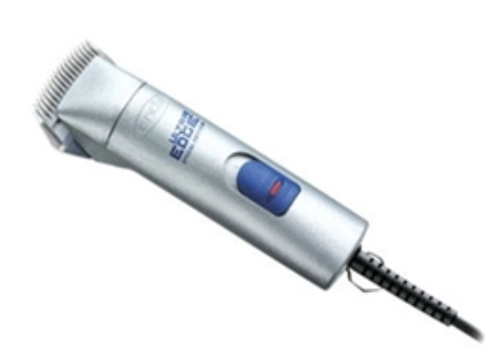
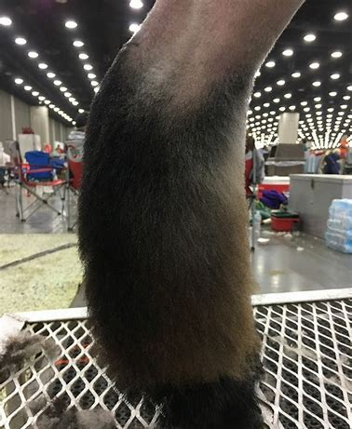
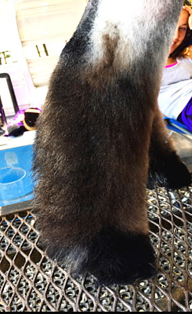
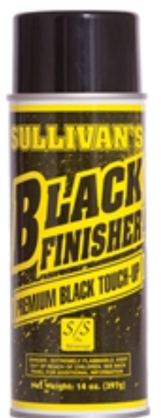
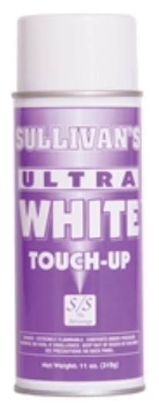
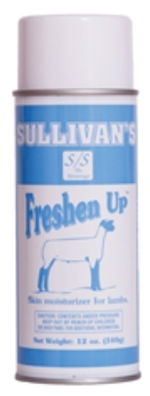
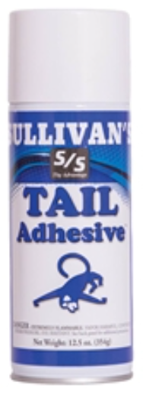
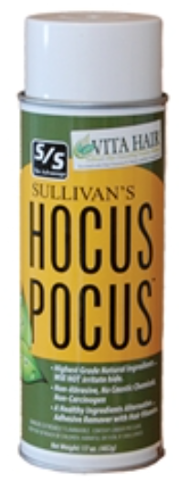
Lambs
Show Day
Shearing (pre show day)
Clipping (pre show day)
Washing/Drying/Working Boot Wool
Fitting
Clean up
Notes:
Allow adequate time before your class to feed, rest and fit.
Shearing
Use sheers to sheer the body and head of the sheep.
DO NOT SHEER OFF BOOT WOOL, or all of your hard work will be lost.
After sheering, use a product like Freshen Up. Also use on show day. It is a wool conditioner.
Clipping
You can use clippers to shape the boot wool. See picture. Similar to cattle.
Use sharp blades and have a brush and oil handy to keep the clippers working well. I suggest using a super blocking blade
Washing/Drying/Working boot Wool
You should have done most of the prep work at home. At the show, you should only need to unwrap your legs and work the hair with a brush and a blower.
Fitting
The following is not mandatory. Unfit boot wool will look fine. But to really go above and beyond, here is what you will do.
Use a strong adhesive and a slicker comb to shape the wool and pull it in the direction you want. The more boot wool you have, the easier this will be and the better the lamb will look. Don’t get glue crazy, or it will look bad and be hard to work with.
You can utilize white building paint to build legs and shape. You can use black paint to blend back to a natural color.
Once wool is pulled, you can get your clippers out to shape the leg. See picture. Similar to cattle.
Clean up
Use adhesive removal product like EZ All or Hocus Pocus to remove glue. You will know that you have enough when you use a scrub brush and can easily comb through boot wool.
After the show, wash with an anti fungal shampoo before you leave the show.

Slide 26
http://www.danekeclublambs.com/ChoosingYourLamb.html
http://www.formulaofchampions.com/pages/beef-cattle/selecting-the-right-one/
http://www.formulaofchampions.com/pages/swine/pick-your-pig/
http://www.formulaofchampions.com/pages/goats/getting-ready/
http://www.formulaofchampions.com/news/2013/6/6/simple-keys-to-goat-nutrition/
http://www.formulaofchampions.com/pages/swine/grow/
http://www.formulaofchampions.com/pages/beef-cattle/market-animal-nutrition/
http://www.formulaofchampions.com/pages/lambs/grow-to-show/

Slide 27
Jesse_Petersen@Cargill.com

