Slide 1
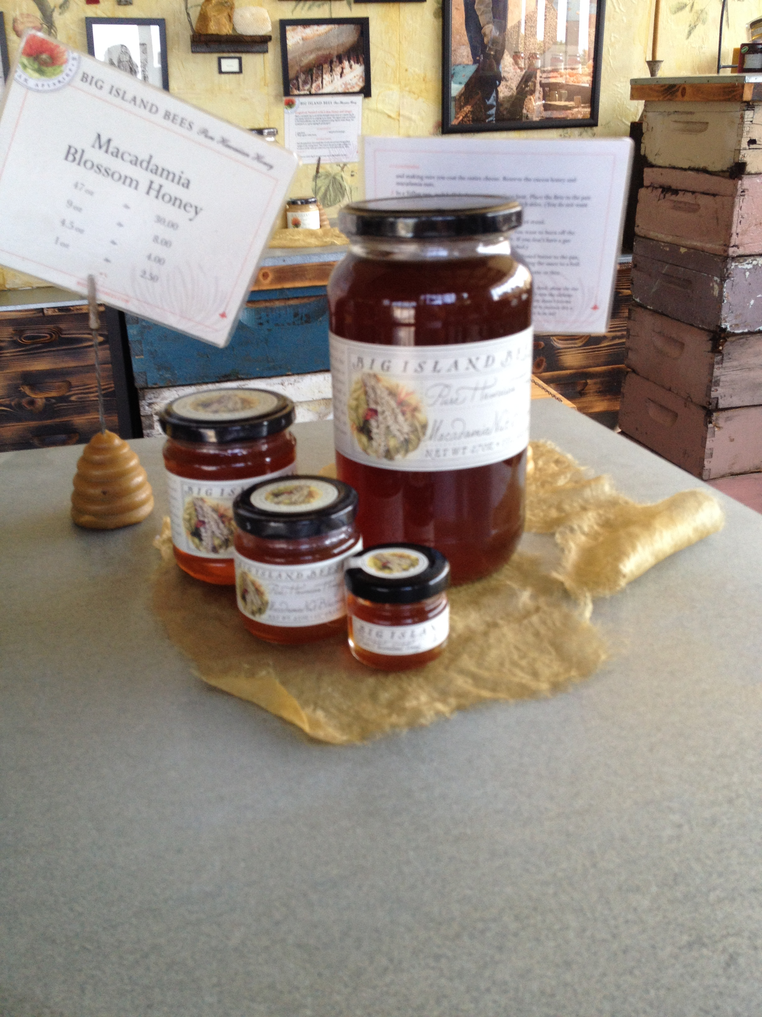
Module 4: Producing and Selling Value-Added Products

Slide 2
Overview
Determine whether or not their food products are considered “processed”
Increase their understanding of the laws and regulations that apply to food product processing at both the state and federal level
Practice proper food safety and sanitation procedures during the processing of food products
Create FDA-compliant food labels for their products

Slide 3
Value-Added Foods
Local, organic, vine-ripened, or specialty crops
“Gourmet” foods
Jams, jellies, preserves
Pickled vegetables
Hot sauces, salsas, tapenades
Herbed oils and vinegars
Must consider regulatory, safety and labeling issues

Slide 4
Unprocessed Produce
Regulations vary by State
Idaho – State Department of Agriculture and Department of Health and Welfare
Nevada – State Department of Agriculture
Utah – State Department of Agriculture

Slide 5
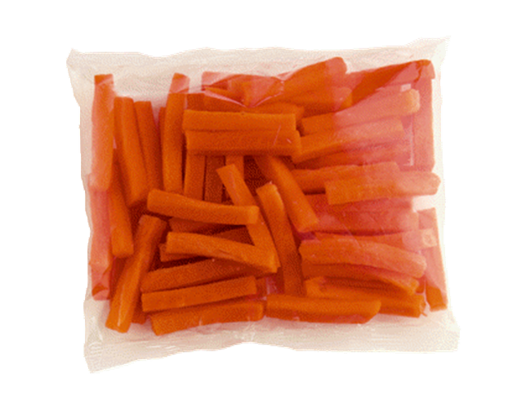
Must Register to Sell Processed Produce

Slide 6
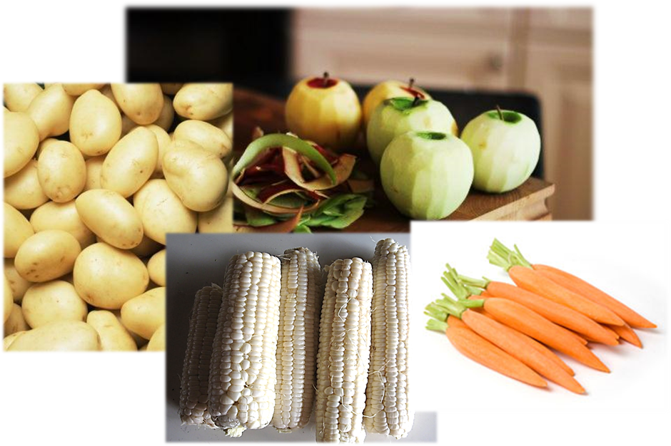
Processed Foods Include: Peeled, Cut, or Washed Produce

Slide 7
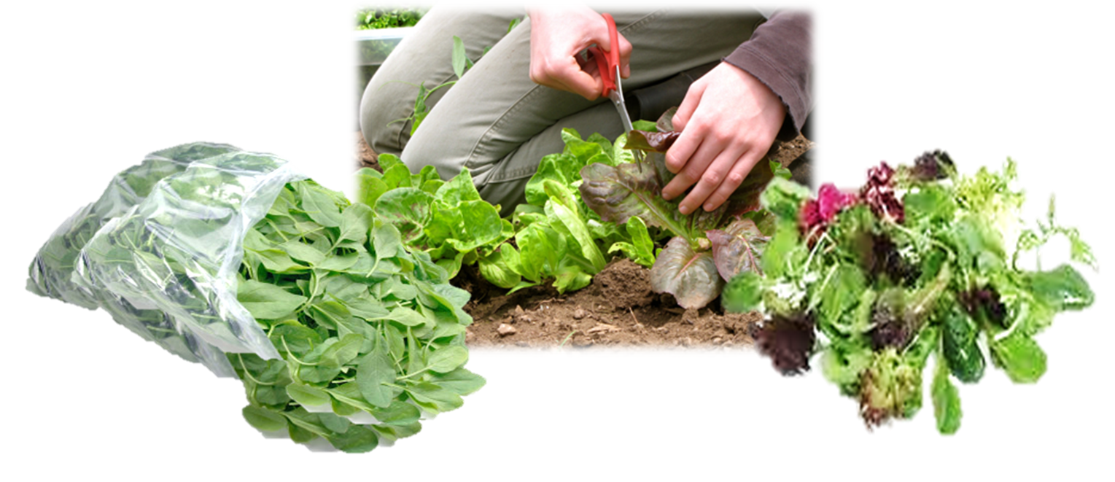
Processed Foods Include: Cut Leafy Greens

Slide 8
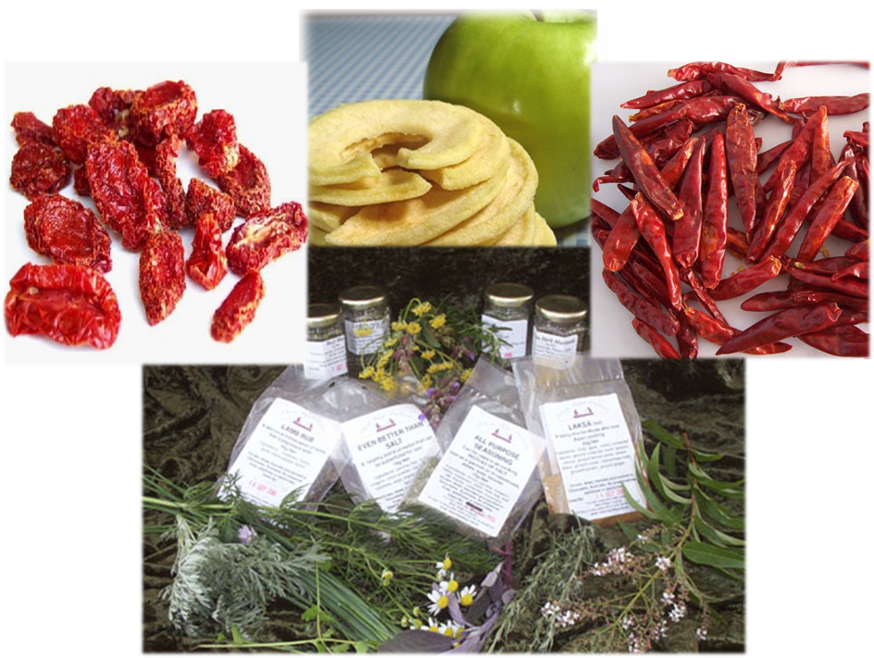
Processed Foods Include: Dried or Dehydrated Produce

Slide 9
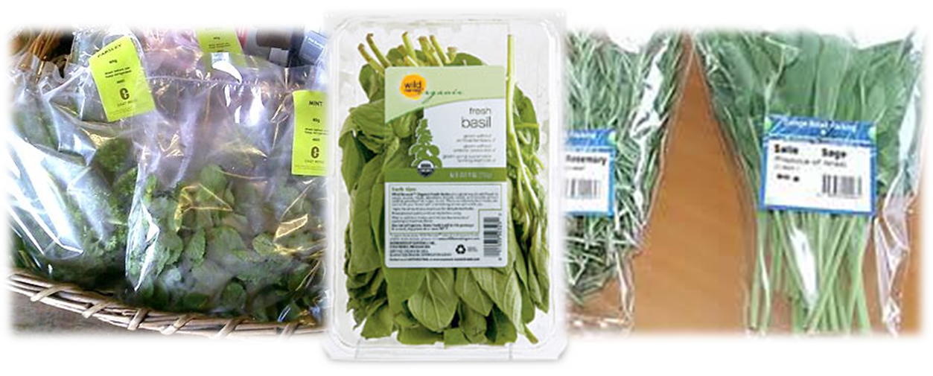
Processed Foods Include: Packaged Fresh Herbs

Slide 10
Processing Options: Cottage Kitchen
Home kitchen, certified by state agency
Program regulations and availability vary by state
Pro: Less expensive than renting or building commercial kitchen space
Con: Limited types of food can be prepared

Slide 11
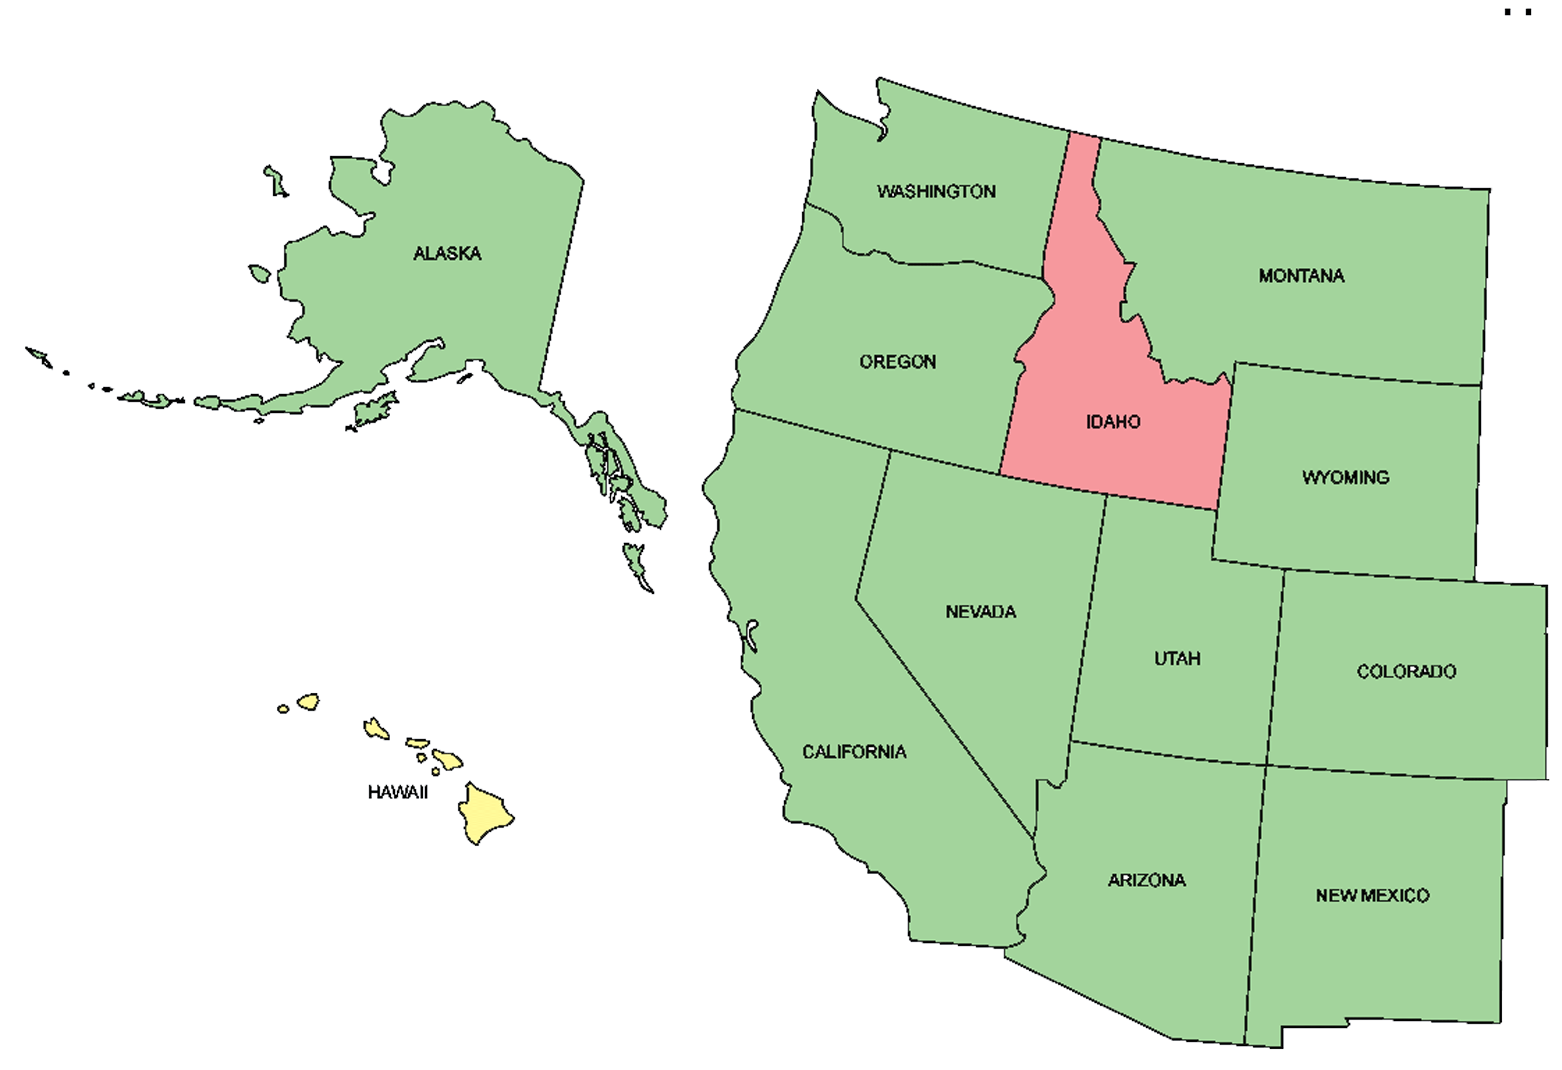
Cottage Production: Western U.S.
Green – Formal Cottage Food laws; Yellow – Formal legislation pending; Red – No formal Cottage Food law

Slide 12
Processing Options: Contract Packaging – “Co-Packers”
Certified food production facilities
Will package your product in their down-time
Each co-packer has different requirements, capabilities & minimum runs
You must license your business, but do not need to register with the FDA

Slide 13
Processing Options: Certified Food Establishments
Commercial facility, certified by local health department
Incubator kitchens, restaurant kitchens
Potentially Hazardous Foods can be produced, but must be approved
On-Farm certified kitchens may be exempt from some FSMA record keeping requirements

Slide 14
FSMA Exemptions: Certain On-Farm processing
“Standards for the Growing, Harvesting, Packing, and Holding of Produce for Human Consumption”
New FDA definition of “Farm”
Harvesting
Includes trimming, sifting, shelling, and washing
Drying/Dehydrating
Packaging and Labeling RACs

Slide 15
Value-Added Foods
Local, organic, vine-ripened, or specialty crops
“Gourmet” foods
Jams, jellies, preserves
Pickled vegetables
Hot sauces, salsas, tapenades
Herbed oils and vinegars
Must consider regulatory, safety and labeling issues

Slide 16
Safety Issues to Consider
How will you clean & sanitize?
How will you prepare or cook your product to minimize safety risks?
How will you package/protect your product?
How will you store & display your product?

Slide 17
Important Definitions
Clean: Free of visible dirt or debris
Applies to whole, unprocessed foods
Sanitary: Free of pathogenic bacteria
Applies to processed foods & food contact surfaces
Sterile: Free of all viable bacteria
Commercial sterility – 99.99% sterile

Slide 18
Safety IssuesKitchen Sanitation
Sanitize at start of production
1 tbsp unscented bleach maximum per 1 gallon water (200 ppm)
Check sanitizer with test strips

Slide 19
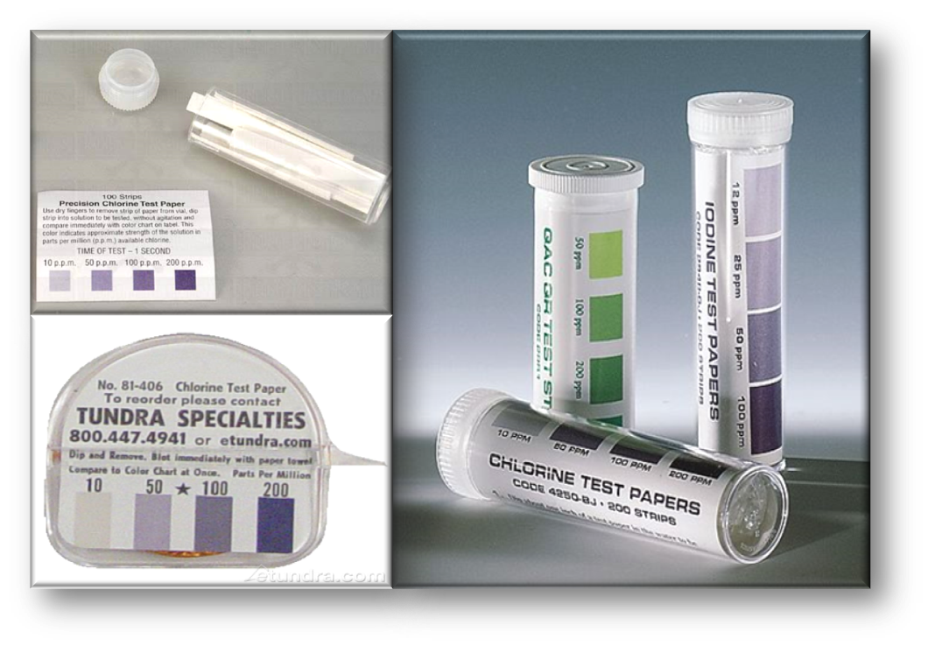
Common Sanitizer Test Strips

Slide 20
Safety Issues Kitchen Sanitation
Sanitize at start of production
1 tbsp unscented bleach maximum per 1 gallon water (200 ppm)
Check sanitizer with test strips
Wipe up spills, sanitize during production
Check / refresh sanitizer every hour
Clean and sanitize at end of production

Slide 21
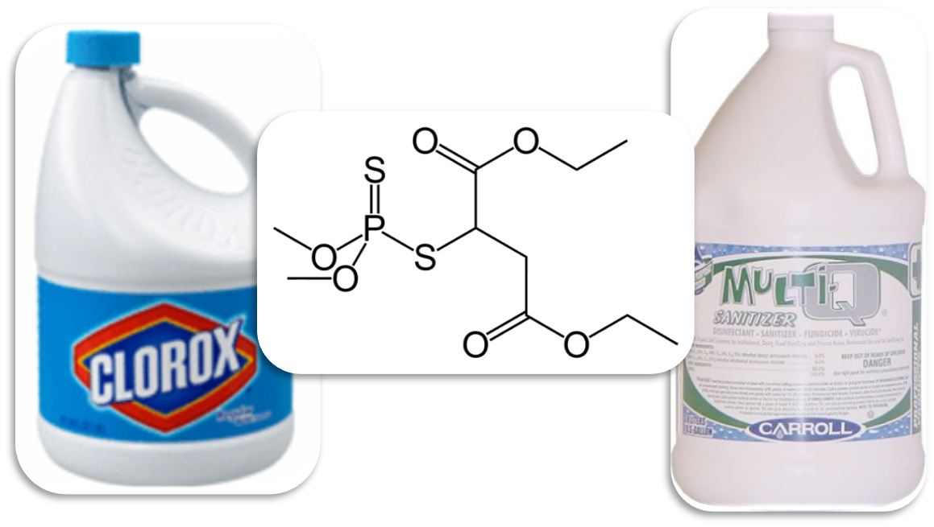
Chemical Contaminants

Slide 22
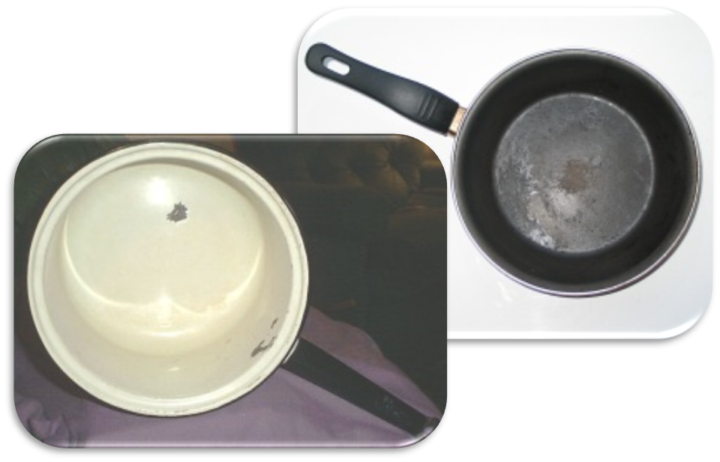
Chemical Contaminants

Slide 23
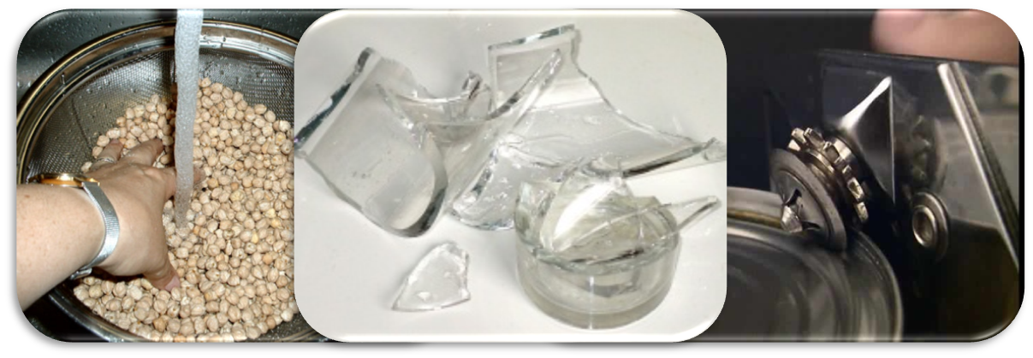
Physical Contaminants

Slide 24
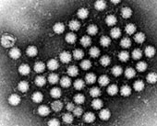
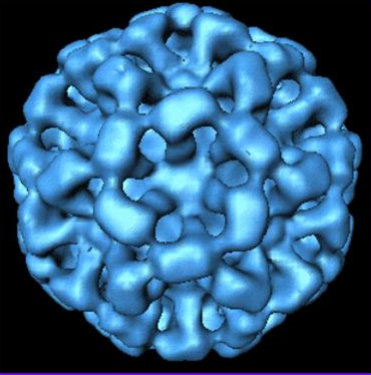
Biological Contaminants
Viruses – must infect a living host cell before reproducing, but can survive without a host

Slide 25

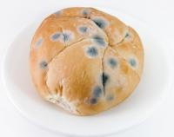
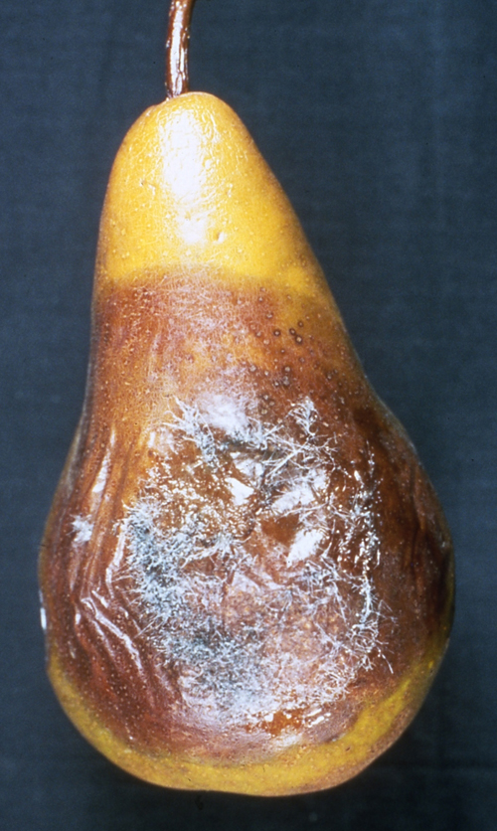
Biological Contaminants
Fungi – multiply and grow without a host

Slide 26
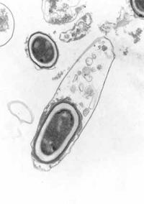
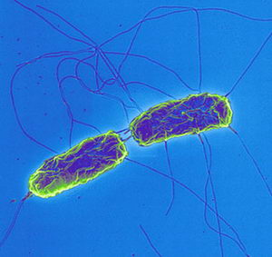
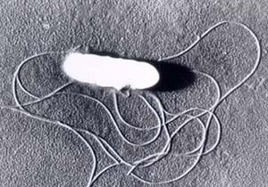
Biological Contaminants
Bacteria – multiply and grow without a host

Slide 27
Bacterial Growth & Survival
Food
Acid
Temperature
Time
Oxygen
Moisture

Slide 28
Survival: Moisture (Aw)
Bacteria must have water available
Aw is a measure of how much water is available, not how much is present
Add sugar or salt to lower Aw
Remove water to lower Aw

Slide 29
Water Activity (A_{w}) | Examples of foods in this range
1.00 – 0.95 | Fresh produce & meat; canned produce & meat; milk; juice; bread
0.95 – 0.91 | Cured meats (ham); semisoft & some hard cheeses (Swiss, young cheddar, provolone); moist cakes
0.91 – 0.87 | Hard or aged cheese; sponge cakes; margarine; most fermented sausage
0.87 – 0.80 | Syrup; flour; fruit juice concentrate; high-sugar cakes
0.80 – 0.75 | Jam & marmalade; marshmallows; beef jerky
0.75 – 0.65 | Soy sauce; molasses; jelly; nuts; oats; peanut butter;
0.65 – 0.60 | Honey; caramels; dried fruit; toffee
0.50 or below | Spices; crackers; cookies; pasta; powdered milk
Notes:
Point out that although there are dehydrated foods on this chart, that is not usually allowed in cottage production. The best way to lower the Aw is to add more salt or sugar.

Slide 30
Survival: Food
Bacteria have specific nutritional requirements
Food must provided that is a ready source of nutrients
We can limit growth of pathogenic or spoilage bacteria by adding a “Good” bacteria

Slide 31
Survival: Atmosphere
Aerobic = require oxygen
Anaerobic = oxygen is toxic
Facultative = anaerobes that can tolerate some oxygen
Places where no oxygen is present?

Slide 32
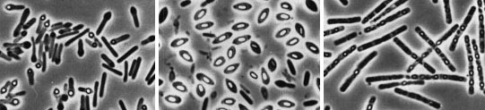
Growth: Acidity
Acid slows the growth of some bacteria
Acid prevents germination of bacterial spores
Vinegar, citrus juices, tomatoes

Slide 33

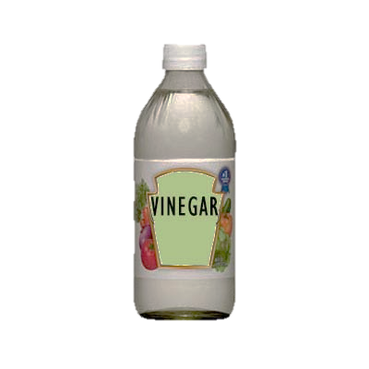



Most foods are between 7.0 (neutral) and 3.0 (acidic)
← | 7.0 | 6.0 | 5.0 | 4.0 | 3.0 | →
Notes:
Point out that tomatoes fall right on the borderline of safe pH (4.6). In general, the sweeter the tomato, the higher the pH, so they will need to be acidified.

Slide 34
Growth: Temperature
Each bacteria prefers a different temperature range
The temperature danger zone: 40 – 140F
Heat can destroy, cold only preserves

Slide 35
FDA – “Exempt” Products
Refrigerated, frozen, or Aw < 0.85
Labeling: 21CFR §101
Processing: 21CFR §110
Standards of Identity: 21CFR §135 to 169
FDA Food Processor registration required

Slide 36
Examples of “Exempt” Products
Candies and syrups
Dry mixes, spices/herbs, and flavorings
Roasted nuts
Dehydrated fruits and vegetables
Dried pasta and noodles
Full-sugar jams and jellies
Some BBQ sauces

Slide 37
FDA – Acid Food Regulations
Canned or bottled foods with a natural pH < 4.6
Should not contain more than 10% low acid ingredients
Labeling: 21CFR §101
Processing: 21CFR §110
Standards of Identity: 21CFR §135 to 169
FDA Food Processor registration required

Slide 38
Examples of Acid Foods
Canned tomatoes and tomato products
Canned fruits
Flavored vinegars
Vinegar and oil dressings
Low-sugar fruit preserves
Fermented foods (no other acid added)

Slide 39
FDA – Acidified Food Regulations
Natural pH > 4.6, but added acid drops pH
Require Process Authority letter & regular filings
Labeling: 21CFR §101
Processing: 21CFR §114
Standards of Identity: 21CFR §135 to 169
FDA Food Processor registration required
FDA Acidified Food Processer registration required

Slide 40
Examples of Acidified Foods
Salsa and spaghetti sauces
Most hot sauces and BBQ sauces
Worcestershire sauce
Pickled vegetables
Mayonnaise and salad dressing
Some vegetable juice blends, Clamato juice

Slide 41
FDA – Acidified Foods Guidance
Draft Guidance for Industry: Acidified Foods (September 2010)
Definitions, decision trees, and example calculations
Form FDA 2541 – Food Canning Establishment Registration
Form FDA 2541a – Process Filing for Acidified Foods

Slide 42
FDA – Low Acid Food Regulations
Natural pH > 4.6, no acid added
Require Process Authority letter & regular filings
Labeling: 21CFR §101
Processing: 21CFR §113
Standards of Identity: 21CFR §135 to 169
FDA Food Processor registration required
FDA Low Acid Food Processer registration required

Slide 43
Examples of Low Acid Foods
Canned vegetables
Canned beans and legumes
Canned or bottled olives
Vegetable juices
Canned vegetarian soups and broth
Evaporated milk
Canned tuna, clams, and shrimp

Slide 44
Value-Added Foods
Local, organic, vine-ripened, or specialty crops
“Gourmet” foods
Jams, jellies, preserves
Pickled vegetables
Hot sauces, salsas, tapenades
Herbed oils and vinegars
Must consider safety, regulatory and labeling issues

Slide 45
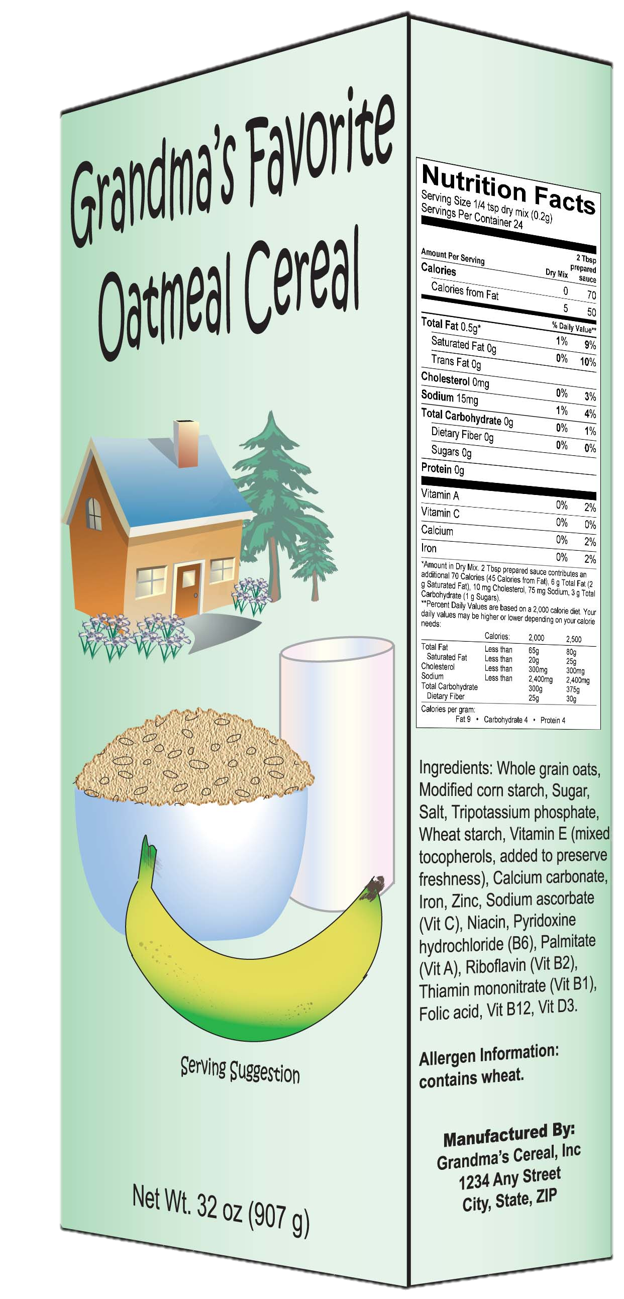
Required Label Components
Primary Display Panel
Statement of Identity
Net weight statement

Slide 46
Statement of Identity
Many foods have a legally established name that must be used [CFR21 §101.3]

Slide 47
Standards of Identity exist for:
§ 131 Milk & cream
§ 133 Cheese
§ 135 Frozen desserts
§ 136 Bakery products
§ 137 Cereal flours
§ 139 Macaroni & noodles
§ 145 Canned fruit
§ 146 Canned fruit juice
§ 150 Jellies & preserves
§ 152 Fruit Pies
§ 155 Canned vegetables
§ 156 Vegetable juices
§ 158 Frozen vegetables
§ 160 Eggs & egg products
§ 161 Fish & shellfish
§ 163 Cacao products
§ 164 Tree nuts & peanuts
§ 165 Beverages
§ 166 Margarine
§ 168 Sweeteners & syrups
§ 169 Dressings & flavorings

Slide 48
Statement of Identity
Many foods have a legally established name that must be used [CFR21 §101.3]
All others must use “common or usual name”
Other requirements include:
Form of food (e.g. sliced, cubed, crushed)
“Imitation” if lower protein, vitamins, minerals
“___% Juice” for any drink showing fruit or vegetables on the label

Slide 49
Required Label Components
Information Panel
Nutrition Facts panel
Ingredient statement
Producer name & address

Slide 50
Ingredient Statement
Ingredients must be listed in order by weight
Must list function of any preservatives
“Ascorbic Acid to promote color retention”
“Spices”, “Natural Flavor” or “Artificial Flavor” can be grouped to save space
Except: onion/garlic/celery items, salt, and MSG
Certified colors must be specified
“Red 40” or “FD&C Red 40”

Slide 51
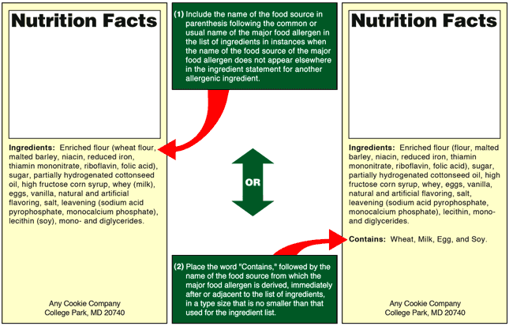
Allergen Statement

Slide 52
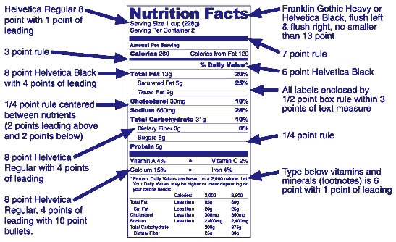
Nutrition Labeling Is Changing…

Slide 53
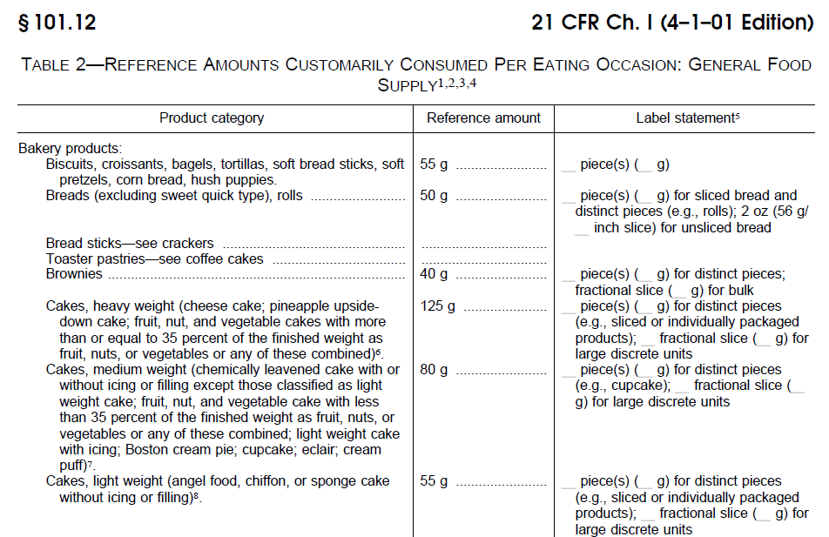
Nutrition Labeling
Reference Amounts Customarily Consumed
Continues on for 6 pages…

Slide 54

Small Business Exemption
Very small companies (< $50,000 total sales or fewer than 100 employees) do not even need to file with FDA
ANY NUTRITION CLAIMS VOID THIS EXEMPTION

Slide 55
Types of Health Claims
Nutrient content claims
Specific guidelines for different types of food
Approved health claims
General scientific consensus has been reached
Must put in context of whole diet
Qualified health claims
No scientific consensus, but some evidence
Stricter wording requirements

Slide 56
Nutrient Content Claims
Content Claims [21CFR§101.60-62]
“Free”, “Low”, “Reduced/Less”
Relative Claims [21CFR§101.13(j)]
“Light”, “Reduced” or “Added”, “More” or “Less”
Other Claims
“High”, “Rich In” or “Excellent Source of”
“Good Source”, “Contains” or “Provides”
“Lean” and “Extra Lean”
“Modified”
“Fiber” claims

Slide 57
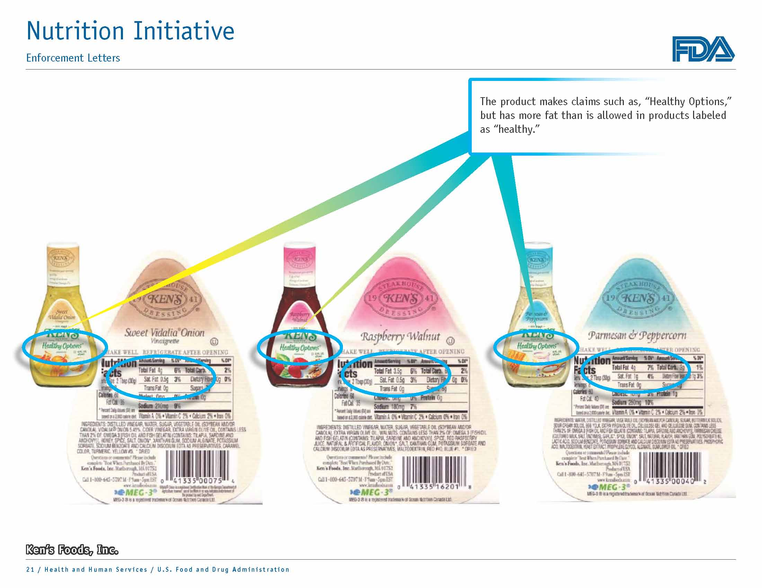

Slide 58
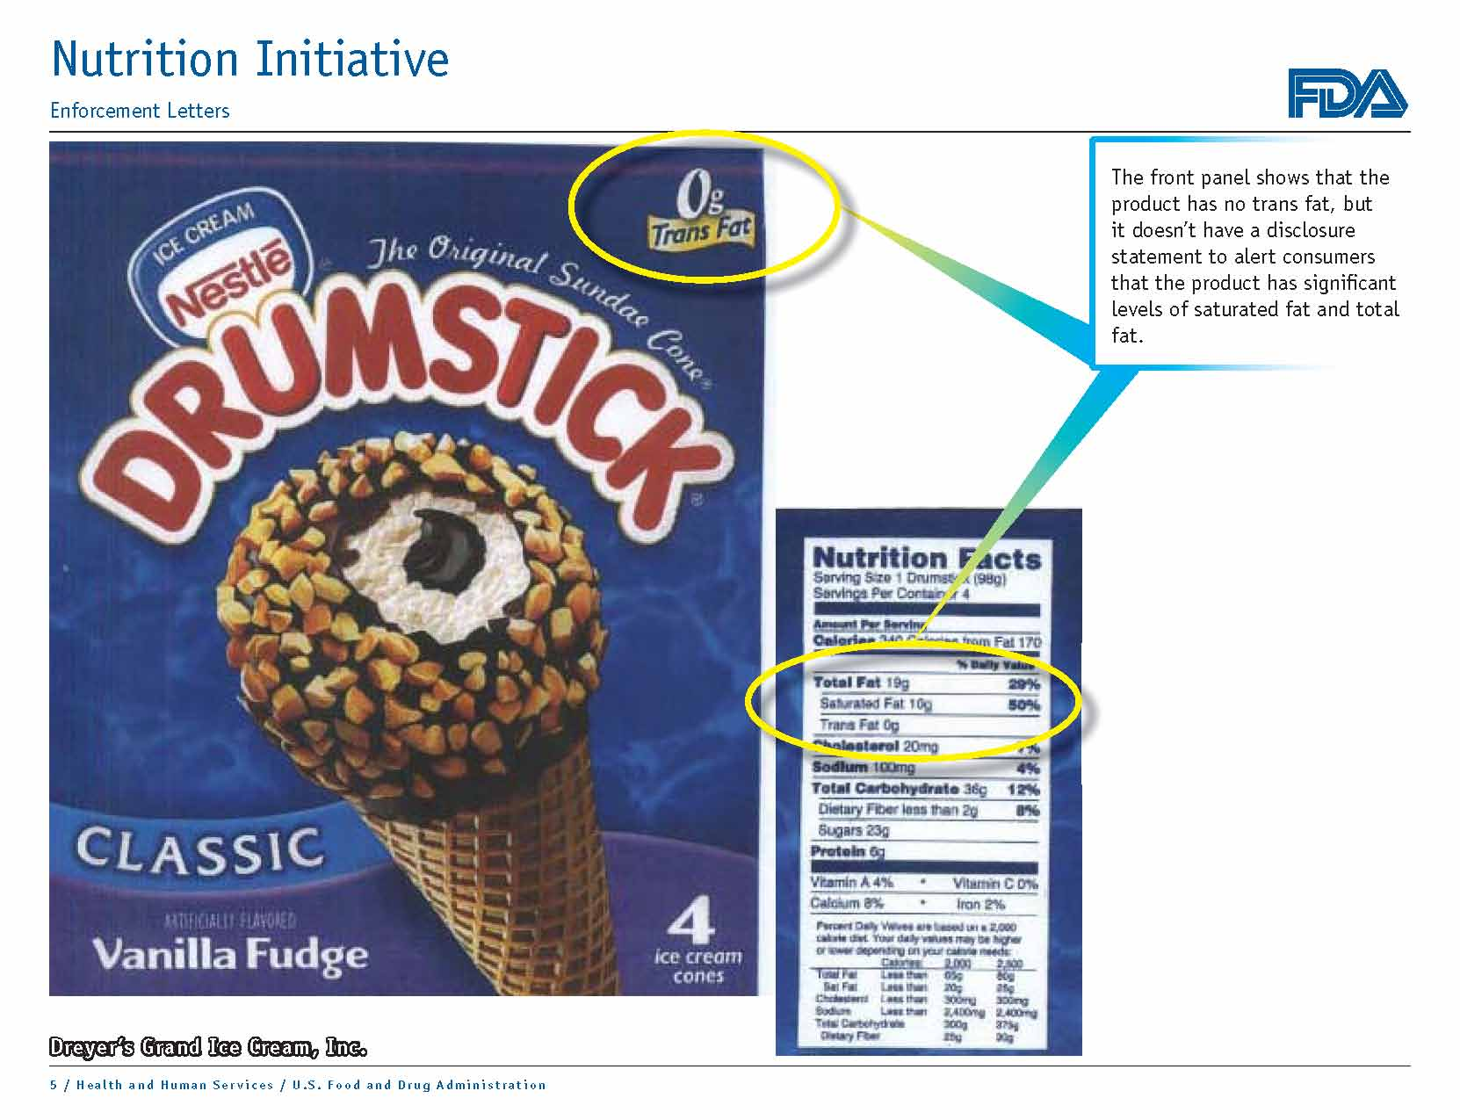

Slide 59

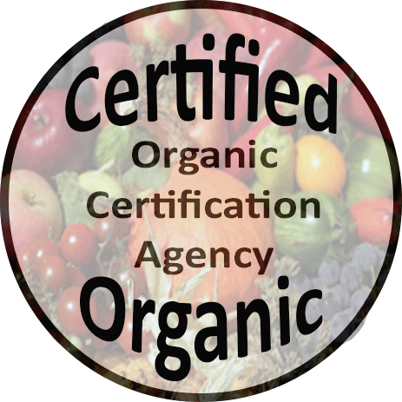
Organic Labeling
Crop, livestock, or food product certification
USDA does not require certification for organic sales <$5000 / year
Specific requirements for how it is stated on the label

Slide 60
“100% Organic”
Must contain only organic ingredients (not including water and salt)
Must list certifying agency information
Can use USDA and/or certifying agency seal

Slide 61
“Organic”
Must contain 95% organic ingredients
Cannot contain sulfites
Must list certifying agency information
Can use USDA and/or certifying agency seal

Slide 62

“Contains Organic __________”
Must contain 70% organic ingredients
Cannot contain sulfites (except wine)
Must list certifying agency information
Can use certifying agency seal, but not USDA

Slide 63
Natural Labeling
No specific legal definition from FDA
USDA has stricter requirements
Cannot contain artificial or synthetic ingredients
Colors
Flavors
Preservatives

Slide 64
Activity
Worksheet 4.1: Potential Food Safety Risks
Choose a product you produce or plan to produce
For each stage of the production process identify potential food safety risks for each risk type
Biological, chemical, and physical

Slide 65
Example
Risk Overview

Slide 66
Thank you!

Slide 67
USDA FSIS – Meat Regulations
All products containing > 3% raw or > 2% cooked meat by weight
Beef, Pork, Lamb, Goat
Labeling requirements: 9CFR §317
Processing requirements: 9CFR §318
Standards of Identity: 9CFR §319

Slide 68
USDA FSIS – Poultry Regulations
All products containing > 3% raw or > 2% cooked poultry by weight
Chicken, Turkey, Goose, Duck, Guinea, Squab
Labeling requirements: 9CFR §381 Subpt. N
Processing requirements: 9CFR §381 Subpt. O
Standards of Identity: 9CFR §381 Subpt. P

Slide 69
FSIS and FDA – Eggs & Egg Products
USDA FSIS regulations
Processing and Grading: 9CFR §590
FDA regulations
Labeling: 21CFR §101
Storage and Transport: 21CFR §115 and 118
Standards of Identity: 21CFR §160

Slide 70
FDA – Dairy Regulations
Labeling: 21CFR §101
Processing: Pasteurized Milk Ordinance and 21CFR §110
Standards of Identity: 21CFR §131 to 135
FDA Food Processor registration required

Slide 71
FDA – Bottled Water Regulations
Labeling: 21CFR §101
Processing: 21CFR §110
Standards of Identity: 21CFR §129
FDA Food Processor registration required
UDAF Food Establishment registration required

Slide 72
FDA – Juice Regulations
Labeling: 21CFR §101
Processing: 21CFR §113 (low acid), §114 (acidified), or §120 (all others)
Standards of Identity: 21CFR §146 and 156
FDA Food Processor registration required

Slide 73
FDA – Fish and Fish Products
Labeling: 21CFR §101
Processing: 21CFR §123
Standards of Identity: 21CFR §161
FDA Food Processor registration required

Slide 74
FDA – Dietary Supplements
Labeling: 21CFR §101
Processing: 21CFR §111
No Standards of Identity for supplements
FDA Food Processor registration required

