Slide 1

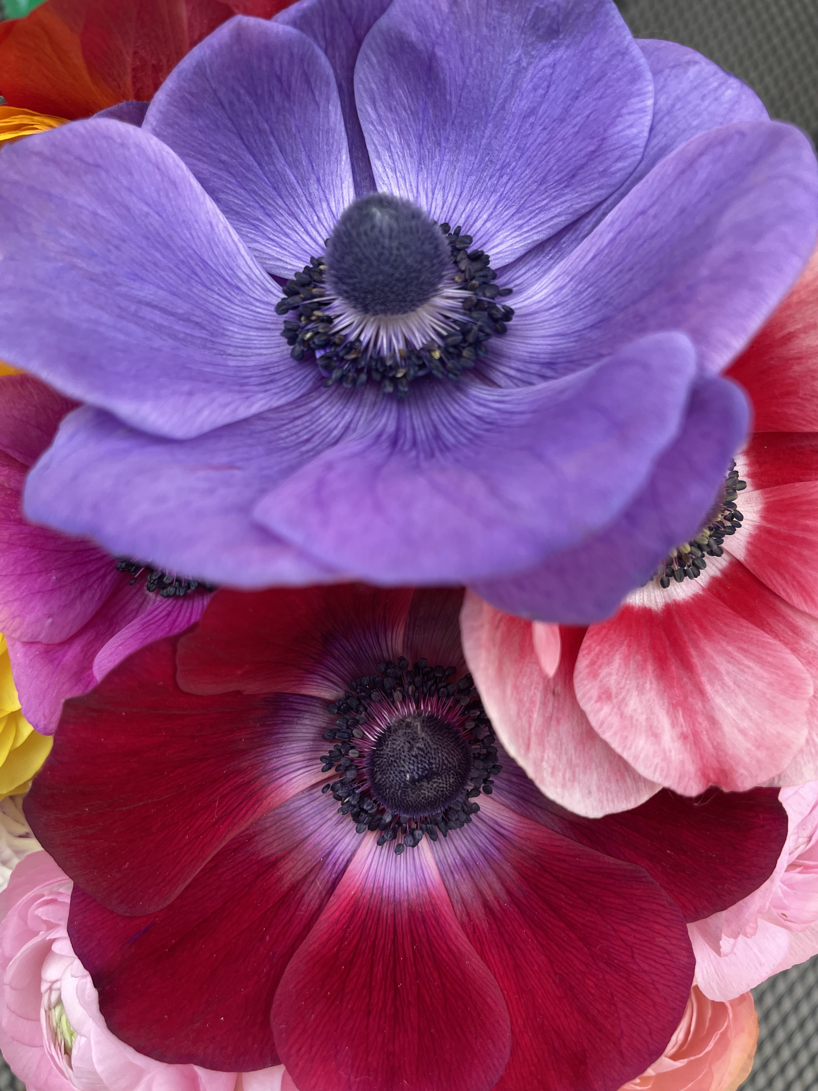
Intermountain Florist & Wholesale Buyer Preferences for Local Cut Flowers
Kynda Curtis, PhD, Professor and Extension Food Systems Specialist
Melanie Stock, PhD, Associate Professor and Extension Small Farms Specialist
Makaylie Langford, Research Assistant

Slide 2
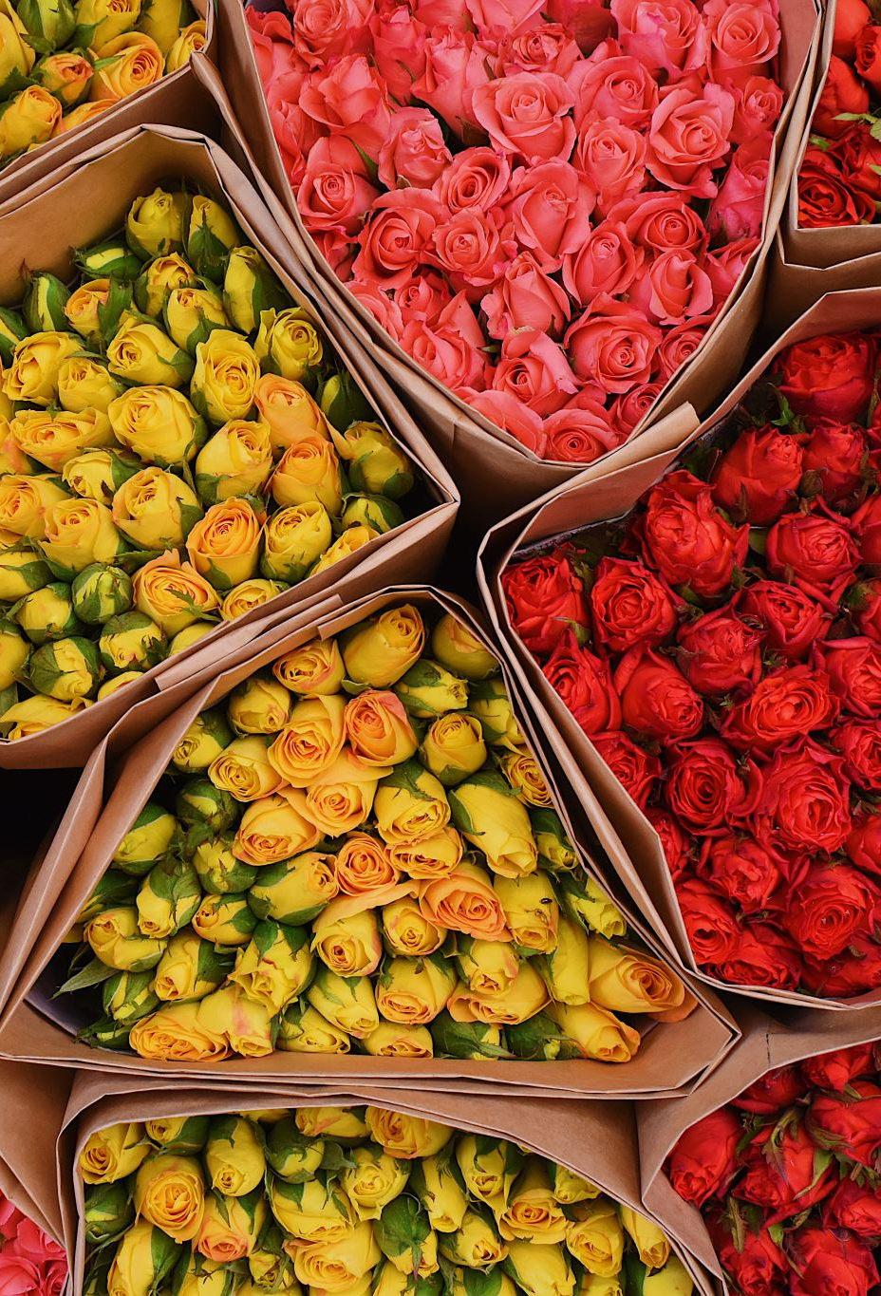
Introduction & Background
Americans purchase 10 million cut flowers daily, spending close $7 billion annually
The majority, 80%, of the flowers sold in the US are grown internationally
California and Florida have the highest cut flower sales in the nation, but the industry is expanding in other regions
  In Utah, the number of cut flower farms rose from 20 to 199, from 2018 to 2023
Intermountain West cut flower grower markets
  Direct-to-consumer markets such as farmers’ markets, CSA’s, etc.
  Wholesale markets such as cooperatives, wholesale buyers, and florists
As growers gain more experience, florists and other wholesale markets often become a larger part of their business

Slide 3

Introduction & Background
Understanding the preferences and needs of florist and wholesale markets will be essential for cut flower growers
  Just over 12,000 retail florist shops in the US, close to 20% of all floral industry businesses
  US floral gift market is expected to grow by over 50% by 2028
Study conducted in early 2024 to provide Intermountain West cut flower growers with pertinent florist/wholesale market information:
  Current sourcing and flower expenditures
  Primary markets and annual sales
  Current supplier challenges
  Market trends, in terms of sales as well as flower variety and color predictions
  Experience sourcing local flowers from growers/grower cooperatives
  Perceived barriers to local sourcing
  Current and projected local flower purchases
  Current preferences and needs for local cut flowers including pricing, quantity, variety, and delivery preferences

Slide 4
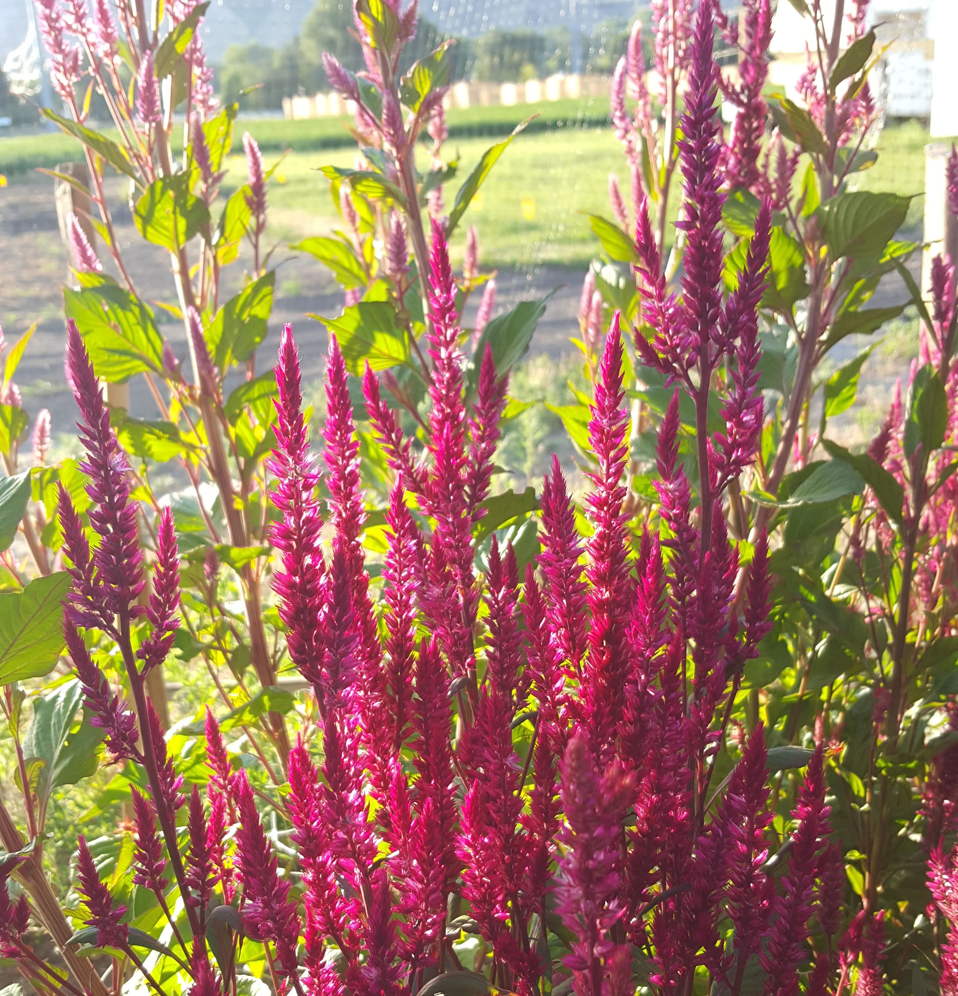
Survey Data Overview
Florist survey
  Survey of florists in Intermountain West
    Utah, Idaho, Nevada, Colorado, Wyoming, and Montana
  Conducted in online in January/February 2024
  1412 florists invited
  204 responses
Wholesale buyer survey
  Same states, online in early 2024
  26 wholesale buyers invited
  8 responses

Slide 5

Florist Survey Results
Florist respondent characteristics
Local sourcing preferences
Hurdles to local sourcing
Floral needs and wants
Suggestions

Slide 6
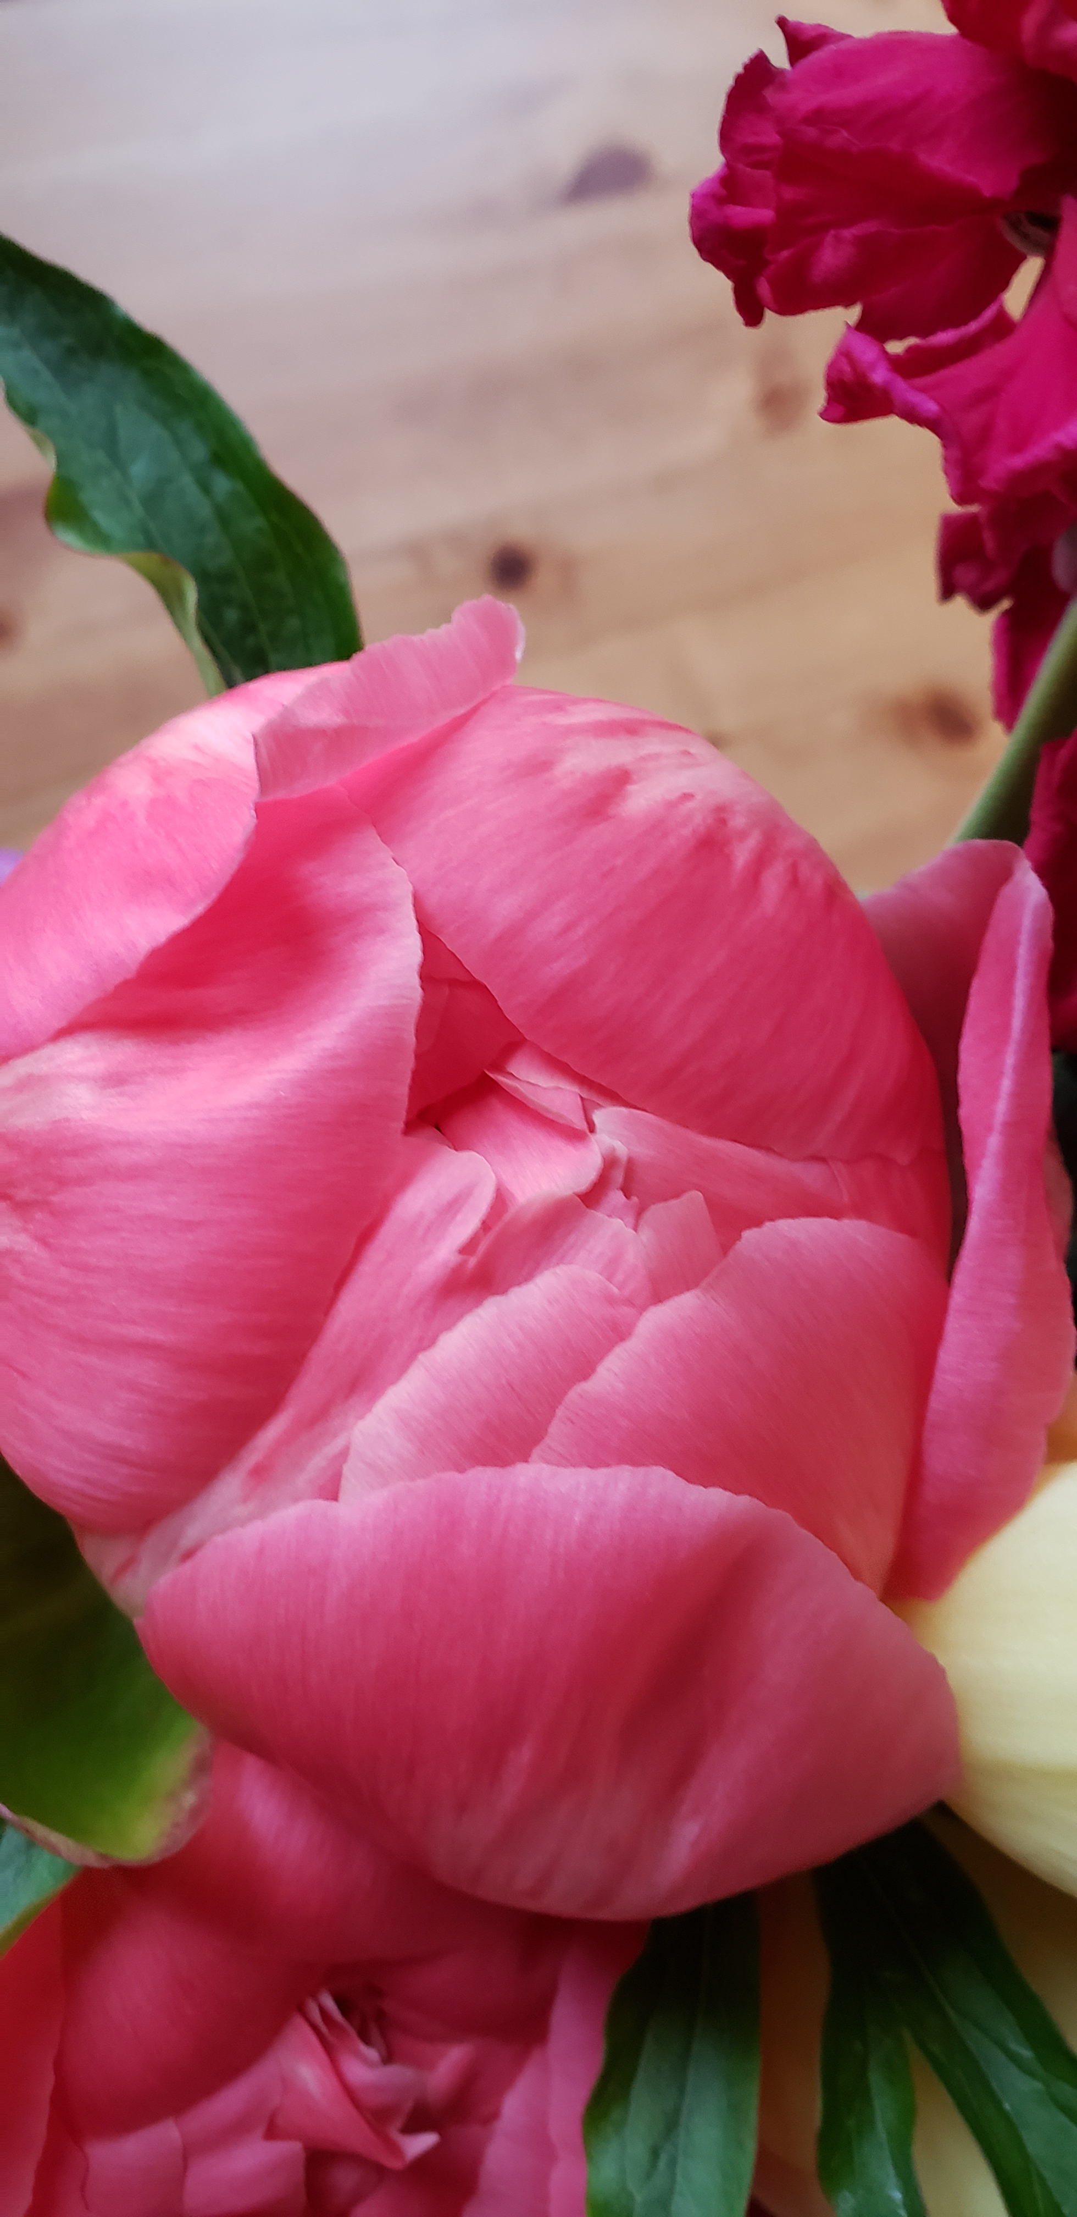
Florist Characteristics Overview
Florists represent all states and experience levels
Florists are primarily women, highly educated across age levels
Primary markets are daily florals and weddings
  Median per wedding income falls primarily between $1,000 and $5,000
  Design their own arrangements
Florists are divided on industry outlook
Source primarily from regional wholesalers
  Salmon, white, blush, and rust colors popular
Challenges with current wholesale providers are flower quality and vase life

Slide 7
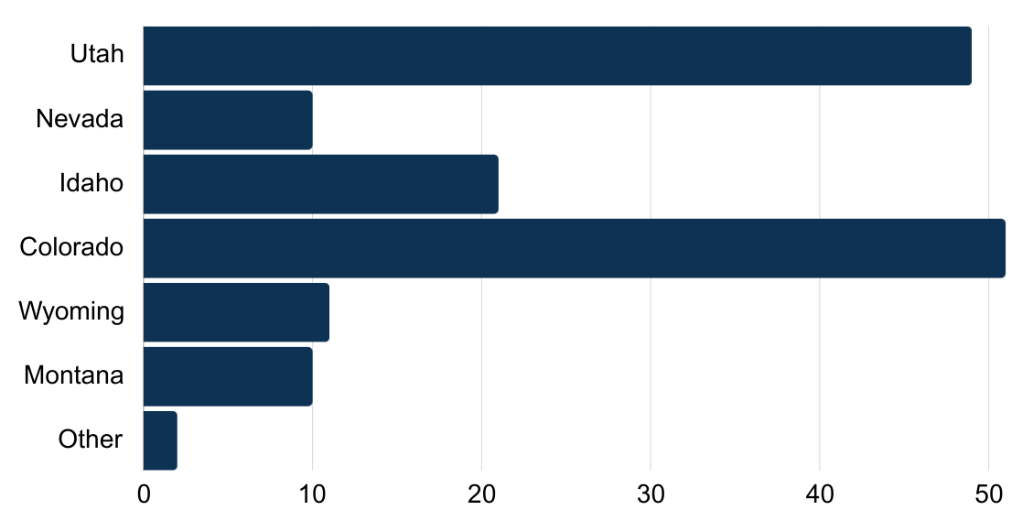
In which state is your floral business located?
Other
Covering multiple Intermountain states

Slide 8
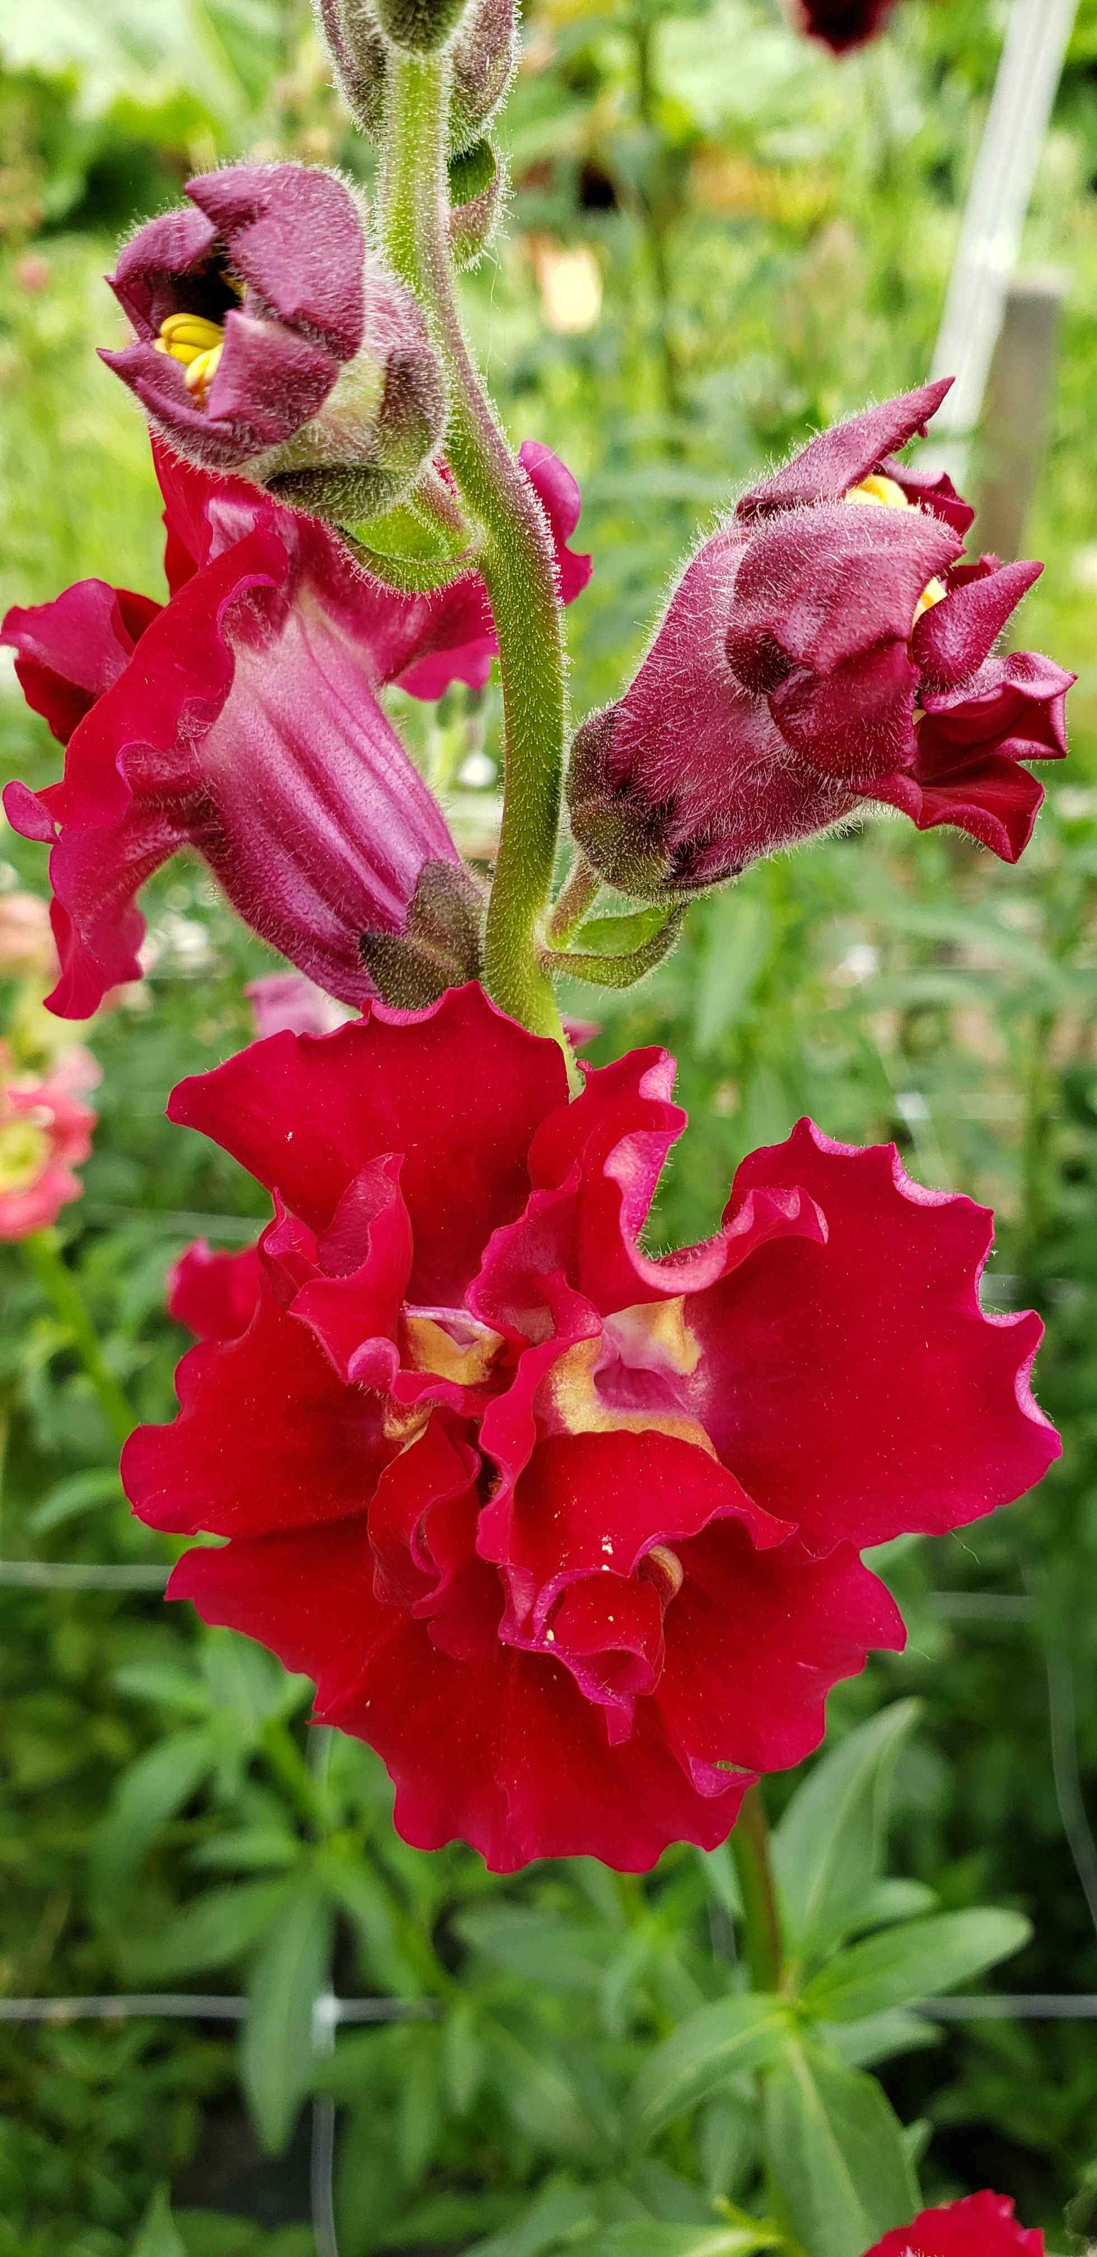
Florist Demographics
Question Description | Category | Sample (%)
What is your current age? | Under 25 years 25-34 years 35-44 years 45-54 years 55-64 years 65 years and over | 1.95% 24.03% 27.92% 20.78% 23.38% 1.95%
What is your gender? | Man Woman Other | 8.44% 90.91% 0.65%
What is your highest completed level of formal education? | Less than high school High school diploma/GED Associate degree/some college College degree Graduate degree | 0% 11.11% 31.37% 49.02% 8.5%

Slide 9
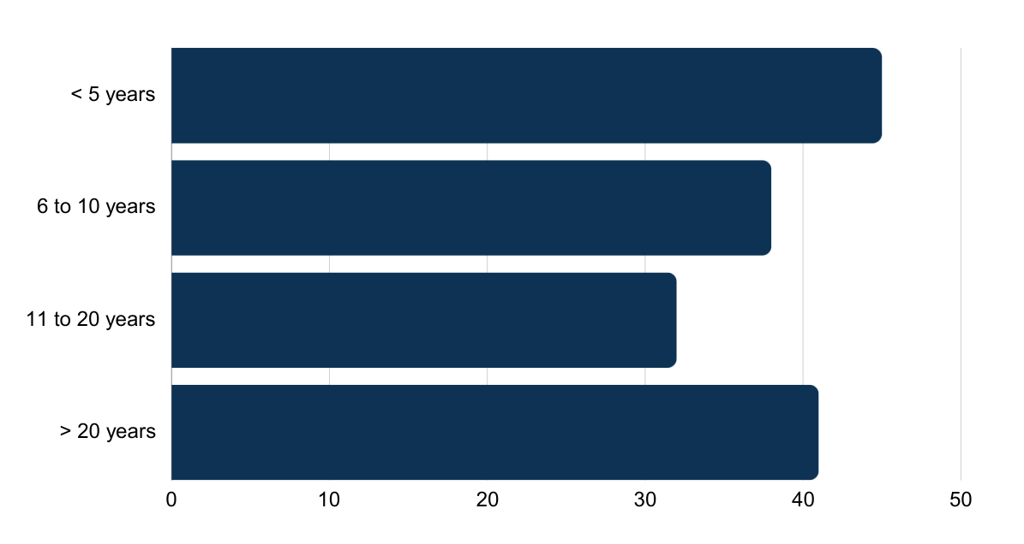
How many years have you operated a floral business?

Slide 10
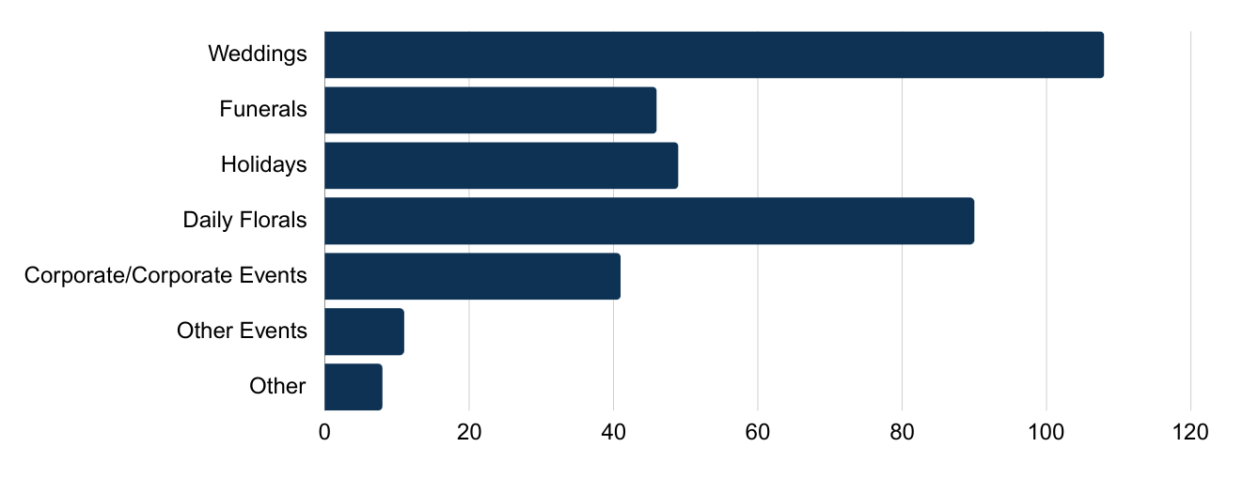
Which of the following best describes your primary clientele? (Select the top two)
Other Events
Birthdays
Dances
Showers
Workshops
Local events
Other
Private homes
Hotels & casinos
Silk arrangements
Brand installations

Slide 11
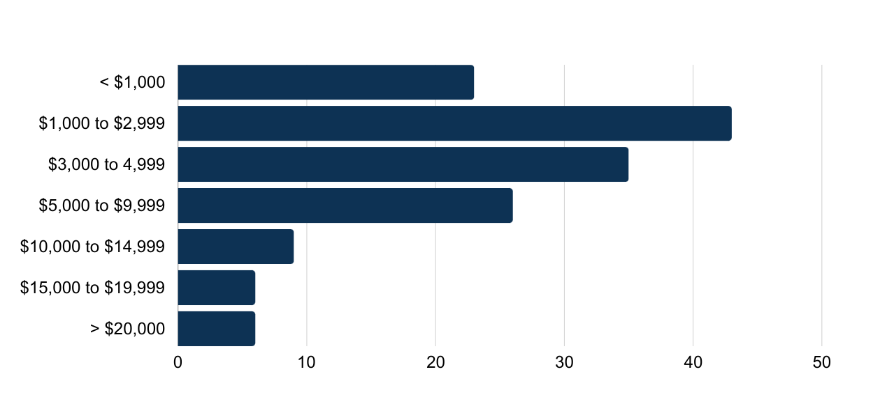
If weddings are part of your business focus, what is your typical wedding size (in dollars)?

Slide 12
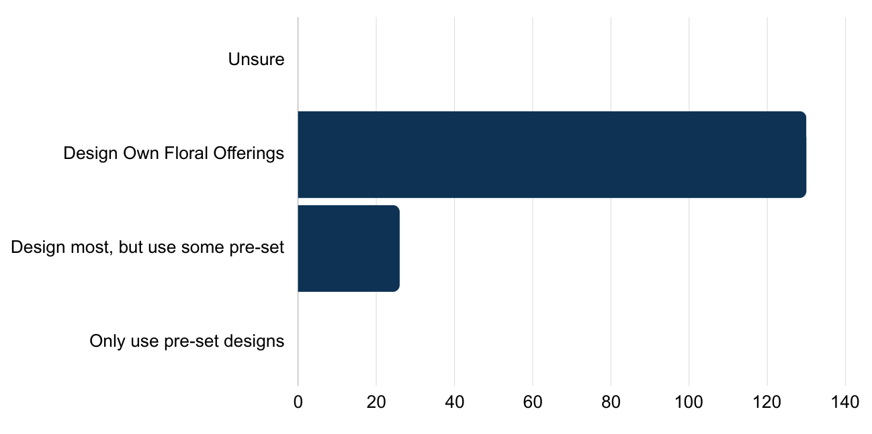
Do you create your own floral designs, or do you normally follow pre-set/prescribed designs?
Florists have a lot of freedom in choosing what flowers to use and how to style them
Notes:
Even with our tremendous growth, there is room in the markets. Fear at beginning is competition

Slide 13
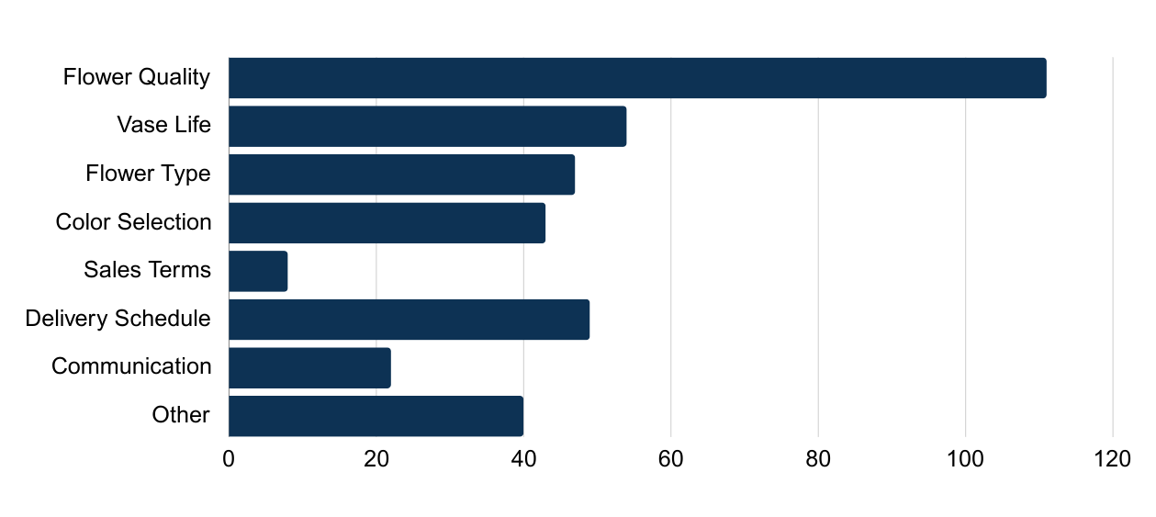
If you source from wholesale providers, what are your primary challenges? (Choose all that apply)
Considerations for farms
Other
Price
Cost of shipping
Distance to wholesaler
Not on delivery route
Availability
Notes:
Rural florists often may have more challenges with wholesale
These are things to focus marketing on! And if command higher prices
Those saying no – may not know anything else

Slide 14
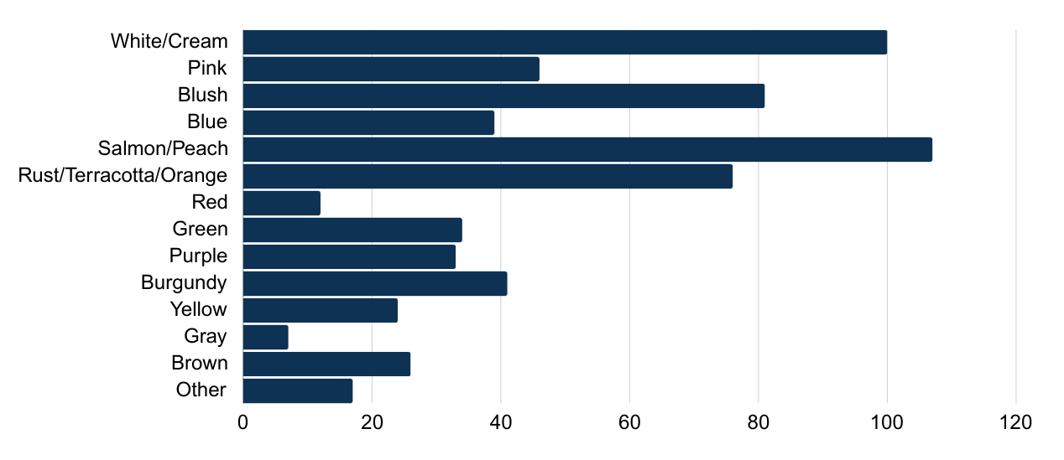
What color trends are you seeing for YOUR business next year? (Select the top three)
Not surprising given the importance of weddings
Notes:
Not surprising bc these florists serve so many weddings

Slide 15
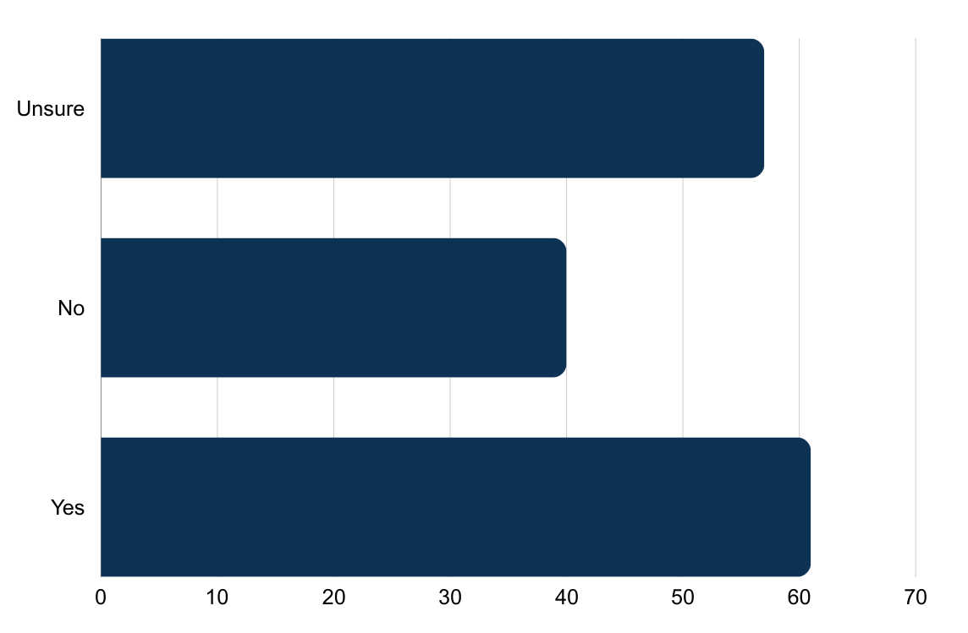
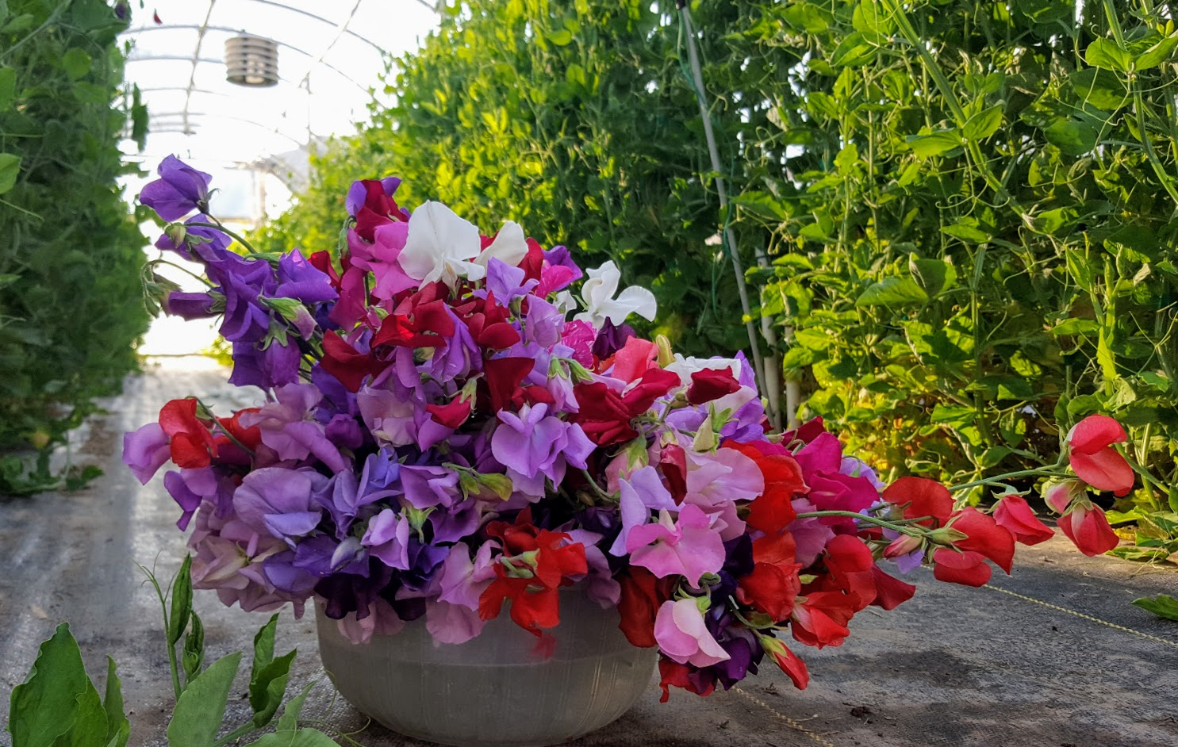
Do you feel your flower sales will increase next year?

Slide 16
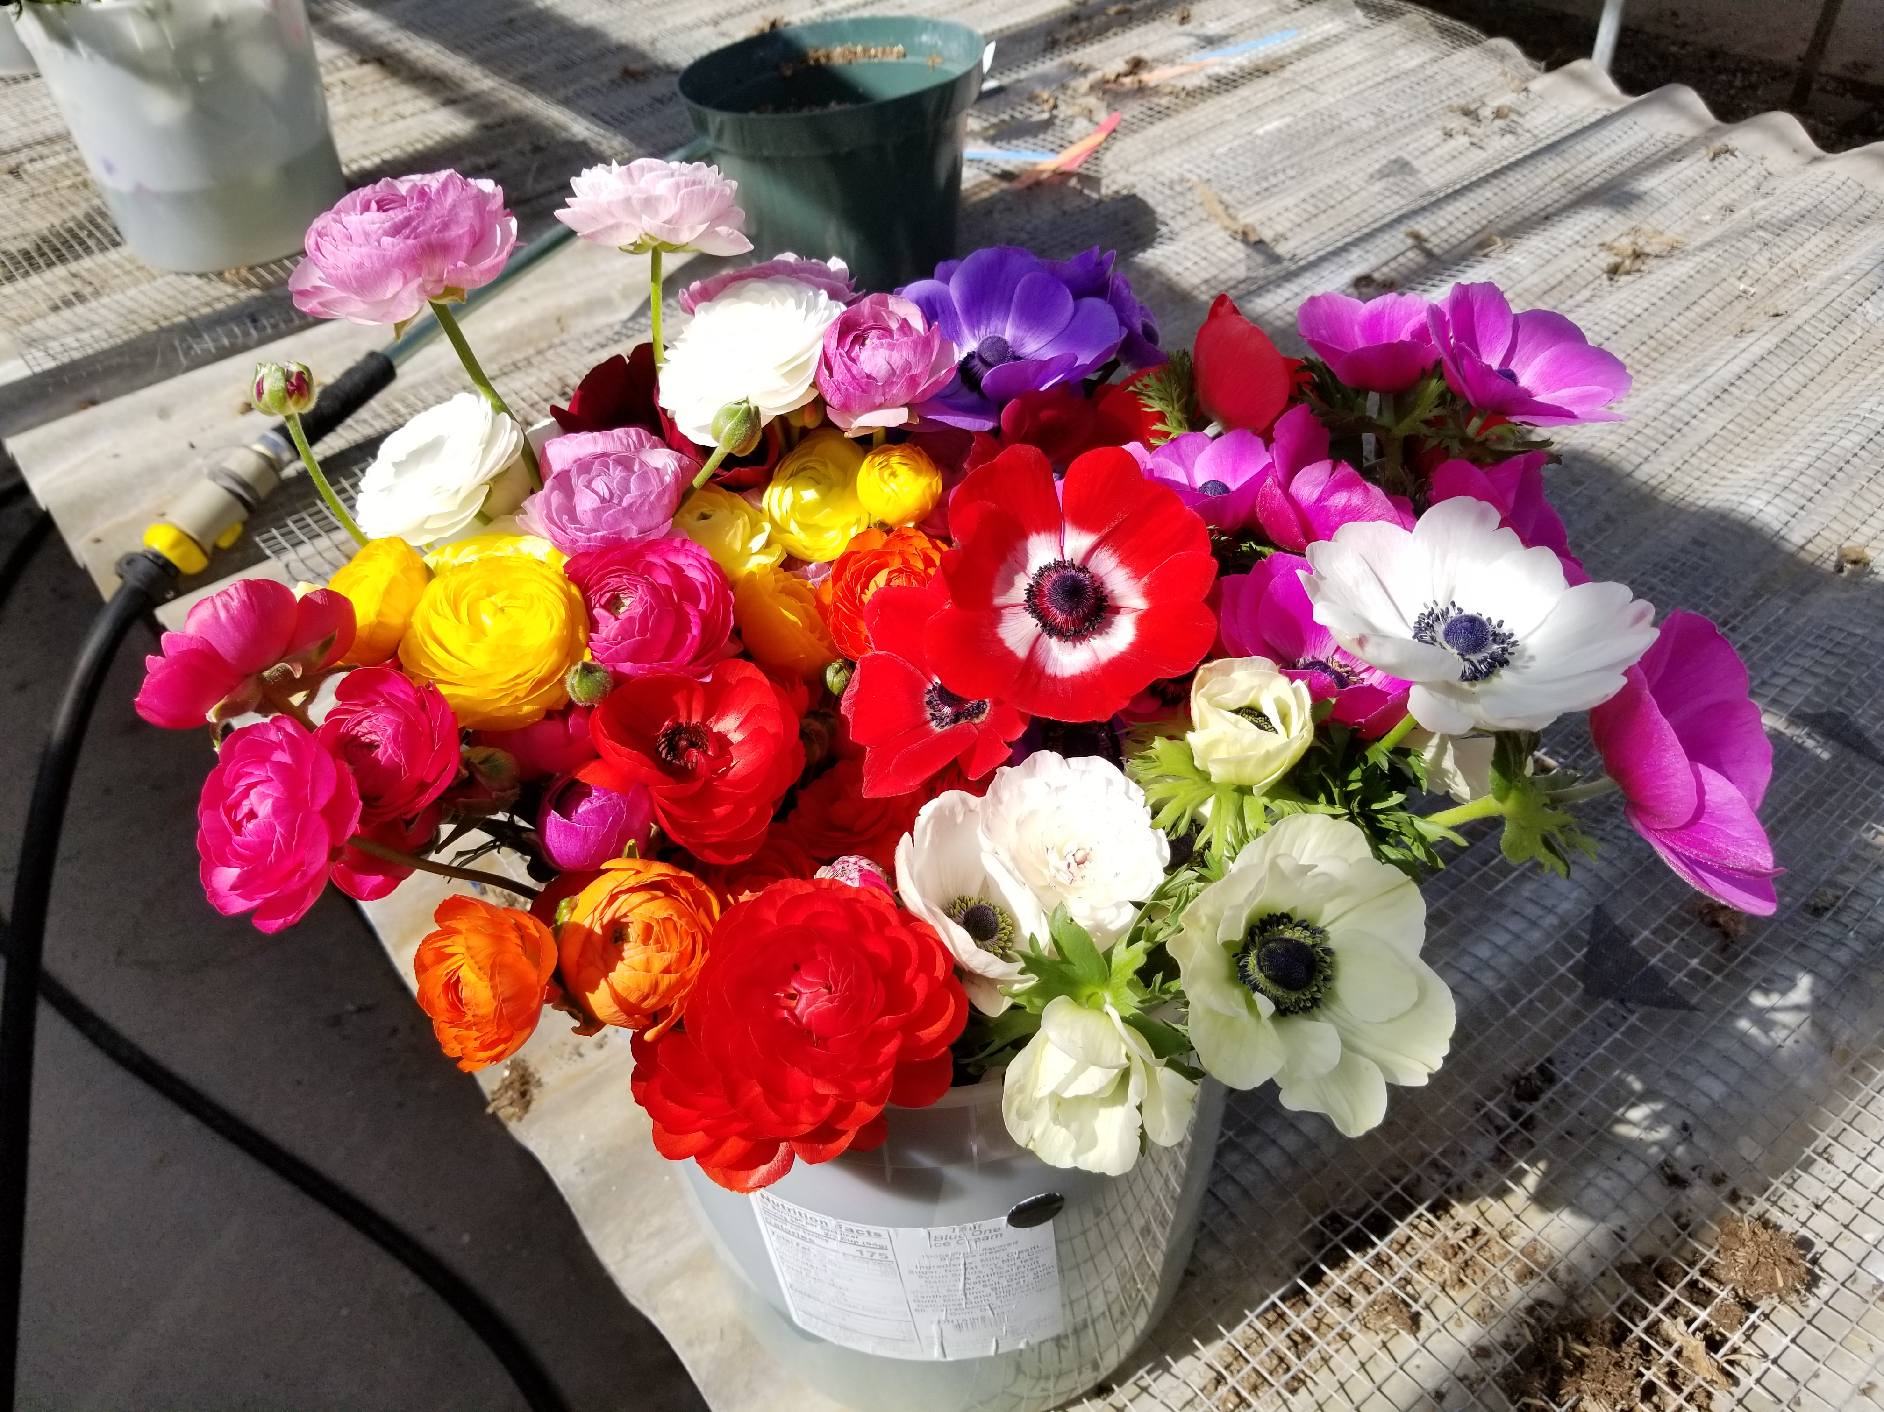
Local Sourcing Preferences Overview
Strong interest in sourcing from local growers
  Would like to source 15-50% of total flowers locally
Florists identified benefits to sourcing locally
  Support local economy
  Unique selection
  Vase life
Florists willing to pay premiums for local flowers!
  Strong preferences for premiums from 6-20%

Slide 17
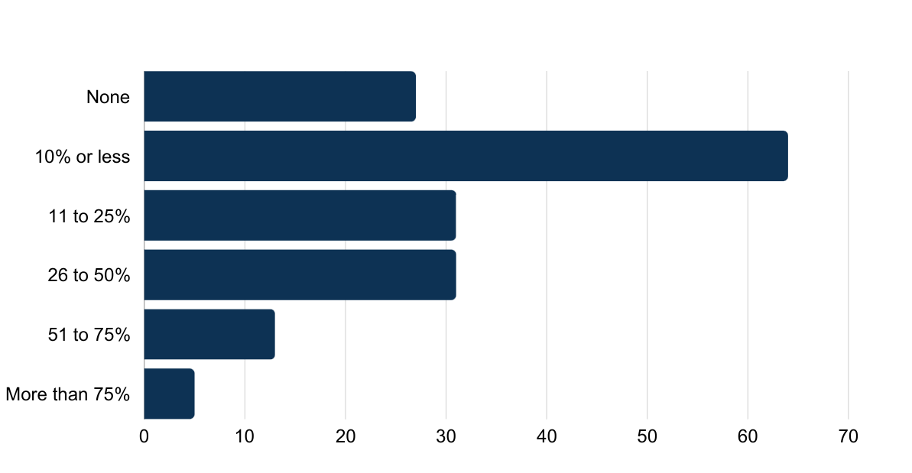
What percentage of the flowers you used last year were sourced from local farms/growers? (In state, or within 150 miles of your floral business)

Slide 18
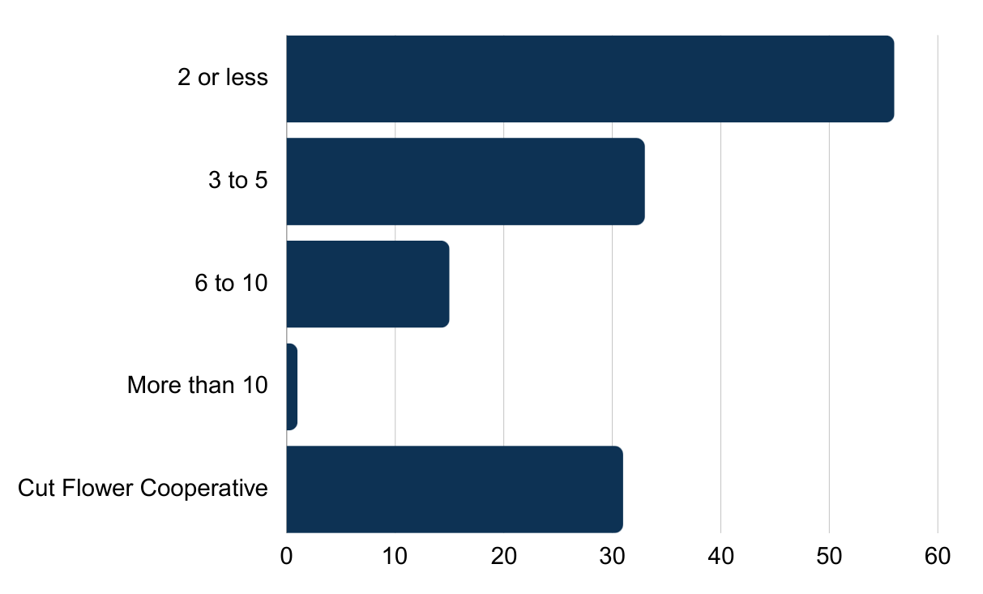
If you sourced flowers locally this year, from approximately how many growers/farmers did you source?

Slide 19
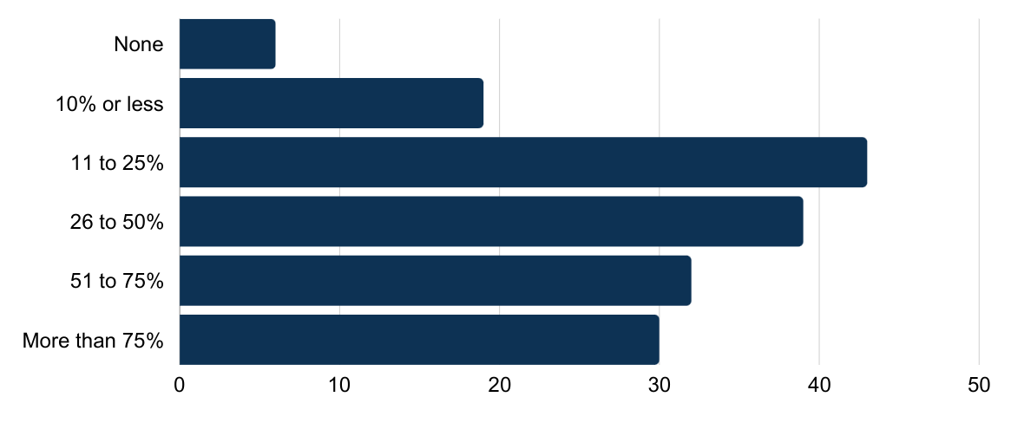
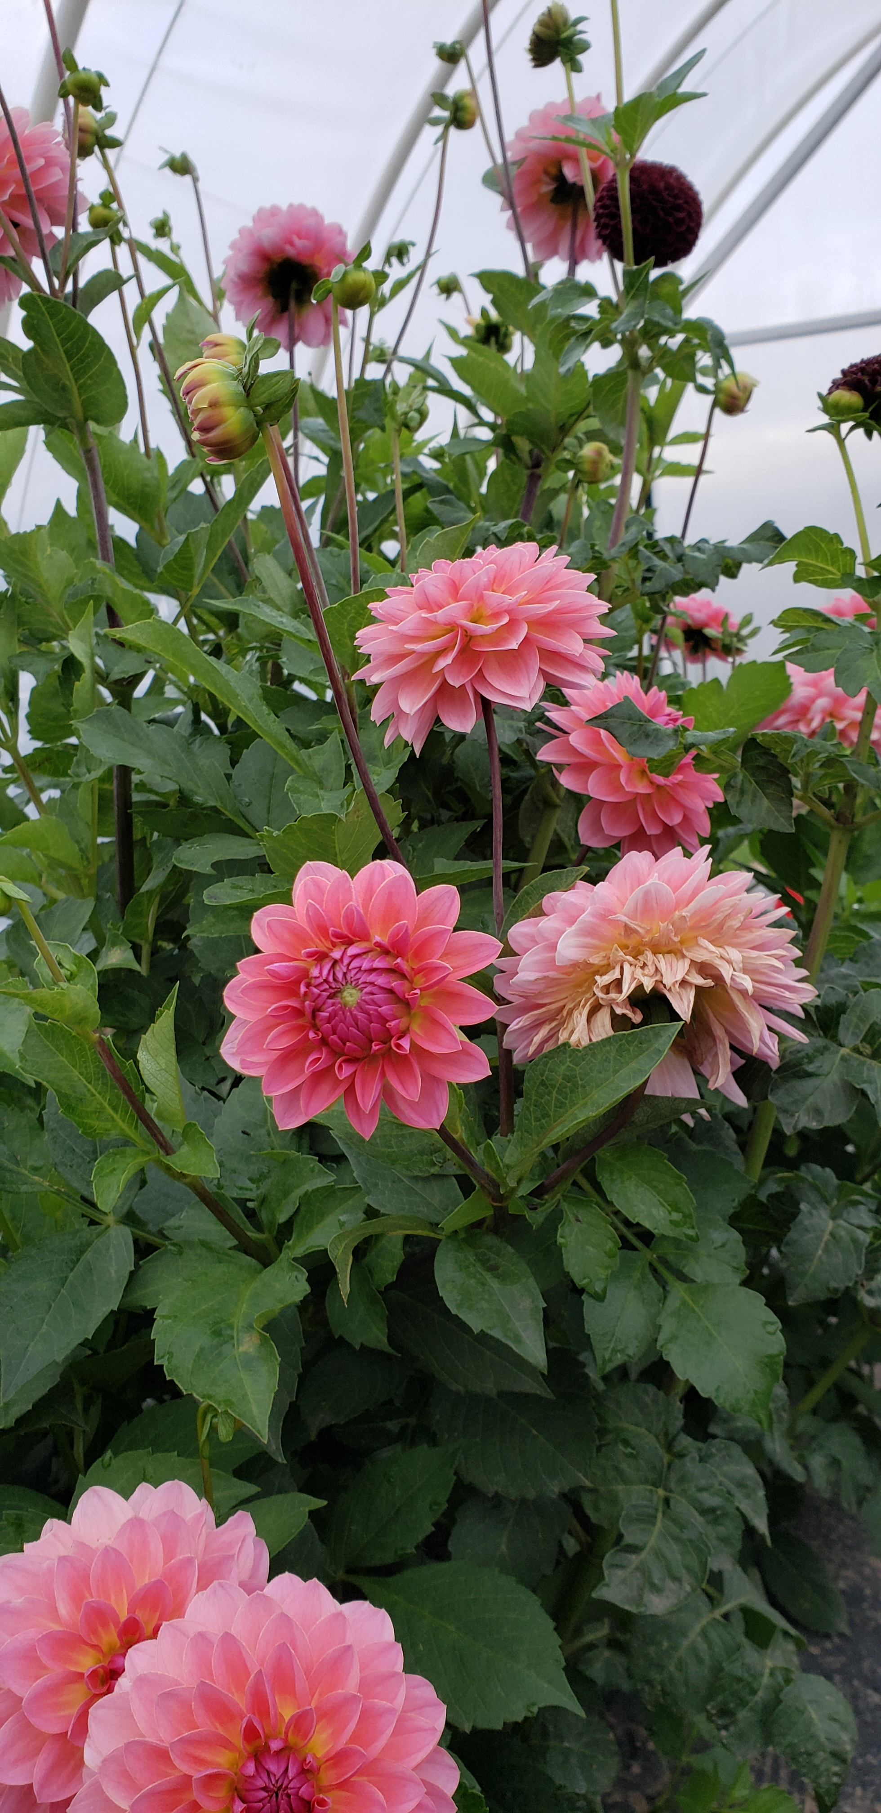
Next year, what % of your flowers would you like to source locally?
Even with the rapid growth in farms, there is still a lot of room in the market, especially as awareness of local flowers increases
Notes:
Even with our tremendous growth, there is room in the markets. Fear at beginning is competition

Slide 20
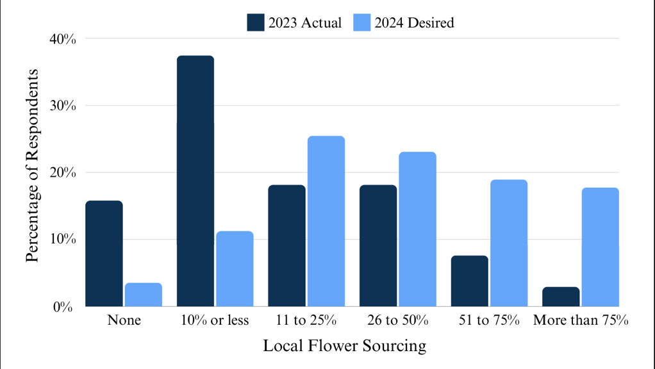
Comparison – 2023 Actual vs. 2024 Desired

Slide 21
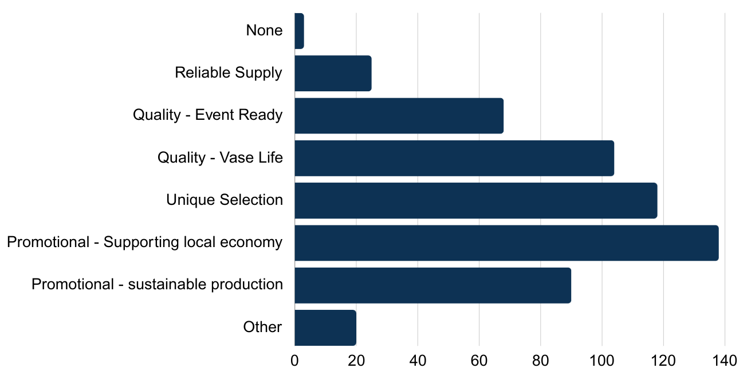
What do you feel are the benefits of sourcing flowers locally? (Choose all that apply)
Notes:
Ideas?
Listed from high to low

Slide 22
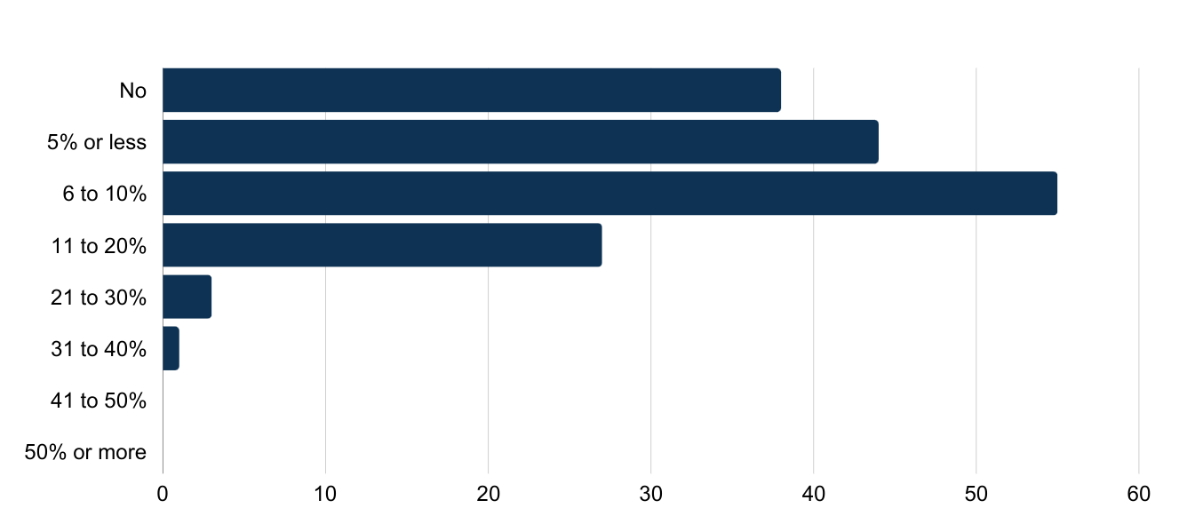
Would you be willing to pay more for locally sourced cut flowers? If so, what percentage over wholesale pricing?
40% of respondents

Slide 23
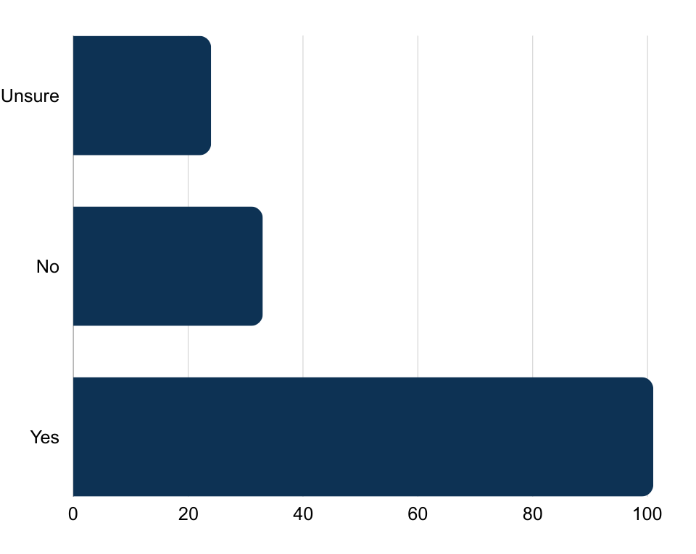
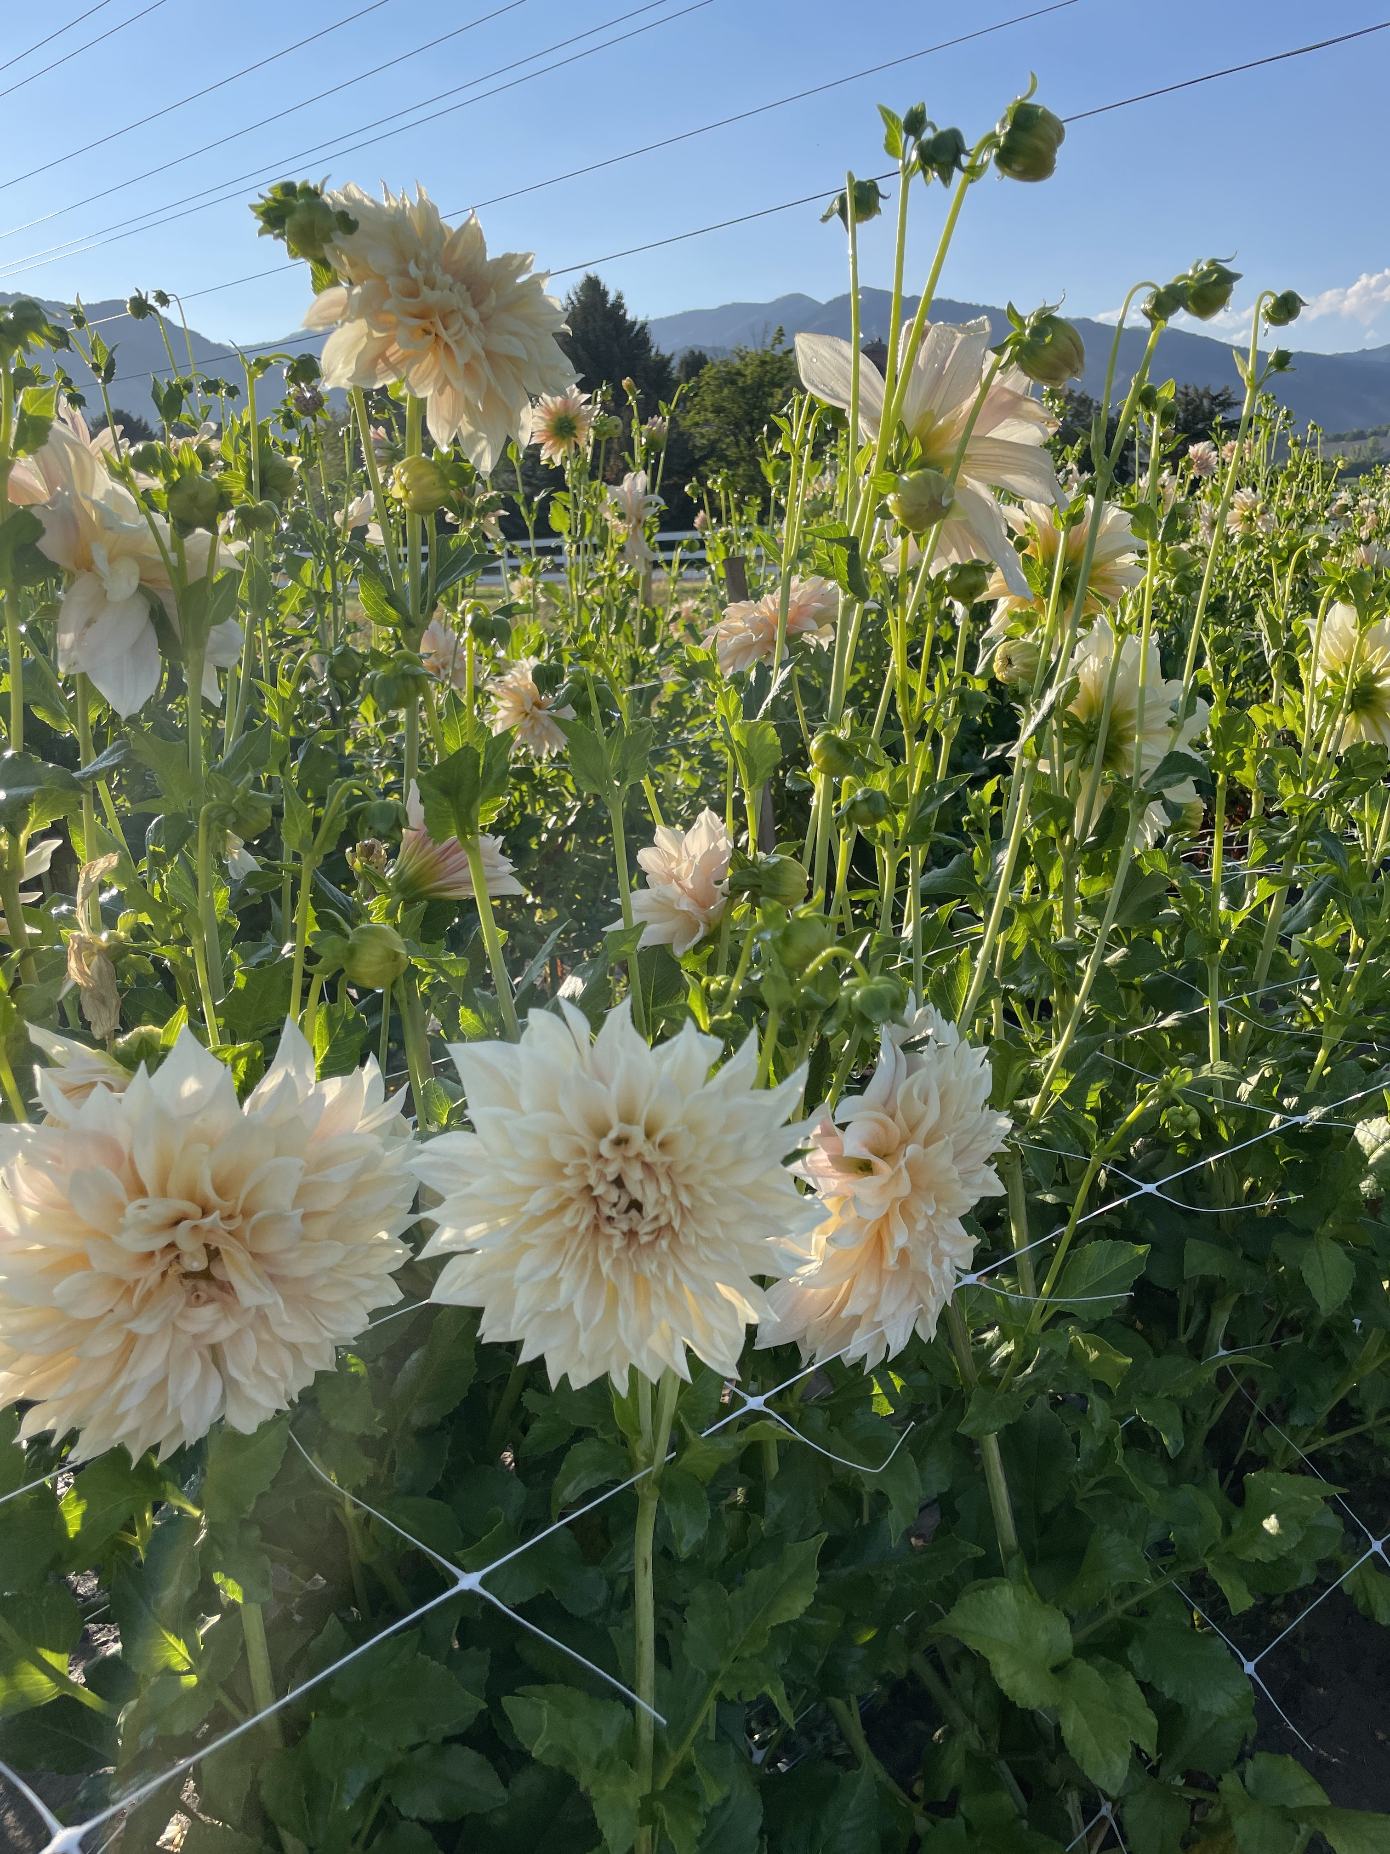
Has the availability of local flowers benefited your floral business?

Slide 24
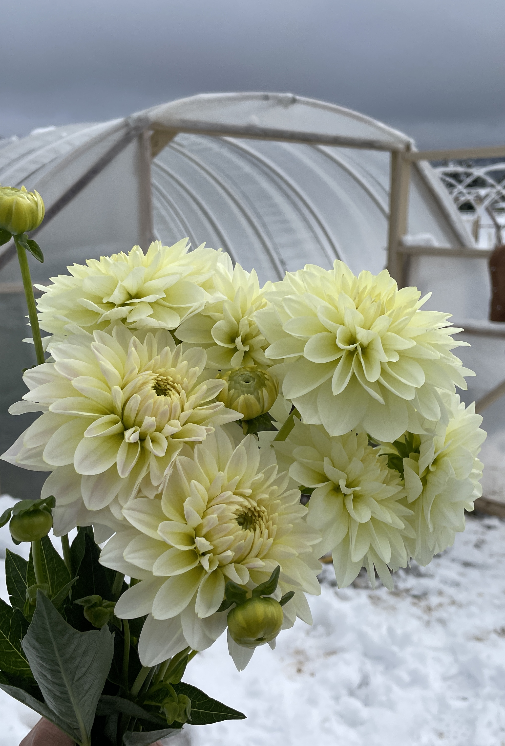
Hurdles to Local Sourcing Overview
Major hurdles to local sourcing
  Lack of inventory/supply (availability, quantities)
    Especially seasonally
  Lack of varieties needed (types)
  Price
Also, lack of knowledge of who to buy from or limited availability near floral shops
Quantity requirements (weekly)
  2-5 bunches per flower – Most common
  6-10 bunches per flower – 2nd most common
Require only 1 or 2 deliveries a week

Slide 25
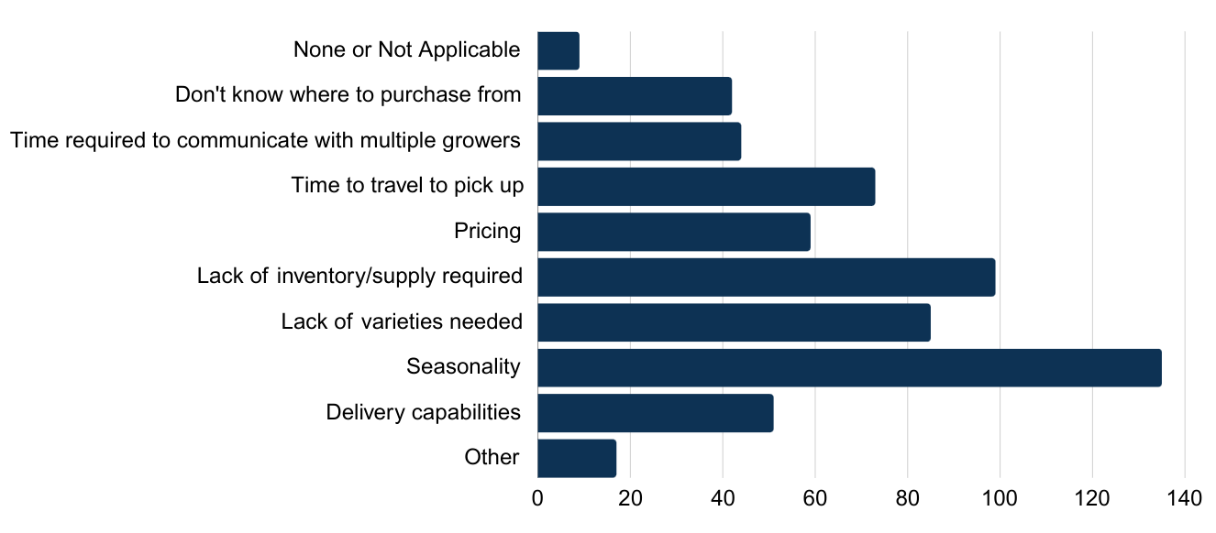
What barriers do you currently face in sourcing local flowers? (Choose all that apply)
Other
Waiting lists for some collectives
Stem length
Weather
Pre-order systems
Not knowing availability in advance
Notes:
Lack of inventory – that means a top barrier is more need to be grown
Communication with florists – what do they need.
Small farms coming together into coop to reduce communication time

Slide 26
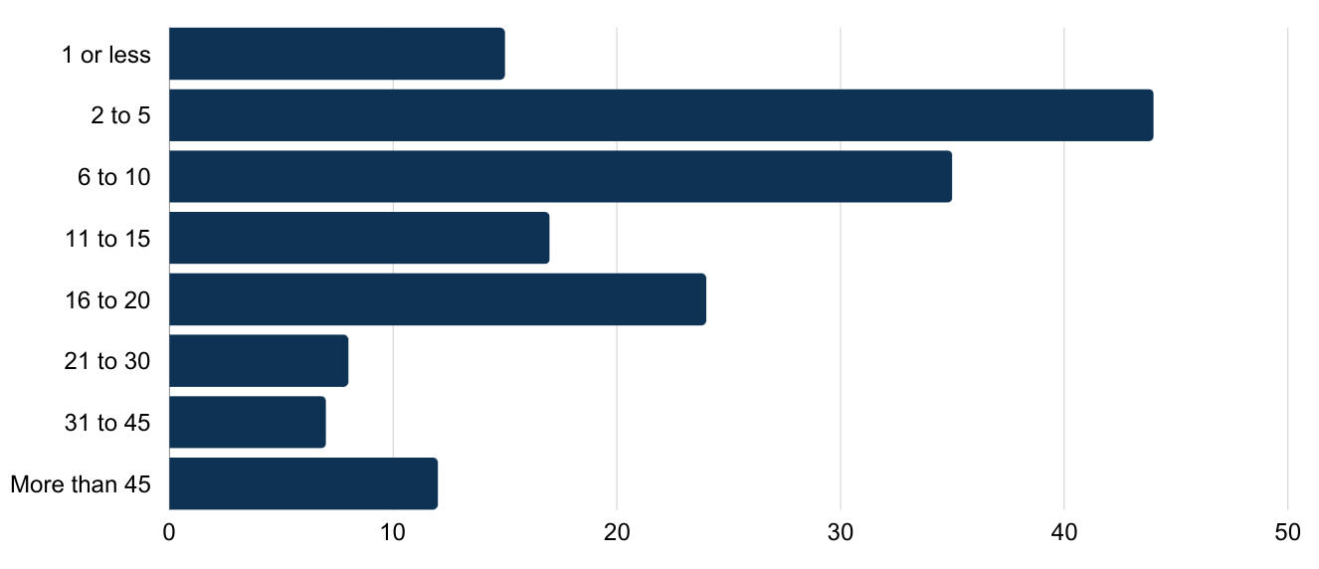
What is the minimum number of bunches per flower you need weekly from a local grower/farmer to meet your quantity goals for a supplier?
Notes:
Surprised that the number of bunches was not higher, but of course, 1 bunch is 5-10 stems, all one color.
One co-op has about 17 farms and have streamlined this by telling farmers what they grow best so that they can focus on a few things.

Slide 27
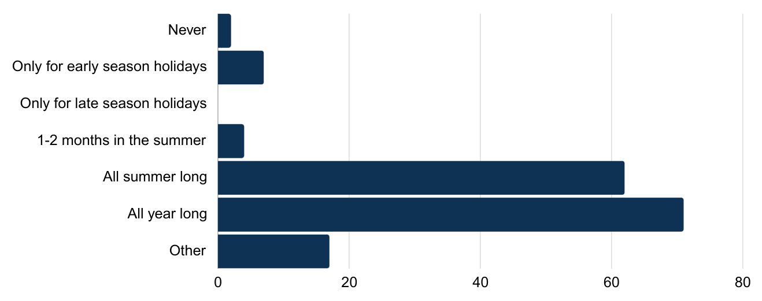
What time of year are you most likely to need cut flowers from a local grower?
Other
Wedding season
Spring through fall
Depends on availability
Notes:
Surprised that the number of bunches was not higher, but of course, 1 bunch is 5-10 stems, all one color.
One co-op has about 17 farms and have streamlined this by telling farmers what they grow best so that they can focus on a few things.

Slide 28
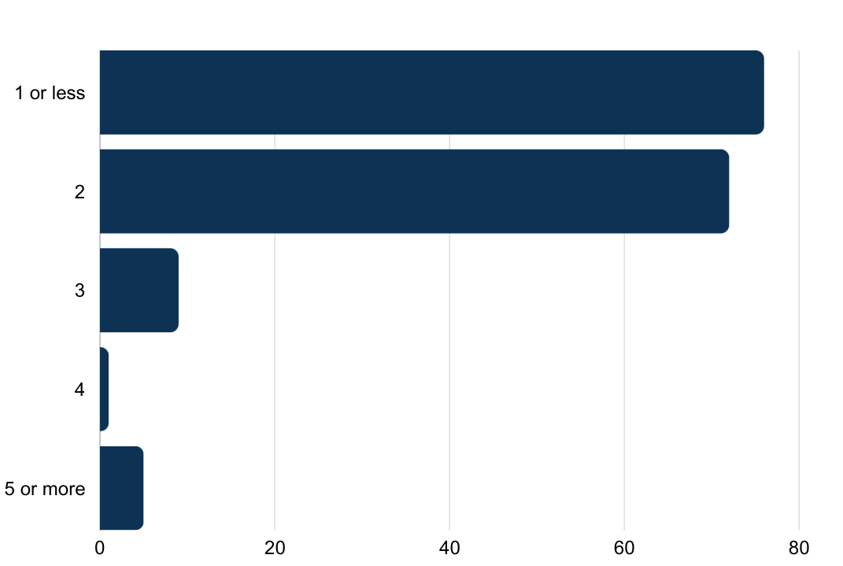
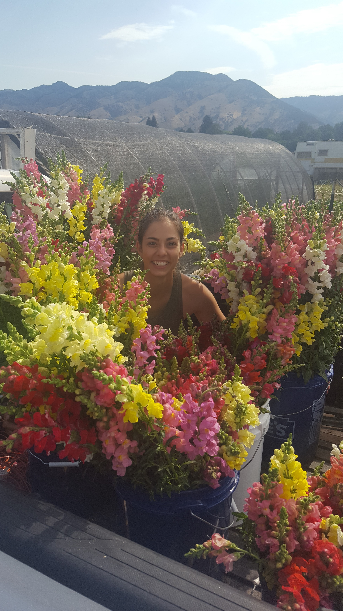
How many flower deliveries would you need weekly from a local grower or farmer?

Slide 29
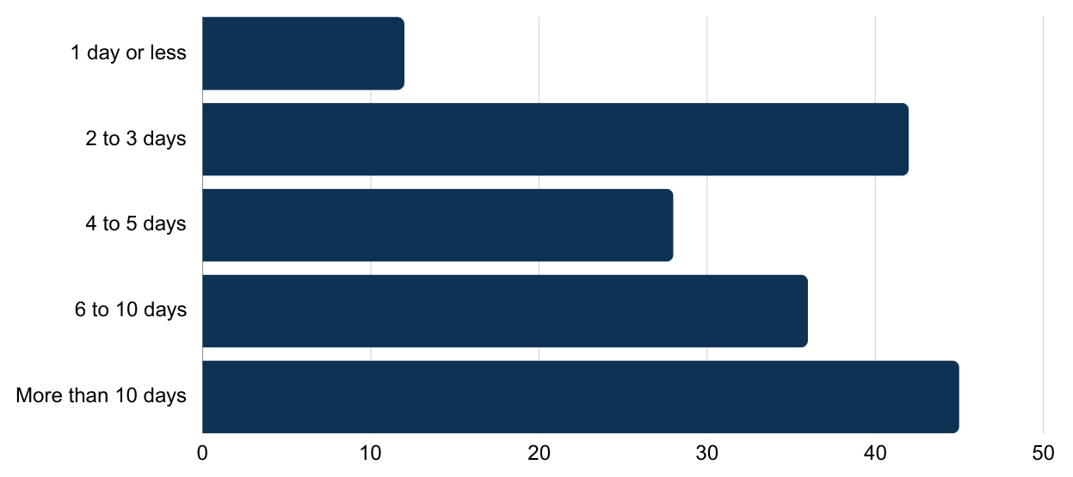
How much lead time/advance notice would you need from a local grower in terms of their cut flower availability?
Notes:
Surprised that the number of bunches was not higher, but of course, 1 bunch is 5-10 stems, all one color.
One co-op has about 17 farms and have streamlined this by telling farmers what they grow best so that they can focus on a few things.

Slide 30
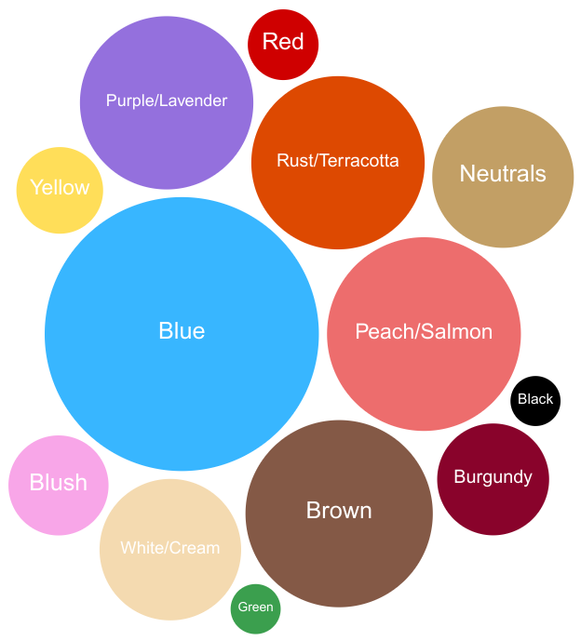
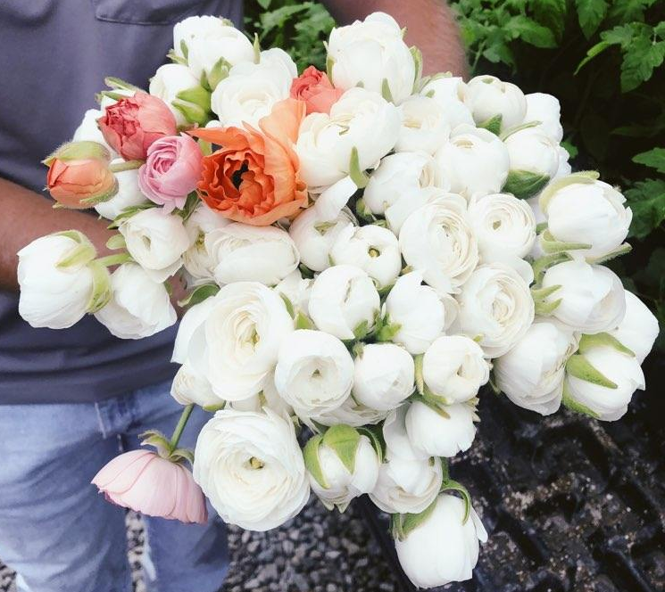

What colors are difficult to obtain wholesale?

Slide 31
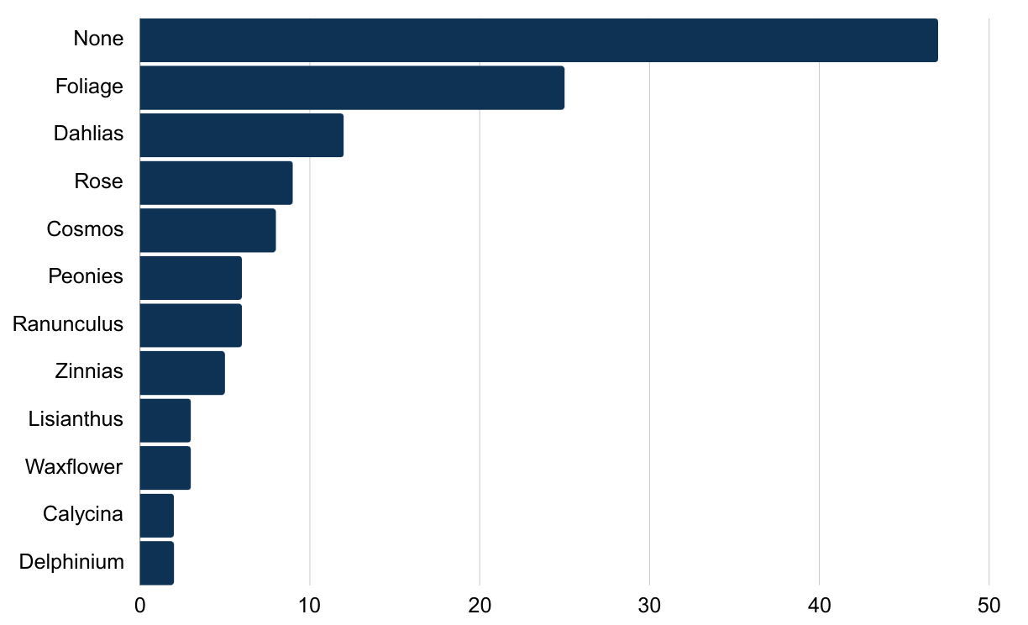
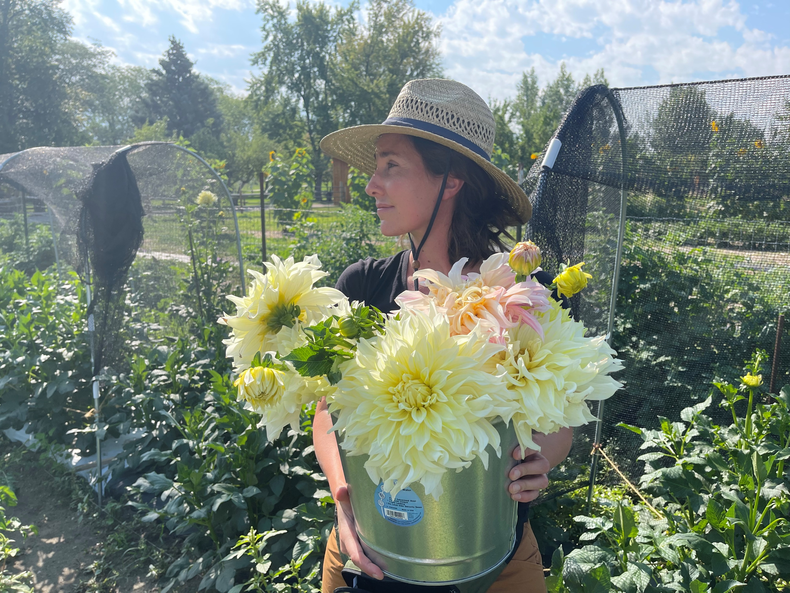
Is there a flower variety that you use in more than 50% of your designs that is difficult to obtain from wholesalers?

Slide 32
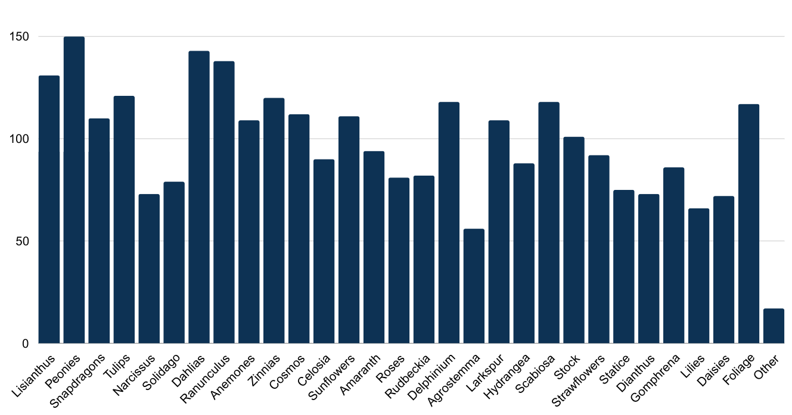
What flower types or varieties would you prefer from a local grower?
Other
Lilac
Alstroemeria
Waxflower
Chrysanthemums
Varieties that don't ship well
Notes:
Spring, summer, fall. Some always popular – dahlia (hard to import quality). Even easy to grow (zinnia) was very popular

Slide 33
Do you have any final tips or suggestions for cut flower growers looking to serve the florist market?
Florists want things to be easy: easy ordering systems, easy pick up or delivery, etc.
Communication is important & knowing what is available
  Weekly newsletters on availability or pictures on website
  Some florists prefer a forecast of availability at the start of the season
Some florists wanted prices closer to wholesale
  Don’t want growers to undercut their pricing when selling direct to consumers
In terms of what varieties to grow, some florists wanted unique things and others in bulk in the grower’s best varieties
  Cooperatives may be useful for growers who can't independently meet florists' volume needs
Florists need flowers through as much of the year as possible
Notes:
Spring, summer, fall. Some always popular – dahlia (hard to import quality). Even easy to grow (zinnia) was very popular

Slide 34
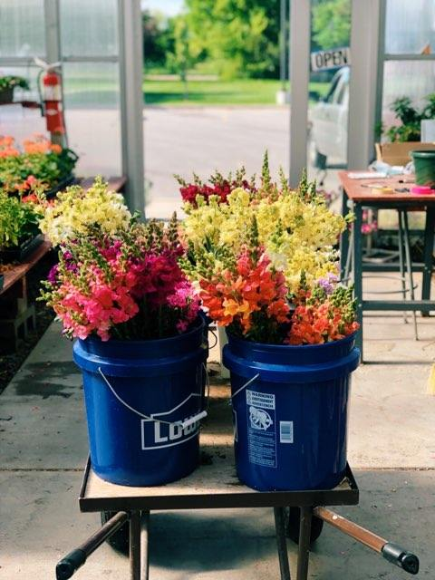
Floral Market Suggestions
Local cut flowers are growing in popularity with florists as awareness increases
Florists can be sensitive to price, but appreciate quality and recognize benefits of local cut flowers
Understanding the florist and their needs important
  Providing a solution to challenges with current suppliers is key
Barriers to work on:
  Reliability/seasonality – Season extension options
  Education – Understand the quality and benefits of local flowers
  Supply – The right kinds and more of them!

Slide 35
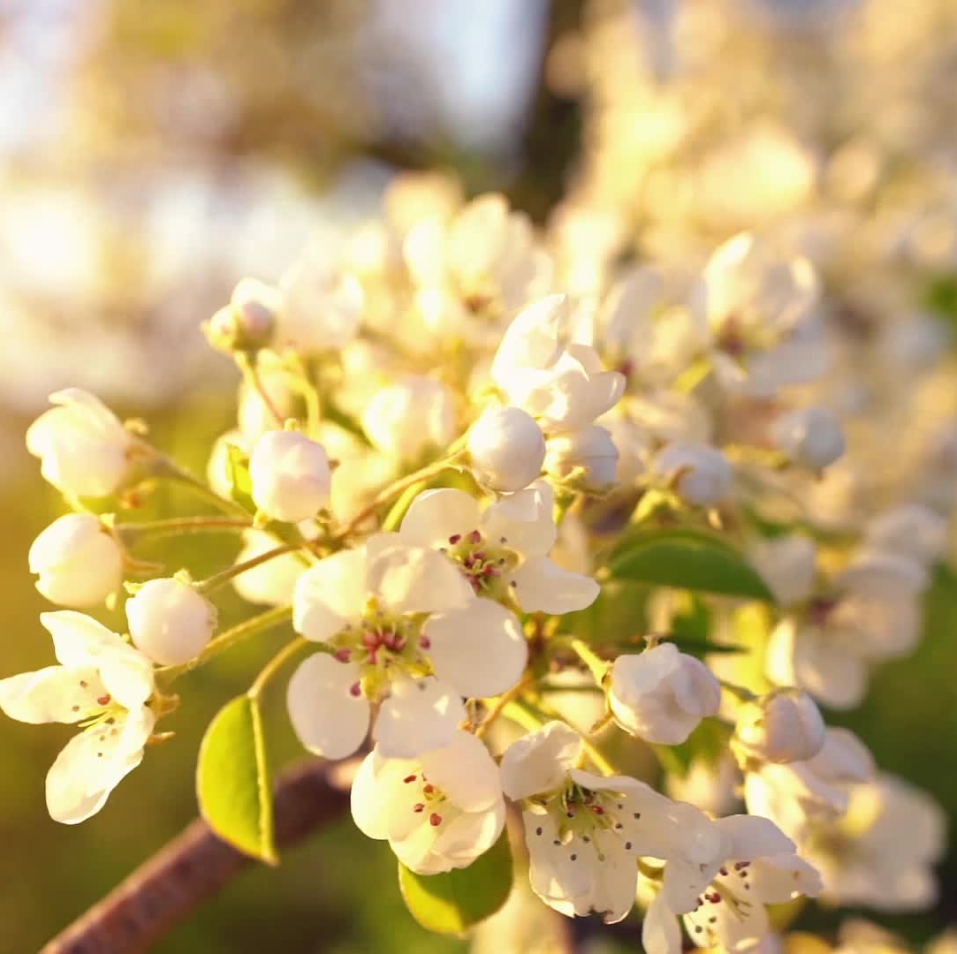
Wholesale Buyer Survey Results
Buyer respondent characteristics
Local sourcing preferences
Hurdles to local sourcing
Varietal needs
Suggestions

Slide 36
Wholesale Buyer Characteristics & Markets

Slide 37
Primary Sourcing Challenges

Slide 38
Local Sourcing Preferences & Hurdles

Slide 39
Local Sourcing Preferences

Slide 40
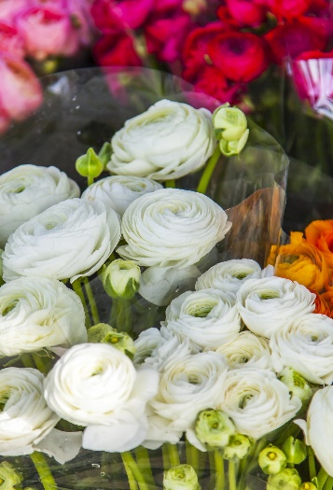
Preferred Varieties
Most interested in varieties that may not handle shipping well
  Peonies
  Lisianthus
  Tulips
  Dahlias
  Ranunculus
Respondents said….Growers should identify flower varieties that grow best and focus on producing large volumes of those rather than producing small quantities of many varieties

Slide 41
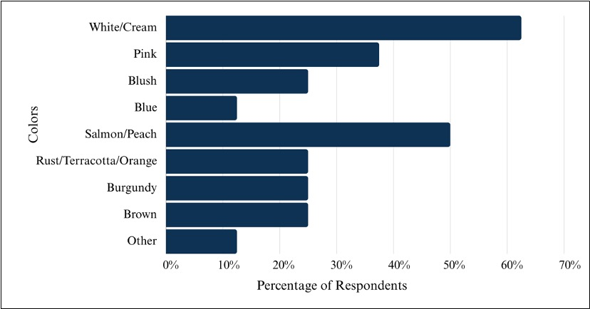
Cut Flower Trends for 2024

Slide 42
Wholesale Buyer Market Suggestions
Cut flower wholesalers handle large volumes of flowers at fluctuating prices based on market demand and availability
Flower quality, shipping damage, and timing/logistics were issues with their current corporate/international suppliers
Largest barriers to sourcing cut flowers from local growers was limited supply or availability, pricing, and lack of grower contact information
Intermountain West cut flower growers may be effective at entering this market by:
  Promoting their location
  Emphasizing variety availability
  Highlighting the quality of their flowers and the reduced stem loss associated with local sourcing
  Using season extension techniques to extend the growing season

Slide 43

Additional Research Studies
Recently completed a survey on Intermountain West consumer preferences and willingness to pay for local cut flowers – 600
Also completed a survey of farmers’ market consumers in Utah on their preferences and WTP for local cut flowers – 248
Results and analysis forthcoming

Slide 44

USU Extension Resources
Resources include
  Factsheets
  Presentations
  Data
  Florist directories
  Production budgets
USU Extension Cut Flower Marketing
  https://extension.usu.edu/apec/cut-flower-marketing
USU Extension Small Farms Lab – Cut Flower Production
  https://www.smallfarmslab.com

Slide 45
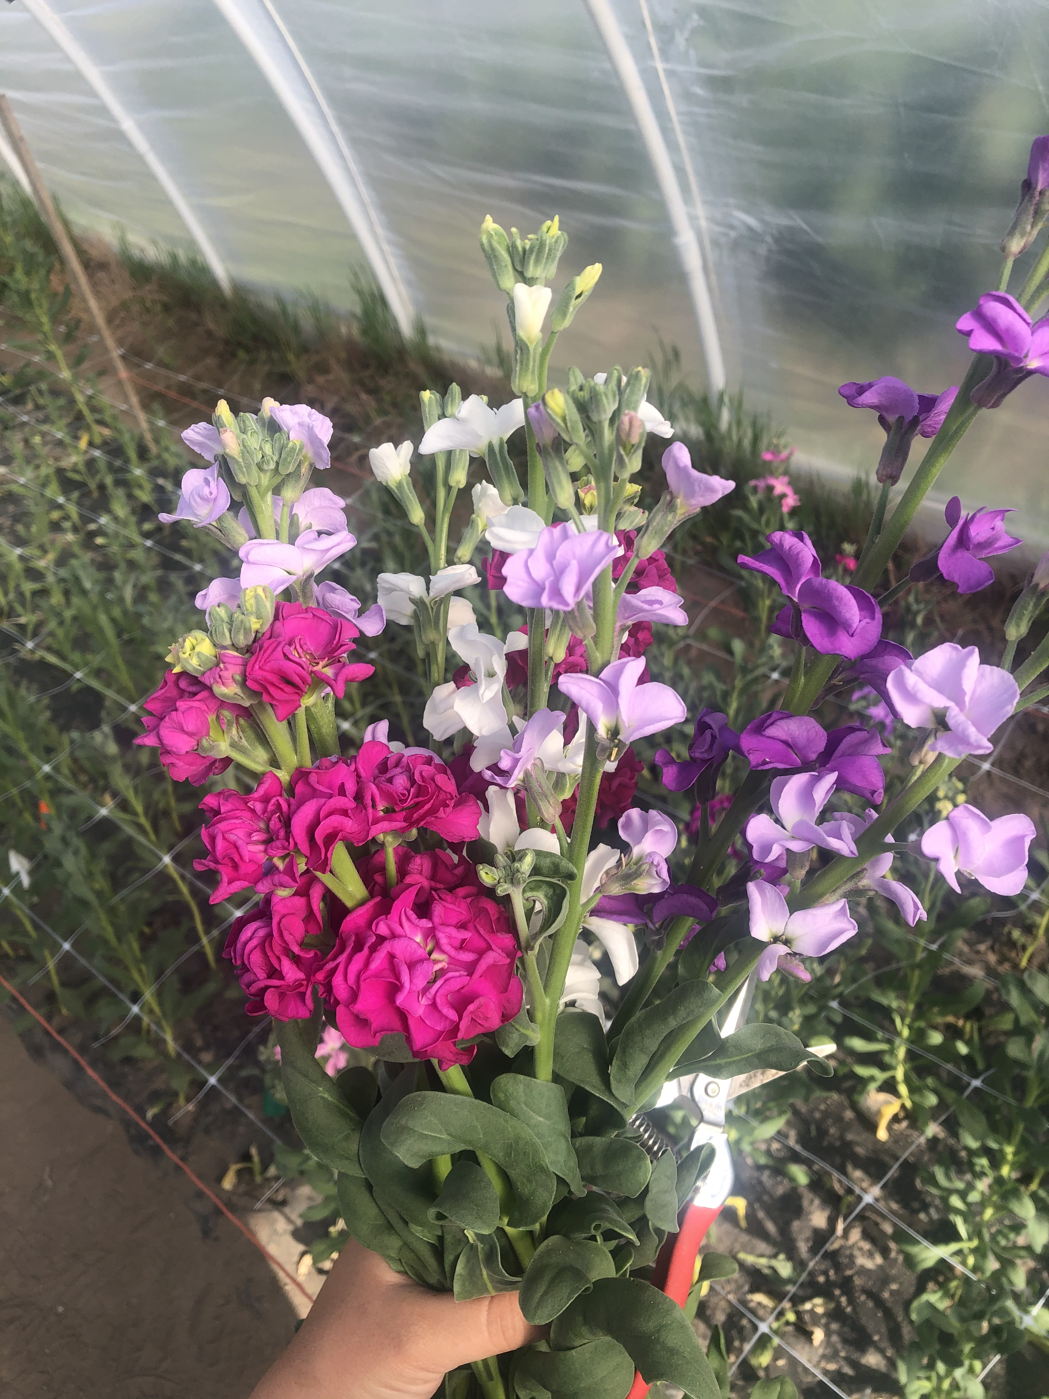
Questions?
Thank you!

