Slide 1
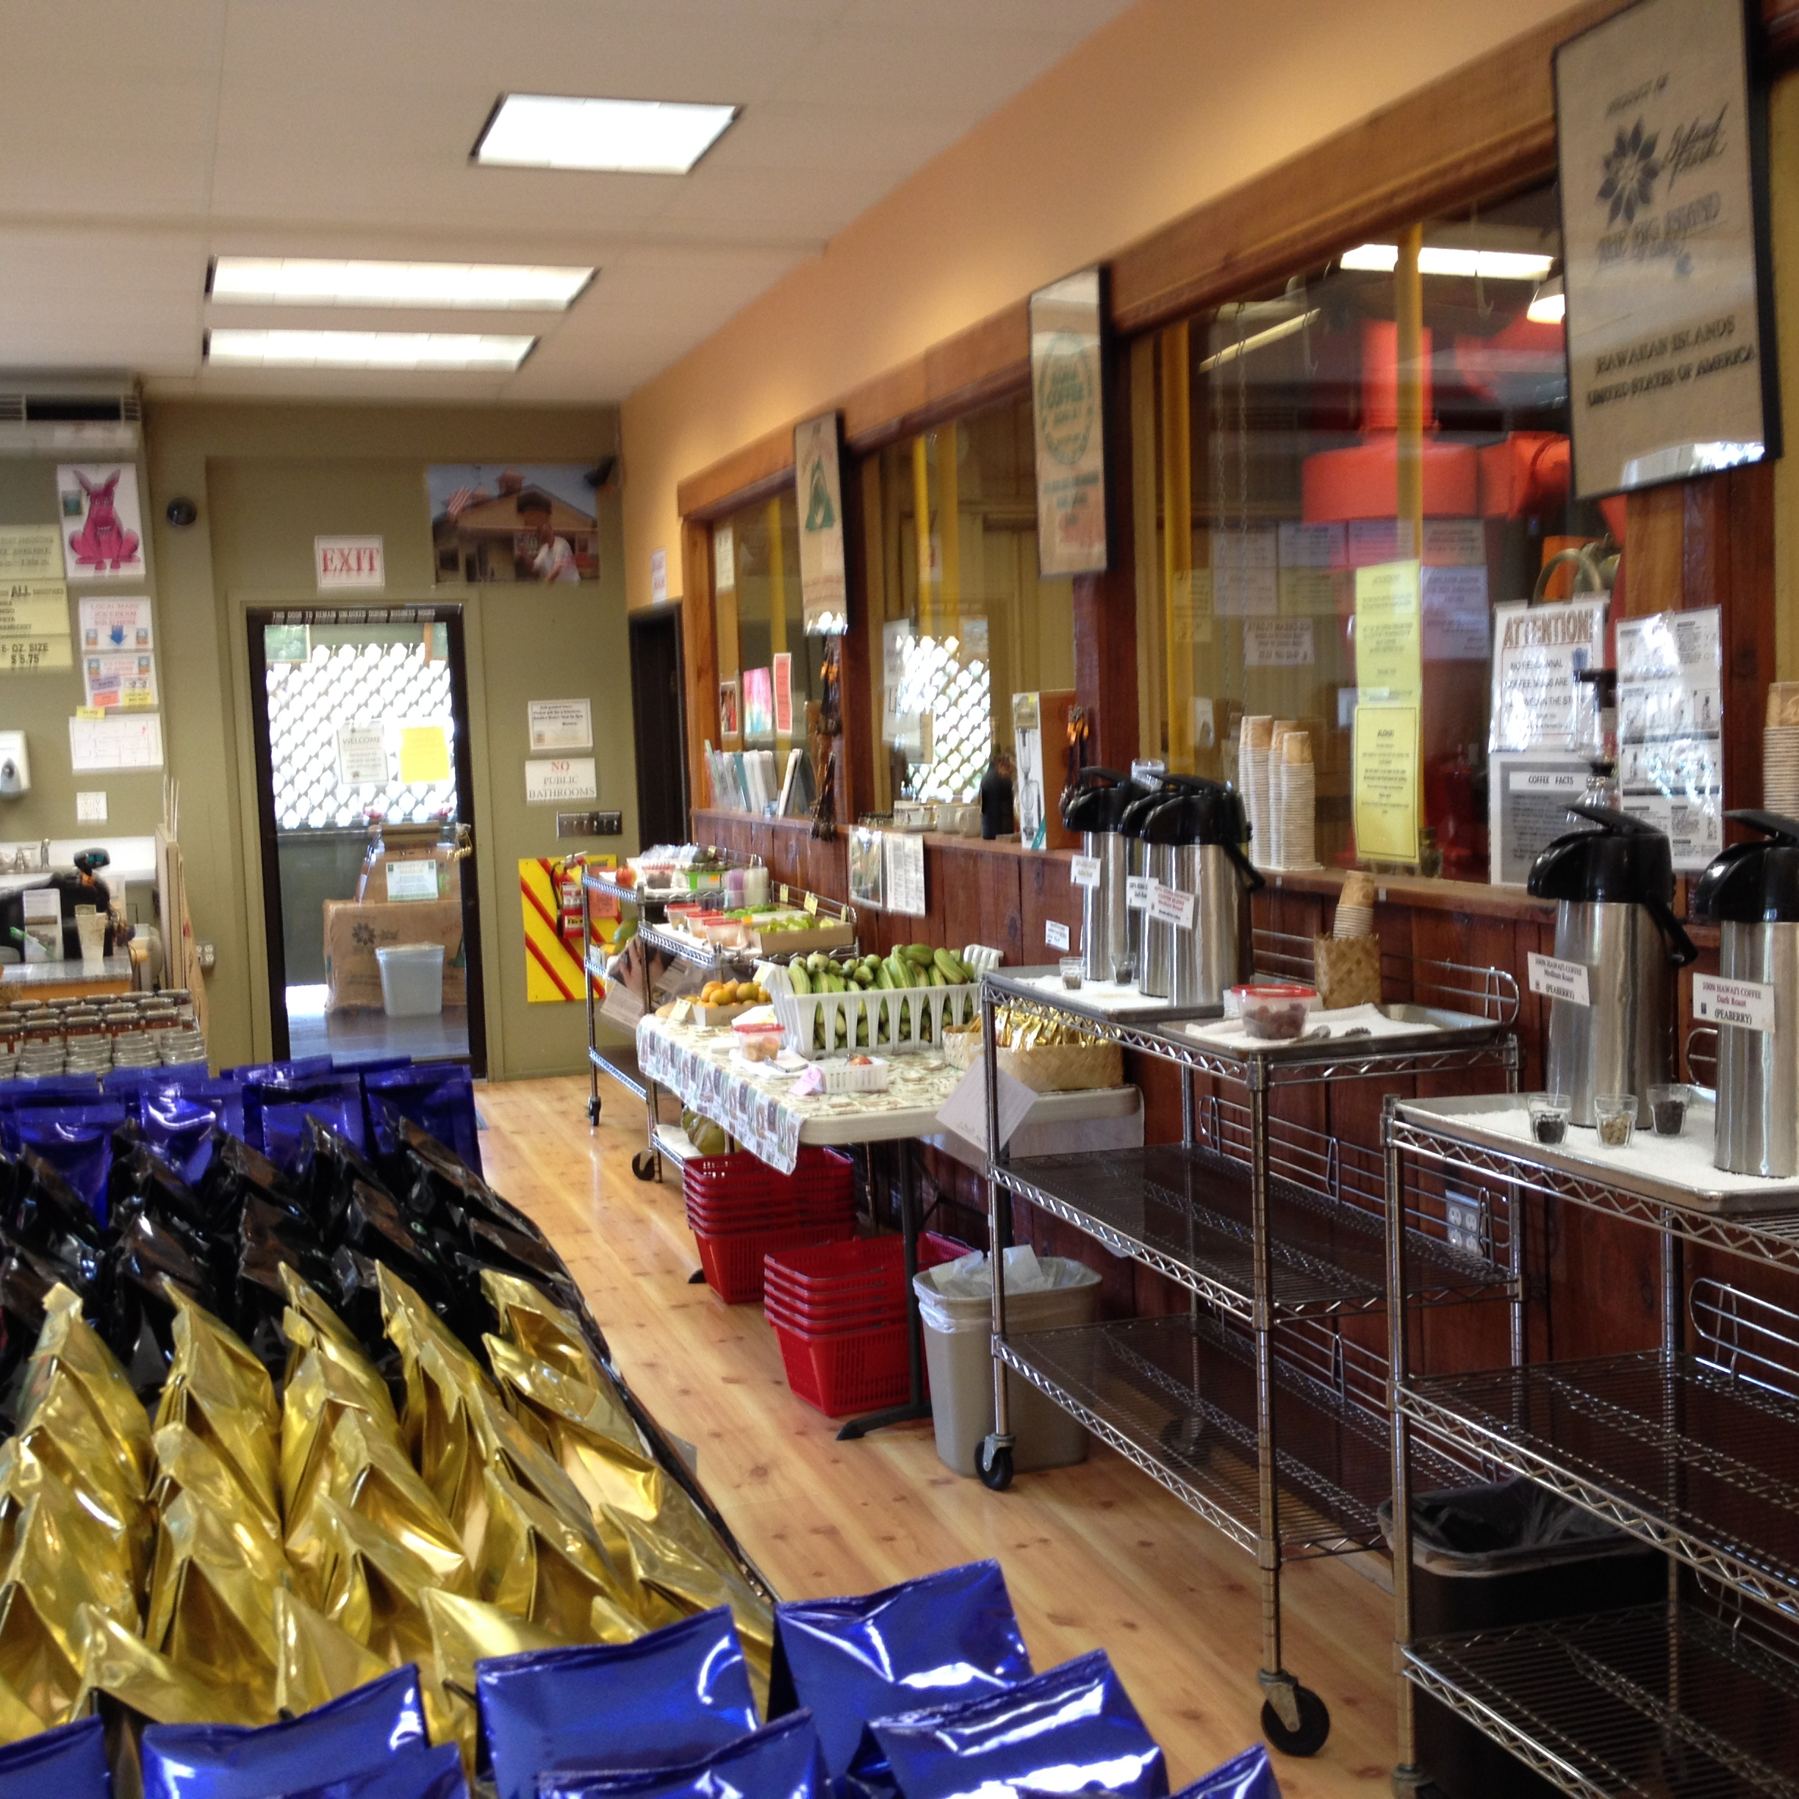
Module 5: Assessing Enterprise Feasibility

Slide 2
Overview
Understand the elements of economic feasibility analysis
Evaluate market size and estimate volume
Calculate cost of production or service
Use break-even analysis to identify minimum required pricing and volumes
Compare pricing approaches and select appropriate pricing

Slide 3
Steps in Economic Feasibility Analysis
Assess potential demand (volume and pricing)
Estimate cost of production
Examine break-even volume and pricing
Choose a pricing approach

Slide 4
Assess Potential Demand
Target consumers who have a need for the product/service
Conduct market research
Estimate available customer base and purchase amount
Estimate feasible range of prices (cover production costs)
Assess consumer sensitivity to pricing
Market research methods
Survey existing customers
Conduct product/pricing trials
Ask fellow providers – competitors
Use secondary data resources
USDA, marketing firms, Extension

Slide 5
Estimating Market Size - Farm Tourism Examples
Local Farm Tourism
Local customers traveling for a day or weekend outing, such as in-state or less than 100 miles away
U-pick strawberry operation example
Destination Tourists
Visitors on a long vacation to specific destinations
National and state parks, heritage sites, etc.
Farm tourism venture example

Slide 6
Local Tourists
If selling items directly from farm/ranch
Consider how far you can expect customers to travel
The USDA Forest Service's National Survey on Recreation found the average distance traveled to visit a farm in 2000 was 80 miles
Western operators find their consumers travel over 75 miles to participate in U-picks, farm festivals, and related farm activities
No other alternatives exist in their metro area

Slide 7
Local Tourists
Potential number of customers
Demographics and population size in the area is an important part of estimating demand
Demographics from the most recent U.S. Census can be searched online by state and by zip code - http://factfinder.census.gov/faces/nav/jsf/pages/index.xhtml
Ages, household and family size, income, ethnicity, etc.
All of which can provide information as to the characteristics of potential customers in the surrounding area
Potential purchase size
Examining current and historical consumption patterns can be helpful
Average annual consumption levels for hundreds of foods in the US can be found on USDA’s Economic Research Service (USDA-ERS) website - http://www.ers.usda.gov/data-products/food-availability-(per-capita)-data-system/.aspx
ERS data is for standard, conventional products only

Slide 8
U-Pick Example
A strawberry producer is considering turning one acre of the operation into a U-pick
Estimates that each acre will yield 10,000 pounds
The average annual consumption of strawberries per person is 8 pounds (ERS, 2014)
Use the following equation to determine the appropriate market size
The producer will need a market size of 64,935 consumers/visits annually to sell all output

Slide 9
U-Pick Example
For the U-pick strawberry operation, the producer may be interested in targeting families
Would be helpful to know if nearby communities have enough families to make up a portion of the 65,000 consumers needed to make the U-pick operation feasible
Bend/Redmond, OR
26,073 families, average of 3.5 persons (2010 Census)
91,255 potential customers

Slide 10
U-Pick Example
What percentage might visit the u-pick?
If 40%, then 36,502 customers
Almost 30% of the US population visited farms one or more times (2000)
But, agritourism has been growing at a rate of 6% annually
If customers purchase 16 pounds/pp for freezing/canning
Only need 32,467 customers/visits annually

Slide 11
Destination Tourists
Many rural areas in the West are located between a major urban center and national/state parks, ski resorts, etc.
Vacation destinations for many foreign and out-of-state visitors
Estimating the potential size of these markets requires information on
Where visitors are coming from
Where visitors are returning to

Slide 12
Grand Canyon National Park Example
Consider Grand Canyon National Park (GCNP)
Attracts around 4.4 million visitors annually
GCNP Statistics at http://www.nps.gov/grca/learn/management/statistics.htm
Seasonal visitation is another important item to consider
Annual visits to the GCNP by season
Winter: 11% of total visits
Spring: 27% of total visits
Summer: 39% of total visits
Fall: 23% of total visits
Visitation by month at https://irma.nps.gov/Stats/Reports/Park/GRCA

Slide 13
Grand Canyon National Park Example
Where visitors to Grand Canyon National Park stayed before and after visiting the park

Slide 14
Grand Canyon National Park Example
Consider a business located between Page, AZ and GCNP
3.4% of visitors stayed in Page prior to visiting GCNP
4.0% of visitors stayed in Page after visiting GCNP
The average number of visitors who would pass by this business location can be found with the following equation:
The number of GCNP visitors that would pass by the business location each month averages 13,567
With a low of around 5,970 visitors during the winter months (11% of total)
And a high of 21,164 visitors during the summer months (39% of total)

Slide 15
Grand Canyon National Park Example
The Page, AZ business is a farm tourism venture (hay rides, farm stays, etc.)
Assume venture needs to earn an average of $10,000 in sales monthly to be viable
Expects average purchase of $25/person
Calculate the percentage of total visitors to GCNP the venture needs to attract

Slide 16
Grand Canyon National Park Example
The venture would need to attract 2.9%, on average, of the monthly GCNP visitors
6.7% of winter visits
1.9% of summer visits
This is a fairly high percentage of total visitors
For the business plan to work, the venture may try
Starting the venture on a smaller scale
Attracting more of the heavy summer traffic

Slide 17
Estimate Cost of Production
Create enterprise budget, by service/product or product groups
Estimate operating costs
Costs that vary with quantity produced
Seed, fertilizer, packaging, etc.
Estimate fixed costs
Costs incurred regardless of production
Land payments, equipment, etc.
Calculate break-even cost per unit
Provides lower limit for pricing

Slide 18
Production Costs
5-acres of vegetable production

Slide 19
Investment Summary

Slide 20
Enterprise Budget
5-acres of vegetable production

Slide 21
Break-Even Analysis
Break-even analysis answers the questions
How much needs to be sold to break even?”
If this quantity fits within potential demand, it may be feasible
Calculate break-even quantity/volume across a range of prices
Or
What would the price need to be to break even?
If the price that would need to be charged is unrealistic, then the idea is not feasible
Calculate break-even prices across a range of possible volumes

Slide 22
Break-Even Example
Initial quantity of 20,000 lbs at a price of $.24/lb, or $4,800 in revenue
Profit is $1,635
Break-even price is total expenses/number of units (20,000) or $.16/lb
Break-even quantity is total expenses/price ($.24/lb) or 13,187 lbs

Slide 23
Estimating Product Price
Major pricing approaches
Cost-based
Demand-oriented
Competition-oriented
Not normally used independently

Slide 24
Cost-Based Pricing
Cost-plus pricing
Price equals total costs divided by number of units
Shortcomings
Not tied to consumer demand
No incentive to reduce costs
Adjustments for rising costs poor
Mark-up pricing
Add a percentage to the cost of product (mark-up)
Very popular for retailers and wholesales
Easy, too many products to estimate demand
Shortcomings
Not tied to demand
Profit biased by pricing

Slide 25
Retail Distribution Example
Plan to sell product retail (local tourist shop)
Set pricing at retail level and then evaluate demand
Ask wholesales and retailers what margin they require
Example
$5.00 cost of production
Multiply by 1.25 for wholesale price (Average 20-30%)
$6.25 wholesale
Multiply by 1.40 for retail price (Average 30-50%)
$8.75 retail
Will consumers pay $8.75?
Need to use this price at all outlets

Slide 26
Demand-Oriented Pricing
Price at customer value (willingness to pay)
Price skimming
Charge high price at first to pick up consumers willing to pay more
Gradually reduce price to pick up consumers who are more price sensitive
Penetration pricing
Initial low price to capture market share
Discourages competition
Price is increased later when consumers are hooked
Common in new food products

Slide 27
Determinants of Consumer Price Sensitivity
Perceived substitute effect
How many substitutes exist?
If many, then consumers more price sensitive
Unique value effect
Increase market share through differentiation
Consumers less price sensitive if “unique” product/service
Switching cost effect
Cost of changing from one product to another
People are reluctant to change and seek out new information
Consumers less price sensitive if large switching costs

Slide 28
Determinants of Price Sensitivity
Difficult comparison effect
Hard to compare products/services, then consumers less price sensitive
Price-quality effect
Often associate a higher price with higher quality
Expenditure effect
Consumers more sensitive to price changes on large, expensive products than small, inexpensive ones
Price changes on meat compared to salt

Slide 29
Determinants of Price Sensitivity
Fairness effect
Impacted by what they consider fair - (sense of value-added)
Inventory effect
Seasonality affects price sensitivity
Higher demand for steak in summer due to outside grilling
End-benefit effect
May be willing to pay more for products that protect the environment, preserve open space, support family farms, etc.

Slide 30
Competition-Oriented Pricing
Simple form of pricing
Ideal when similar products exist
Penetration pricing
Lower than competition pricing
Stimulate demand
Parity pricing
Equals competition pricing
Premium pricing
Higher than competition pricing
Signal quality

Slide 31
Competitive Analysis
How many competitors operate in the market?
Are competitors large or small? Near or far?
What types and numbers of products do they sell?
What pricing methods do they use?

Slide 32
Consider External Factors
Distribution
Wholesale and retail margins
Transportation and packaging costs
Environmental factors
Taxes, weather events, fad diets, energy policy
Legal/regulatory factors
Labeling, certification, permits, safety

Slide 33
Pomegranate Juice Pricing Example
Produce and sell juice at specialty/health stores
Cost of production is $.80 per 8 oz. juice
$.80 cost of production (multiply by 1.20)
$.96 cost with profit (multiply by 1.25)
$1.20 wholesale price (multiply by 1.40)
$1.68 minimum retail price required
$1.47 per 8 oz. retail price (ERS, 2013)
Pricing data is US average, specialty retail price may be much higher
Target market may be willing to pay more (health benefits, families with children, seniors, etc.)
What packaging, labeling, etc. may differentiate the product?

Slide 34
U-Pick Pricing Example
Strawberry u-pick operation
10,000 pounds per acre
$23,600 in revenue per acre
$2.36 per pound retail price (ERS, US Average 2013)
$18.88 in revenue per person
Average consumption is 8 pounds/year (ERS, 2014)
Need to know the cost of production (including visitor services, permits, etc.)

Slide 35
U-Pick Pricing Example
Considerations
Visitors may purchase much more than 8 pounds (processing, events, etc.)
Visitors may be willing to pay more or less than retail depending on…
Experience
Family outings, may pay much more per pound for the farm experience
Amount purchased
Bulk purchases for canning, freezing, etc., may pay less per pound
Specialty item
For organic, and other specialty labels or designations may pay more per pound
$3.48 organic wholesale price per pound (ERS, San Fran 2013)

Slide 36
Pricing Resources
Fresh and processed fruits and vegetables
http://www.ers.usda.gov/data-products/fruit-and-vegetable-prices.aspx
Meats and poultry
http://www.ers.usda.gov/data-products/meat-price-spreads.aspx
Organic foods
http://www.ers.usda.gov/data-products/organic-prices.aspx
Drinks and meals away from home
http://www.ers.usda.gov/data-products/quarterly-food-away-from-home-prices.aspx

Slide 37
Activity
Worksheet 5.1: Potential Volume
Identify 1-2 target consumer groups
Where are they coming from?
Where are they headed?
How many do you estimate?
What quantities will they use/buy?

Slide 38
Thank you!

