Slide 1
UWW Tier 1 Training Ellen Bailey ellen.bailey@usu.edu 801-536-4432

Slide 2
Utah Water Watch
Partnership between USU Extension and the DWQ
Started in 2012
Trained 750+ volunteers, monitoring 250+ sites

Slide 3
Utah Water Watch
Goals:
Increase the public’s knowledge about water quality
Collect credible data for water managers to use
Create a network of trained volunteers
Engage and empower our volunteers
Encourage protection through education

Slide 4
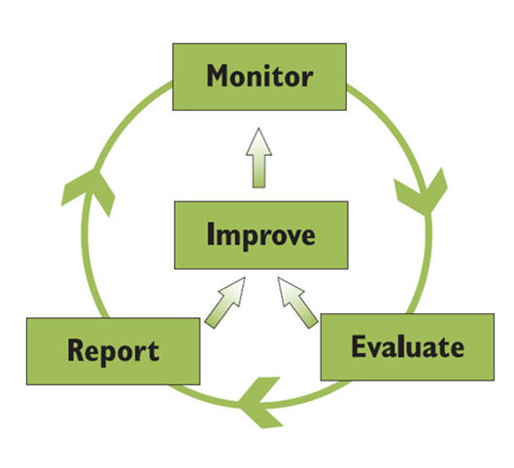
Why do we monitor?
Want to have more information
Identify current conditions
Show changes and trends
Identify problems or solutions
Why monitor water quality?
We all use water
Increase our knowledge about the environment
It’s the LAW!

Slide 5
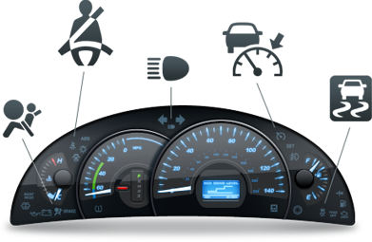
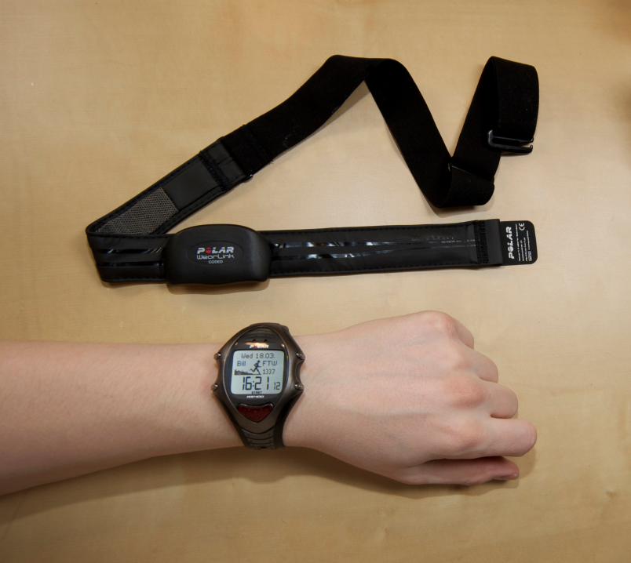
Do you have experience monitoring?

Slide 6
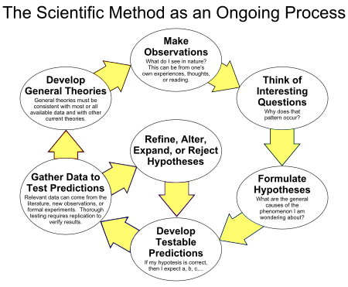
What is citizen science?
Provides an opportunity for citizens to engage in the scientific process to address problems

Slide 7
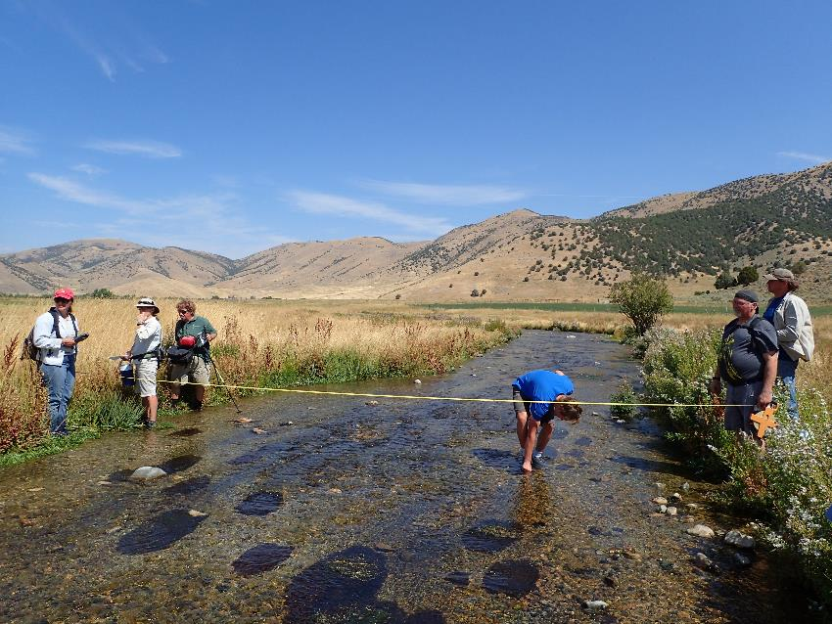
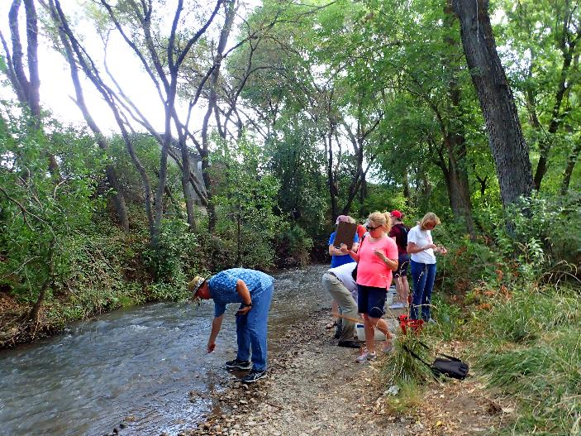
Who monitors?
Local: Municipal (City, County) and Private
State: Watershed Coordinators & DWQ
Federal: BLM, USFS, NRCS, etc.
Volunteers!

Slide 8
Why do we need volunteers?
How many lakes are there in Utah?
2,085
How many miles of streams?
14,750 miles of permanent streams
+89,000 miles of intermittent streams

Slide 9
What is a watershed?
Geographic area within which all water drains to a common point.

Slide 10
Watersheds are defined by structure and by function
Structure: How is it formed
Lakes / Rivers / Wetlands
Mountains / Valleys
Geology
Precipitation
Land use
Function: What does it do?
Processes water – but what else?
Notes:
Structure: How is it formed?
Function: What does it do?

Slide 11
Connection between watersheds and water quality?
Everything that happens in a watershed can affect the quality of the water downstream
….“we all live downstream”

Slide 12
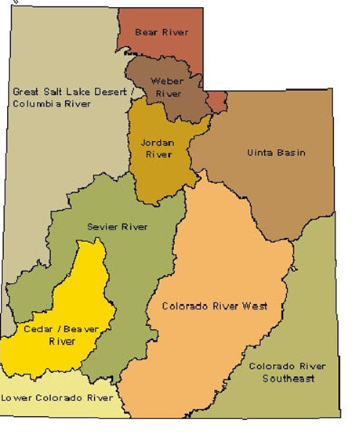
The scale you work at depends on the question you want to answer.
Nested watersheds

Slide 14
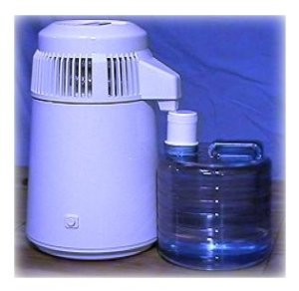
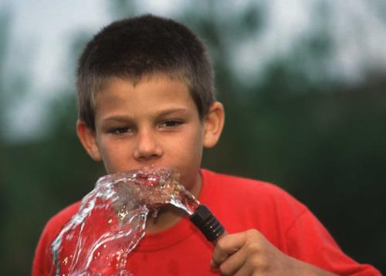
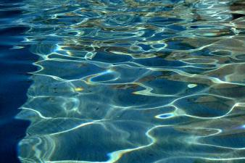
What is Clean Water?
Distilled?
Safe to drink ?
Crystal clear?

Slide 15
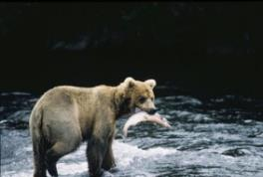
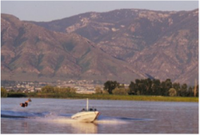
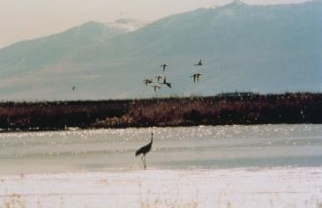
There is no single definition of clean water.
The Clean Water Act defines clean water according to how we use it.
Drinking water
Agriculture
Recreation
Fisheries and aquatic life
Aesthetics
Great Salt Lake

Slide 16
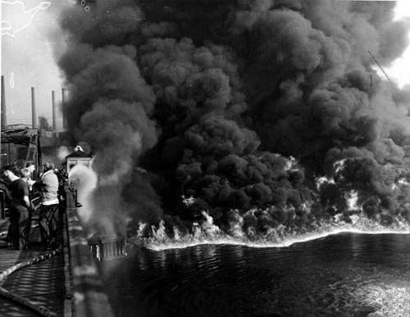
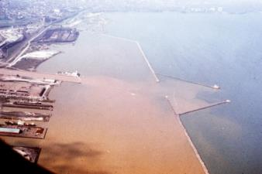
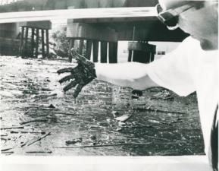
Water quality is regulated through the Clean Water Act (1972)
Waters of U.S. must be “fishable and swimmable” by 1983
Eliminate all pollution discharge to waters by 1985
Cuyahoga River, June 22 1969
http://blog.cleveland.com/metro/2009/06/cuyahoga_river_fire_40_years_a.html

Slide 17
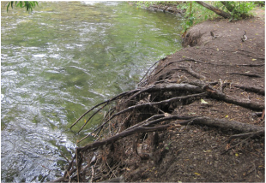
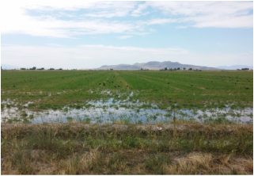
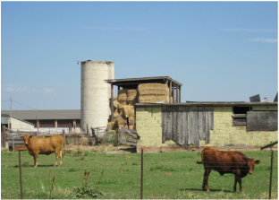
Water Quality Standards
Clean Water Act (CWA) regulates the amount of pollutants that enter US Waters from point sources
Types of pollution
Point Source
Nonpoint Source

Slide 18
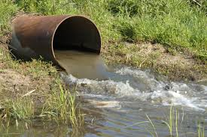
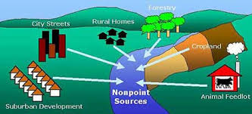
Pollution source types:
Point sources
Nonpoint sources

Slide 19
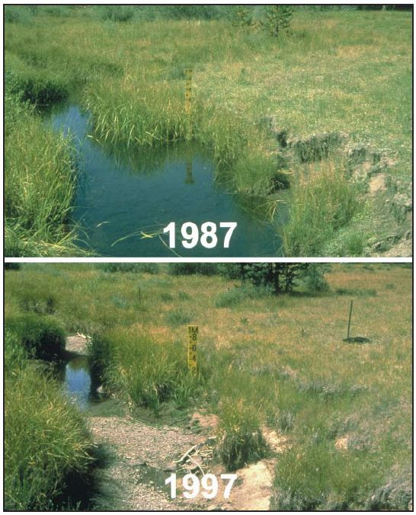
Utah Water Watch monitors:
Physical:
Temperature
Turbidity
Habitat
Chemical:
pH
Dissolved oxygen
Biological:
E. coli (bacteria)
Macroinvertebrates
Qualitative:
Weather
Photos
Other observations

Slide 20
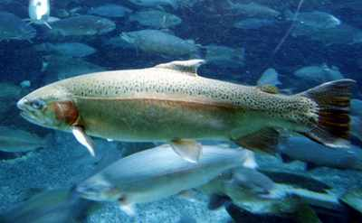
Why do we care about temperature?
Fish and other aquatic life
Other effects from temperature…
How much oxygen water can absorb
The toxicity of ammonia
Fish and other aquatic life require:
Cold water fish: 20°C
Warm water fish: 27°C

Slide 21
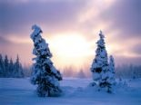
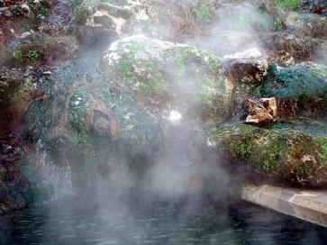
What causes temperature to rise?
Natural causes:
Seasons
Length of river
Location of river
Hot springs
Human causes:
Removal of streamside vegetation (shade)
Runoff over concrete and other heated surfaces
Changes in stream shape
Reductions in flow
Impoundments
Industrial discharges

Slide 22
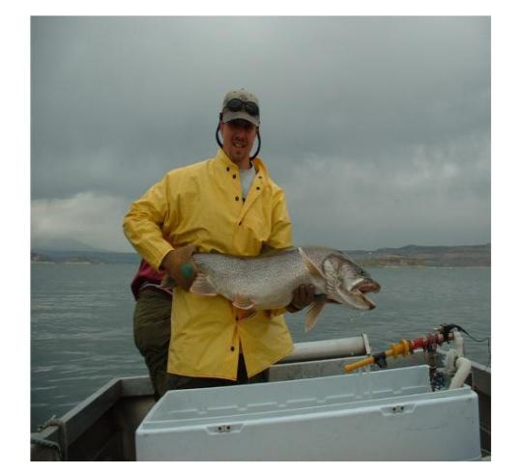
Why do we care about dissolved oxygen?
Fish and other aquatic life
Other effects from dissolved oxygen…
Oxygen in water affects solubility of metals and other chemicals
Fish and other aquatic life require:
Cold water fish: 6.5 mg/L
Warm water fish: 5.5 mg/L

Slide 23
What causes oxygen concentrations to change?
Natural causes
Uptake by organisms
Natural increases in temperature
Quiet water (low re-oxygenation) vs. turbulent waters
Human causes
Any source of biological material that will decay in water
High temperatures or low flows
Excessive plant growth in water

Slide 24
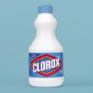
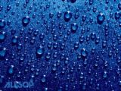
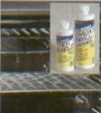
pH
pH Scale:
Pure Hydrochloric Acid
Baking Soda
Pure Sodium Hydroxide
Vinegar, Wine, Orange Juice
Milk
Bleach
0.0 |  |  |  |  |  |  | 7.0 |  |  |  |  |  |  | 14.0
Gastric Fluids
Lemon Juice
Rain
Water
5.6
Sea Water
Household Ammonia
Oven Cleaner

Slide 25
Why do we care about pH?
Low pH can affect membranes (e.g. gills of fish or macroinvertebrates and eggs)
At low pH, causes some metals to dissolve into a more toxic form
At high pH, ammonia is more toxic
An acceptable pH range is 6.5-9.0

Slide 26
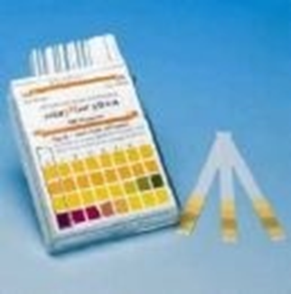
What causes pH to rise or fall?
Natural causes:
Rain is naturally acidic
Rapid snow melt
Photosynthesis in water → higher pH
Human causes:
Combustion causes acids in the atmosphere → acid precipitation
Industrial discharge
Mine drainage

Slide 27
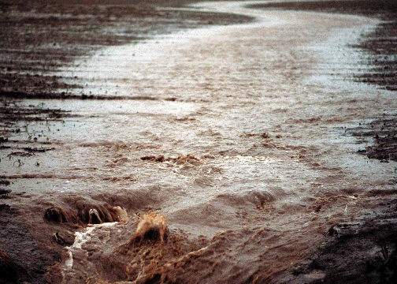
Why do we care about turbidity? Turbidity refers to sediments in streams and lakes
Fills space between cobble in stream and smother fish eggs and tiny aquatic life
Very cloudy water affects visual predators
Sediments fill in reservoirs
Sediments bring nutrients, metals, and more into water

Slide 28
What are sources of sediment in rivers?
Natural causes:
Natural “reworking” of flood plain as stream meanders
Remobilized bedload sediment under high flows
Seasonal effects
Human causes:
Runoff (construction, agriculture, forestry, mining)
Stream bank erosion
Turbidity should not increase rapidly from site to site:
An increase of more than 10 NTUs violates water quality criteria

Slide 29
Why do we care about E. Coli (bacteria)
E. coli can make people sick
Concern in drinking water
Recteation
Swimming (contact recreation)
Boating (non-contact recreation)
Contact recreation: 409 colonies/100ml
Drinking water and non-contact recreation: 668 colonies/100ml

Slide 30
What are the sources of E. coli?
Natural causes:
Lives in the intestines of warm blooded animals
Birds and other mammals
Human causes:
Not picking up after dogs
Failing septic systems or wastewater treatment plants
Animal feeding operations (manure)

Slide 31
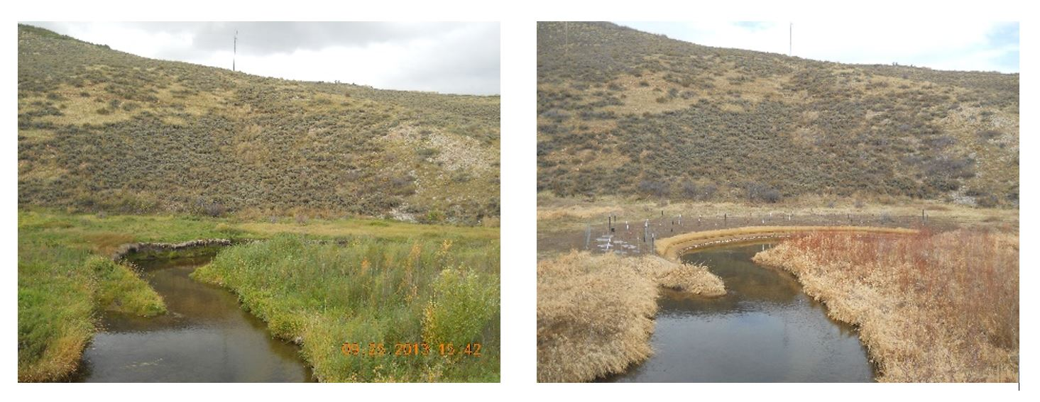
Photo point monitoring
Simple way to monitor change.
Riparian area, erosion, seasons, etc.
Things to consider when determining a site:
What are the changes we are looking to document?
Will the photo capture the “area of interest”?
Is this location consistently easy to access?
Will the location of the photo point need to change over time? (ideally no)

Slide 32
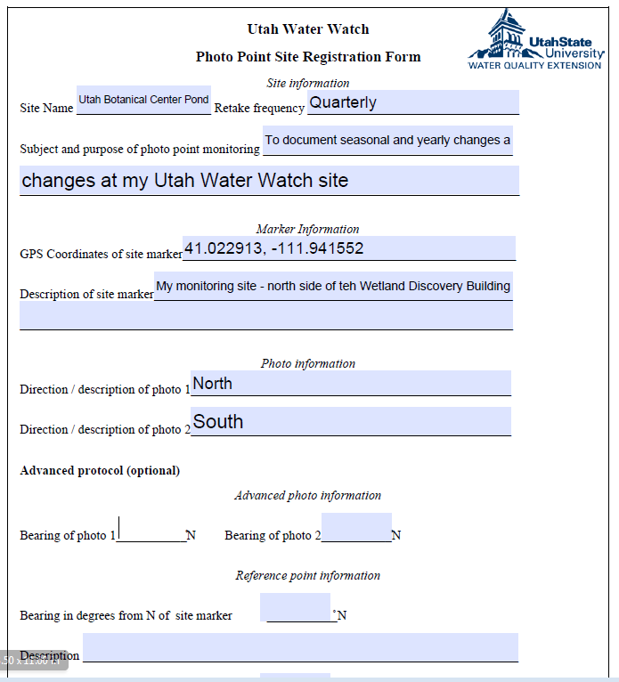
Photopoint monitoring
Simple way to monitor change
Taking the picture at the same location and angle each time
Basic instructions for streams: photo taken upstream and downstream from the monitoring site.
Basic instructions for lakes: take a photo in both directions along the lake shore capturing both the bank and water
Photos are uploaded into a shared Google Drive – we will share a link

Slide 33
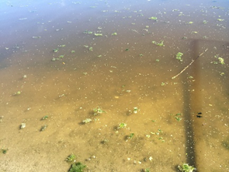
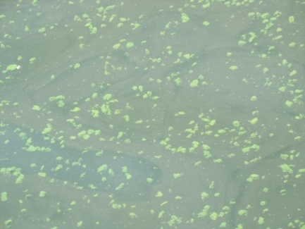
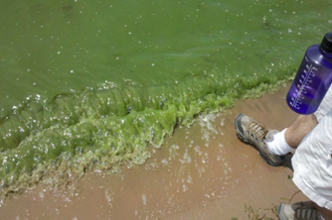
Harmful Algal Blooms
What are harmful algal blooms?
Harmful algal blooms (HABs) are large growths of cyanobacteria that change the water color or form surface scums, and occur in lakes, reservoirs and ponds.
Cyanobacteria blooms are occurring more frequently in Utah, likely in response to increased nutrients and a warmer climate.
These tiny plant-like bacteria can produce deadly toxins that are harmful to humans, livestock and pets.
If you are concerned there may be HABs present
Use caution – avoid ingesting the water or inhaling boat spray, wash hands thoroughly after coming into contact
Contact us
Take photos
Collect a sample if possible, wearing gloves, and drop off to a nearby microscope location (Weber Health Department in Ogden, Salt Lake County USU Extension)

Slide 34
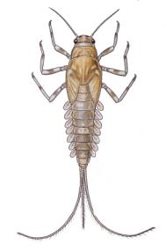
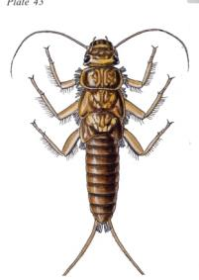
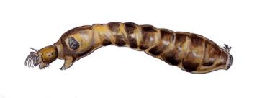
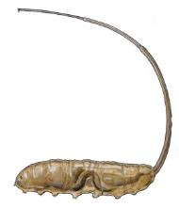
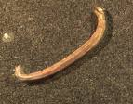
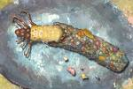
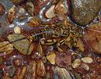
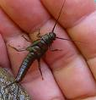
Macroinvertebrates
Indicators of water quality
Good indicators, pollution sensitive :
Poor indicators, pollution tolerant :

Slide 35
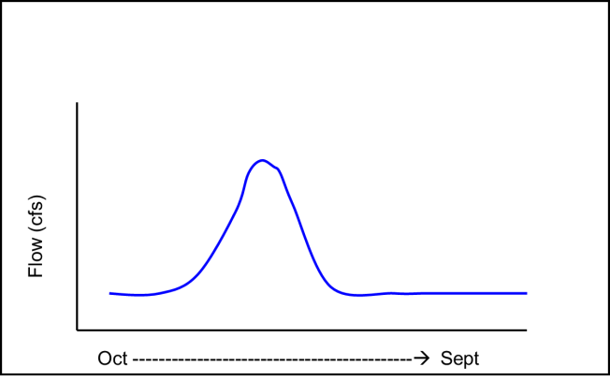
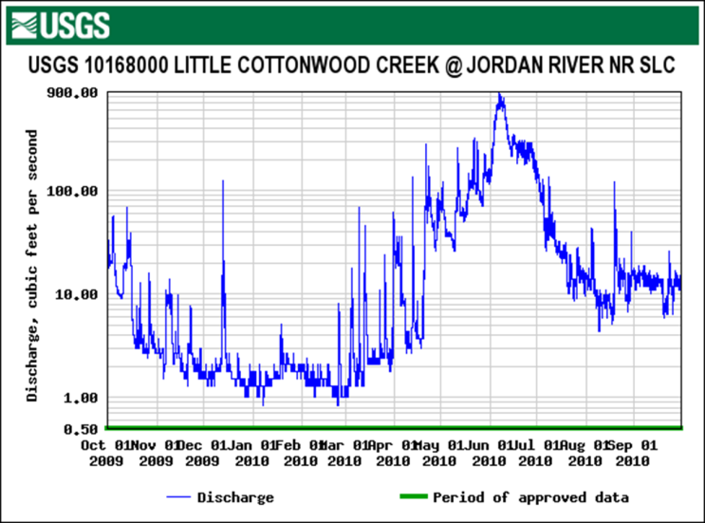
Water is not static
It has regular seasonal and daily fluctuations.

Slide 36
Daily manually measuring DO

Slide 37
Continuous measuring dissolved oxygen

Slide 38
Understand your site
Each site will have unique characteristics
Some streams are naturally clear while others are naturally turbid
Monitor the site long term to capture the changes
Documenting field parameters on the data sheets help understand the site and current conditions
Flow, algae, water color, water odor, etc.

Slide 39
Database
https://uww.usu.edu
For photos, we will share a link where you can upload your photos to a Google Drive

Slide 40
Quality Control
Follow procedures in your field notebook
Also available online with videos
Ensure use of the proper units (ᵒC vs ᵒF) and decimals are correct
Enter data into the database (https://uww.usu.edu)
Keep all copies of your field sheet and scan to the Utah Water Watch program coordinator at the end of the year
Make sure equipment is stored properly and follow decontamination procedures

Slide 41
Safety!
Safety is always more important than the data!
Be aware of slippery banks or ice
Don’t let students enter water over their knees or that is moving very fast (more than 1 foot per second)
Watch for poison ivy, broken glass or other hazards
Review the Sampling Safety guide

Slide 42
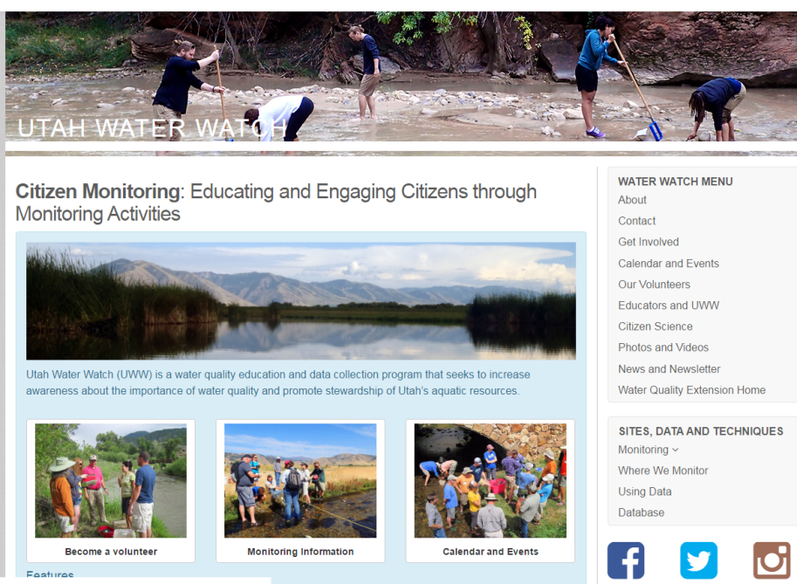
Resources
http://extension.usu.edu/utahwaterwatch
Instructions
Events
Maps
Photos
Also,
http://extension.usu.edu/waterquality
http://streamsidescience.usu.edu
www.utahcleanwater.org

Slide 43
For more information:
Ellen Bailey
Utah Water Watch Program Coordinator
Ellen.bailey@usu.edu
801-536-4432
USU Water Quality Extension
435-797-2580, waterquality@usu.edu
http://extension.usu.edu/waterquality

