Slide 1
Industrial Water Usage: Why We Need It!
Sample PowerPoint
Utah State University Extension
Utah Nature Explorers

Slide 2
What does Industrial Water Usage mean?
Industries are an important part of our everyday life. The water that they use helps to make things like:
Metals
Wood and paper products
Gasoline
Chemicals
Food

Slide 3
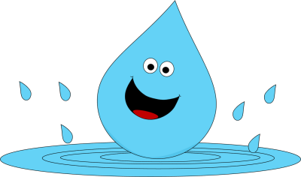
How is Water Used in Industries?
You may ask, “How is water used to make all of these different products in industries?” Well, here are a few ways water may be used…
Laundry
Kitchen needs
Cooling
Sanitation
Incorporating water into a product or diluting
Restrooms

Slide 4
Industrial Water Use
https://www.youtube.com/watch?v=Uy_mwVcuPvI
This video clip shows the importance of industrial water usage.
Time: 1:20

Slide 5
Making it Real
So, how does industrial water use affect your life?
Without it, you couldn’t go to a car wash, your diet would severely change (as industries that process fruit, vegetables, and meats need a lot of water), valuable goods like gasoline wouldn’t be easily accessible to you, and your electronics would even be affected, as these are processed in industries that need WATER!

Slide 6
Bibliography
Perlman, Howard. "Industrial water use." Industrial Water Use, the USGS Water Science School. USGS Water Science School, 1 Jan. 2014. Web. 25 June 2014. <http://water.usgs.gov/edu/wuin.html>.
Schroeder, Brett. "Water is Life - Industrial use." Water is Life - Industrial use. University of Wisconsin Eau Claire, 1 Jan. 2004. Web. 25 June 2014. <http://academic.evergreen.edu/g/grossmaz/SCHROEBJ/>.
"Water & Energy Efficiency by Sectors, Industry." EPA. U.S. Environmental Protection Agency, 1 Dec. 2013. Web. 25 June 2014. <http://www.epa.gov/region9/waterinfrastructure/industry.html>.

