Slide 1
Desert Adaptations
Utah State University Extension

Slide 2
Welcome Aboard!
Today you will get a chance to look at some adaptations of plants and animals that live in the desert. Because the desert is SO hot and dry, these plants and animals have to adapt in order to survive!
While you go through the PowerPoint, think about what kind of adaptations you might want to have if you were a plant or animal in the desert.
Good luck, Utah Nature Explorers!

Slide 3
General Adaptations
Before we get started, here are a few of the general adaptations that you might see in desert plants and animals:
Animals:
Nocturnal or Crepuscular (Morning and Evening) activity
Light coloration, which reflects heat and acts as camouflage
Burrowing deep into moist soil
Plants:
Specialized root systems
Waxy skin to seal the moisture in
Now, onto the specific animal and plant adaptations…

Slide 4
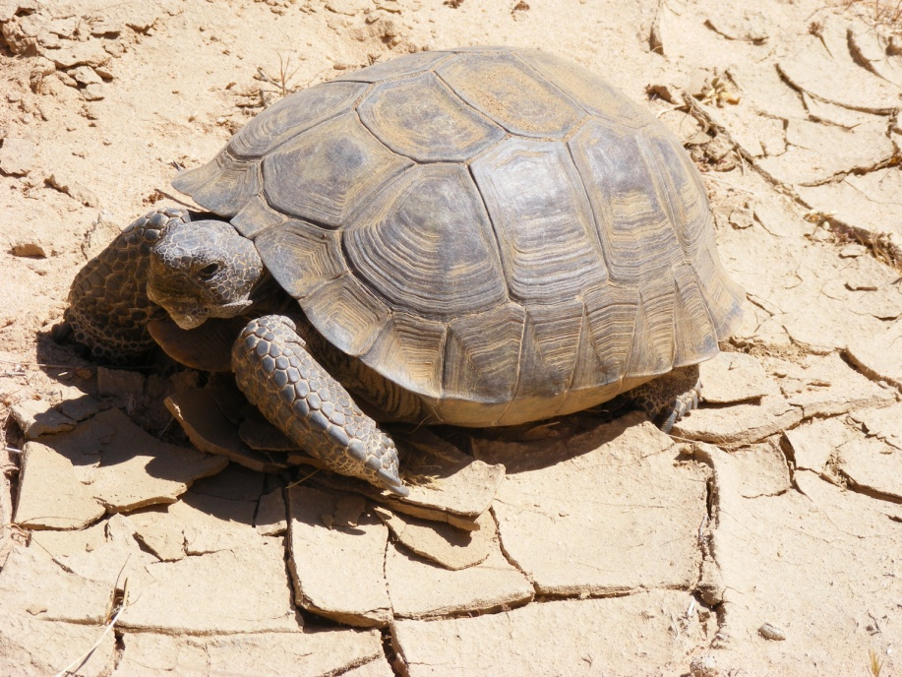
Specific Animal Adaptations Desert Tortoises
Desert Tortoises are land turtles. They are large and move very slowly. They are well adapted to desert life. They often dig burrows in sandy soil or under rocks using their long claws and front legs. In addition, their shells protects them from almost all natural predators (with the exception of mountain lions).
The Desert Tortoise can weigh up to 50 pounds, and their shells can be over a foot long!

Slide 5
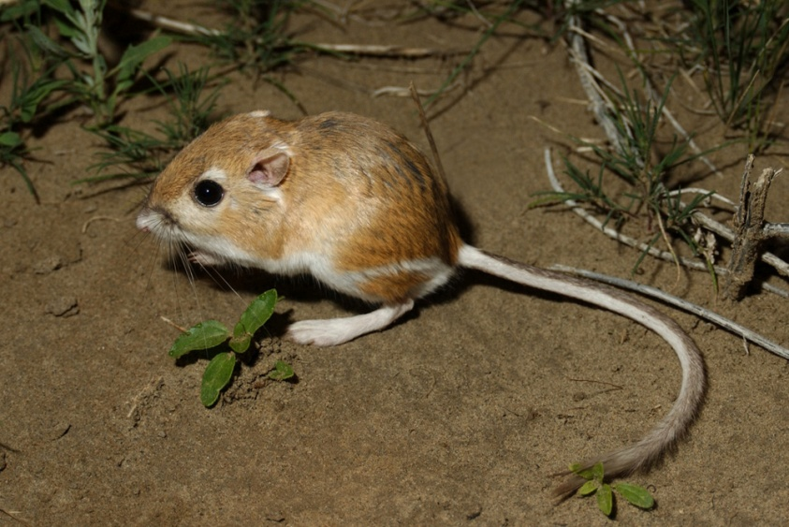
Specific Animal Adaptations Desert Kangaroo Rats
Desert Kangaroo Rats are very well adapted to desert life. They have light colored and dense fur, which protects them from the heat of the sun. They eat seeds and dry plant matter, and can store this food for weeks at a time. If needed, they can get their needed moisture from the seeds they eat. Desert Kangaroo Rats don’t sweat, in order to conserve moisture, and have a variety of other adaptations to help them survive in the desert.
The Kangaroo Rat has very large back feet, which help it jump in the deep desert sand!

Slide 6
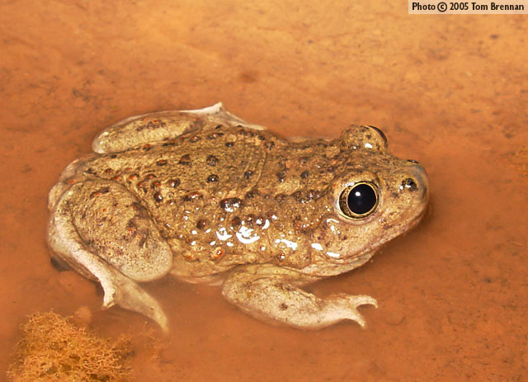
Specific Animal Adaptations Spadefoot Toads
The Spadefoot Toad has many adaptations that help it to survive in the desert. One of its most important adaptations is that their spade feet allow them to easily dig burrows for themselves. The toads will stay in these burrows nearly all year, except during warm spring rains. They are also able to increase urea levels in the blood while they stay in their burrows, to allow the moisture from the soil to soak into their skin.
Check out that crazy foot! These ‘spade feet’ help the toad dig in the sand!

Slide 7
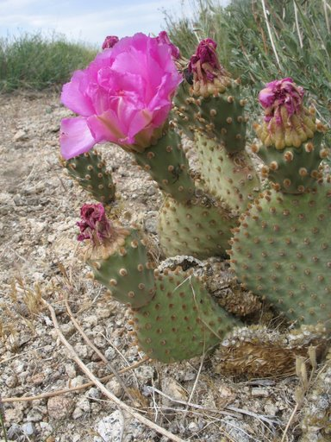
Specific Plant Adaptations Prickly Pear Cactus
Prickly Pear Cacti are well suited for the desert environment. They have thick, succulent pads and cylindrical jointed stems, which allow them to store water, undergo photosynthesis, and produce flowers. They also have waxy skin, which allows them to hold in moisture.
The flowers of the Prickly Pear Cactus produce juicy (and edible) fruit!
These pads are set up to help the cactus store water better!

Slide 8
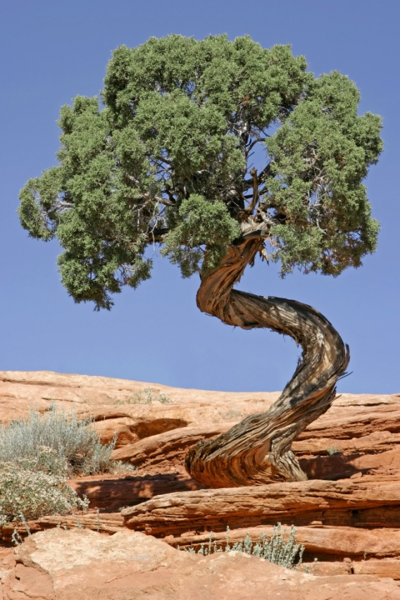
Specific Plant Adaptations Utah’s Juniper Tree
The Juniper tree has an extensive and dense root system, which allows it to get the moisture it needs. The stems and trunks of Juniper trees are very durable, but are also light in weight. This tree is the most abundant desert tree in Utah!
Juniper trees can live for up to 650 years! That’s pretty old!
It’s not everyday that you see a tree trunk that looks like that!

Slide 9
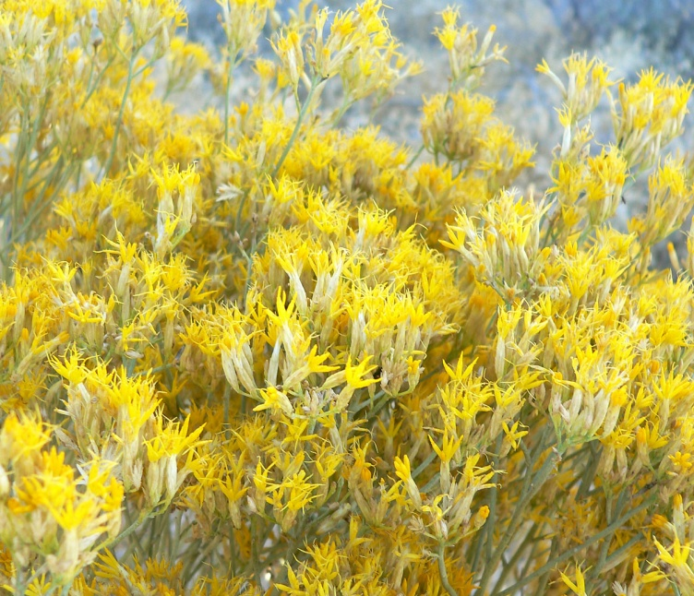
Specific Plant Adaptations Rubber Rabbitbrush
This plant grows well in many different environments. It can grow in sunny areas, in gravel or rough soil, can grow in saline (or salty soil), and is even tolerant of the cold! It’s stems are covered with a special covering called ‘trichomes,’ which feels a bit like felt. This covering helps to insulate the plant and reduce transpiration (or water loss).
Rubber Rabbitbrush was used in the past by Native Americans as a cough syrup!
This plant can grow between 1 and 7 feet tall.

Slide 10
See you later!
Thanks for learning about desert animal and plant adaptations with us today! We hope you enjoyed it as much as we did!
Sincerely,
The ‘Utah Nature Explorers’ Team

