Slide 1
Desert Ecosystems: Living vs. Nonliving

Slide 2
Welcome Aboard!
Welcome to the desert, Utah Nature Explorers! We hope you brought some water, because the desert gets REALLY hot!
Enjoy looking at the beautiful things (living and non-living) that are a part of the desert ecosystem as you go through this slideshow.
Have fun!

Slide 3
Instructions
The next 10 slides have pictures of living or non-living things that you might find in the desert.
Each time a new slide is brought up, do a sketch of the picture in your scientific notebook, along with a label of its name.
After you are finished sketching, you will talk with your group to determine which things are living, and which things are non-living.

Slide 4
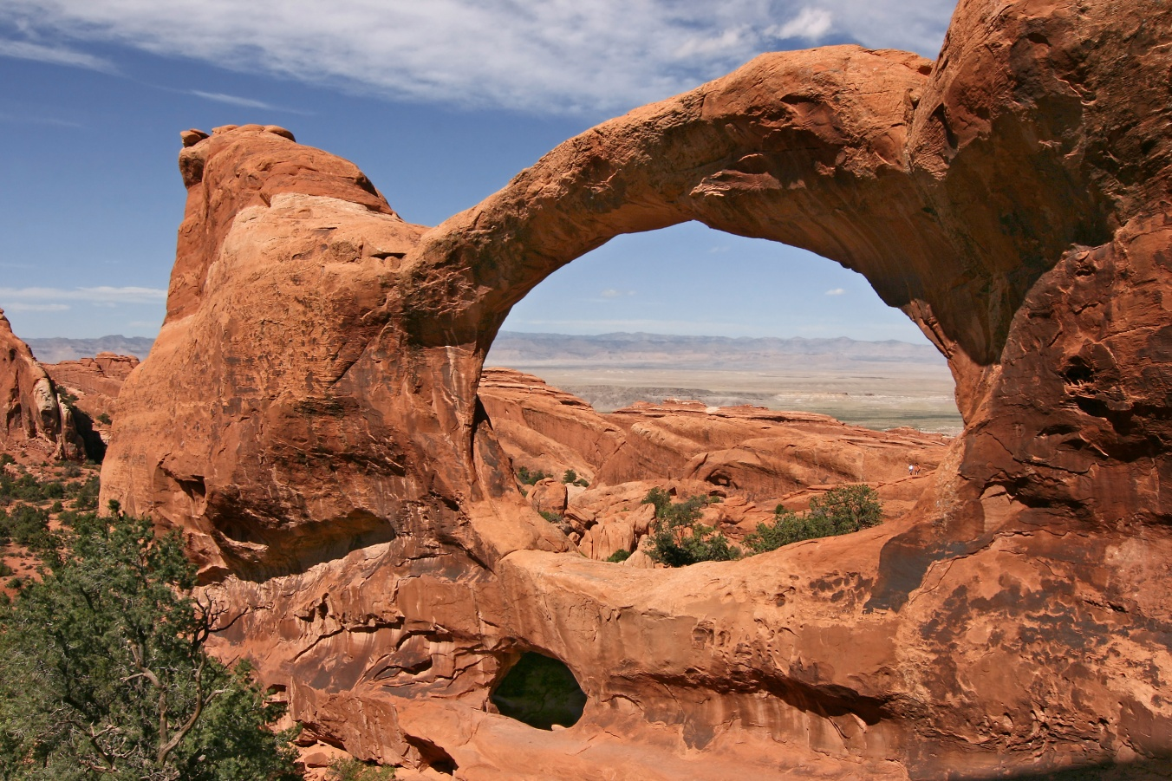
Living or Nonliving? Arches

Slide 5
Living or Nonliving? Desert Tortoise

Slide 6
Living or Nonliving? Big Sagebrush

Slide 7
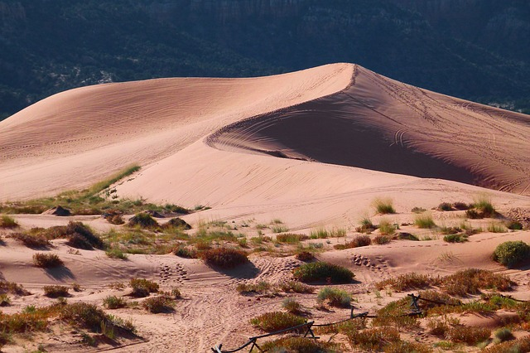
Living or Nonliving? Sand and Soil

Slide 8
Living or Nonliving? Desert Cholla

Slide 9
Living or Nonliving? Desert Kangaroo Rat

Slide 10
Living or Nonliving? Mountain Lion

Slide 11
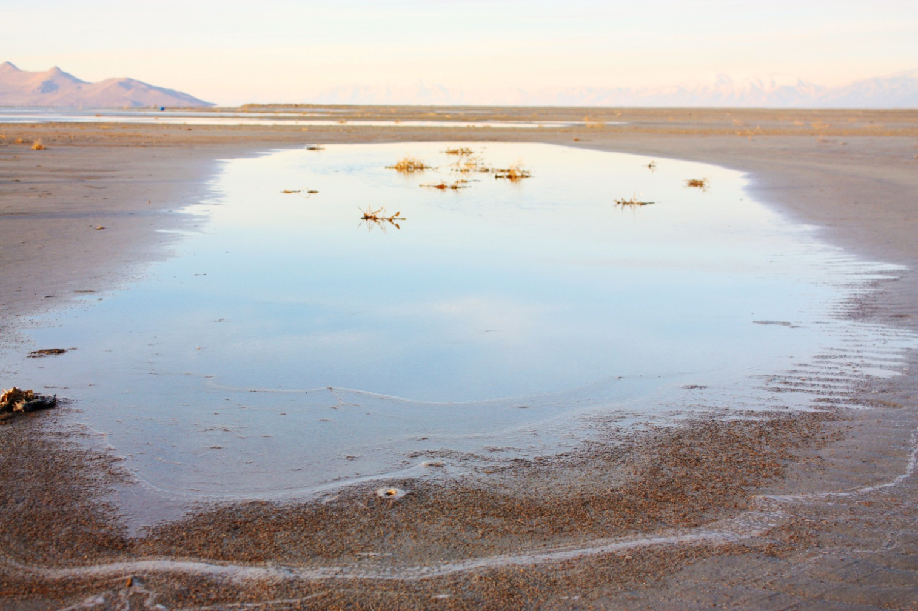
Living or Nonliving? Water

Slide 12
Living or Nonliving? Juniper Tree

Slide 13
See you later…
We hope you had a great time studying the desert ecosystem, and we hope to see you again soon!
Until next time,
The ‘Utah Nature Explorers’ Team

