Slide 1
Do the Worm
Using worms to create garden magic and reduce your environmental impact

Slide 2
…where a subject forms a rippling motion through the body, creating a wave reminiscent of a worm crawling.
The Worm |verb| 1. Sometimes referred to as the dolphin, a dance motion often associated with breakdancing and funk…
2. Using worms to convert home food waste into vermicompost, aka “garden magic”

Slide 3
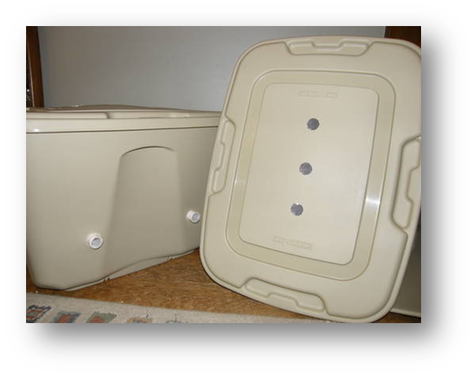
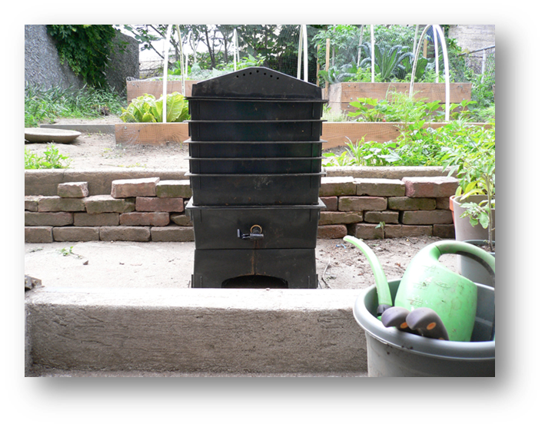
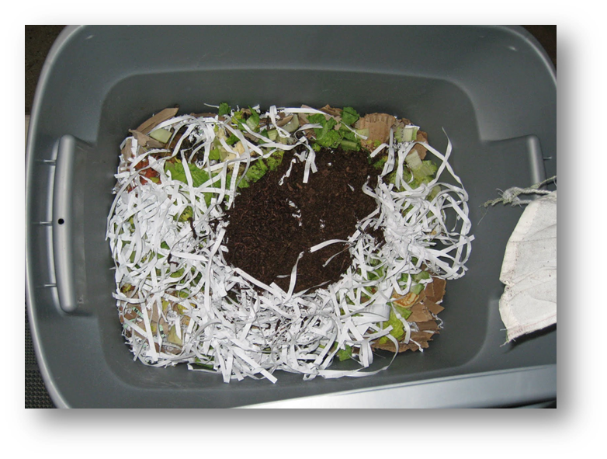
Vermicomposting (Worm Composting):
The process of using worms to break down discarded food and other organic waste and convert them into compost and liquid fertilizers.
Notes:
Go over what a self-contained, virtually odorless worm compost system allows you to do, including:
Recycle kitchen food waste
Save energy
Produce fertilizer for house plants and your garden
Reduce waste disposal costs
Compost faster than other composting methods
Produce compost year round rather than semiannually

Slide 4
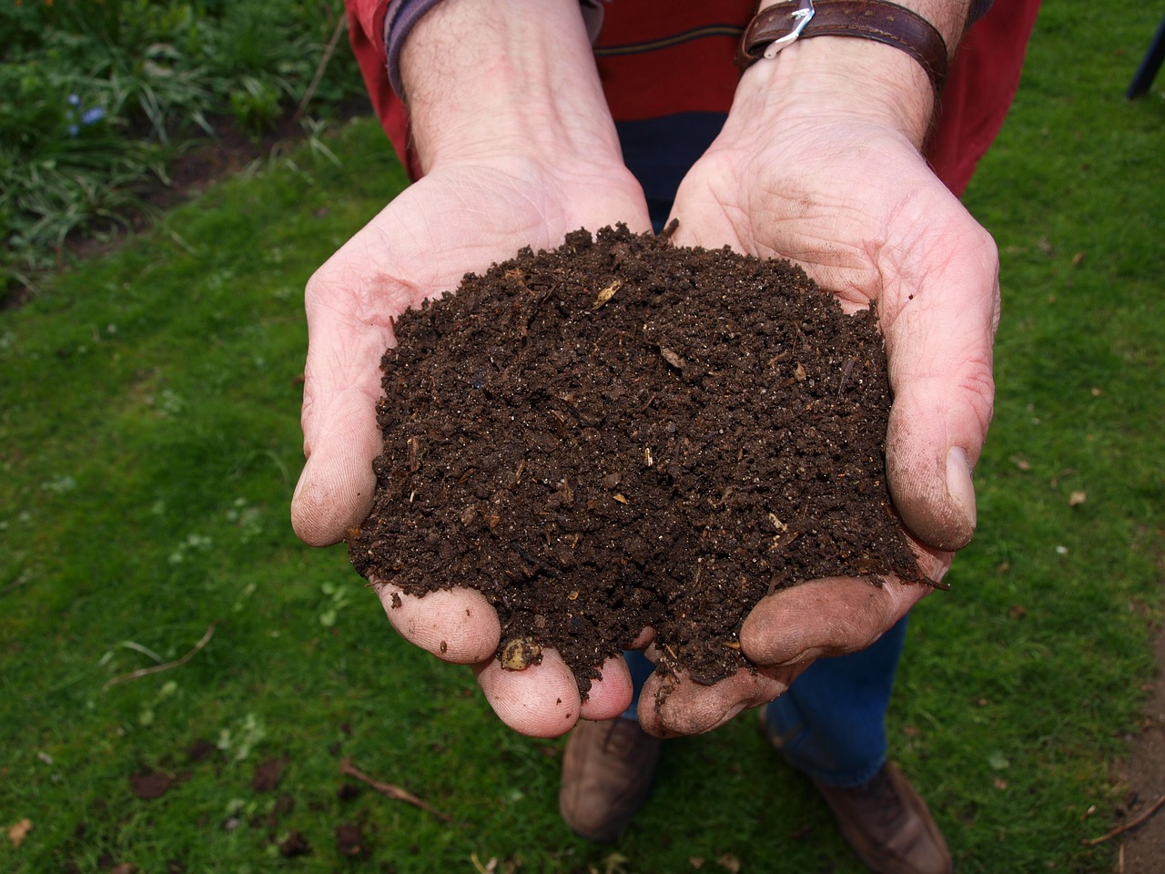
Why Vermicomposting?
Notes:
Ask the kids what benefits come with composting– go over answers and make sure to cover the following points:
Bragging rights
Increases moisture and nutrient retention in your soil
Lessens crusting and other physical damages common to soils in arid climates
Nutrients:
Contains more nitrogen, phosphorus, and potassium than farmyard manure
Micronutrients:
Contains more manganese, copper, zinc, iron, and same amount of magnesium than farmyard manure minerals
So nutrient rich – spread around plants, not touching or in seedling holes

Slide 5
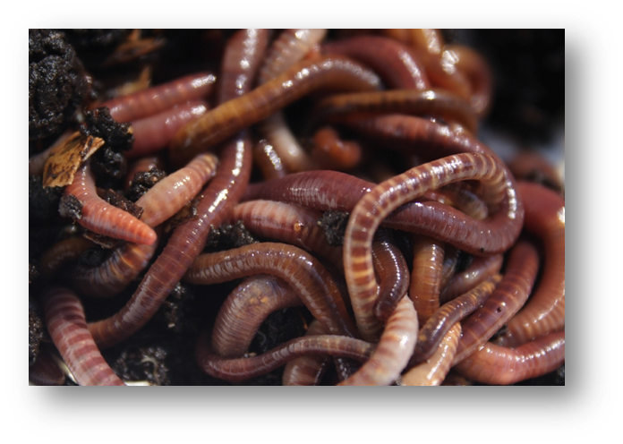
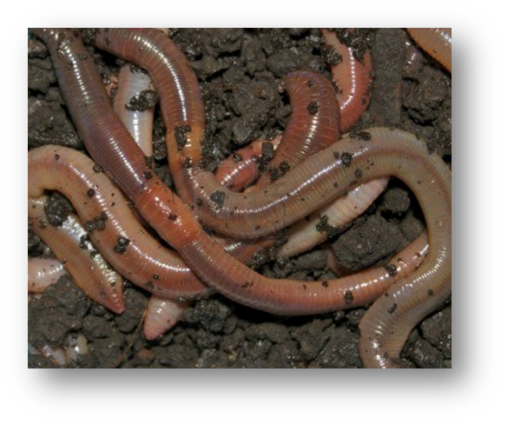
A word about worms… All worms are not created equal!
Red Wigglers- Composting Worms
vs.
Earth Worms- Earth Workers
Notes:
Red Wigglers- Composting worms process large amounts of organic waste daily, can handle disturbances, and thrive in confinement.
Earth Worms- Earth workers don’t process large amounts of organic waste, thrive well in confinement, or deal well with disturbance.

Slide 6
Red Worms
“The most satisfactory kind of worm to use in your vermicomposting system.” ~ Worm guru Mary Appelhof
Also known as red wigglers, manure worms, red hybrids, tiger worms, striped worms, etc.
Favorable Red Worm varieties:
1. Eisenia fetida
2. Eisenia andrei
3. Lumbricus rubellus
4. Perionyx excavatus (intolerant of cold)
5. Eudrilus eugeniae (intolerant of cold)

Slide 7
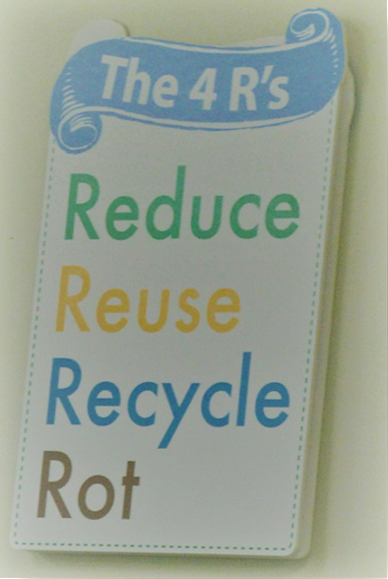
Waste Reduction
Worms can consume full body weight in mass/day!
Save Money! Many landfill diversion sites charge a “tipping fee” for green waste being brought to them, ranging from $15 to $75 per ton.

Slide 8
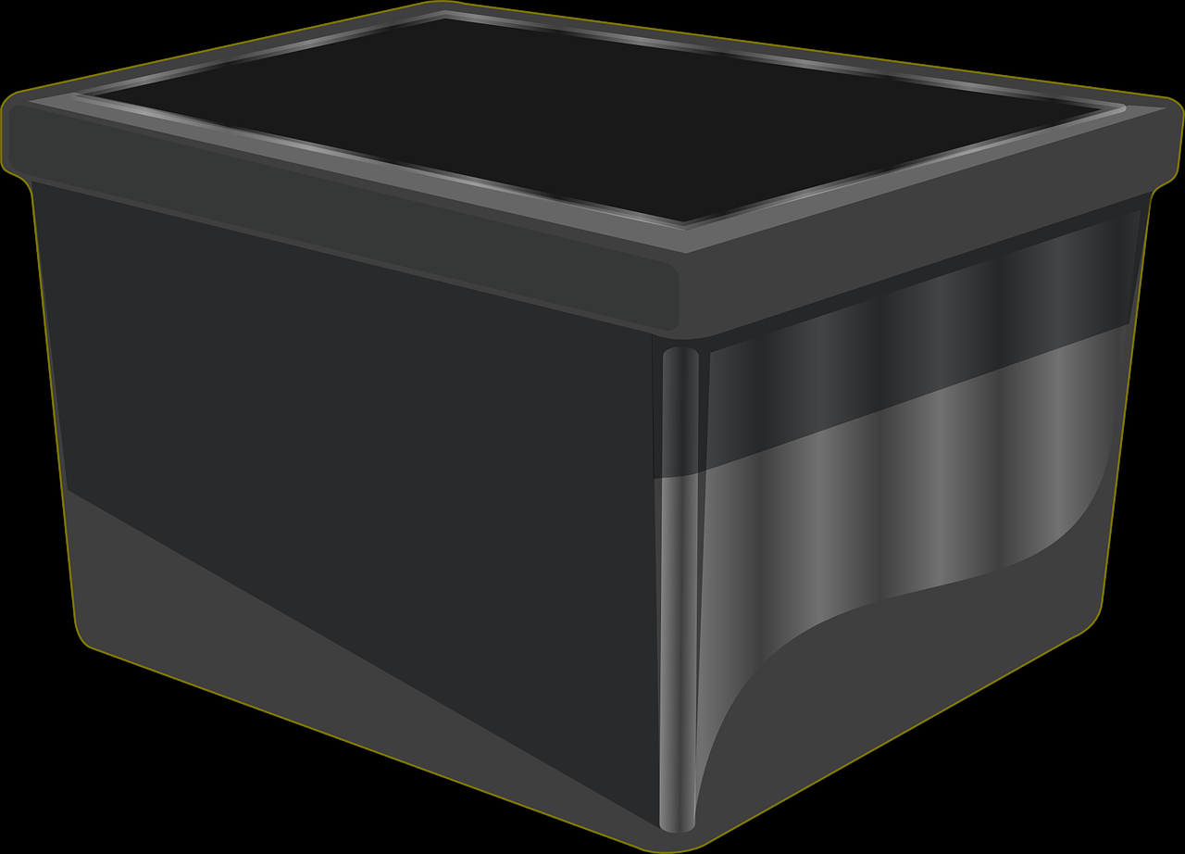
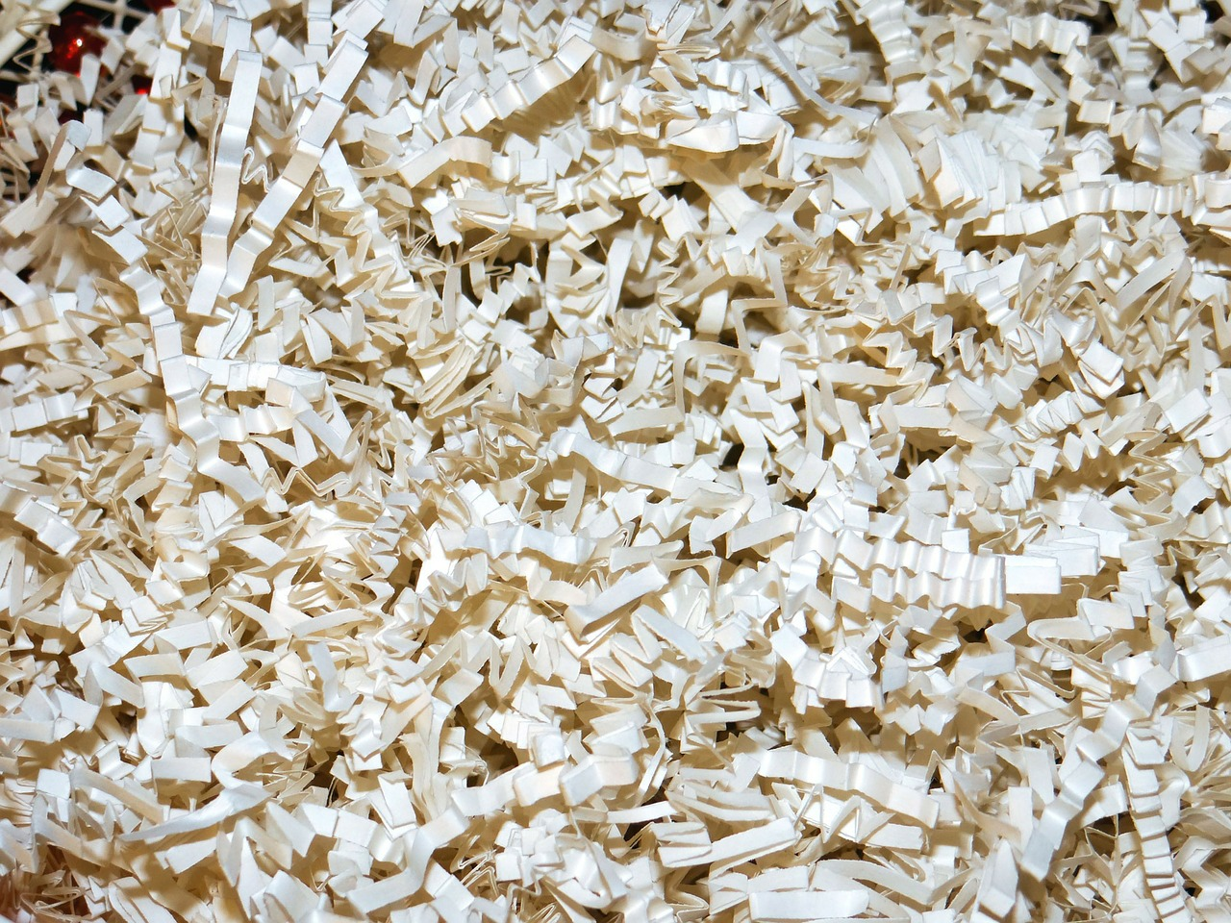
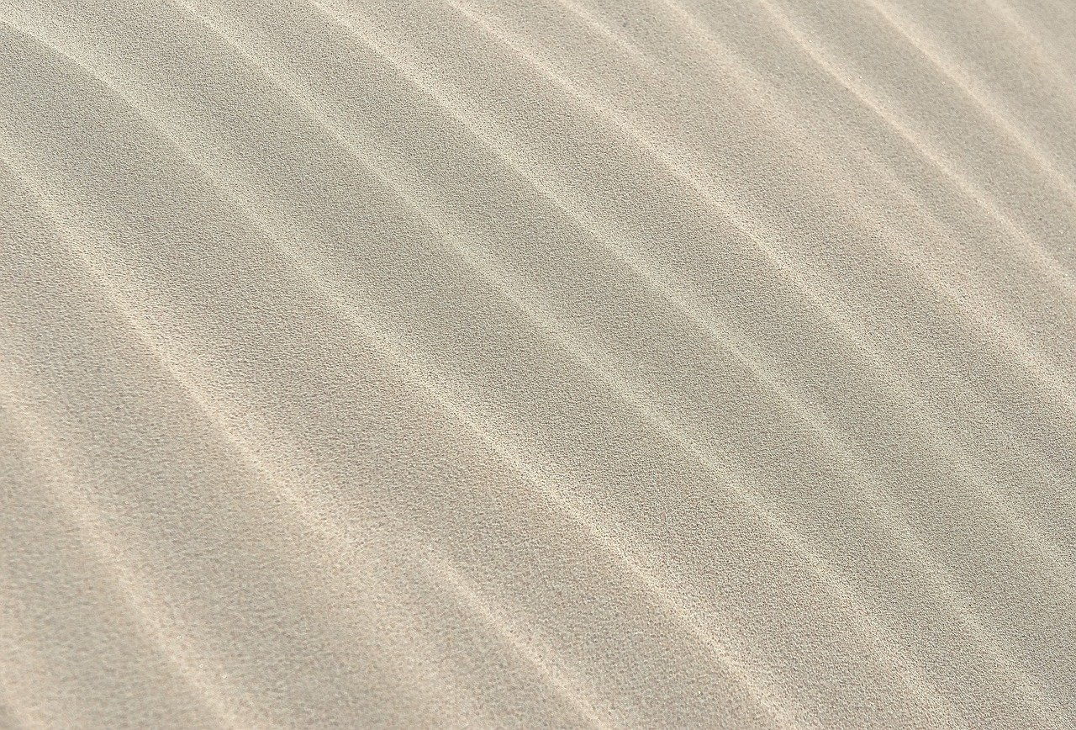
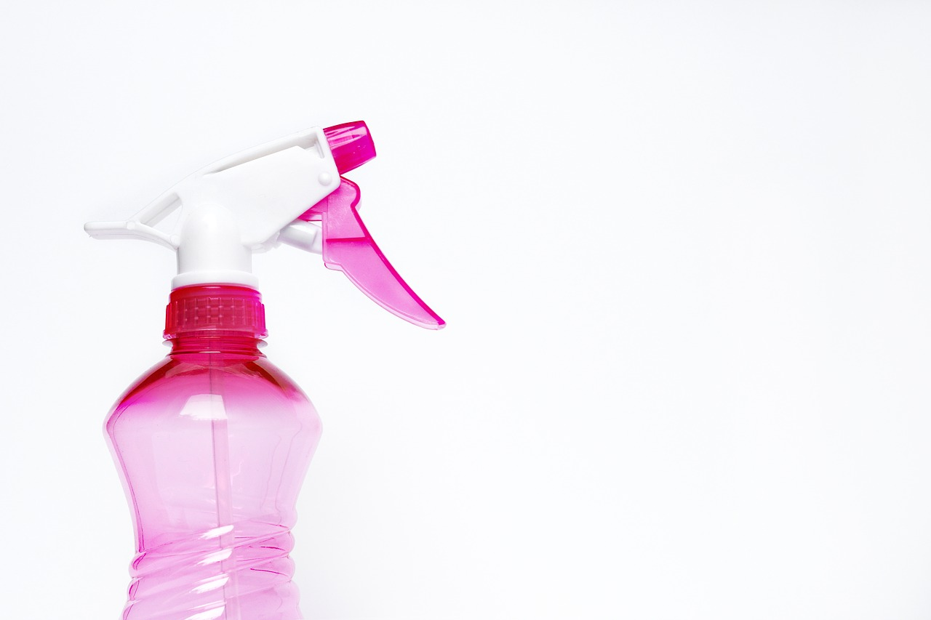
How to create your own Vermicompost: Materials
Worm Bin
Bedding
Grit
Water
Notes:
Worm bin-Get creative! Use old buckets, garbage cans, etc. Rubber and plastics are cheap, easy to use, and durable. Wood will eventually be eaten, but will work in a pinch. Be cautious of any chemical treatments containers may have undergone.
Bedding- Use newspaper scraps, coconut coir, or peat moss (less sustainable)
Grit- Worms grind down food in their gizzards. This requires grit. Add a small amount of sand to bedding.
Water- Mist occasionally to maintain good moisture.

Slide 9
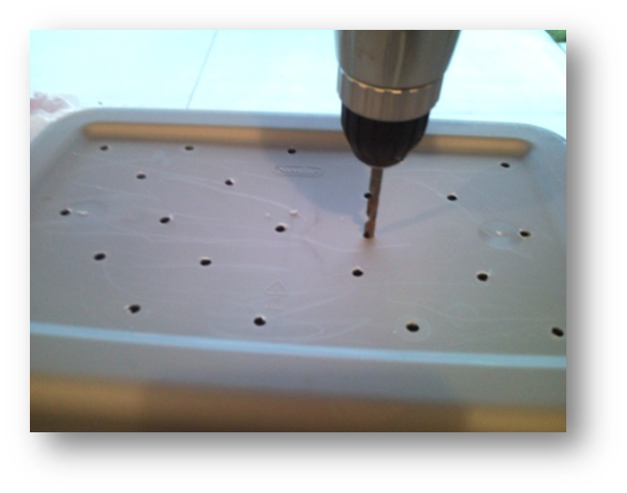
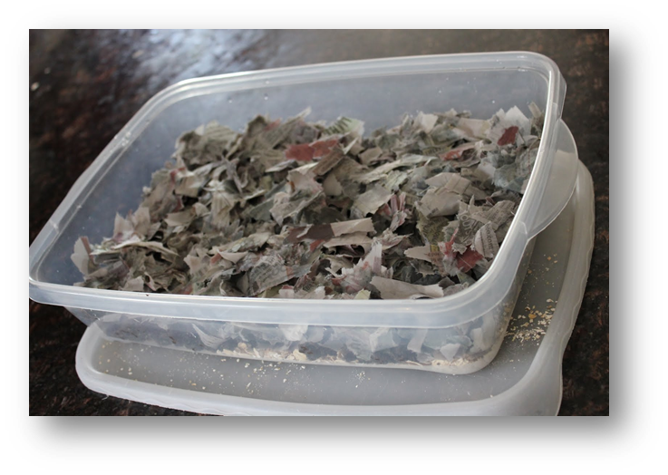
Creating your own Vermicompost
1
2
Notes:
1. To prepare your container, drill several dozen small holes on the top and sides (bottom optional, depending on design). Untreated wood bins are naturally ventilated.
2. Fill your bin with organic substrate (thin strips of shredded newspaper, coconut coir, or peat moss). Sprinkle a handful of dirt with sand on top, and thoroughly moisten. Allow water to soak in before adding worms.

Slide 10
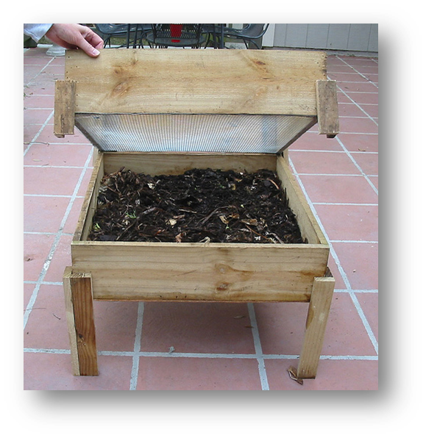
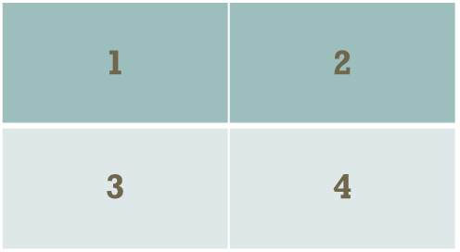
Creating your own Vermicompost
3
Add worms and food scraps. Feed worms in quadrants.
4
Harvest castings and compost.

Slide 11
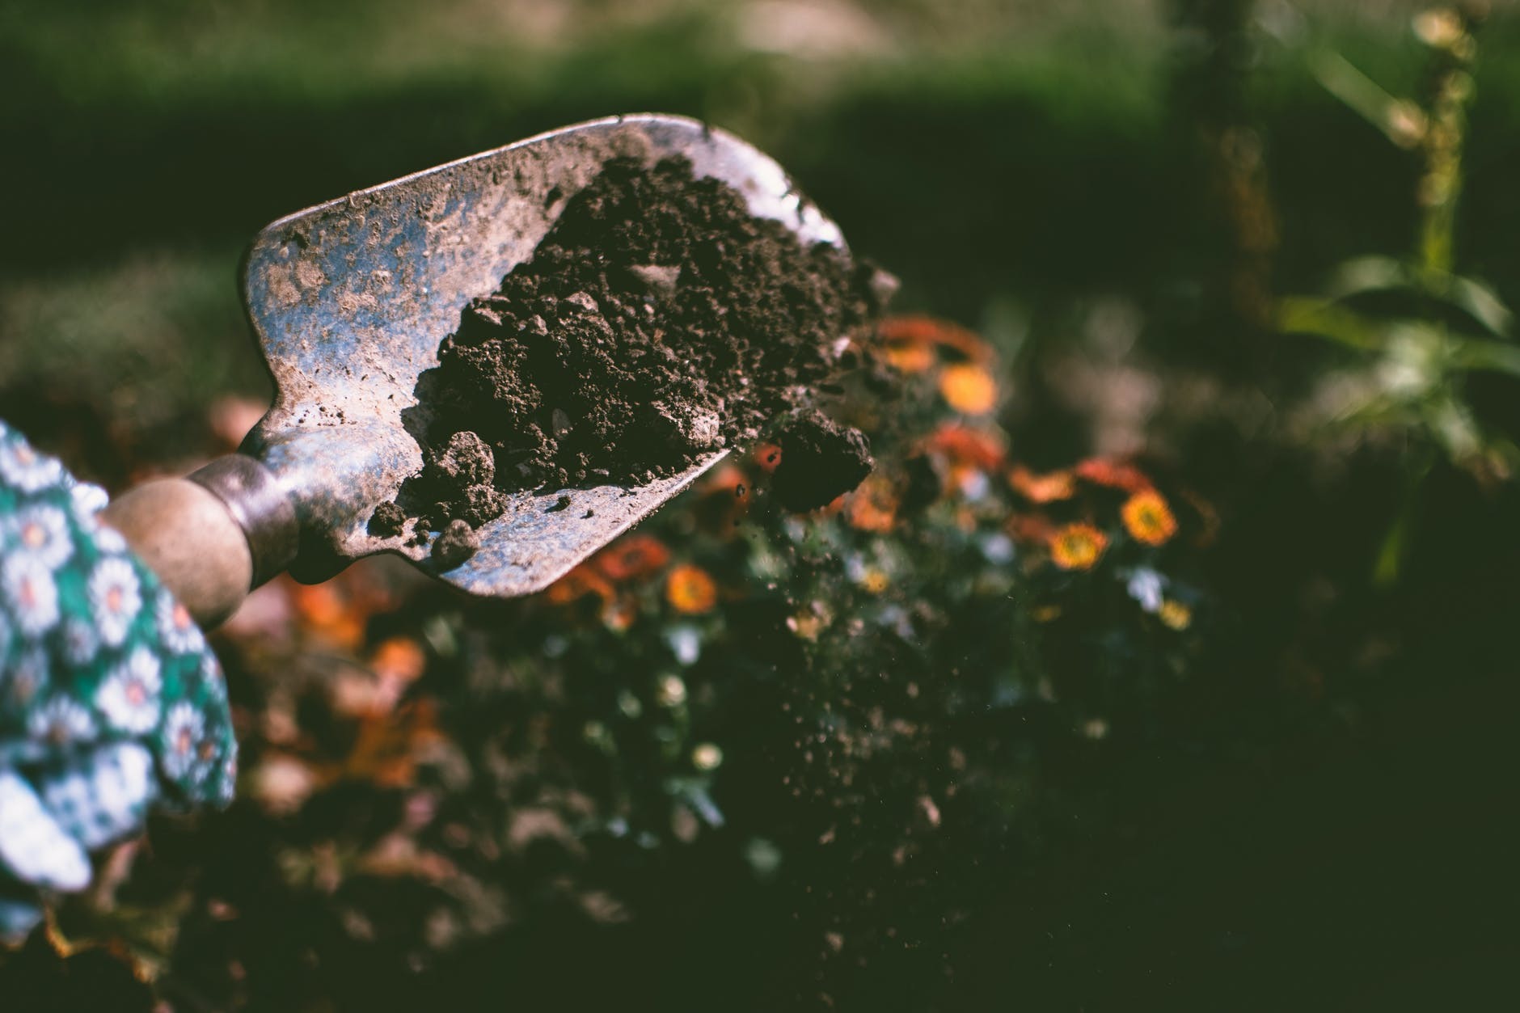
Garden Magic
What is the difference between worm castings and worm compost?
Notes:
Worm castings: Deposits that have moved through a worm’s digestive tract. More homogenous. Higher salt concentration.
Worm compost: A dark mixture of worm castings, organic material, and bedding in varying stages of decomposition.
Feeding smaller amounts less often: Castings
Feeding larger amounts more often: Compost

Slide 12
Garden Magic
Using Vermicompost
Seed bedding: Mix in bottom of seed rows to give seedlings a boost.
Transplanting: Deposit vermicompost around prepared transplant hole.
Topdressing: Sprinkle around the base of growing plants.
Using Castings
Potting soil: Mix with other potting materials to decrease salt concentration.
Top dressing: Pure castings as top dressing for house plants.
Worm tea: Mix castings with water and use as a liquid fertilizer.

Slide 13
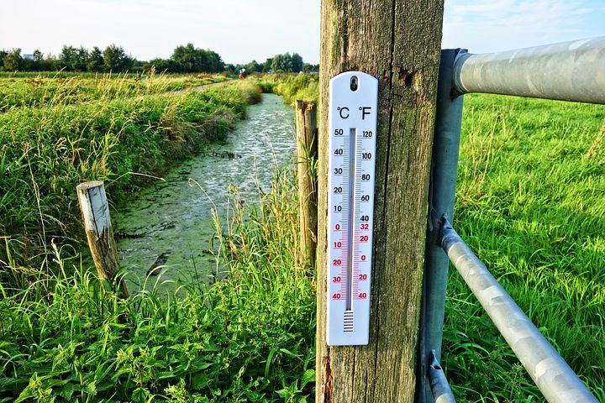
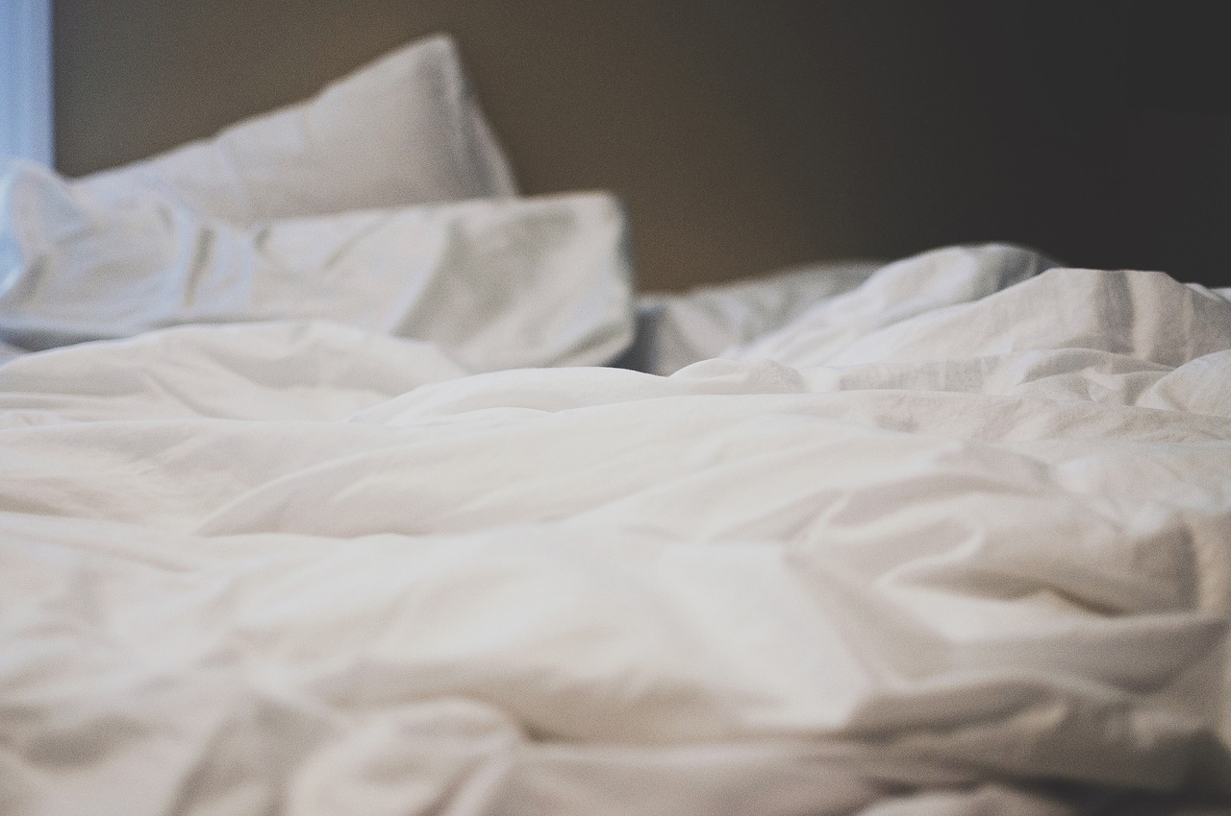
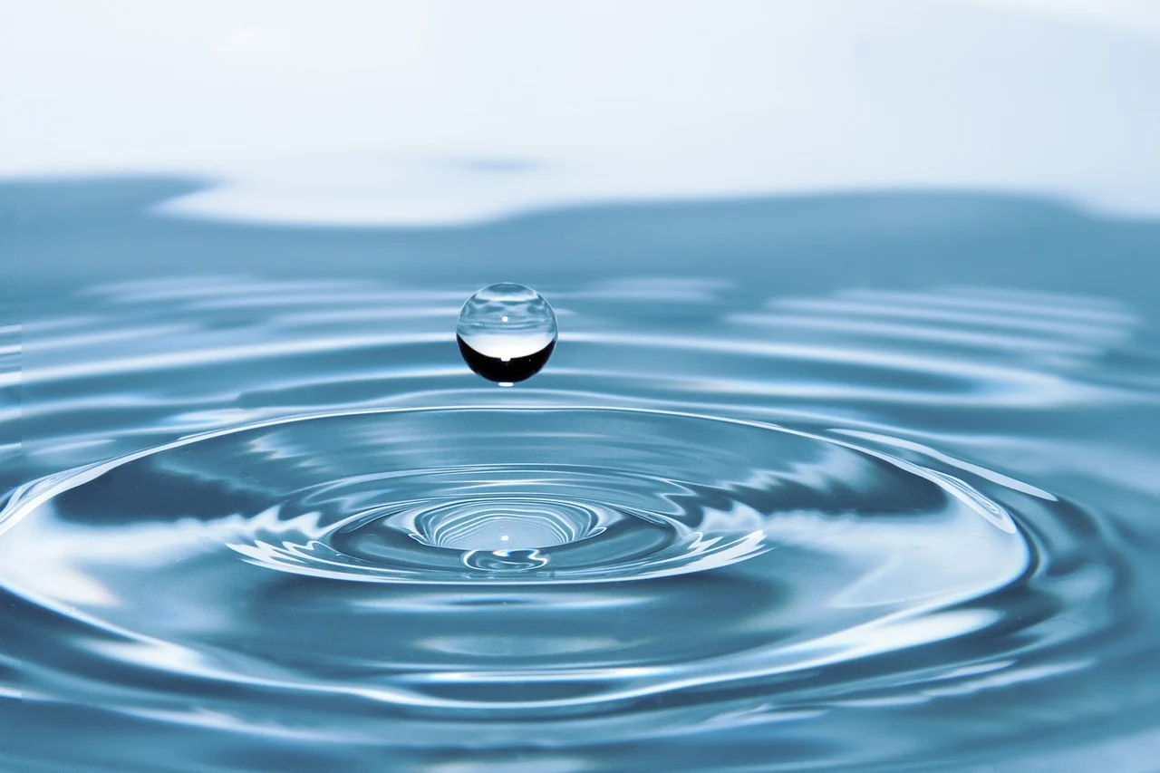
Maintenance - What do worms need?
Temperature
Bedding
Moisture
Notes:
Temperature
Can handle a wide variety of temperatures. Thrive best at temperatures between 55 and 77° F.
Bedding
A moist organic substrate in which to live (this will be eaten and converted to castings along with other feed).
Moisture and Oxygen
Keep bedding moist. Not too wet, not too dry, about as damp as a wrung-out sponge. Keep compost aerobic, preventing the stinky smell usually found in anaerobic garbage cans and poorly ventilated compost piles.
Fluff bedding often.

Slide 14
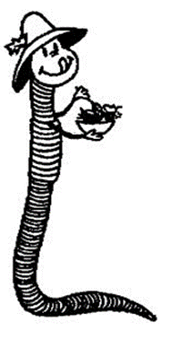
What you can/cannot feed your worms?
Notes:
Place the following in a worm bin:
Shredded paper
Products
Fruit and vegetables
Trimmings
Grains, beans, or
breads (without butter,
margarine, or mayonnaise)
Egg shells
Fallen leaves
Tea bags
Coffee grounds and filters
Lawn clippings and weeds
Do not place the following in a worm bin:
Meat products
Dairy products
Oily products

Slide 15
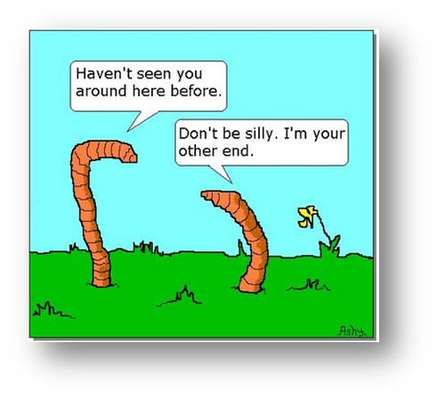

Slide 16
Worm Trivia
A worm has no arms, legs, ears, or eyes.
There are approximately _________ different kinds of EW.
Worms will leave if they don’t have _____, _______, ______, oxygen, and a comfortable ________.
In 1 acre of land, there can be more than ______ earthworms.
The largest earthworm ever found was in SA, measuring ___.
Worms are warm blooded.
Worms are born live.
Notes:
Answers:
T
6,000 (only 150 species widely distributed)
Food, Bedding, Moisture, Temperature
1,000,000 (Rich farmland estimate: 1,750,000, Poor soil: 250,000)
22 ft (African Giant Earthworm)
F
F (from cocoon, smaller than grain of rice)

Slide 17
Worm Trivia
Relative to their size, worms are about ____x’s stronger than humans.
Red wigglers are hermaphrodite.
Red wigglers have teeth.
Red wigglers use cutaneous respiration (breathe through skin).
One pound of red wigglers is approximately _____ worms.
Red wigglers don’t like spice or onions.
You can use extra wigglers as fishing bait.
Notes:
Answers:
1,000
T
F
T
1,000
T
T

