Slide 1
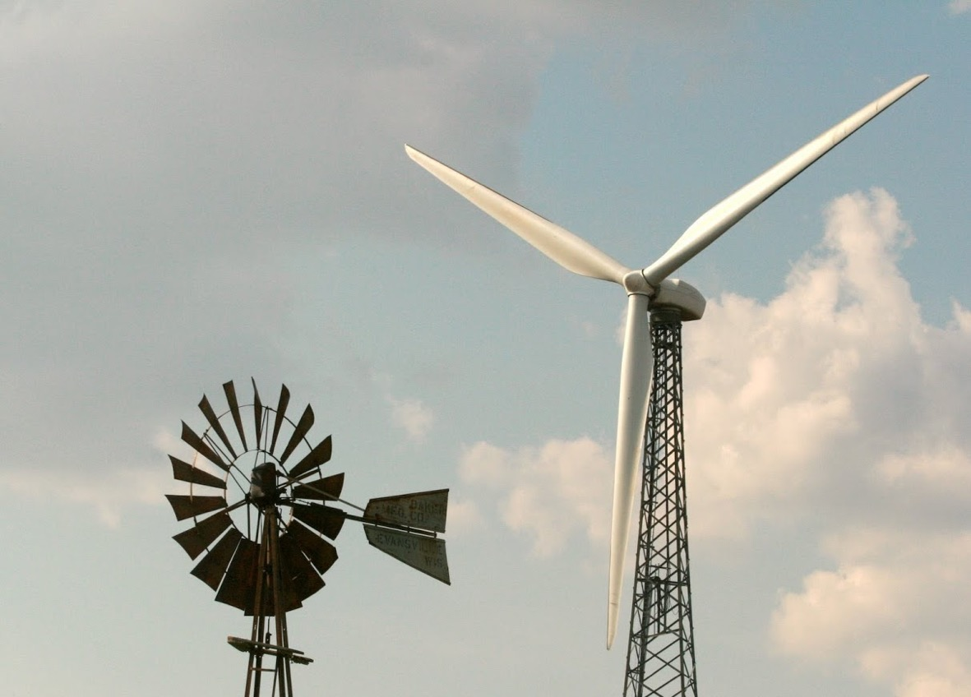
Energy
© USU Extension
extension.usu.edu

Slide 2
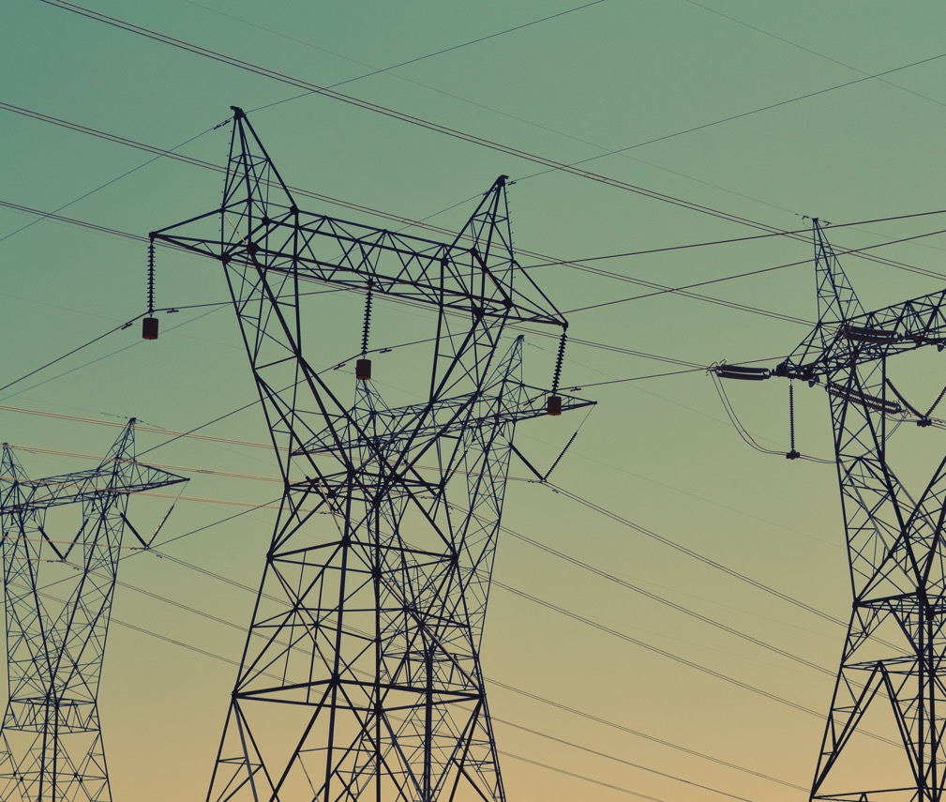
What is
Energy?
Notes:
Give campers a chance to give examples or their definition of energy. Additional possibilities include:
The power used to accomplish a task.
Stems from physical or chemical resources to provide light and heat or to work machines.
All ultimately comes from the sun, and thereafter stem from a variety of sources.

Slide 3
Coal Formation
Massive forests 300 million years ago covered most of the earth
Death of vegetation formed peat
Peat is compressed between sediment layers to form lignite
Further compression forms bituminous and subbituminous coal
Eventually anthracite (hard coal) forms

Slide 4
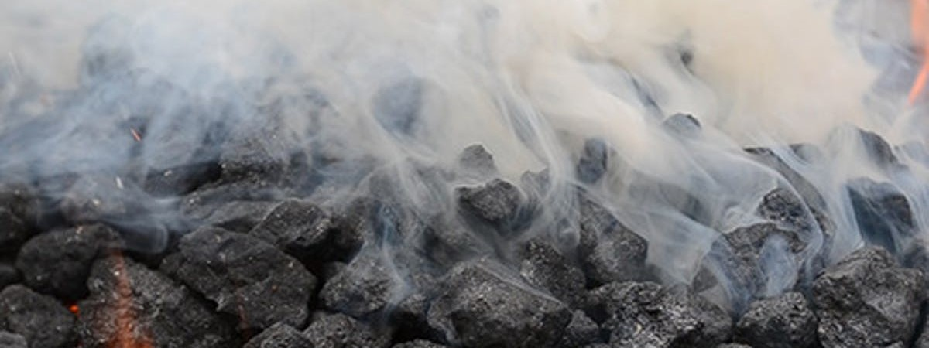
Coal can be burned to produce heat.
This heat is used to boil liquid (turn it into a gas).
Steam rises and this rising motion turns a wheel (turbine). This wheel then turns a generator.
When the generator spins, it creates a flow of electrons.
This is one way we make electricity!
https://elements.envato.com/thick-white-smoke-from-burning-coal-KPGFESY

Slide 5
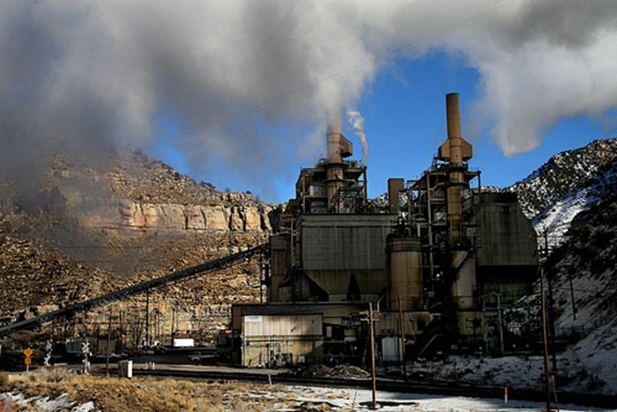
In 2018, 66% of Utah's electricity came from coal.
Notes:
https://www.eia.gov/state/analysis.php?sid=UT

Slide 6
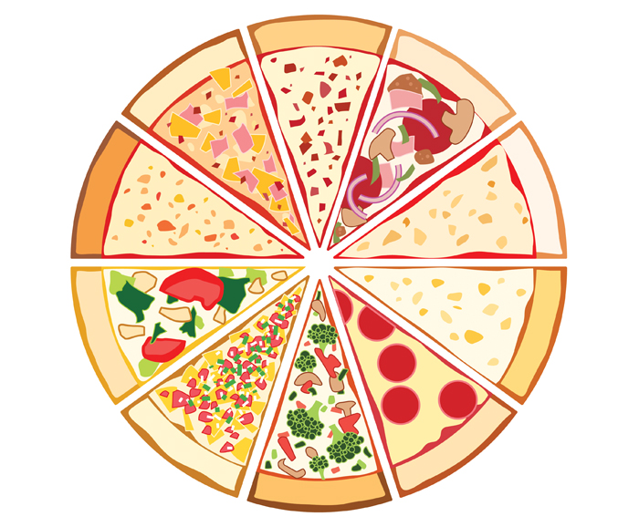
What’s in that pizza?
Coal
That means if all the electricity generated in Utah were put into a pizza with 10 slices, more than 6 of them would be generated by coal.
Coal
Coal
Coal
Coal
Coal
Coal

Slide 7
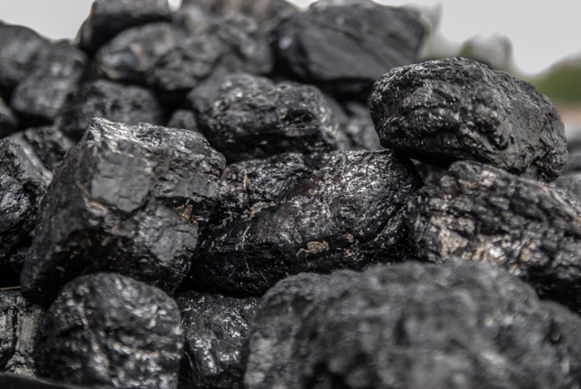
Coal Byproducts
Burning coal creates hazardous by products such as:
Nitrous Oxides
Carbon Dioxide (greenhouse gas)
Mercury (hazardous to all biological life, especially when it enters the water – has been linked to neurological problems and developmental damage)
Particles that contribute to smog, haze, and associated respiratory illnesses, and diseases

Slide 8
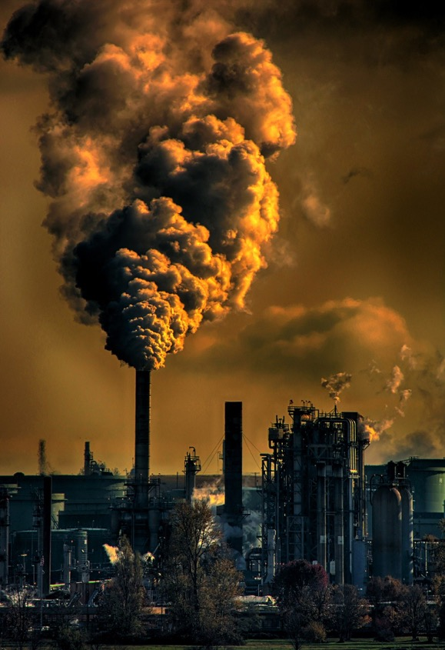
If it is so bad for our health and planet, why do we use it?
Notes:
Give students a chance to answer the question before telling them that it is because we have an abundance of it and have existing energy infrastructure designed around coal.

Slide 9
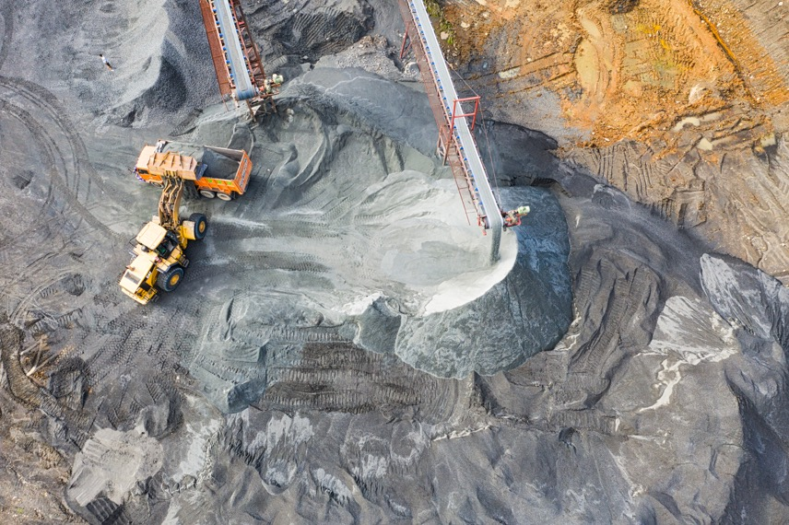
Coal Decline
“Nearly all of the coal produced in the United States goes for electricity generation, but its share has been eroded in recent years by growing natural gas-powered generation and rising share of renewable energy generation.” https://oilprice.com/Latest-Energy-News/World-News/The-US-Coal-Industry-Is-Declining-Irreversibly.html
“The United States is on track to produce more electricity this year from renewable power than from coal for the first time on record…the coronavirus outbreak is pushing coal producers into their deepest crisis yet.” https://www.nytimes.com/2020/05/13/climate/coronavirus-coal-electricity-renewables.html

Slide 10
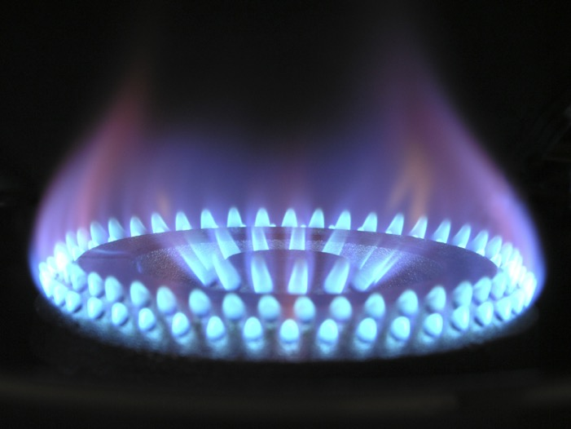
Natural Gas

Slide 11

What is it?
Where does it come from?
Notes:
It is a gas called Methane CH4.
As with coal, made from dead plant and animal matter.
This matter fell to the bottom of the sea millions of years ago and was covered by layers of sediment.
These layers caused heat and pressure.
The heat and pressure changed the plant and animal matter, producing natural gas.
The natural gas (methane) seeps up through porous rock underground.
Humans pressurize it and divert it into pipes that deliver it to communities

Slide 12
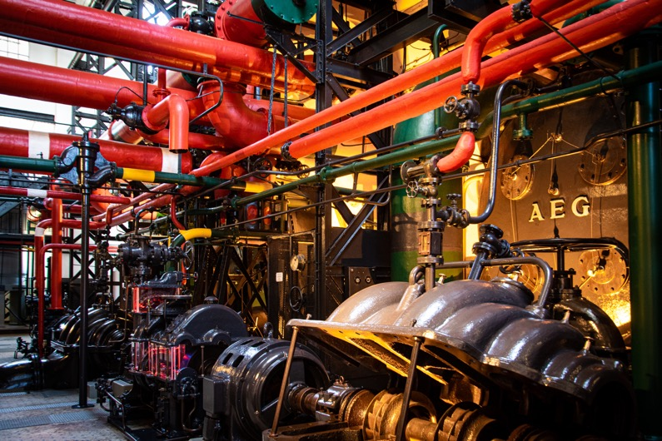
As of 2018, Utah generates 16% of its power from Natural Gas

Slide 13

Lets get back to pizza…
Coal
So 6 slices are coal, and almost 2 are natural gas.
Natural Gas
Coal
Natural Gas
Coal
Coal
Coal
Coal
Coal

Slide 14
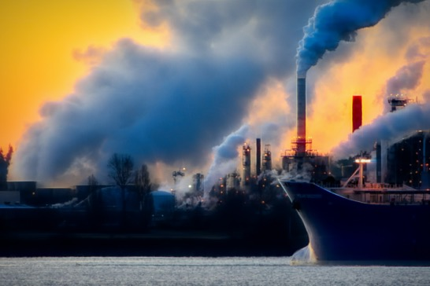
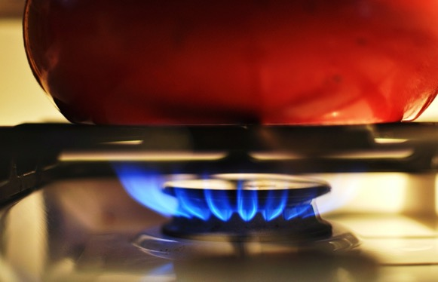
Carbon Dioxide (Greenhouse Gas)
Methane (Greenhouse Gas- more potent)
By-Products of Natural Gas

Slide 15
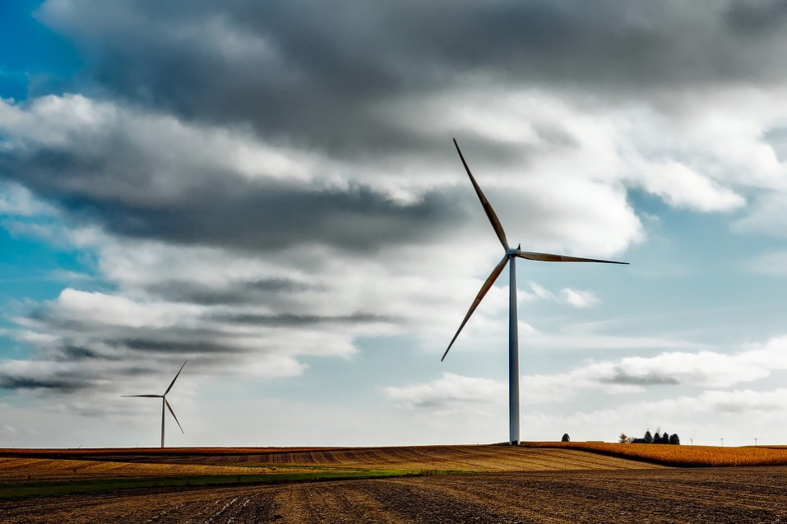
Wind

Slide 16
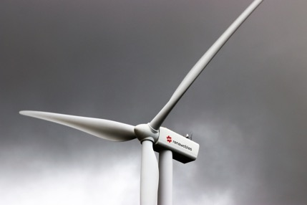
How it works
Wind contacts blades. These blades then spin. The spinning motion turns a turbine.
The turbine spins a generator.
The generator is able to create a flow of electrons.
This is electricity!

Slide 17

11% of Utah’s electricity generation is from renewable energy.
18% of this is from wind.

Slide 18
Back to Pie
Coal
Coal
Coal
So far, out of 10 slices, 6 are coal and 2 are natural gas, which make 8.
We have 2 slices of pizza left in our pie.
Renewable energy accounts for just over 1 piece of pie.
Wind accounts for about 1/5 of that piece of pie or 18%.
Renewables
Wind
Coal
Coal
Natural Gas
Natural Gas
Coal
Coal

Slide 19
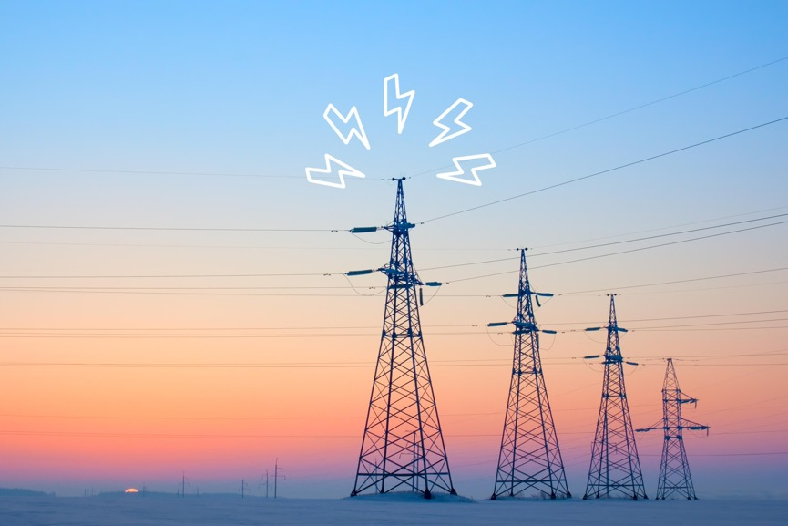
What other things are used in Utah to generate electricity?
https://www.rd.com/home/6-electricity-myths-that-can-kill/

Slide 20

Solar Power
Zero emissions!
Energy from the sun creates electricity using photovoltaic cells. These are what solar panels are made out of.
Solar panels are becoming more efficient and less expensive every year.

Slide 21
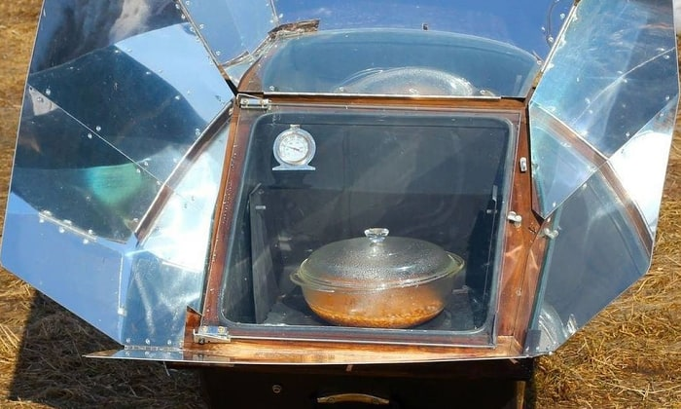
We can also use the sun’s energy to cook!
How?
https://cleanenergysummit.org/best-solar-ovens/
Notes:
Solar ovens are like miniature greenhouses that are really good at focusing the sun’s energy into a black box. The box heats up and the heat is trapped inside. This increases the temperature inside the box.
This is like an oven, and we can use the heat to cook food without using any electricity!

Slide 22
Back to the Pie
Coal
Coal
Coal
6 slices are coal, 2 are natural gas.
Renewable energy accounts for just over 1 piece of pie.
Wind accounts for about 18% of that.
Solar accounts for over 50% of Utah’s renewable energy.
Renewables
Solar
Wind
Coal
Coal
Natural Gas
Natural Gas
Coal
Coal

Slide 23
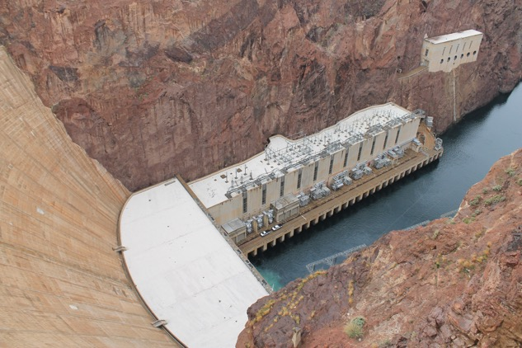
Hydroelectric
The movement of water turns a turbine…
You know the rest!
(Turbine turns a generator, which creates a flow of electrons=electricity)
Hydroelectric power generation accounts for 21% of Utah’s renewable energy portfolio.

Slide 24
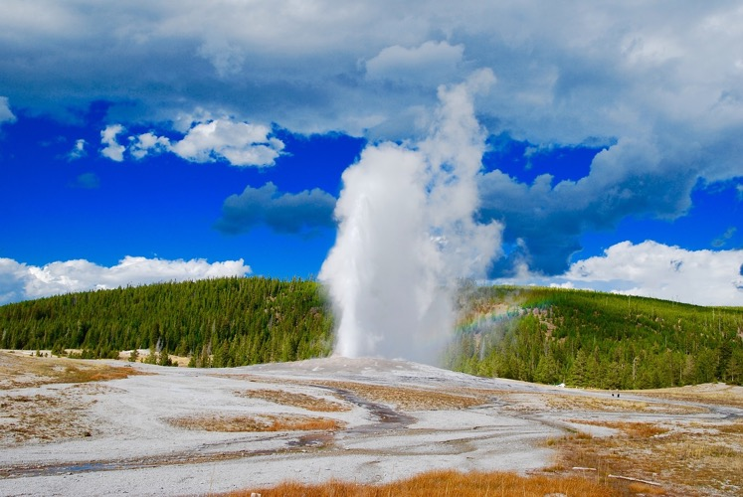
Geothermal
Geothermal is the heat that comes out of the Earth; things like hot springs or geysers (think about Old Faithful in Yellowstone).
The heat that comes out of the earth can be used to turn a turbine that then turns a generator…. ELECTRICITY!
Geothermal accounts for 10% of Utah’s renewable electricity portfolio.

Slide 25
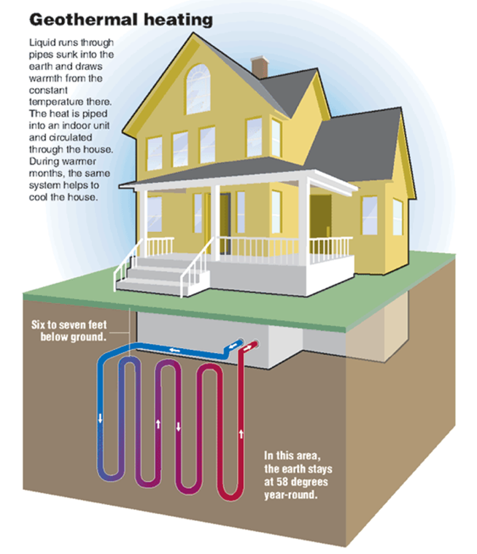
How it Works
http://gaci.biz/category/georgia-geothermal
Notes:
Geothermal can also be used for heating and cooling buildings. You dig a big hole in your yard (like you would for a swimming pool), then you put copper tubing that is all coiled up in the hole.
You then bury the copper tubing with one end connected to a special machine on your house.
The copper tubes will become the same temperature as the ground they are buried in (in this case it is about 70 degrees).
The special machine in your house can take the 70 degrees from the copper tubes and blow it into your home.

Slide 26
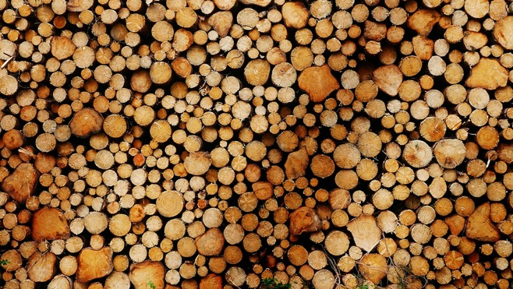
Biomass
Landfill Gas
Wood pellet manufacturing
Biomass accounts for 2% of Utah’s renewable energy portfolio.

Slide 27
Back to the Pie
Coal
Coal
Coal
6 slices are coal, 2 are natural gas.
Renewable energy accounts for just over 1 piece of pie.
Wind accounts for about 18% of that.
Solar accounts for over 50% of Utah’s renewable energy.
Hydroelectric is 20% of that portfolio.
Geothermal is 10%
Biomass is 2%
Renewables
Solar
Wind
Hydroelectric
Geothermal
Biomass
Coal
Coal
Natural Gas
Natural Gas
Coal
Coal
Notes:
Ask what source of energy do you think we should use less of? More of?
https://www.eia.gov/state/analysis.php?sid=UT#:~:text=Electricity,generation%20came%20from%20renewable%20energy.

Slide 28
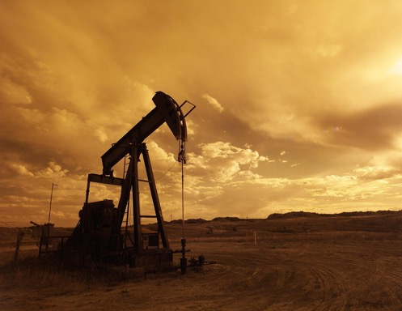
Petroleum (Oil)
Petroleum makes up the remainder of Utah’s power. Petroleum is VERY hard to clean up if it contaminates the environment.
One gallon of motor oil can contaminate 1 MILLION gallons of water.
One quart of motor oil can create an oil slick 2 acres in size.
Notes:
By-products:
Carbon dioxide, carbon monoxide, sulfur dioxide, nitrogen oxides, particulate matter, lead and various air toxins.
Nearly all of these by-products negatively impact on the environment and human health.

Slide 29
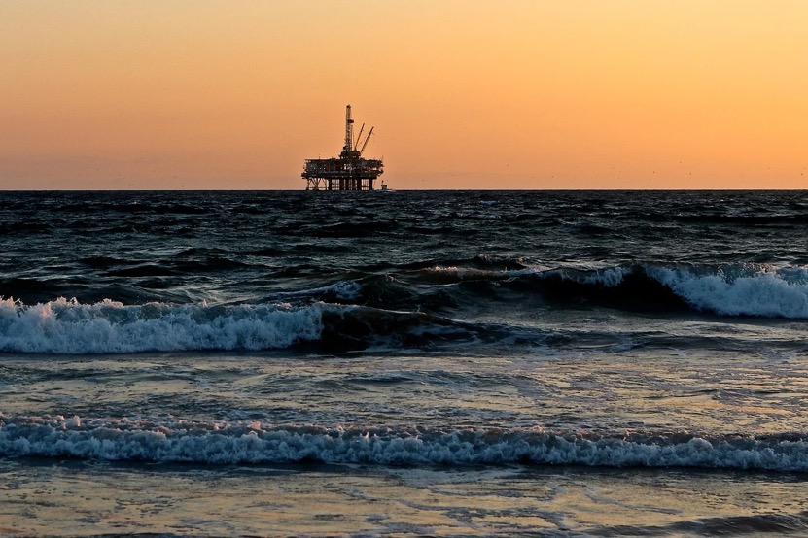
If it is so harmful, why do we use it?
Notes:
It is easy to transport.
Oil can be placed in a variety of containers, and is stable unless it is subjected to extreme heat and pressure.
It used to be abundant, but is now starting to be less so.
It is a finite resource - which means that there is only so much of it in the world. When it’s gone, it’s gone and it will take millions of years to make more. That said, there are still more than enough reserves to heat our planet to unlivable conditions.

Slide 30

Summary
There are different sources of energy.
Humans have historically used the sources that were the most easily obtained at the time of their development, including things like firewood, coal, and petroleum.
Fossil fuels aren’t very good for the environment or human health, and they are becoming more expensive than renewable electricity sources.
Renewable sources of electricity will probably become big energy sources in your lifetime.

