Slide 1
Coupon Craze
Presented by:
Darlene Christensen and Teresa Hunsaker

Slide 2
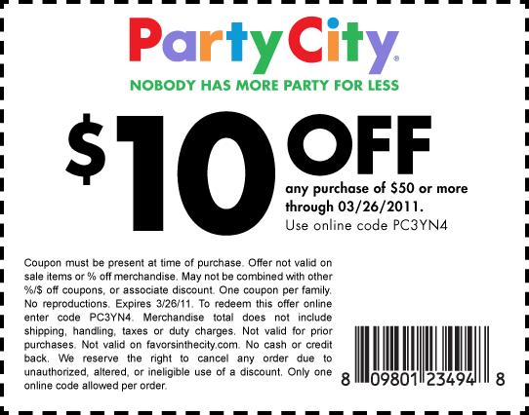
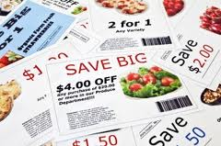
Objective
Teach consumers how to effectively use coupons, online/mobile coupons, and coupon codes to save money.
Notes:
Cash that you would have spent originally can now be saved. Are you ready for couponing; not obsessive couponing but smart, casual, routine coupon clipping and savings.

Slide 3
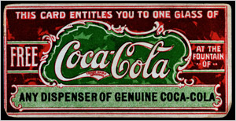
How Far Back Do Coupons Go?
1887
Notes:
Coca Cola was among the first to offer free goods. In 1887 Coca Cola started offering slips for complimentary Coke and provided the vendors with free syrup to compensate. By 1913 nearly 8,500,000 people had enjoyed a free beverage. Asa Chandler, marketing guru and Coca Cola mogul, took the French word "couper" (to cut) and officially calls what he offers “a coupon.”
Reference: Promotion Marketing Association (PMA) Educational Foundation, Inc
Photo Source: http://www.ilovecouponmonth.com/resources/history-of-coupons.htm

Slide 4
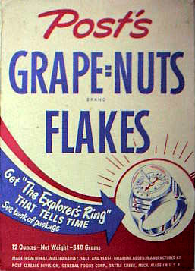
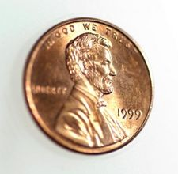
1st Grocery Coupon…
1895
Notes:
The next year, another successful businessman, C.W. Post, began to promote his new health cereal.
He offered a one cent coupon, good towards the purchase of his new product called Grape Nuts.
Reference: Promotion Marketing Association (PMA) Educational Foundation, Inc
Photo Source –
Grape Nuts box: http://blogs.static.mentalfloss.com/blogs/archives/20822.html
Penny: www.clipart.com

Slide 5
Nielson Clearing House Developed
1957
Notes:
The Nielson Coupon Clearing House was created in 1957 to sort, count and tabulate coupons to determine how much money was owed to each retailer.
Photo Source: http://artskooldamage.blogspot.com/2009/11/5-cents-8-cents-10-cents-off.html

Slide 6
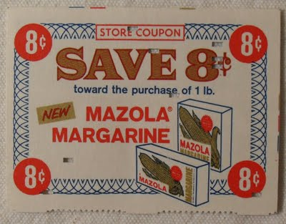
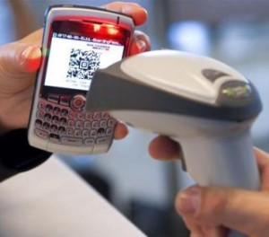
Evolution of Coupons Continues…

Slide 7
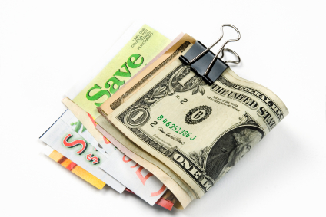
Coupons Today
Digital
OR
Print?
Notes:
Source: http://www.ilovecouponmonth.com/statistics/
Information from:
Valassis Annual Topline U.S. Consumer Packaged Goods Coupon Facts Report for 2011
NCH Marketing Services, Inc.
RedPlum eMarketer Nielsen Company
Fortune3.com
Inmar
Internet Retailer
NCH Marketing
Coupon Info Now
Photo Source: freecoupons.com

Slide 8
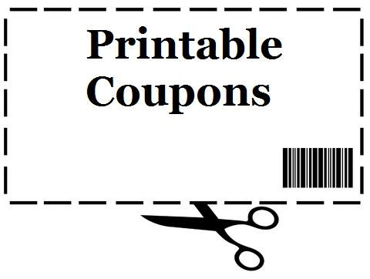
AND
95%
Notes:
Source: http://www.ilovecouponmonth.com/statistics/
Information from:
Valassis Annual Topline U.S. Consumer Packaged Goods Coupon Facts Report for 2011
NCH Marketing Services, Inc.
RedPlum eMarketer Nielsen Company
Fortune3.com
Inmar
Internet Retailer
NCH Marketing
Coupon Info Now
Photo Source: freecoupons.com

Slide 9
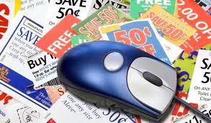
Which one do you use more?
61% Print
39% Digital

Slide 10
Who uses coupons?

Slide 11
Who Uses Income by Income?
Under $25,000 74%
$25-50,000 – 80%
$50-75,000 – 77%
$75,000 – 76%

Slide 12
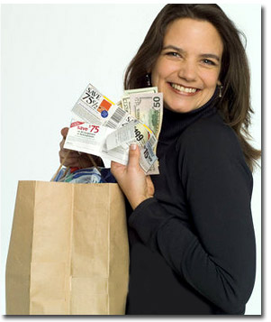
Who Uses Coupons by Age
Age 18-24 – 65% Age 25-34 – 71% Age 35-44 – 77% Age 45-54 – 80% Age 55-64 – 81% Age 65+ 80%
Notes:
Thanks partly to on-line coupons, coupons are now cool. Source: National Coupon Council

Slide 13
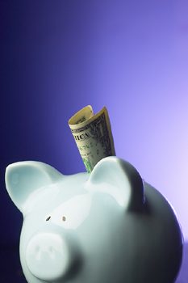
Coupon Savings Used For…
Paying debt
Long-term savings
Emergency fund
Only7% splurge!!
Notes:
Source: 2015 Vlasis Report

Slide 14
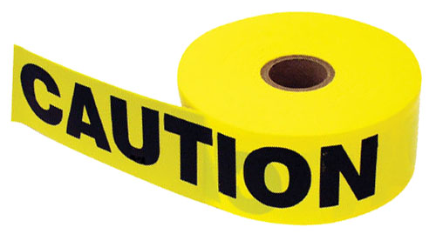
Ask Yourself:
Are you buying just because you have a coupon?
Will you use cash or credit?
Notes:
Just because you have a coupon, does not mean you should buy the item. And just because it is a good deal, does not mean you should but the item. Using a coupon on something you do not want or will not use is a waste of money no matter how cheap.
Use coupons to purchase items that you already buy and use in your normal routine or for a substitute brand if it will fulfill the same need/taste/desire. Source: Couponfinder.com
Photo Source: Savingwithshellie.com

Slide 15
Virus Protection

Slide 16
Websites…coupons and promo codes
RetailMeNot.com
Offers.com
CouponCabin.com
SmartSource.com
Coupons.com
Groupon.com
Savings.com
Krazycouponlady.com

Slide 17
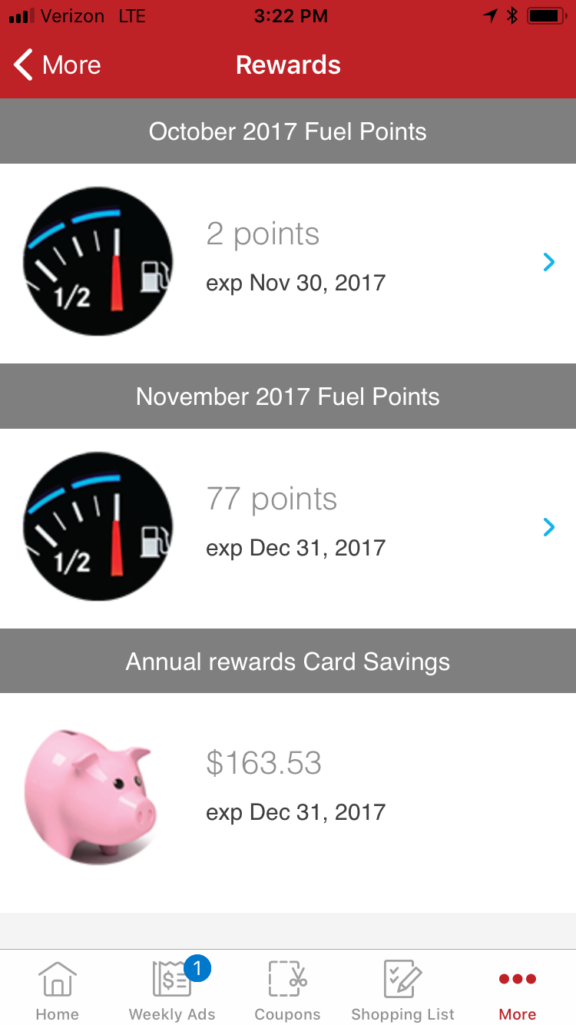
Apps
There IS an app for that…
Travel/lodging
Food
Store loyalty
Coupon
Free Wifi location

Slide 18
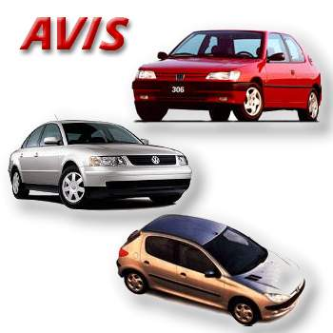
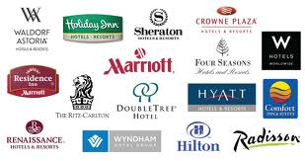
Travel
Value points
Coupon codes
Discount travel websites

Slide 19
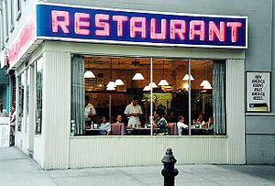
Eating Out
Papa Johns
McDonalds
Panera Bread
Chili's
TGI Fridays
Wendy’s
Taco Bell
Applebee’s
Panda Express
Einstein Bagels
Chick-fil-a
Olive Garden
Jimmy Johns
Sonic
Chipotle
Subway

Slide 20
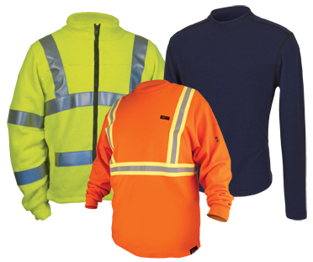
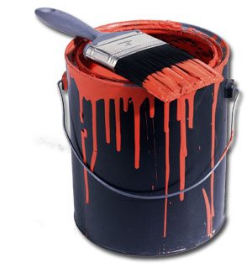
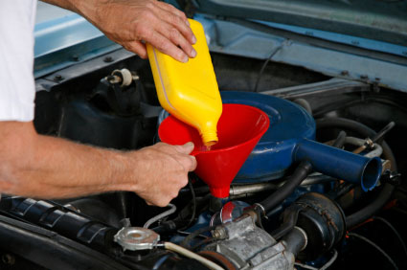
Other Categories for Savings
This is when coupon codes are really helpful

Slide 21
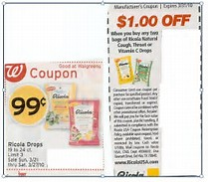
Coupon Stacking
Not the same as double couponing.
The way we layer coupons, rebates, sales and promotions to maximize our savings.
Stacking could mean using a store coupon with a manufacturer coupon on one item.
Or, it could mean submitting a rebate on a rollback price.

Slide 22
Stacking Continued…
In the offline world, “stacking” commonly means “using one store coupon with one manufacturer coupon together for greater savings” (often used in addition to “sale” items).
In the online world…essentially means you can use more than one coupon or coupon code per order.
The mechanics of stacking coupon codes online is simple. When you go to your online cart to check out, there will be a blank box with a prompt that states something like "enter coupon/promo/discount code here."

Slide 23
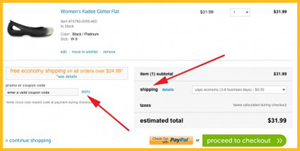
Stacking Promo Codes
For stackable online codes, in most cases (except where specifically instructed otherwise) you will enter each code one at a time, pressing "enter" after each to adjust your total balance to reflect all coupon codes.
You can double-check your work by looking at your online invoice before you pay—you should see all coupon codes reflected above your final amount owed. If one of your codes is for free shipping, then also check the "shipping" line to be sure the amount is zero

Slide 24
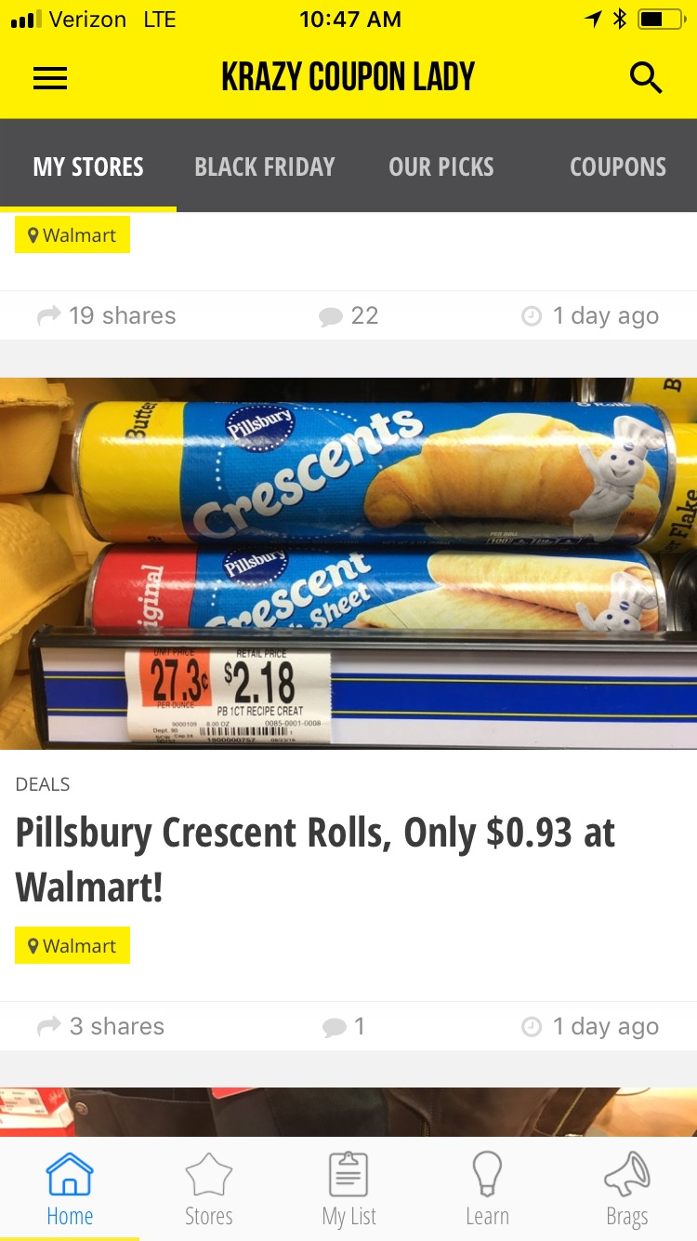
Krazy Coupon Lady
Here’s an example:
Buy 1 Pillsbury Crescent Rolls (or Grands) at @$2.18, regular price.
Use one $.50/1 printable or online coupon. Price is now $1.68
Submit one $.75 rebate via Ibotta rebate app
Final Price, $.93
Notes:
Source:

Slide 25
Another Local Example
Tillamook Ice Cream…
Stack a store coupon and a manufacturer coupon to score Tillamook ice cream for just $1.99
Regularly, this ice cream sells for $5.99+ per carton.

Slide 26
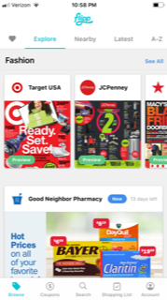
Flipp
Choose your category
Choose your stores

Slide 27
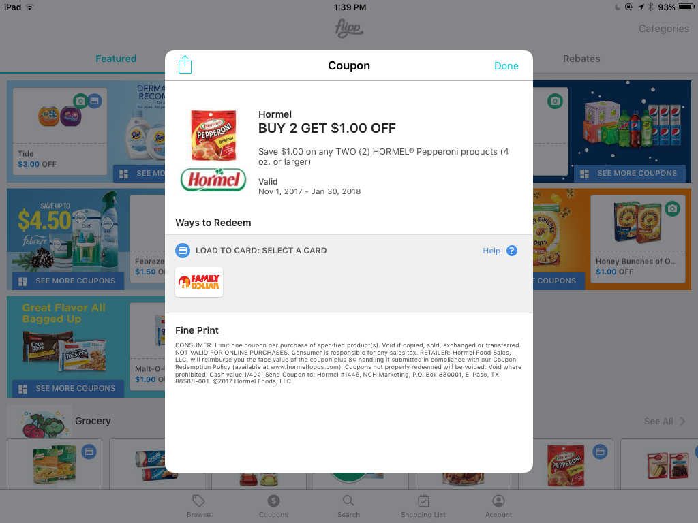
Flipp Grocery

Slide 28
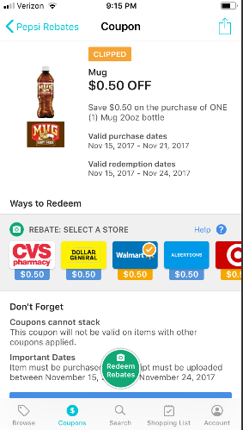
Flipp App

Slide 29
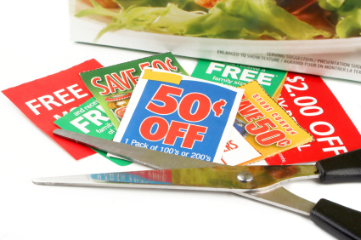
Questions?

