Slide 1
Utah’s SNAP-Ed Program

Slide 2
ABOUT US
SNAP
CREATE BETTER HEALTH (SNAP-ED)
Supplemental Nutrition Assistance Program
A person who qualifies for SNAP, also qualifies for Create Better Health (SNAP-Ed) education.
Supplemental Nutrition Assistance Program – Education
Free educational classes focused on increasing food security and helping participants make healthy food choices and be physically active on a limited budget.
Notes:
Explain SNAP and SNAP-Ed, include the following talking points:
Create Better Health is a Utah-specific term.
Create Better Health is a partnership of USU Nutrition, Dietetics and Food Science Department, USU Cooperative Extension Services, Utah Department of Workforce Services and other collaborating agencies including Utah’s State Nutrition Action Coalition.
Utah's SNAP-Ed mission: “We work with partners to provide food and nutrition education to people in need in a way that inspires public confidence and supports American agriculture.”

Slide 3
GOALS & FOCUS
Provide nutrition education to those eligible.
Work with partners to help create communities in which participants can act on the education they receive.
Notes:
FOCUS:
Provide strategies and interventions along with other health promotion efforts, to help the SNAP-Ed target audience establish healthy eating habits and a physically active lifestyle.
Teach the SNAP-Ed target audience of the risk factors for nutrition-related chronic disease, such as obesity, to help prevent and postpone the onset of disease by establishing healthier eating habits and being more physically active.
GOALS:
Improve the likelihood that persons eligible for SNAP will make healthy food choices within a limited budget and choose physically active lifestyles consistent with the current Dietary Guidelines for Americans and the USDA Food Guidance.
As a result of Utah’s Policy, Systems and Environment (PSE) work, SNAP target audiences will have improved access to nutrition food and physical activity opportunities in their communities.

Slide 4
WHERE IS CREATE BETTER HEALTH
Create Better Health programming is available in all 29 counties in Utah.
Notes:
Through In-person and Online Education, Community Partnerships, Food Pantry and other Policy, Systems and Environment work and efforts with Social Marketing: Create Better Health can be found in all 29 counties in Utah!

Slide 5
COMPREHENSIVE PROGRAMMING
Multiple approaches include:
Individual, group and family nutrition education and physical activity promotion, in addition to related interventions.
Comprehensive, multi-level interventions in environmental settings.
Community and public health approaches that reach a large segment of the population.
Notes:
Over the years, SNAP-Ed has morphed from a simple nutrition education program into a comprehensive program reaching low-income populations through multiple ways. In Utah, we have provided many innovative practices to meet the guidance given by Food and Nutrition services. Create Better Health programming is divided into areas of five main focuses. These areas include Policy, Systems and Environment work, Direct Education both to Adults and Youth, Indirect Education, Social Media efforts and Social Marketing.

Slide 6
POLICY, SYSTEMS & ENVIRONMENT
Make the healthy choice, the easy choice.
Notes:
Adopting healthy behaviors can be challenging. For example, if you are trying to follow MyPlate recommendations, but do not have access to whole grains or vegetables, you won’t be able to do it. Policy, system and environment work is designed to help change factors that make it hard for SNAP-Ed participants to adopt the healthy changes they learn in Create Better Health classes. Our program primarily focuses on improving factors in food pantries, retail stores, and schools. Whether it is helping with a healthy food drive to increase access to healthy choices, using marketing strategies to nudge customers to choosing healthy items, or helping a school make a Smarter Lunchroom that encourages children to eat well, Create Better Health is ready to create healthy choices for SNAP-Ed participants.

Slide 7
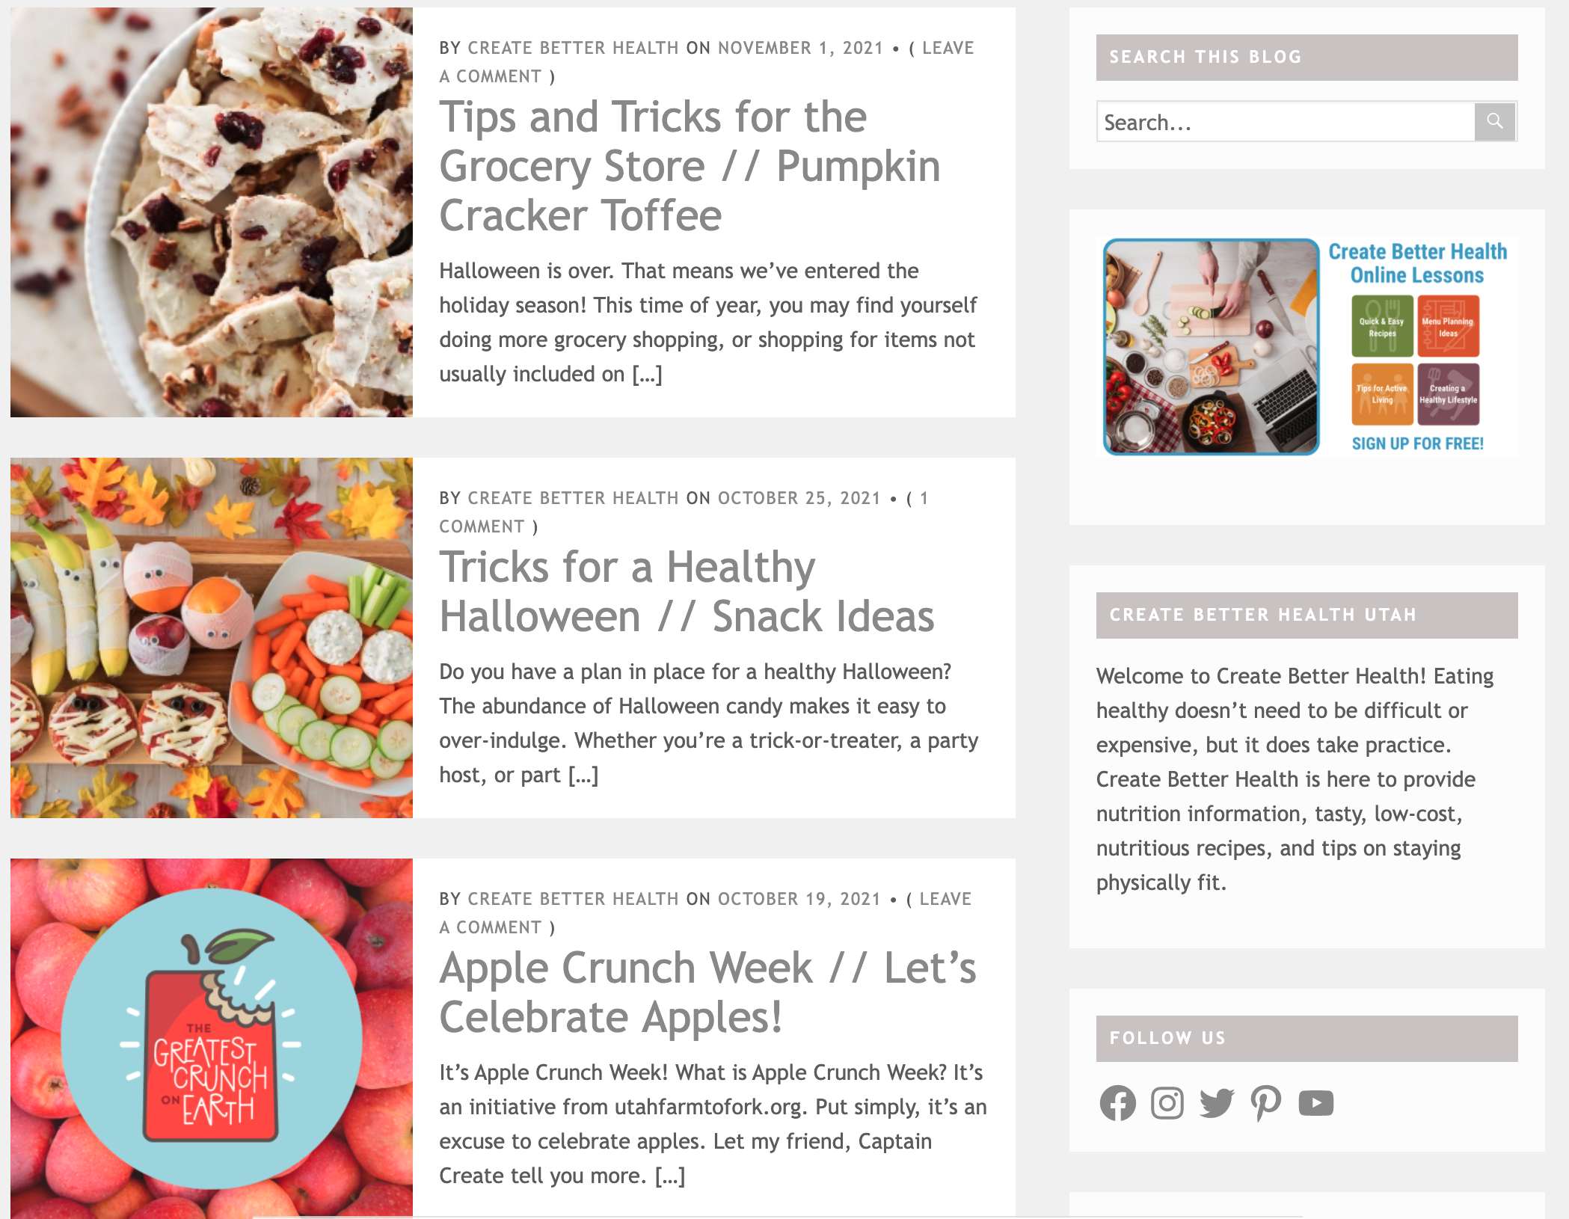
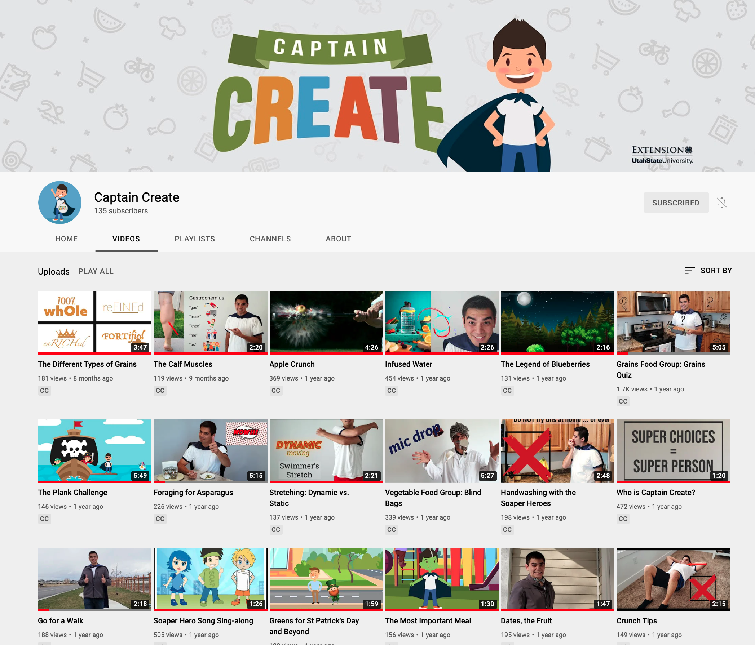
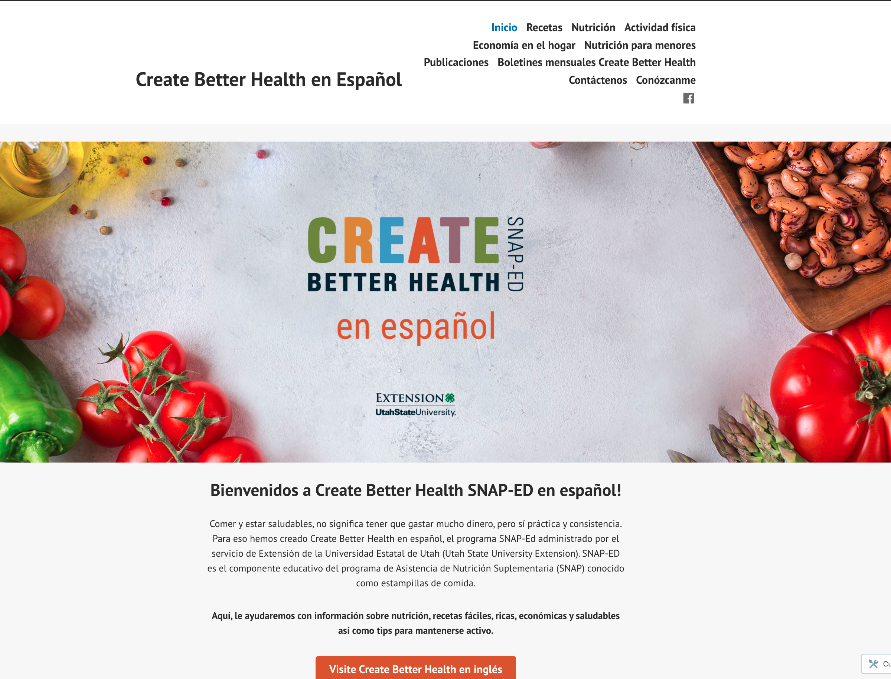
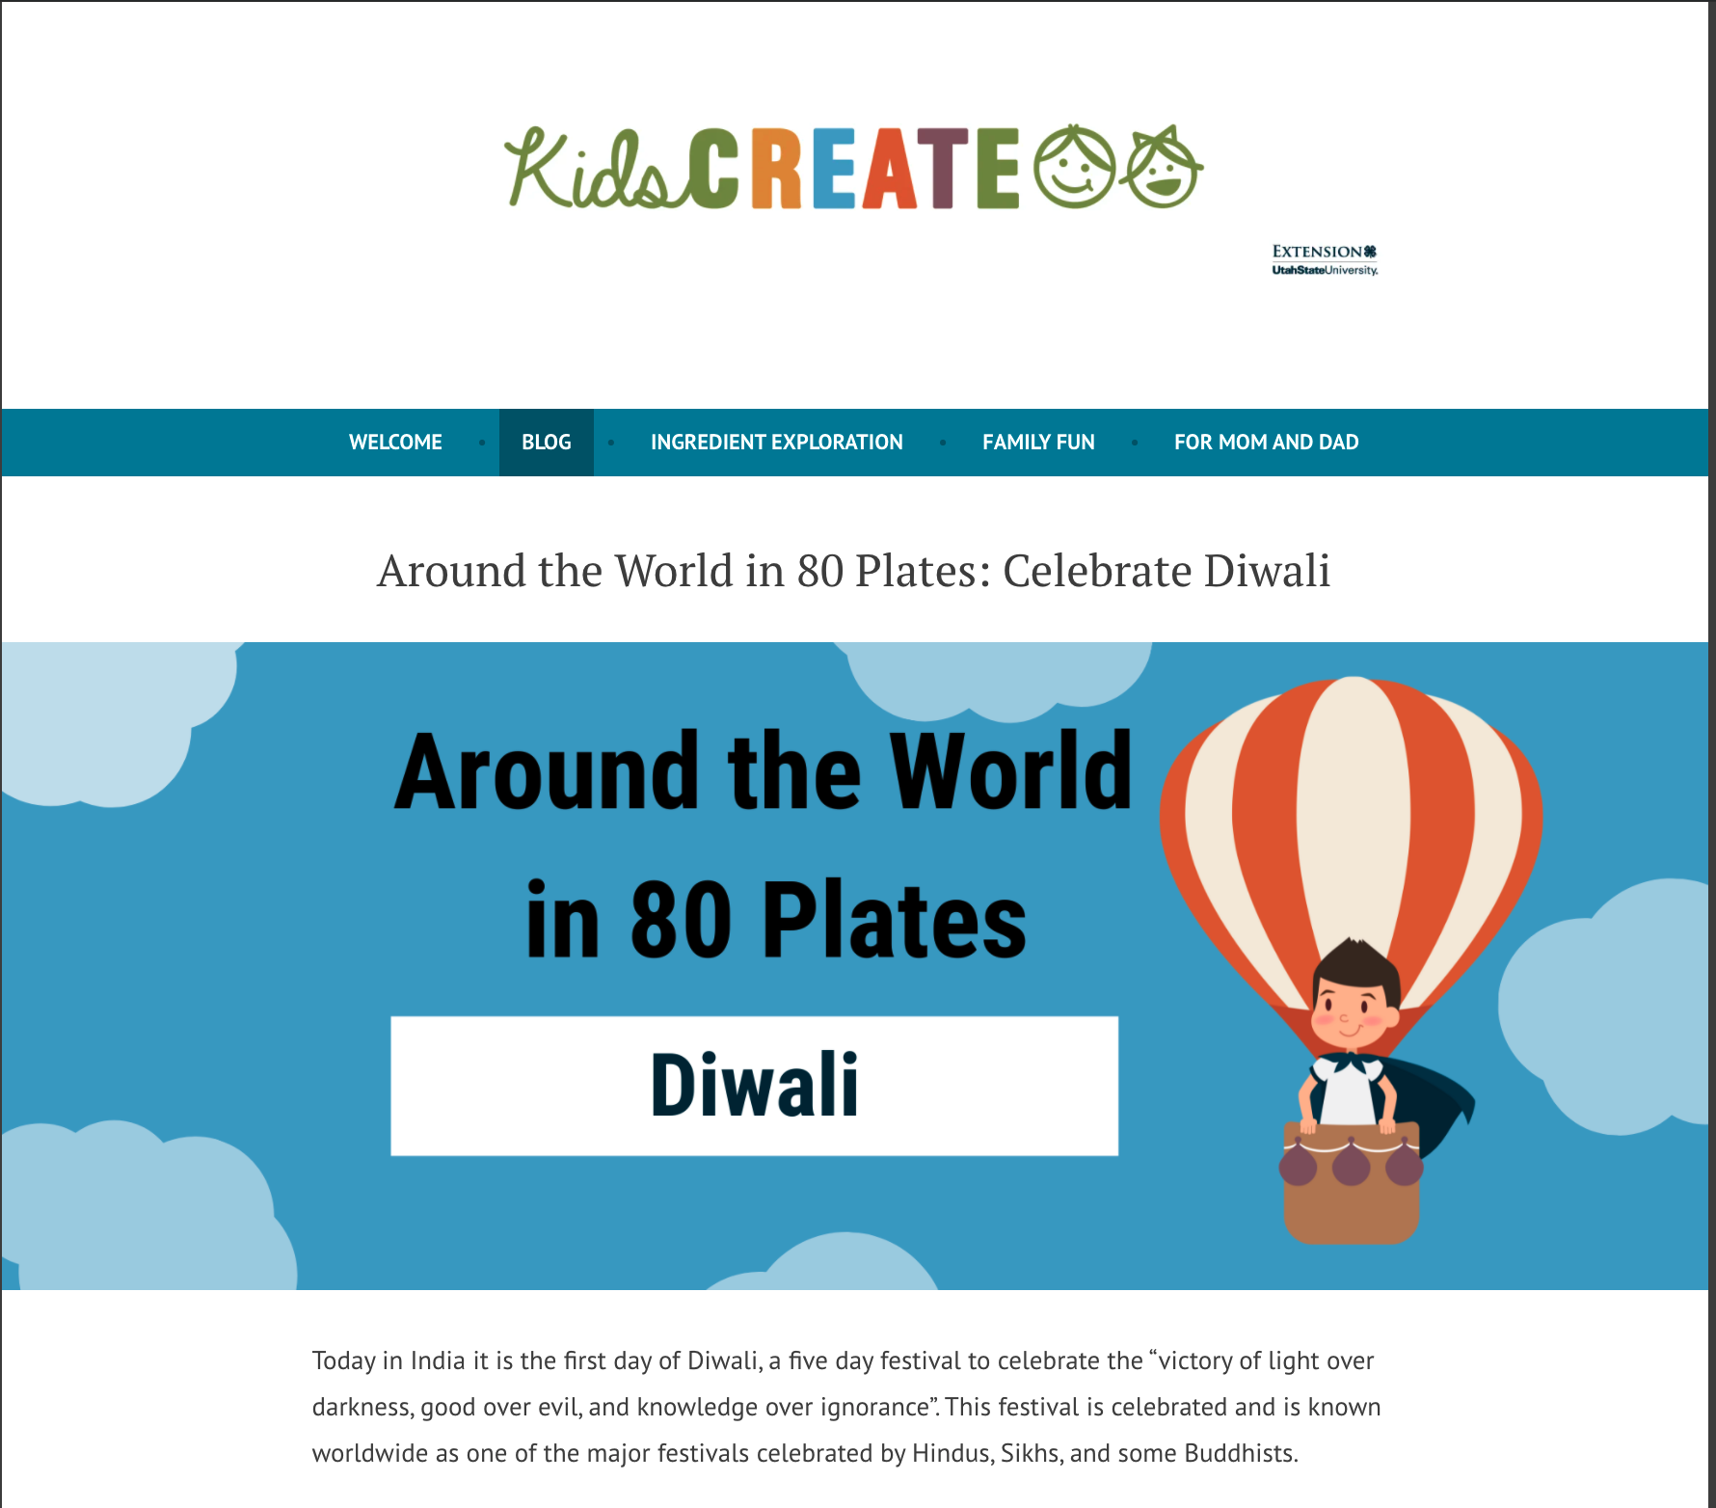
SOCIAL MEDIA
Notes:
The Create Better Health social media program is a vibrant and active part of Utah SNAP-Ed. Education and encouragement are shared across all platforms, including: YouTube, Facebook, Instagram, Pinterest, Twitter, blogs, and websites. There are more than 30 Create Better Health County Facebook pages; some counties host both English and Spanish pages. The social media pages share recipes, nutrition information, and physical activity tips. They also promote local face-to-face classes and ongoing PSE efforts. County pages are a place where ambassadors can teach Facebook Live classes and inform people of upcoming virtual classes. Local efforts to fight food insecurity are posted on these pages.

Slide 8
INDIRECT EDUCATION
Notes:
Various indirect activities increase awareness and recognition of the Create Better Health Utah program. You may find our ambassadors at a weekly farmers’ market, an employee wellness faIr, back to school nights or distributing brochures to different locations throughout the state.

Slide 9
NEWSLETTERS
Notes:
Create Better Health also sends a monthly newsletter to SNAP recipients and SNAP-Ed participants. This newsletter shares SNAP-Ed concepts and promotes healthy lifestyle choices. The monthly letter is specific to each county so it announces local farmers markets accepting SNAP EBT cards, healthy seasonal recipes, physical activity tips, and upcoming Create Better Health classes (live or virtual). Many county ambassadors choose to send an even more personal newsletter to their local class participants. These newsletters often contain information related to recent classes or events.

Slide 10
SOCIAL MARKETING
Healthy Choices Create Better Health
“Your Choice, Your Move”
Notes:
Social marketing uses marketing strategies to influence behavior change that is good for a person or society. At Create Better Health, we have designed the Healthy Choices Create Better Health campaign to remind people that each healthy choice they make is helping them achieve better health. Our current campaign focuses on physical activity with the tagline: “Your Choice, Your Move.” It encourages adults to take small steps to improving their physical activity level, finding ways to naturally add activity to their busy day, and involving others, like a workout buddy, for support and motivation. The campaign has two challenge components. One is a small scale, 4-week challenge that is provided to class participants. The second is a community-wide challenge that requires support from community partners. We have found that many people enjoy taking on a challenge and earning points as they make healthy choices.

Slide 11
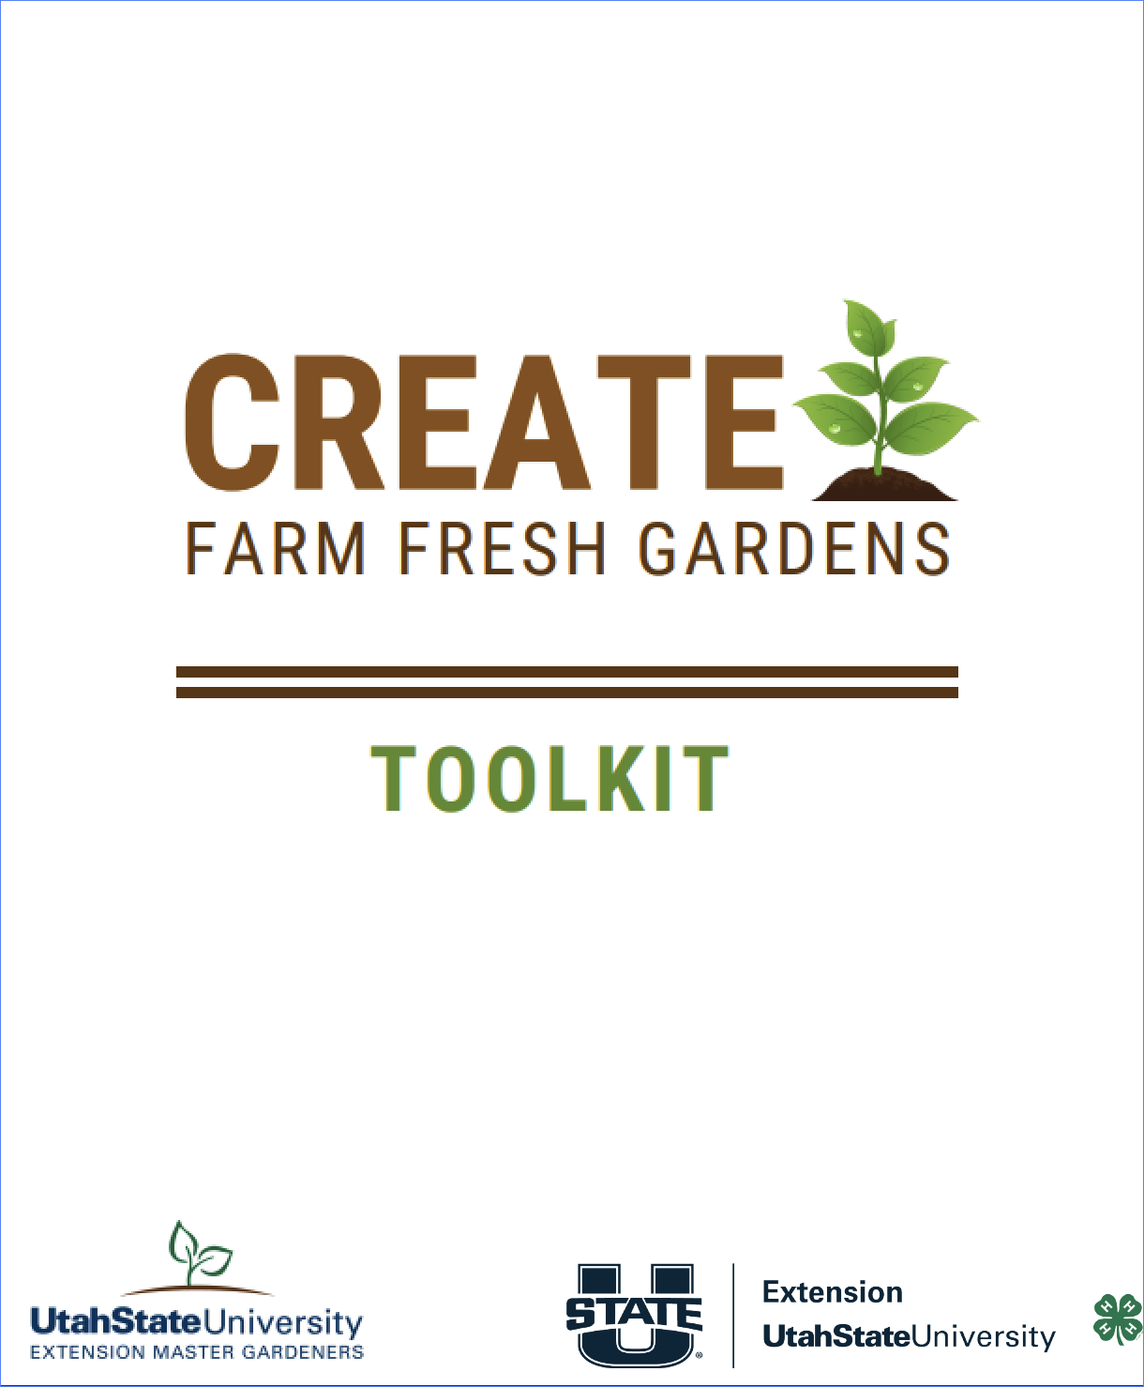
DIRECT EDUCATION
Notes:
1. The Create Better Health series teaches lessons from the USDA dietary guidelines and the Physical Activity Guidelines for Americans. The unique Creates concepts teach participants how to utilize the food they have on hand to prepare tasty and nutritious meals. Lessons share tips about budgeting money for food to last all month and recipe demonstrations that showcase how to navigate the kitchen. Create Better Health lessons are available in both English and Spanish.
2. Create Family Meals brings families together for a fun and engaging class about the importance of healthy eating and physical activity. By working together families learn that mealtime is family time and everyone has a part to play. Create Family Meals classes are available in both English and Spanish
3. Other lessons for adults include Create Farm Fresh where utilizing the summer harvest is the focus. They also include learning to shop at local Farmer’s markets and utilizing SNAP benefits at the market to increase the intake of fruits and vegetables. The Create Farm Fresh Gardens classes encourage food security by teaching garden and harvest basics in a community garden setting.

Slide 12
YOUTH
Notes:
Captain Create is the star of our youth programming. The Captain Create MyPlate lessons teach about the MyPlate food groups. Captain Create encourages them to try new foods and experiment in the kitchen. His promotion of an active lifestyle inspires kids to get out and play.
For kids ages 3-8 the Food, Fun, and Reading lessons combine the joy of storytelling with nutrition education. This younger group of children learn about the MyPlate food groups, get moving with some fun games, and enjoy a creative snack.

Slide 13
CONNECT WITH US
Contact Information Here

