Slide 1
Name of Region Here
SNAP-Ed
2018
Nutrition Education
Success and
Impact Report

Slide 2
Table of Contents

Slide 3
1
3
3
7
11
15
19
23
27
31
35
39
43
Executive Summary
Reports
Regional
State Name
State Name
State Name
State Name
State Name
State Name
State Name
State Name
State Name
State Name

Slide 4
Executive Summary
The Supplemental Nutrition Assistance Program (SNAP) is essential to improving the health and nutrition among low-income individuals. During Fiscal Year 2017, over 42 million people living in nearly 21 million households received SNAP in the United States. Within the Mountain Plains Region, 2.5 million people living in 1.2 million households received SNAP. The Supplemental Nutrition Assistance Program Education (SNAP-Ed) not only supports SNAP’s role in addressing food insecurity, but also works to improve nutrition and prevent or reduce diet-related chronic disease and obesity among SNAP recipients and other eligible low-income individuals. For Fiscal Year 2017, The Mountain Plains Region allocated over 26 million dollars to state agencies administrating SNAP to deliver nutrition education and obesity prevention services.
According to the Centers for Disease Control and Prevention (CDC), more than one-third of U.S. adults are obese. Obesity is one of the leading health concerns of our nation due to the increased risk of chronic diseases and associated health care costs. The CDC also states obesity accounts for $147-$216 billion in healthcare costs annually and doesn’t include lost productivity.
1

Slide 5
The SNAP-Ed program delivers evidence-based nutrition education and obesity prevention interventions through a combination of educational strategies coupled with policy, system, and environmental (PSE) interventions to promote healthy eating and active lifestyles.
Through collaborative efforts with federal, state, and local partners, SNAP-Ed has demonstrated success by delivering evidence-based programs to individuals, groups, and families; improving healthy eating and physical activity choices by implementing multi-level changes within the environment where we eat, learn, live, play, shop, and work; and supporting community and public health approaches by connecting with other sectors of influence. The following report provides an overview of the impact each state has in the region, including reach, partnerships, coalitions, and program activities. Success stories are also highlighted, illustrating the positive changes as a result of the SNAP-Ed program.
2

Slide 6
Region Name Here SNAP-Ed Works
{REGION NAME HERE} SNAP-ED CHALLENGE
Text Here…
Setting Examples and icons.
Drag icons onto template.
Regional Obesity Rates
Regional Chronic Disease Rates
National Cost
Adults
Youth
?% Coronary Heart Disease
$147-216 billion
spent nationally on obesity
and chronic diseases a year.
?%
?%
?% Cancer
?% Diabetes
Grocery Stores
Places of Worship
Schools
{REGION NAME HERE} SOLUTIONS PROVIDED BY SNAP-ED
Text Here…
Food Pantries
Group Classes
Farmers Markets
Individual
Settings
Top Education Focuses
Adults
Text Here…
Text Here…
Text Here…
Youth
Text Here…
Text Here…
Text Here…
Text Here…
Early Childhood Education
Meal Sites
Health Clinics
Setting Here
Setting Here
?% Youth Participants
?% Adult Participants
Setting Here
Setting Here
Job Training Programs
Foundations/
nonprofits
Public Housing
Community
Text Here…
Setting Here
Setting Here
Community Organizations
Gardens
Human Services
Text here…
Top PSE Strategies
Government Programs
3

Slide 7
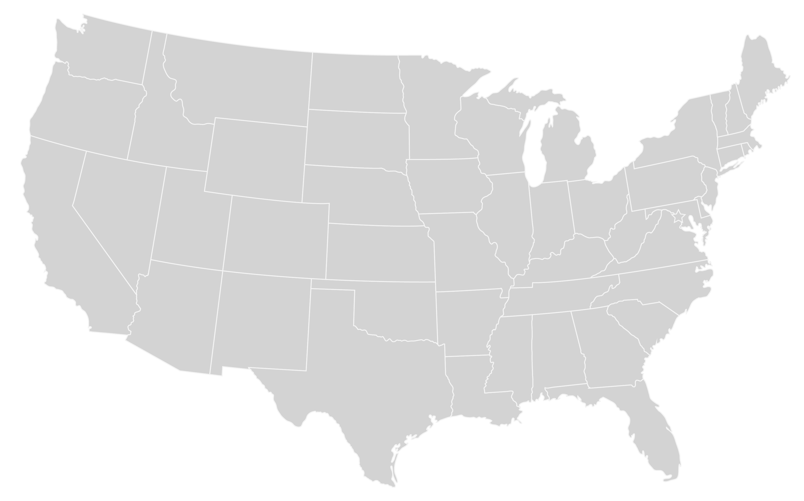
{State Name}
Text here…
{State Name}
Text here…
{State Name}
Text here…
{State Name}
Text here…
{State Name}
Text here…
{State Name}
Text here…
{State Name}
Text here…
{State Name}
Text here…
{State Name}
Text here…
{State Name}
Text here…
4

Slide 8
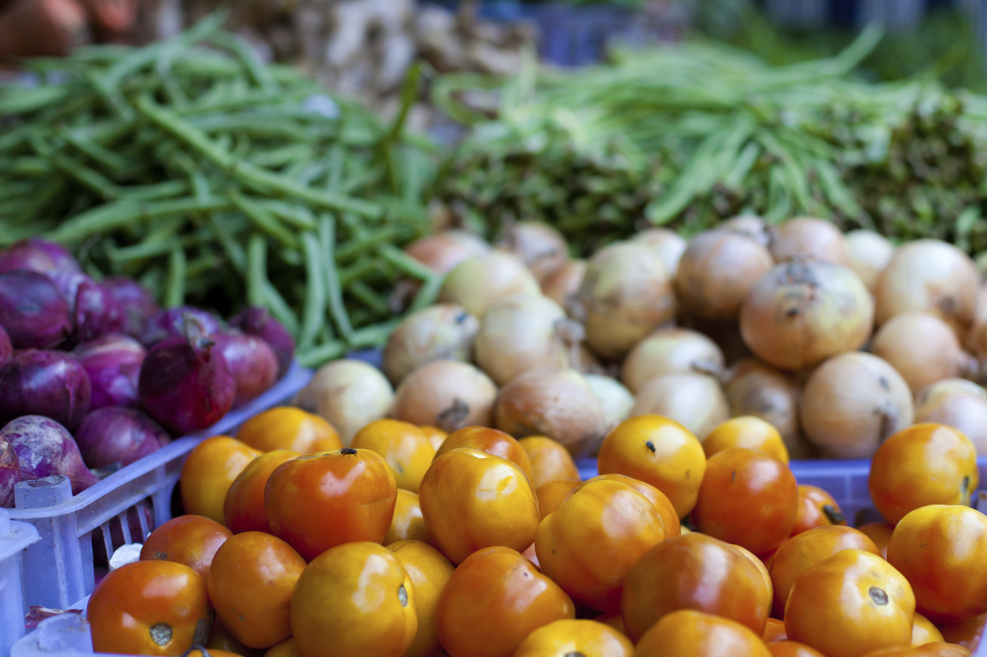
Regional SNAC Highlights
Text here…
5

Slide 9
Comprehensive Programming
Text here…
6

Slide 10
Insert state logo here
SNAP-Ed Works
{STATE} SNAP-ED CHALLENGE
Text Here…
Setting Examples and icons.
Drag icons onto template.
{State} Obesity Rates
{State} Chronic Disease Rates
National Cost
Adults
Youth
?% Coronary Heart Disease
$147-216 billion
spent nationally on obesity
and chronic diseases a year.
?%
?%
?% Cancer
?% Diabetes
Grocery Stores
Places of Worship
Schools
{STATE} SOLUTIONS PROVIDED BY SNAP-ED
Text Here…
Food Pantries
Group Classes
Farmers Markets
Individual
Settings
Top Education Focuses
Adults
Text Here…
Text Here…
Text Here…
Youth
Text Here…
Text Here…
Text Here…
Text Here…
Early Childhood Education
Meal Sites
Health Clinics
Setting Here
Setting Here
?% Youth Participants
?% Adult Participants
Setting Here
Setting Here
Job Training Programs
Foundations/
nonprofits
Public Housing
Community
Text Here…
Setting Here
Setting Here
Community Organizations
Gardens
Human Services
Text here…
Top PSE Strategies
Government Programs
3

Slide 11
{STATE} SNAP-ED RESULTS
Success Stories
Text here…
Highlights
Text here…
Map of state including counties here
{STATE} IMPACT DATA
86%
86%
86%
86%
86%
Statistic here
Statistic here
Statistic here
Statistic here
Statistic here
TOP PARTNERSHIPS
Text Here..
Text Here..
Text Here..
Text Here..
Text Here..
TOP COALITIONS
Text Here..
Text Here..
Text Here..
Text Here..
Text Here..

Slide 12
Use photos relating to the State SNAP-Ed Programs
{State Name} Success Stories
Text here…
5

Slide 13
Use photos relating to the State SNAP-Ed Programs
SNAC Highlights
Text here…
6

