Slide 1
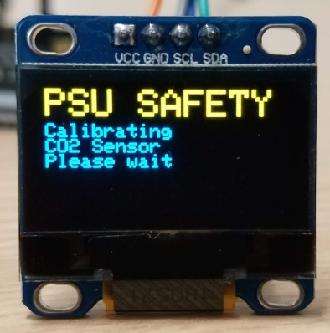
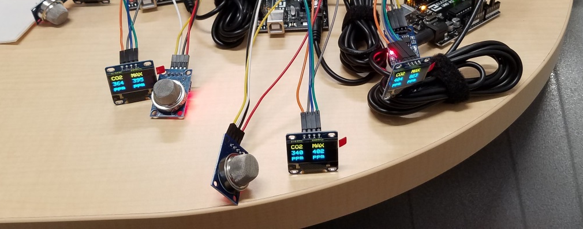
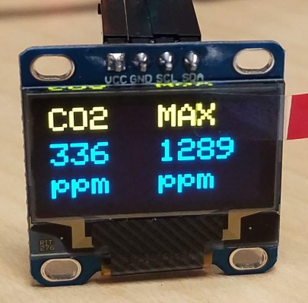


Ag Safety Arduino CO₂ Sensor Workshop
Gas Monitor STEM Activity for Agriculture
D. Hofstetter and M. Pate, 2019

Slide 2
What gases are in the air we breathe?
Oxygen 21%
Nitrogen 78%
Argon < 1%
Trace gases: carbon dioxide, methane, helium, hydrogen, ozone, and others!
Can you see or smell these?
Notes:
Most gases in the air we breathe do not have properties that allow you to detect their presence simply by sight or smell. That includes oxygen, nitrogen, and argon, which make up the largest fraction of gases in air, with trace amounts of carbon dioxide, methane, helium, hydrogen, ozone, and many others. Can you see or smell these in the air right now?

Slide 3


Gas hazards on farms
Digesters
Manure
storages
Silos
Barns above
manure pits
Notes:
Some of these gases, in varying levels of concentrations, can be found in agricultural confined spaces such as barns,manure pits, silos, and digesters.

Slide 4
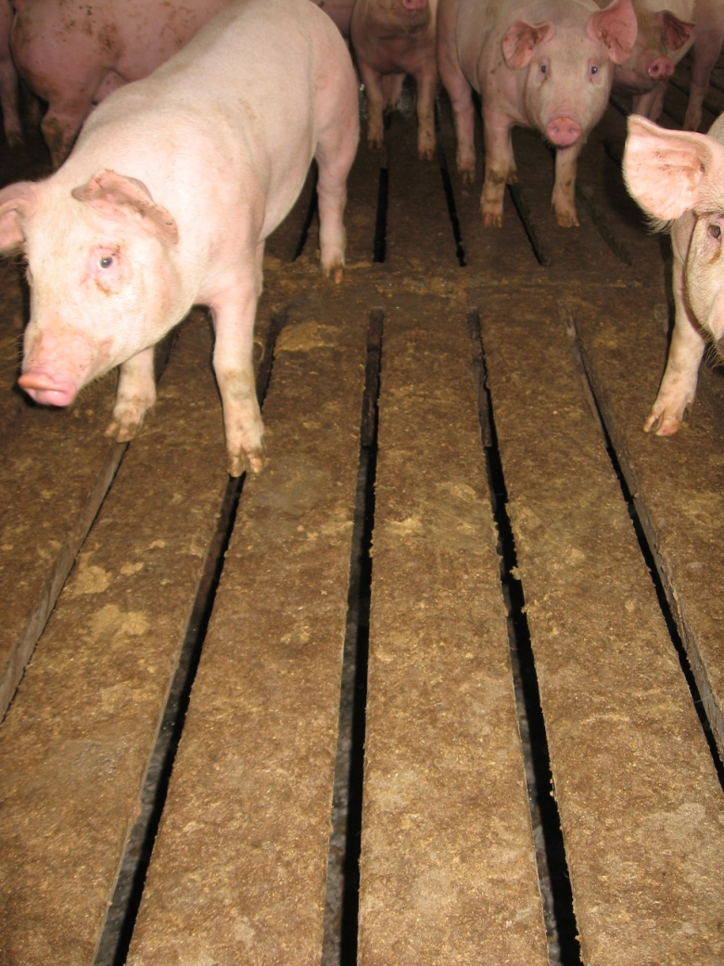
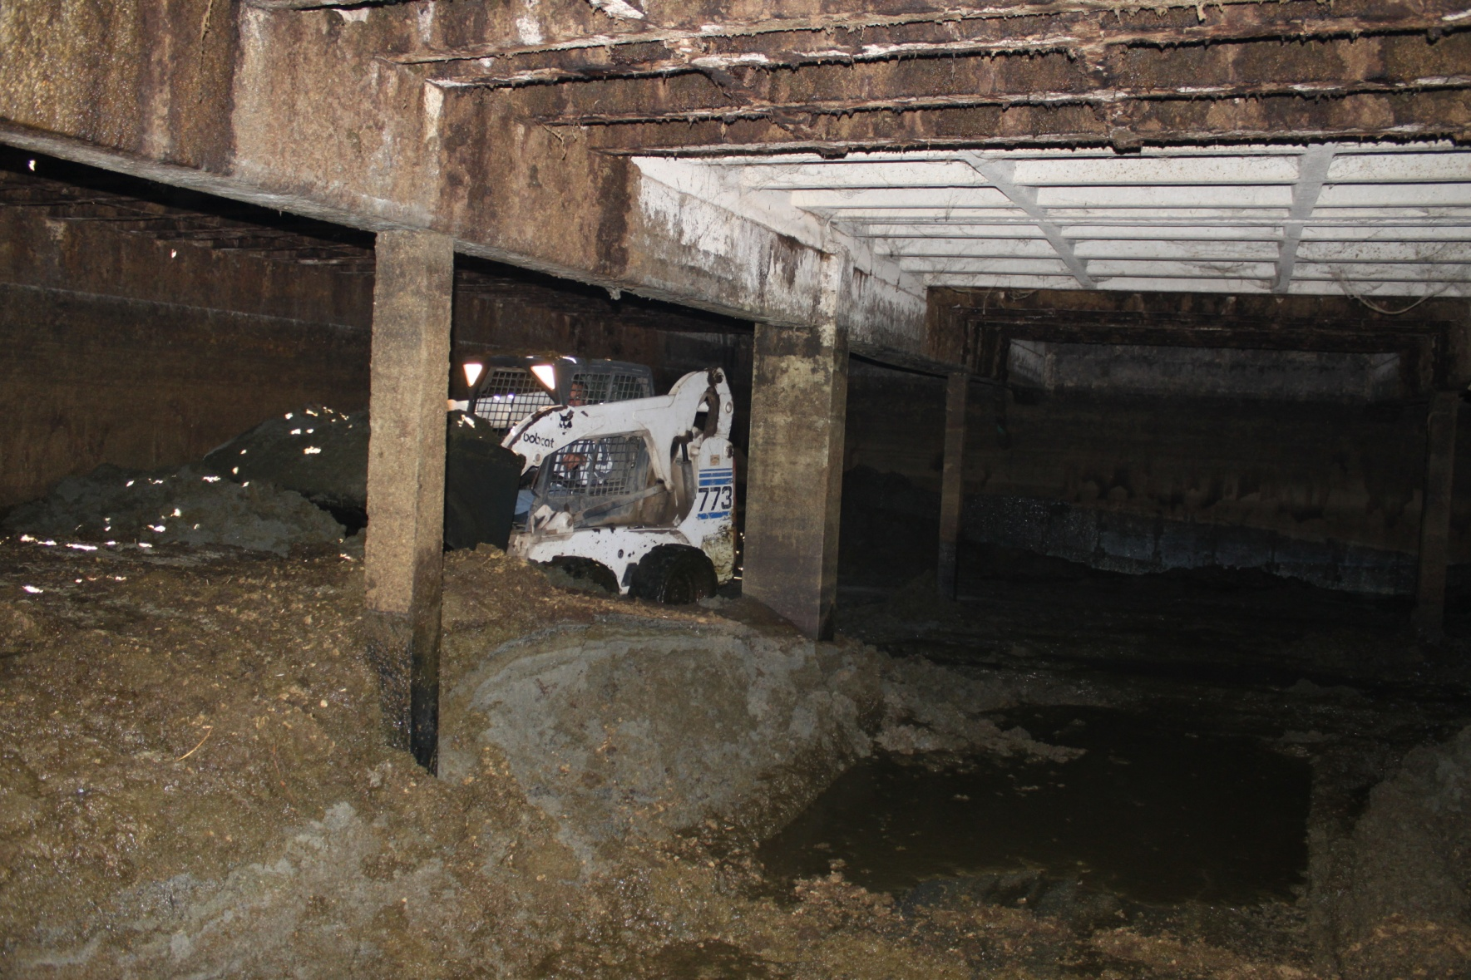
Gas hazards to animals and humans
Workers cleaning out manure pits
Animals living in barns
above manure pits
Notes:
Human workers occasionally must enter manure pits or silos for equipment maintenance. Ventilation and gas detection is important to keep human workers safe, but it is also an important aspect of agriculture for animals raised for food that live indoors in environmentally controlled barns. In addition to being hazardous to humans, high levels of ammonia gas can negatively affect the health and welfare of poultry, swine, and other animals raised indoors. And gases such as hydrogen sulfide that are toxic to humans are also toxic to animals.

Slide 5
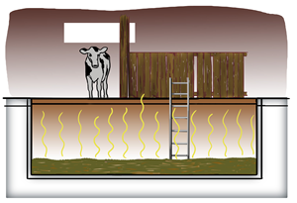
Hazards in Barns above Confined-Space Manure Storages
Toxic and asphyxiating gases
Hydrogen Sulfide
Carbon Dioxide
Ammonia
2. Oxygen deficient atmosphere
3. Explosive gases
Methane
Activity
focus
How do we detect gases if we can’t see or smell them?
Notes:
Hazardous gases *may be present in barns located above manure pits such as *hydrogen sulfide, *carbon dioxide, and *ammonia. This can create an *oxygen deficient atmosphere due to those gases displacing oxygen from the air. *There may also be explosive gases present such as *methane. *Today’s learning activity will focus on carbon dioxide since it is safe at concentrations found in typical indoor air. So, how do we detect gases if we can’t see or smell them?

Slide 6
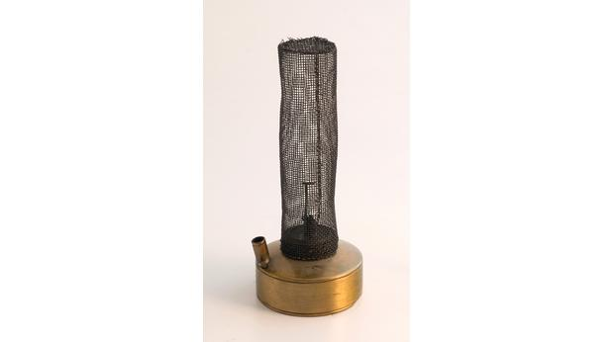
1800s Miner’s Lamp
http://www.bbc.co.uk/ahistoryoftheworld/objects/g2qOTFtvQkGU35dJ_9QH8w
Notes:
Many mechanical methods exist to detect toxic gases and hazardous atmospheres at worksites. Davy lamps were used in the early 1800s to detect flammable gases and low oxygen levels in coal mines. The lamp flame would burn higher in the presence of flammable gases or would be extinguished if the oxygen level became dangerously low. The lamps used a fine mesh screen around an oil lamp wick. This wire mesh served as a flashback arrestor by preventing explosions since the flame was not able to propagate into the work area.

Slide 7
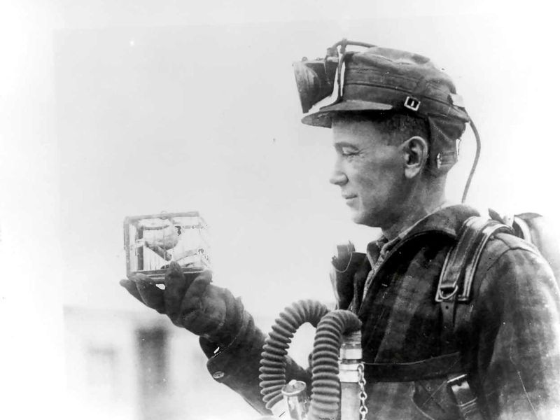
1900s Canary in the Coal Mine
https://www.smithsonianmag.com/smart-news/story-real-canary-coal-mine-180961570/
Notes:
Another early method of detecting toxic gases included the use of Canaries. Canaries were used in the early 1900s in coal mines to detect toxic gases, because the birds would experience distress or die before gas levels were high enough to hurt human workers.

Slide 8
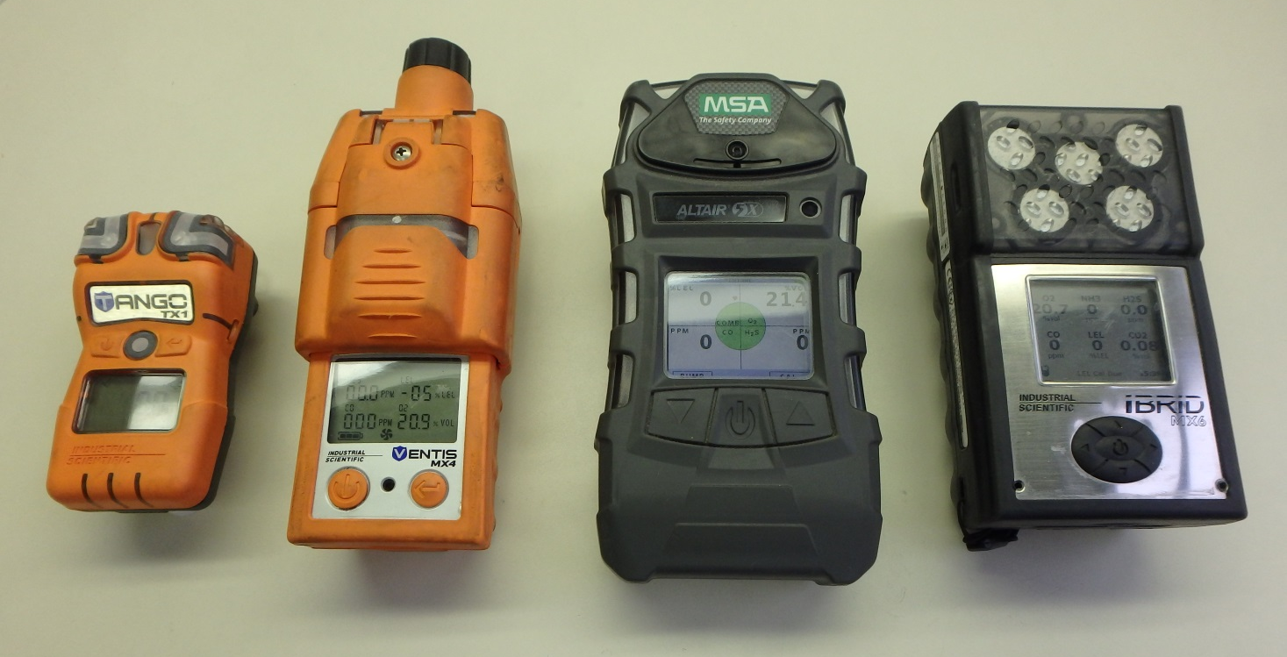
Today Portable Gas Detectors
Notes:
Today, there is a wide range of gas detection technology to measure and monitor gas concentration in real time such as the personal handheld gas monitors shown here.

Slide 9
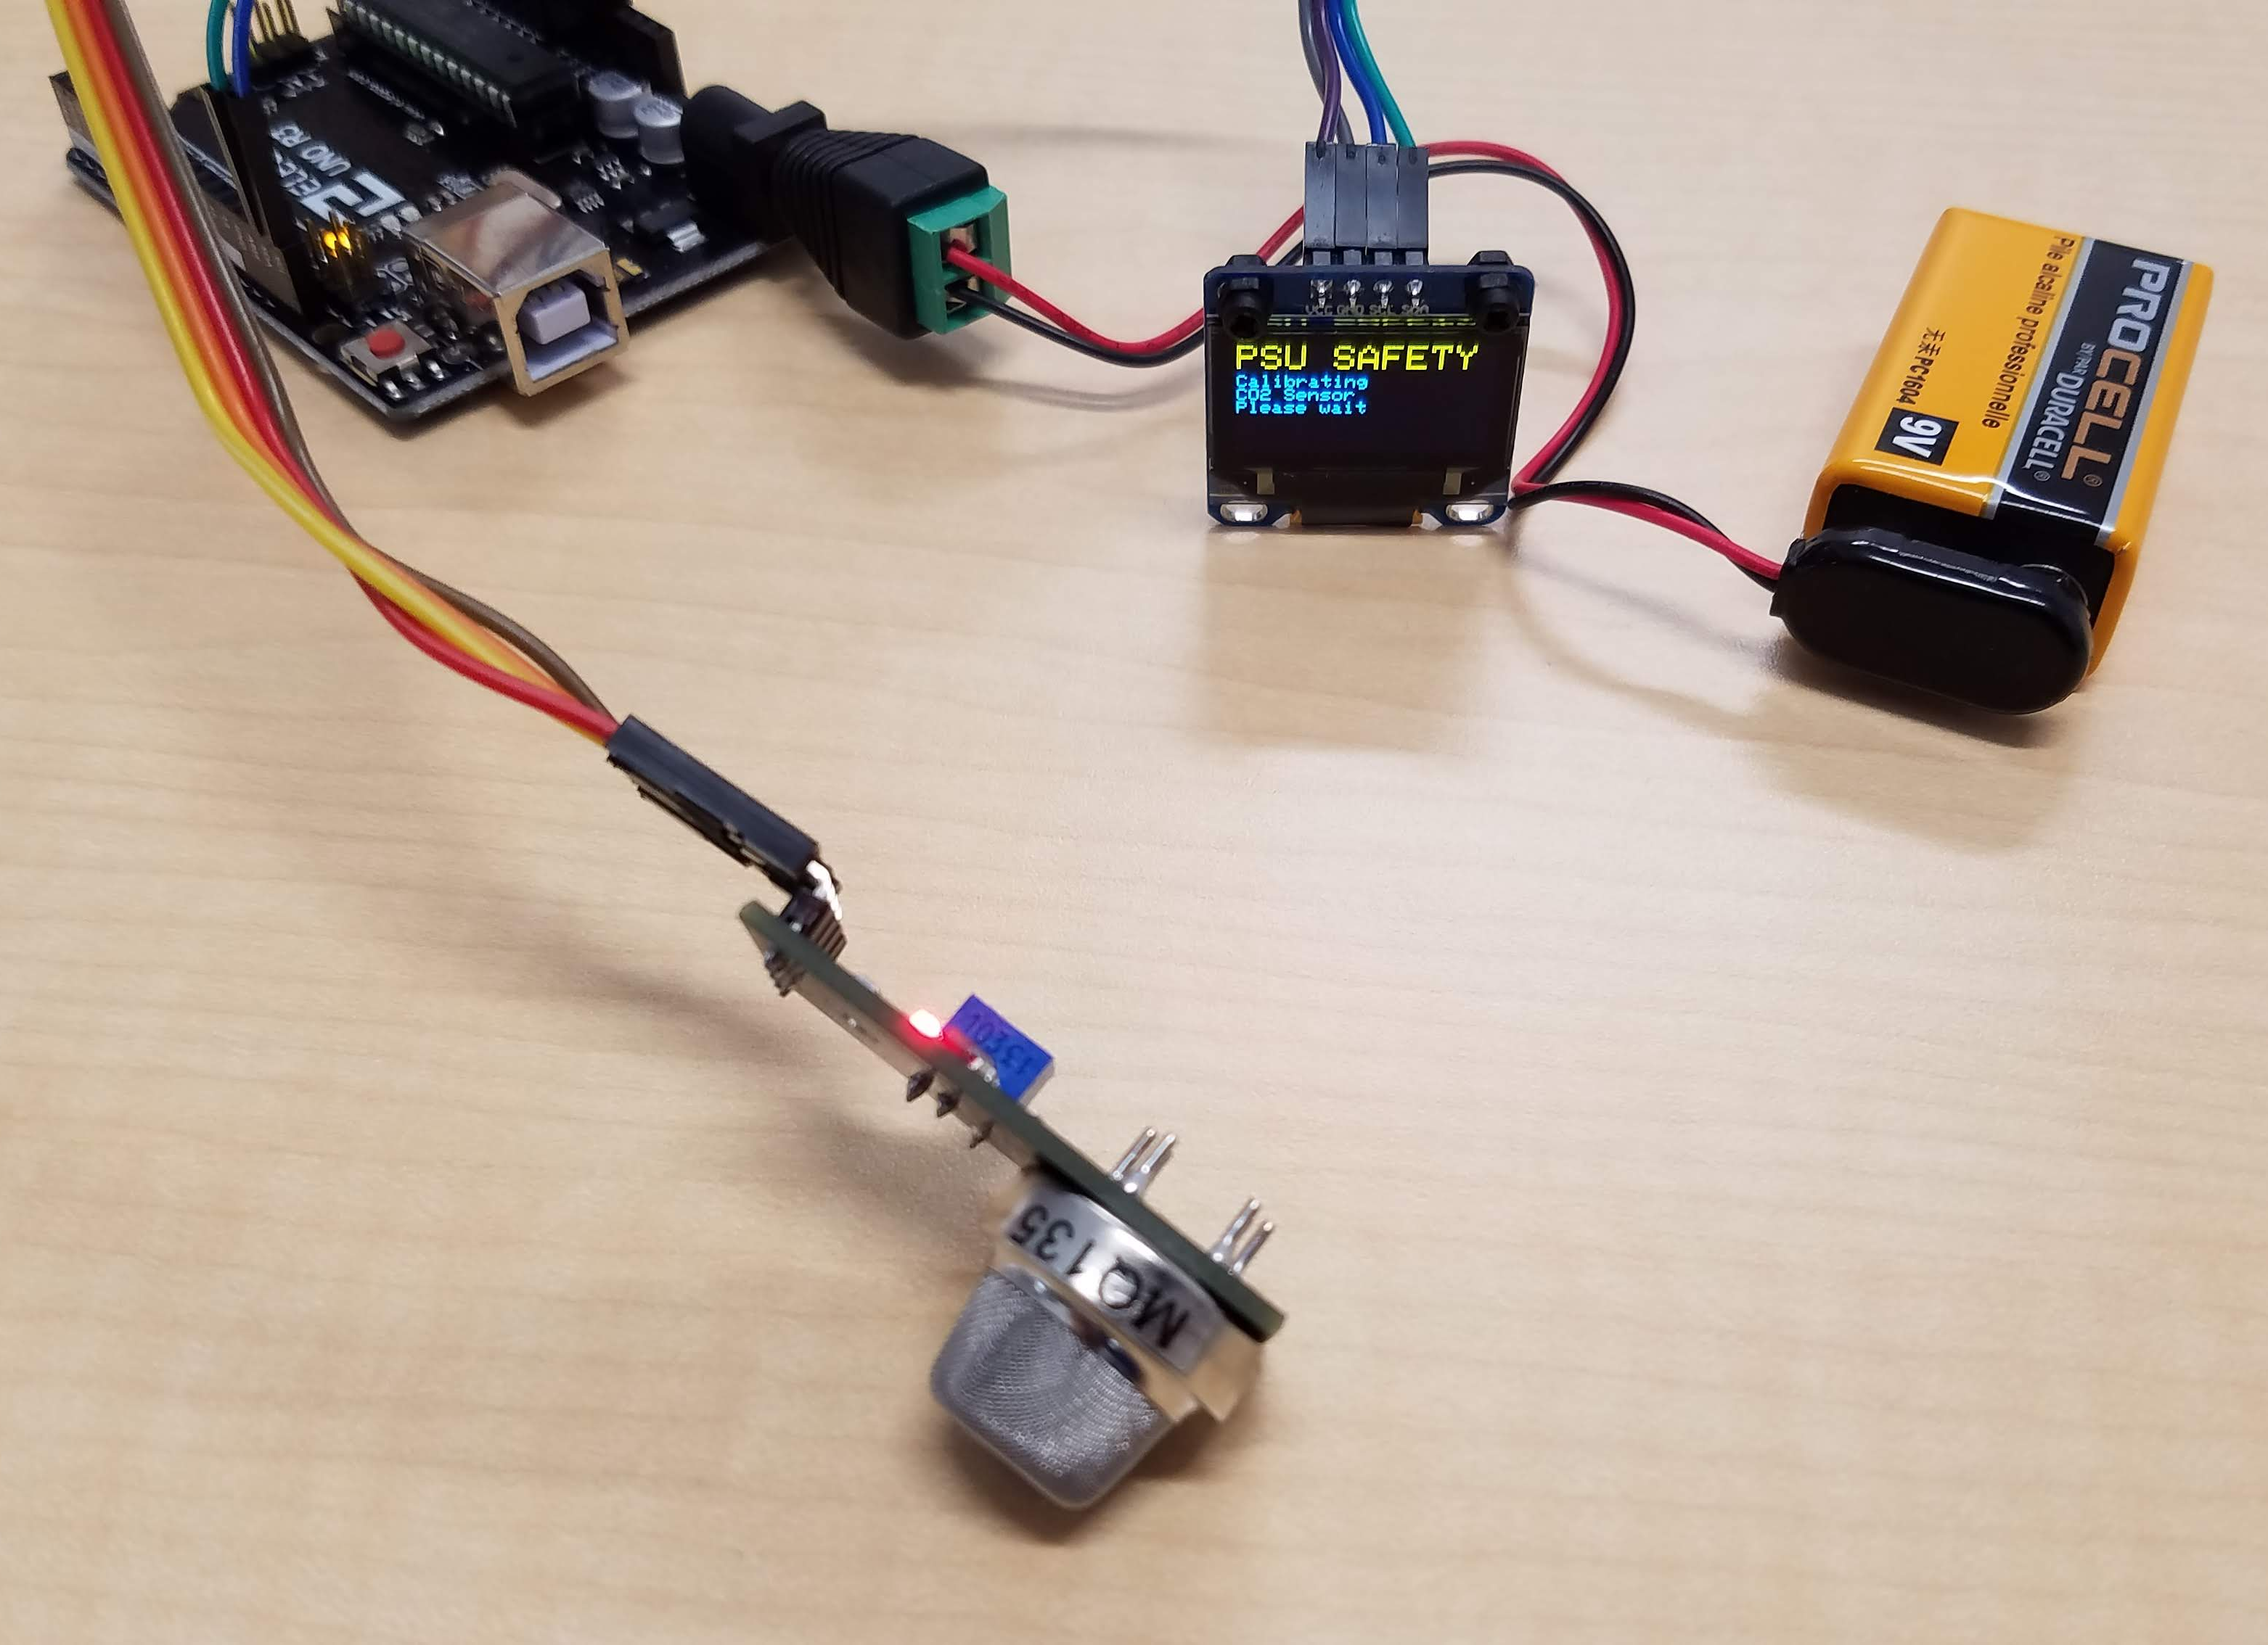
Activity: Arduino CO₂ Sensor Circuit
Notes:
For today’s activity, we are going to build a simple gas detection circuit.

Slide 10
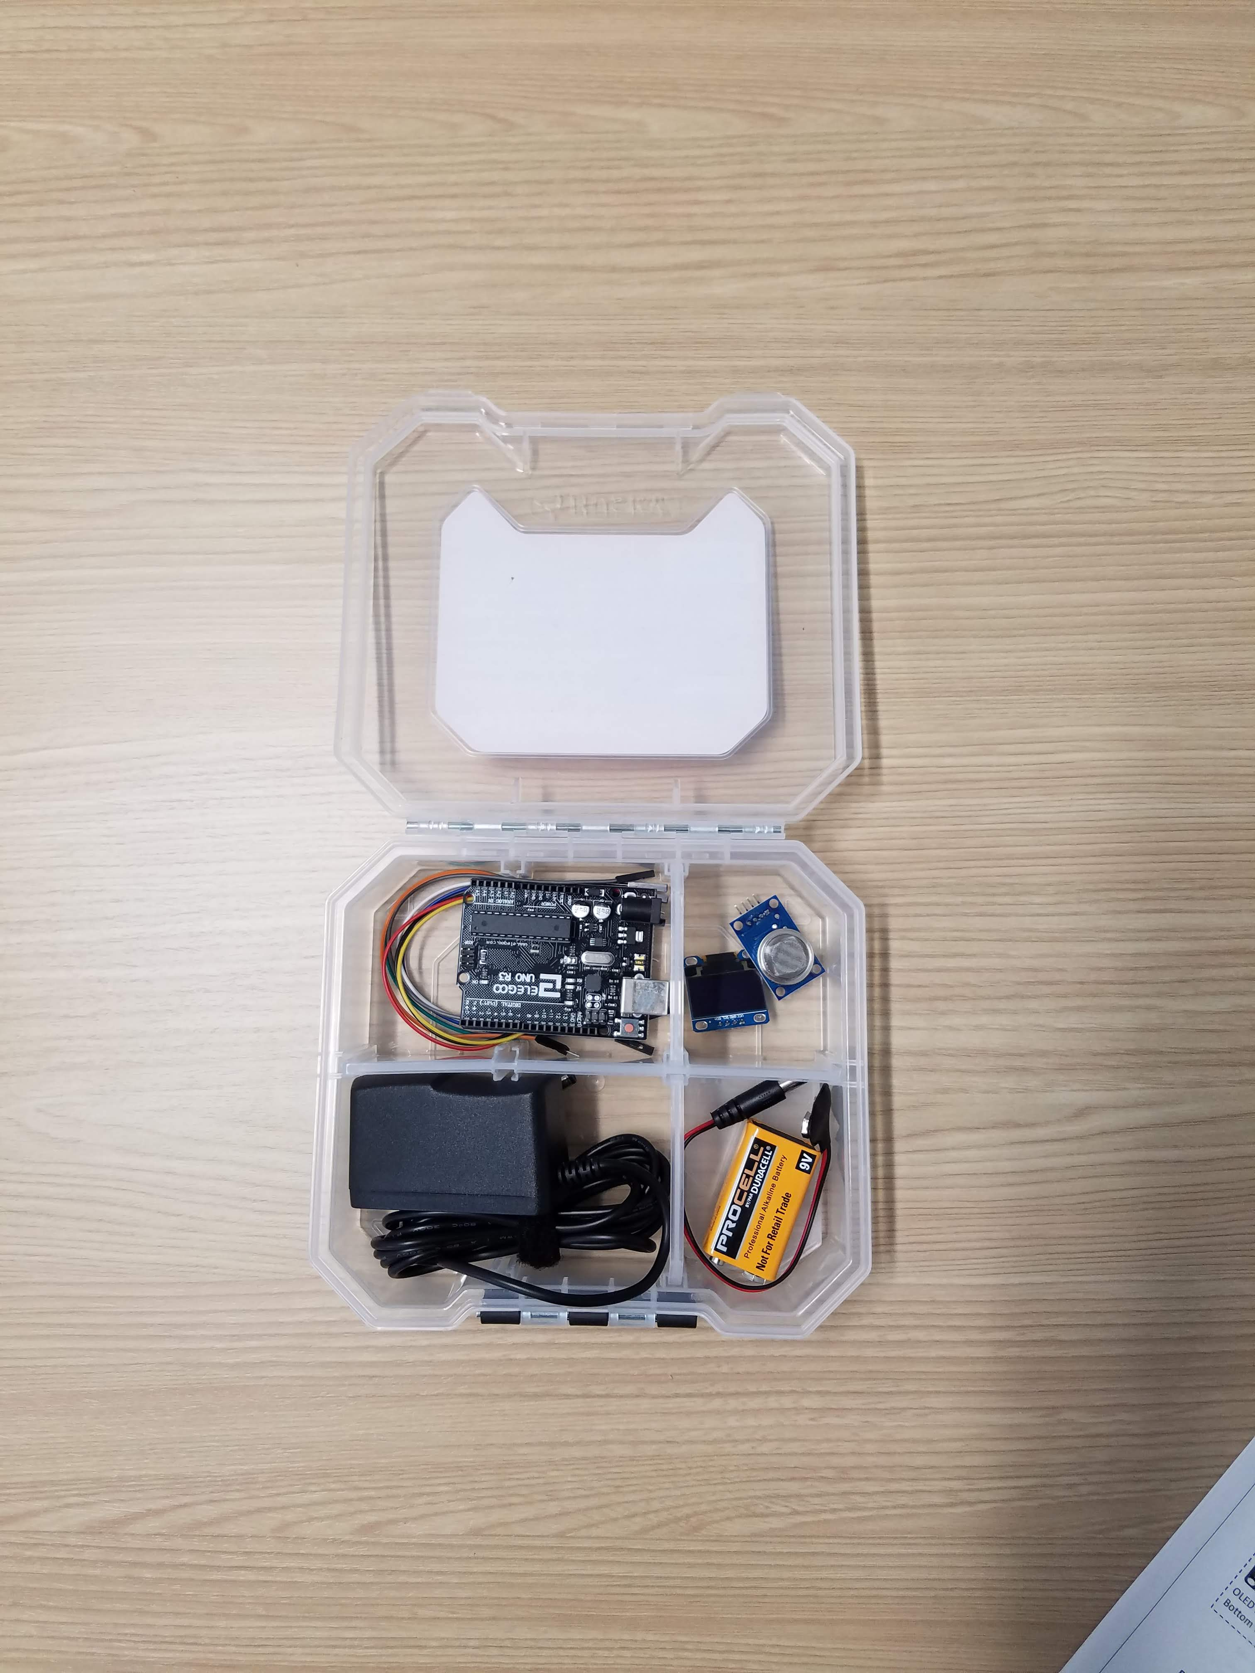
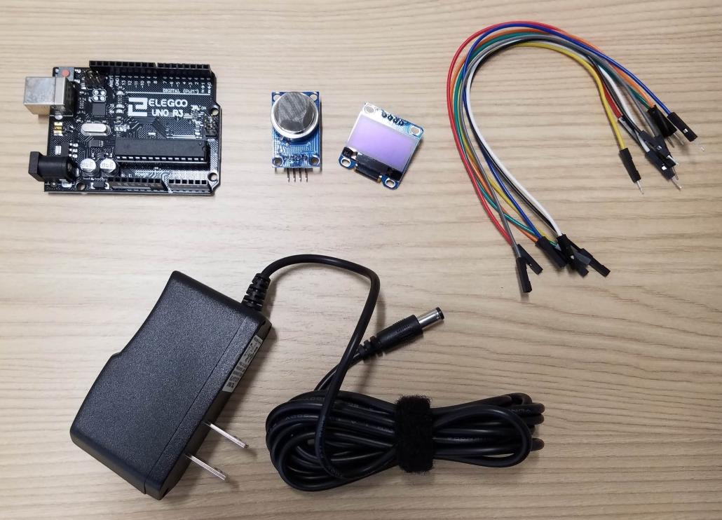
Activity Supplies
Storage
box
Arduino
UNO R3
MQ-135
gas sensor
OLED
display
Jumper
wires
Optional: 9V battery and
5.5mm plug adapter
9V AC/DC
power adapter
Notes:
The supplies needed for this activity include an Arduino UNO microcontroller, a MQ-135 gas sensor module, an OLED display, eight colored jumper wires, and a 9V AC/DC power adapter.

Slide 11
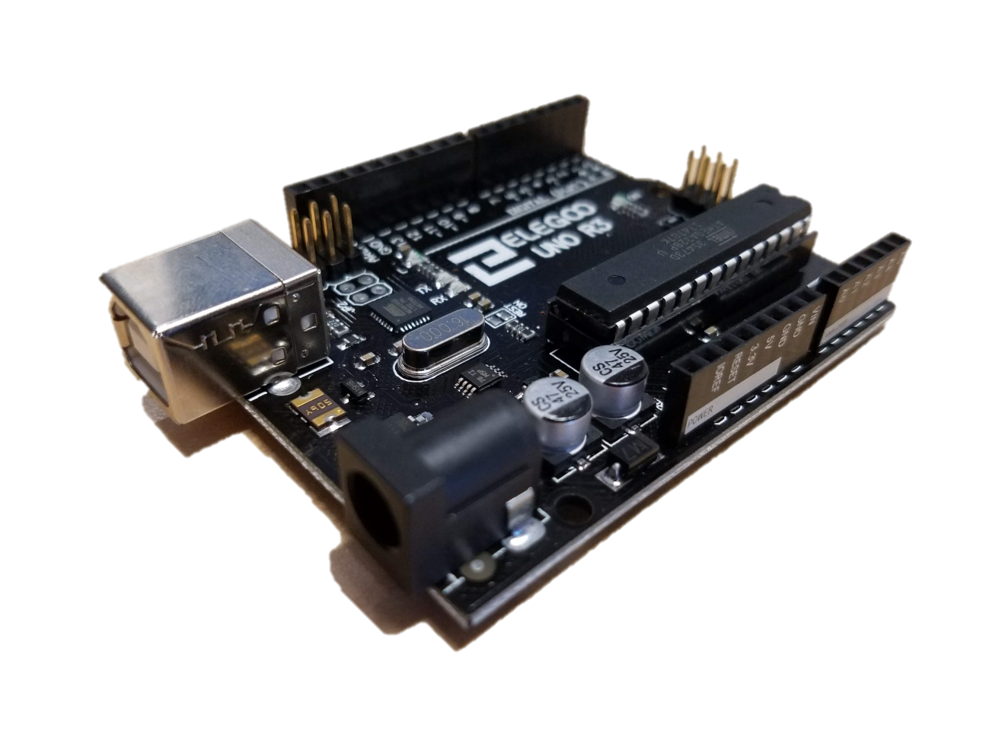
Arduino Microcontroller
Notes:
Arduino is an open-source electronics platform that allows users to connect a wide variety of inexpensive sensors and other hardware with a microprocessor that can be easily programmed to perform many useful functions. The Arduino boards used for this activity are pre-programmed so you do not need to write or upload code.

Slide 12
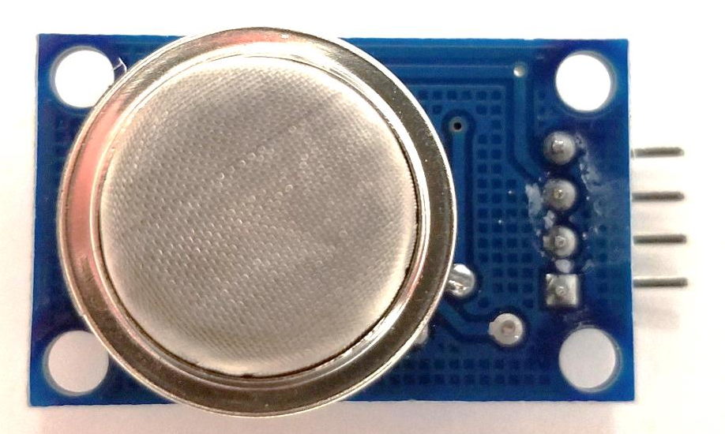
MQ-135 Gas Sensor Module
Notes:
The MQ-135 gas sensors we will use for this activity are sensitive to more than one type of gas, including carbon dioxide, ammonia, and alcohol. If these sensors are used in the presence of multiple gases at the same time, the measured concentrations may not be meaningful. Since we do not expect ammonia or alcohol to be present indoors, we can use the MQ-135 gas sensors to measure carbon dioxide concentration for this activity.

Slide 13
Build the Sensor Circuit
Follow the directions provided and make connections between components using the colored jumper wires.
Note: Wire colors may differ slightly or may be difficult to tell apart. The important thing is to make the correct connections between pins on the components as listed in Table 1 of the instructions.
Notes:
Go ahead and open up your box, and carefully take out the components. Follow the directions and make connections between the components using jumper wires. Connections are listed at the top of the page, and are shown in the wire connection diagram in Figure 1.

Slide 14
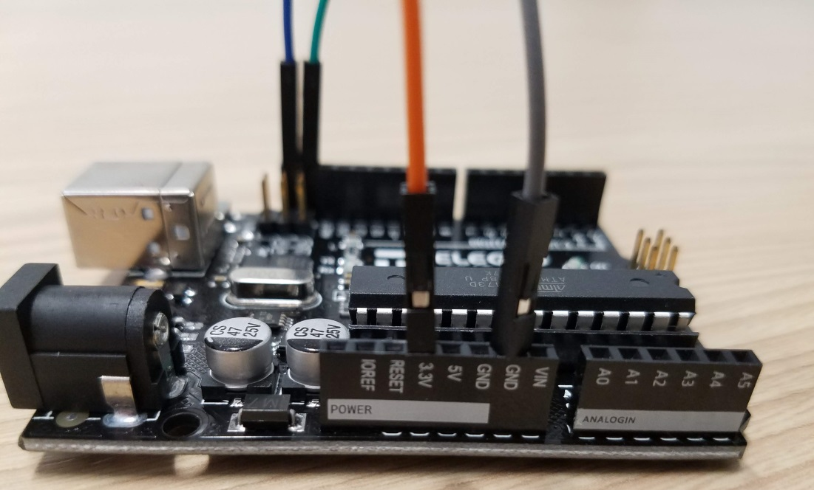
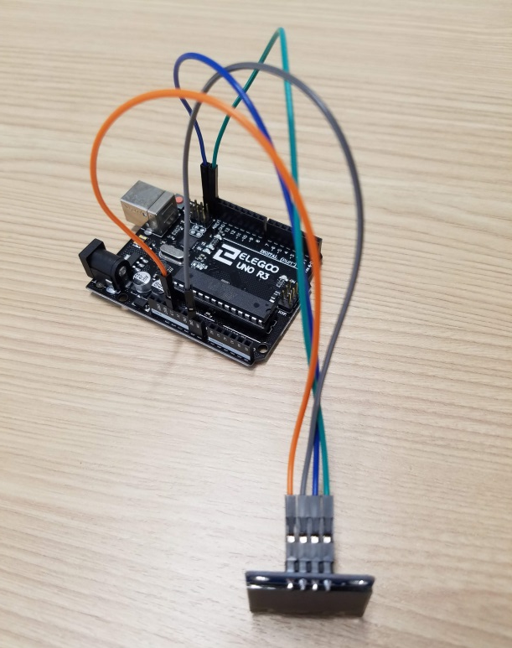
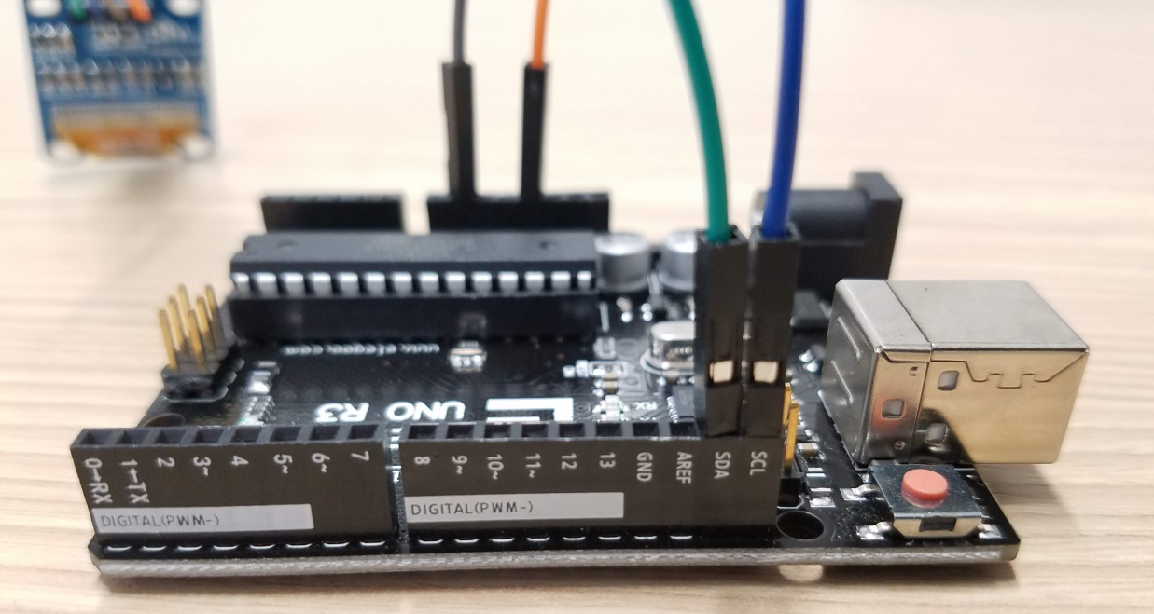
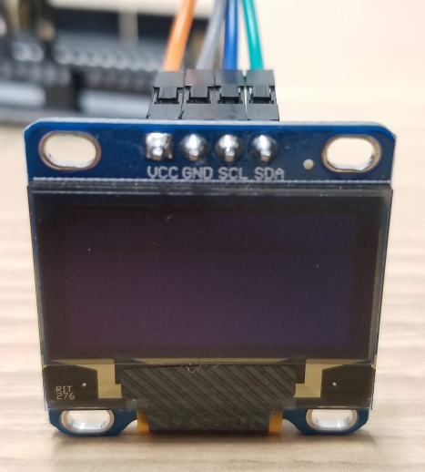
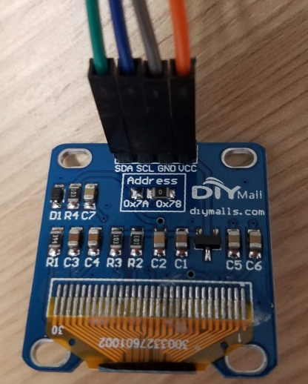
Connect OLED Display
Top View
Bottom View
Notes:
Note: the Arduino pins are labeled both on the top of the circuit board and on the sides of the headers.

Slide 15
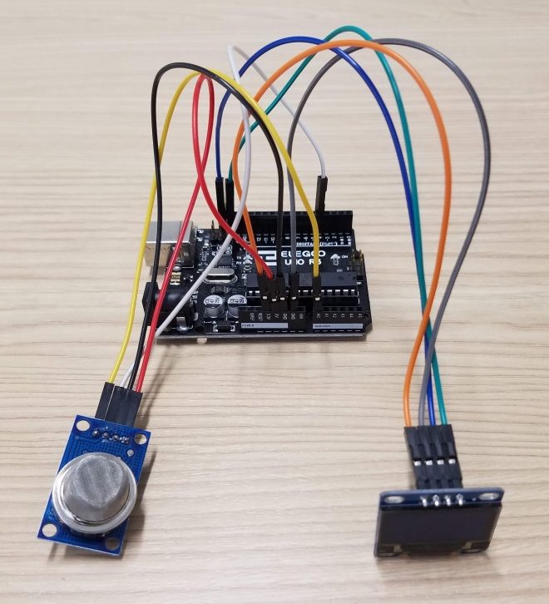
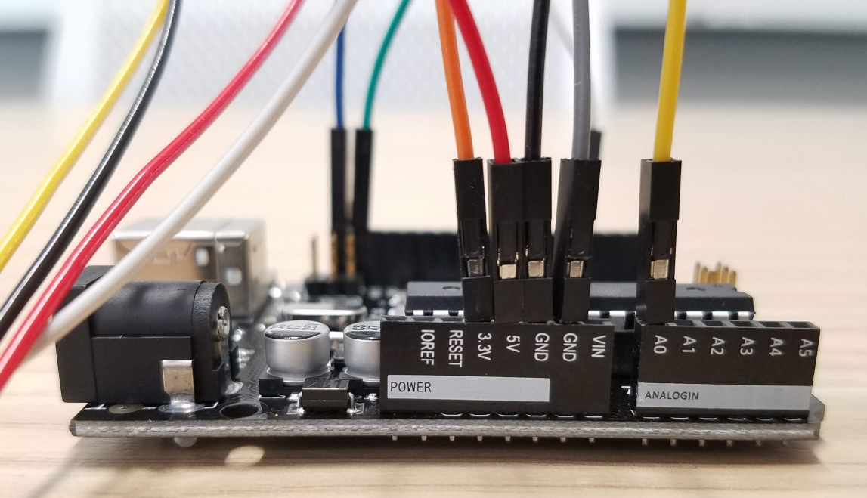
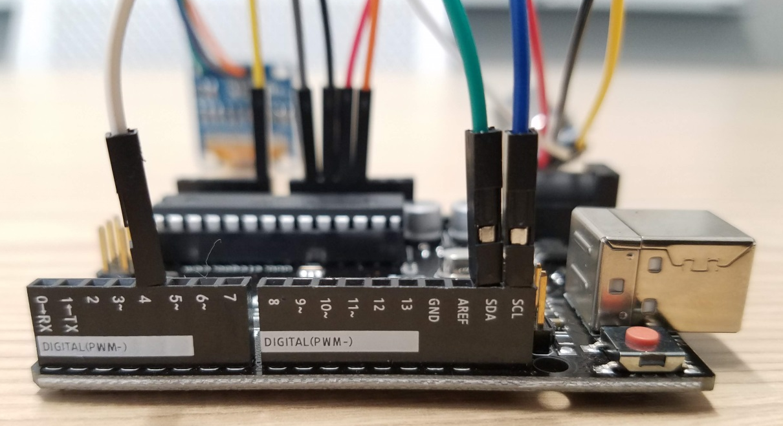
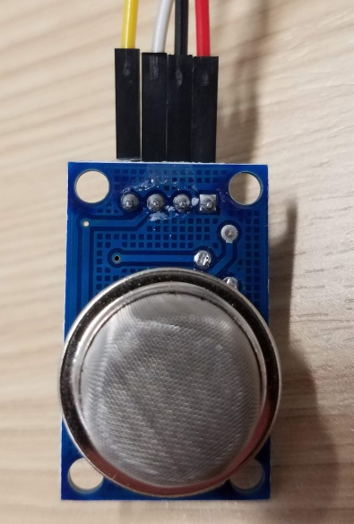
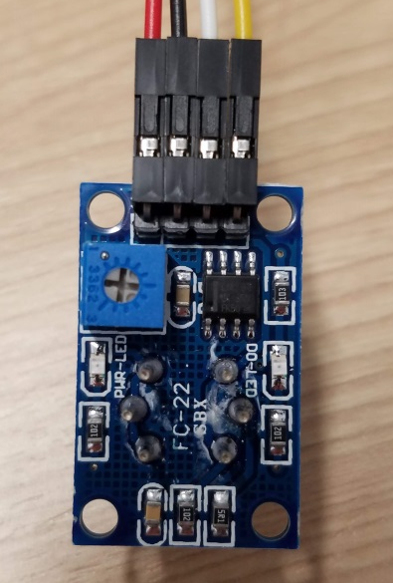
Connect MQ-135
Top View
Bottom View

Slide 16
STOP! Wait until instructed to continue.
Your instructor needs to check your wiring connections before you can power the circuit.
What will happen when the circuit is powered on?
Notes:
Once you have connected everything, stop and ask an instructor to check your circuit to make sure everything is correct. What will happen when you power on the circuit?

Slide 17
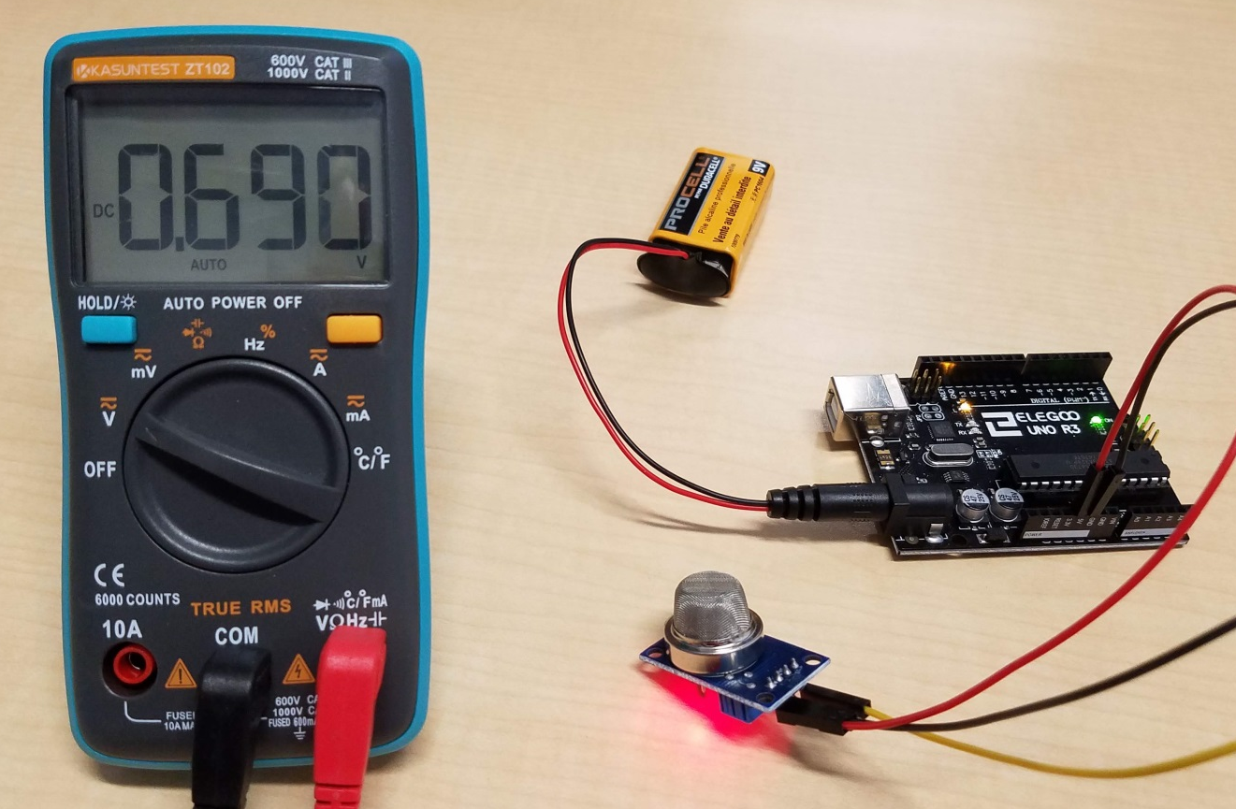
Calibration
0.690V DC = How many ppm of CO₂?
Notes:
The Arduino UNO measures the analog output voltage from the MQ-135 gas sensor, but we need to convert that voltage to how many parts per million, or ppm, of carbon dioxide gas is being measured. We do that by calibrating the sensor to a known quantity of gas. The CO₂ concentration of outdoor atmospheric air is approximately 400 ppm, and may exceed 1,000 ppm indoors. For this activity, a background CO₂ level of 400 ppm is assumed, and that level will be used to calibrate the MQ-135 sensor after a brief warm-up period. We won’t see the actual measured voltage, the Arduino will convert that into parts per million and display the measured value on the connected display.

Slide 18
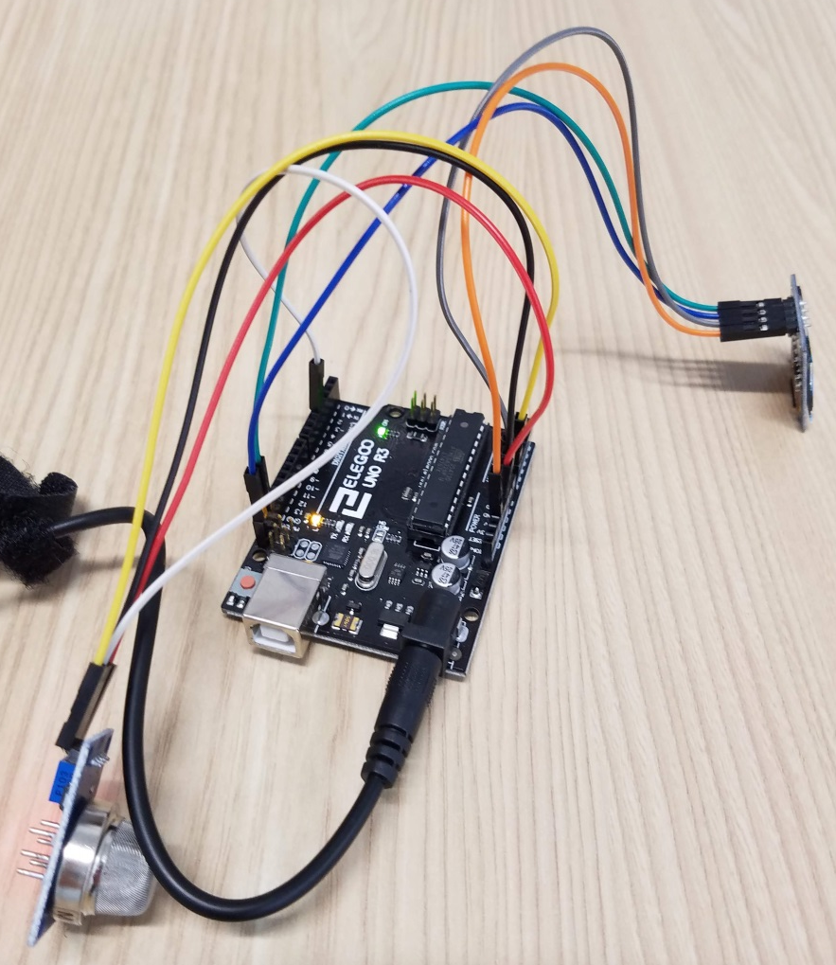

Connect 9V power source

Slide 19
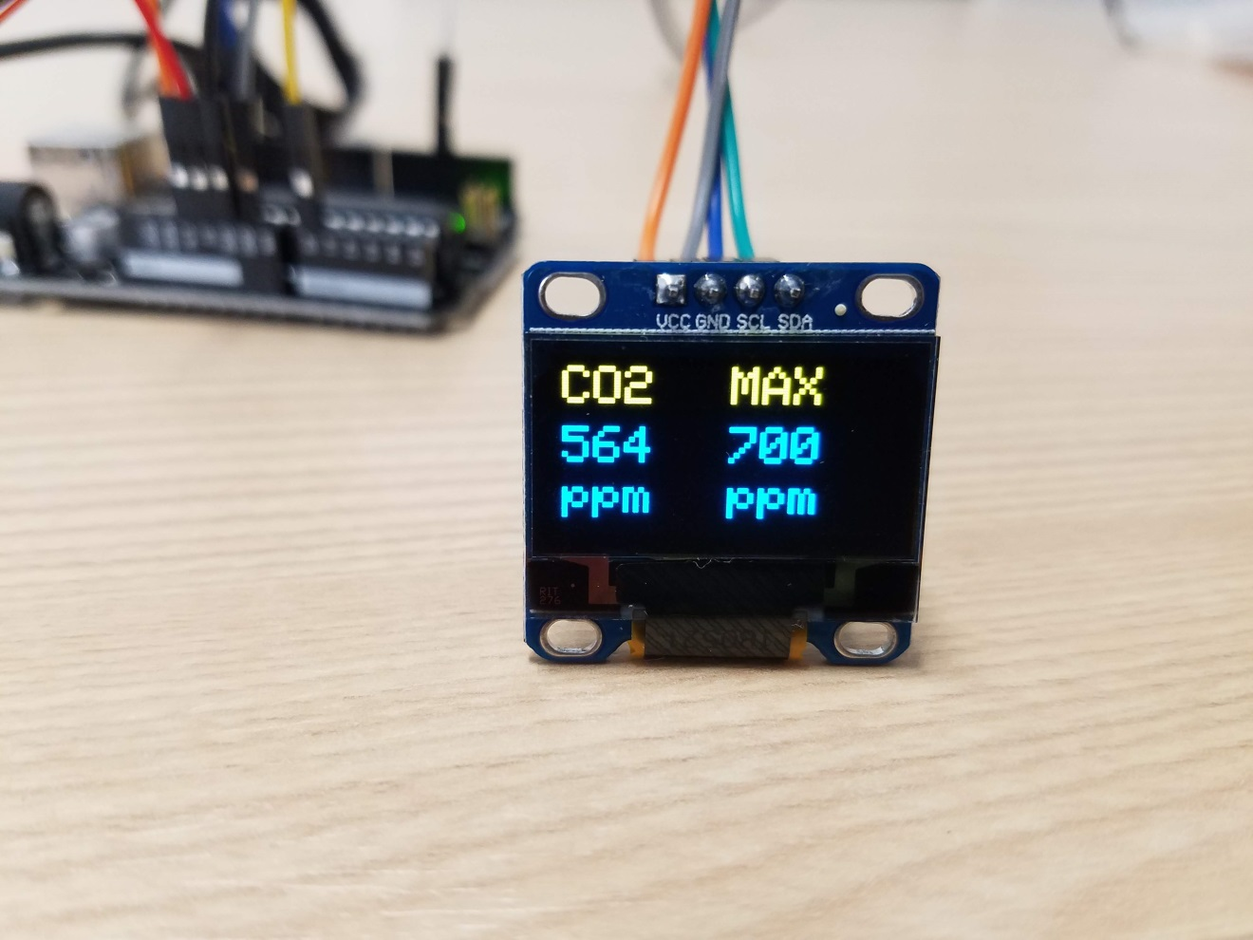
Breathe into the sensor

Slide 20
Press the Reset Button

Slide 21
Discussion

Slide 22
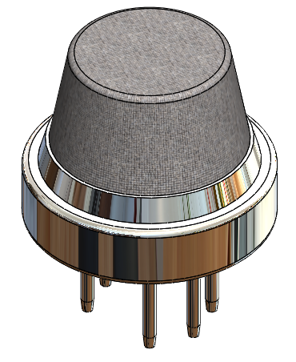
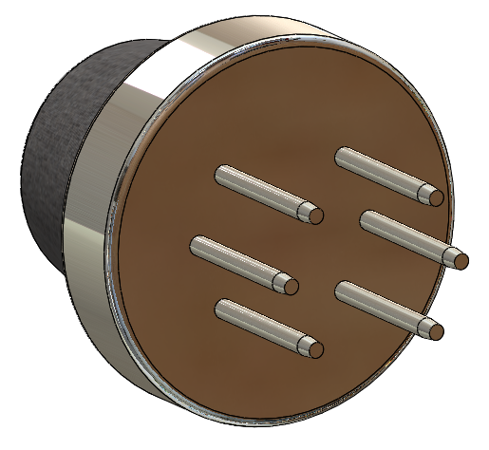
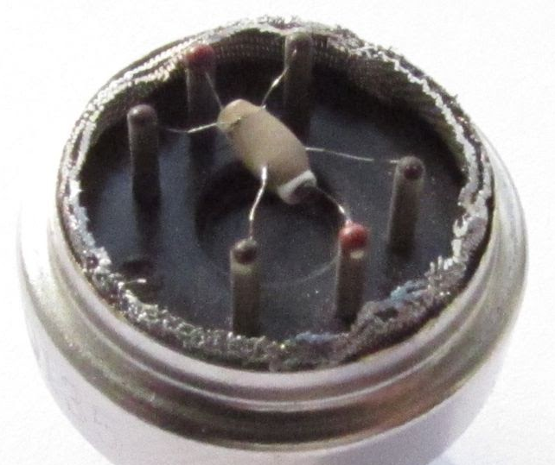
Metallic Oxide Gas Sensors
Heated
metallic
oxide
sensing
element
Mesh
screen
B
H
B
A
H
A
Gas sensor cutaway photo from
http://davidegironi.blogspot.com/2017/07/mq-gas-sensor-correlation-function.html
Notes:
Metallic oxide gas sensors contain a metal oxide semiconductor, typically tin dioxide (also called stannic oxide), which undergoes a chemical reaction that changes its resistance when exposed to a target gas. The reaction works best at high temperatures in air, so a heater in the circuit raises the temperature of the semiconductor. A fine metal screen prevents flame propagation, similar to the Davy miner’s lamp. The concentration of target gas is proportional to the change in resistance of the sensor.

Slide 23
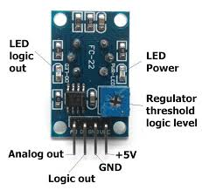
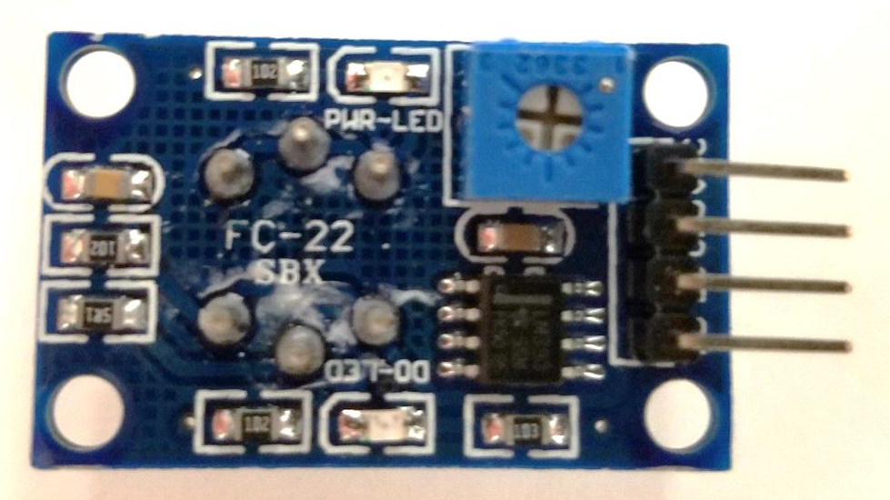
MQ-135 Gas Sensor Module
Top View
Bottom View
VCC
GND
DO
AO
VCC = Supply power (+5V DC)
GND = Ground
DO = Digital output (high or low, 5V or 0V)
AO = Analog output (from 0.0 to 5.0 VDC)

Slide 24
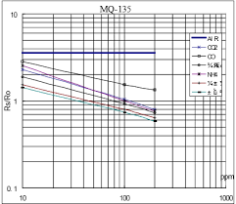
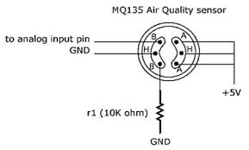
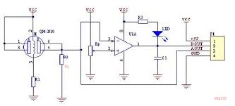
Gas Measurement Circuit
V_{CC}
V_{RL}
A
B
A
B
H
H
R_{L}
V_{H}
GND
GND
Notes:
The resistance across the metallic oxide sensor element changes with gas concentration. These gas sensor modules typically include a load resistor, RL, which enables us to calculate the resistance of the sensor using a voltage divider circuit as shown here. The Arduino measures the analog output voltage, VRL, and we calculate the resistance across the sensor element using VRL and RL. We then use the calculated sensor resistance and the supplied curve from the data sheet to determine the target gas concentration in parts per million.

Slide 25
Gas Measurement Circuit
+5V
V_{RL}
A
B
A
B
H
H
R_{L}
10kΩ
GND
GND
Notes:
In our MQ-135 module, the heater voltage and Vcc are both connected to +5V, and the load resistor RL is 10kOhms.

Slide 26
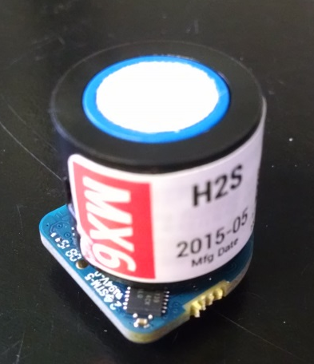
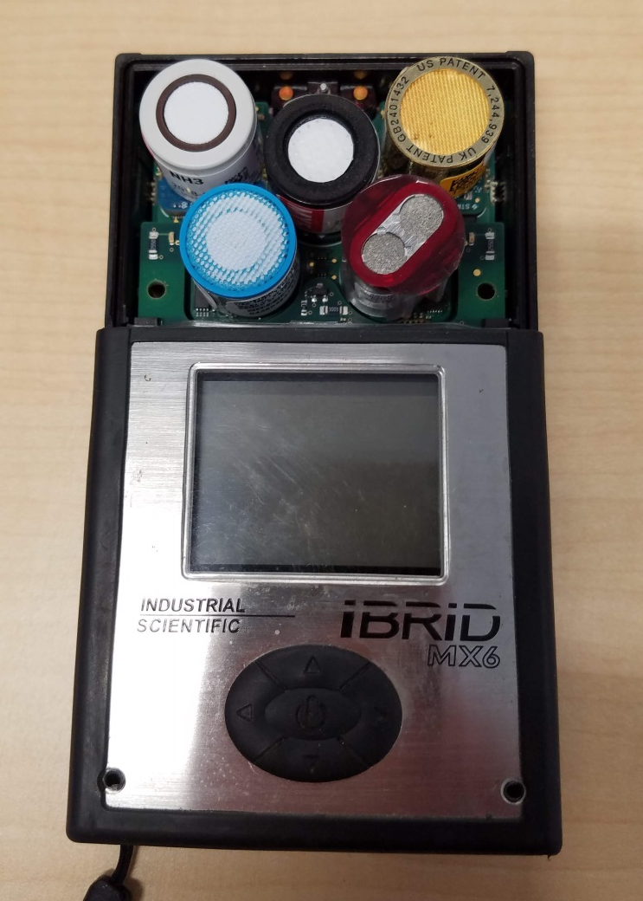
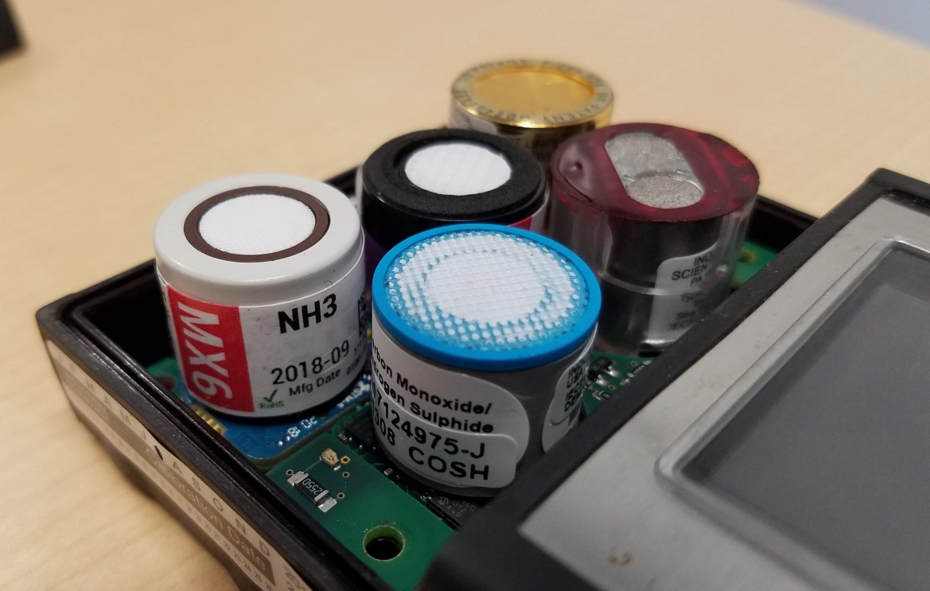
Electrochemical Gas Sensors
Notes:
These photos show some of the electrochemical gas sensors used in a hand-held multi-gas meter.

Slide 27

Electrochemical Gas Sensors
Toxic
gas
Teflon
membrane
Electrodes
Electronic
circuit
Liquid
electrolyte
Notes:
Electrochemical gas sensors are commonly used in hand-held (portable) gas monitors. They contain electrodes that are surrounded by a liquid electrolyte. When gas comes into contact with the sensing electrode, an electrochemical reaction produces an electric current that is proportional to the gas concentration.

Slide 28
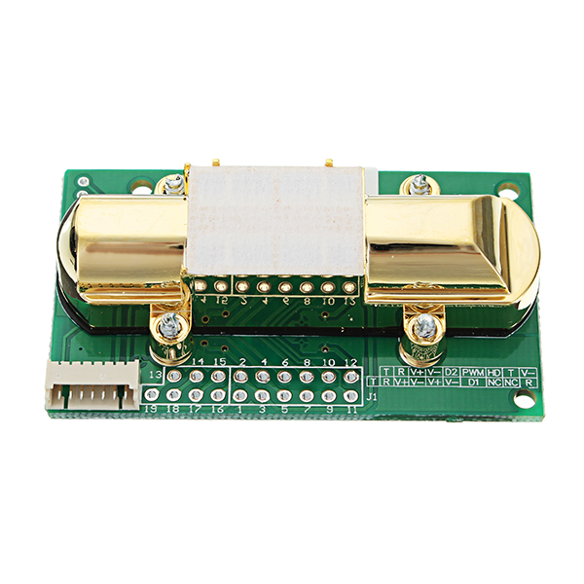
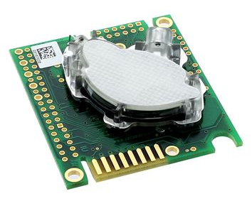
Infrared (IR) Gas Sensors
K30 10,000 ppm NDIR CO₂ Sensor
(https://www.co2meter.com/products/k-30-co2-sensor-module)
MH-Z14A NDIR CO₂ Sensor
https://www.winsen-sensor.com/sensors/co2-sensor/mh-z14a.html
Notes:
These photos show examples of some commercially available non-dispersive infrared (or NDIR) carbon dioxide gas sensors.

Slide 29
Infrared (IR) Gas Sensors
Gas Sample
IN
Gas Sample
OUT
Gas
Chamber
IR
Emitter
IR
Detector
Transparent
Window
IR
Filter
Target gas molecules
Other gas molecules
Notes:
This illustration is a simplified schematic that shows how infrared gas sensors work. Infrared gas sensors are based on the principle that gases absorb infrared light at certain wavelengths. Infrared gas sensors have a sensing chamber with an infrared emitter located at one end, and an infrared detector at the opposite end where an optical filter only allows the wavelength of infrared light specific to the target gas to reach the detector. When a gas sample passes through the chamber, infrared light gets absorbed by the target gas molecules, which reduces the amount of infrared light received by the detector. The gas concentration is proportional to the amount of emitted infrared light received by the detector.

Slide 30
Additional Resources
https://www.indsci.com/globalassets/documents/general-gas-education/electrochemical-sensors.pdf
  Industrial Scientific electrochemical sensor reference
https://www.figaro.co.jp/en/technicalinfo/principle/electrochemical-type.html
  Figaro website has nice videos illustrating how MOS and electrochemical sensors work, see “Gas Sensor Tutorials”

