Slide 1
Enhancing Instruction to Connect with Diverse Audiences
Dallas L. Holmes EdD, USU Extension
Adapted from an article by Lisa A. Guion and David C. Diehl, Florida State University Cooperative Extension, 2010.

Slide 2
Education and Social Constructs
Social science literature has revealed that an individual’s way of thinking, behaving, and being are deeply influenced by race/ethnicity, social class, language, and other cultural constructs.
Likewise, the preferred way in which information is delivered is also closely tied to social constructs.
An individual’s learning style, in most cases, is culturally influenced.

Slide 3
Ethnic Learning Styles
The degree that the individual’s learning style is influenced by culture depends on the person’s level of ethnicity, which is contingent upon many environmental, economic, and social factors.
Thus, educators must identify the learning style preference of the diverse clientele they wish to reach.

Slide 4
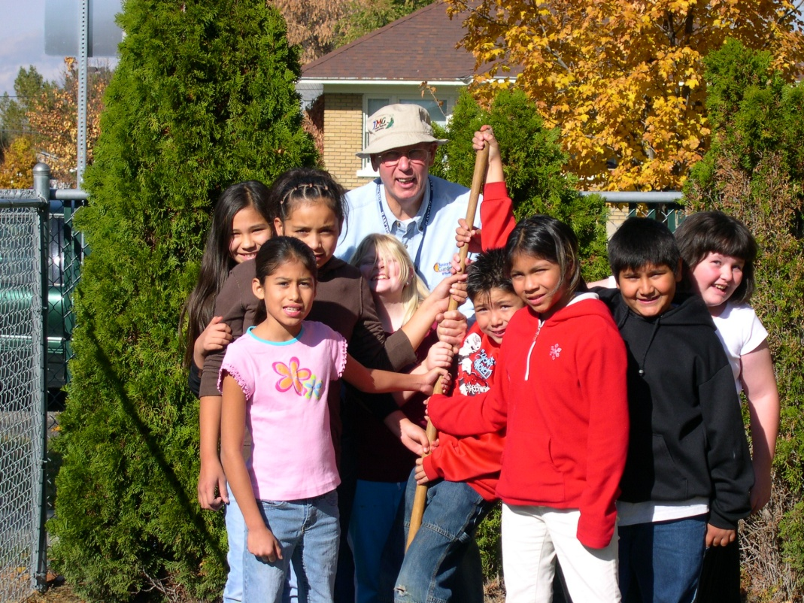
Educator Preparation
Educators tend to teach the way that they prefer to learn.
Visual learners are visual teachers.
It is important to recognize this tendency in order to structure teaching strategies for diverse groups effectively.

Slide 5
Educator Preparation
Once the educator has identified his or her own style of learning, it is important to find out how the culturally diverse individuals prefer to learn.
Consult the literature on preferred cultural learning styles.
Validate your findings via cultural brokers (guides), surveying (telephone, written, email), or a representative sample of the targeted clientele to determine if the cultural learning style holds true for the majority.

Slide 6
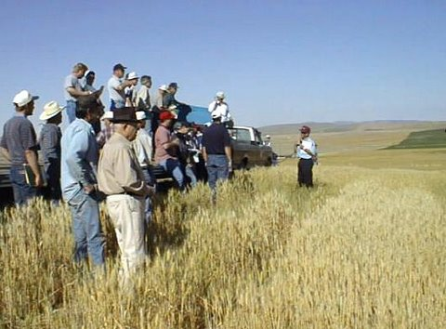
Benefits of Culturally Appropriate Instruction
Increases participation in a program
Increases interest in a topic
Enhances learning of the subjects taught
Shows respect for their culture
Shows commitment to planning programs for a diverse audience.
Notes:
Increases participation in a program: Individuals are more likely to participate and to attend future programs if they feel that the material taught was valuable and meaningful to them.
Increases interest in a topic: The attention span is extended when information is taught via the learner’s preferred learning style.
Enhances learning of the subjects taught: There is an increase in knowledge of the subject taught when learners receive education in a way they can readily process and understand.
Shows respect for their culture: Developing teaching strategies that take into account preferred cultural learning styles demonstrates a true commitment to education and respect for the culture. It takes the emphasis away from the educator (what the educator likes to do, his/her preferences) and focuses on what will enhance learning.
Shows commitment to planning programs for a diverse audience: Takes cultural diversity from an occasional thought to a natural, ongoing part of the planned learning process.

Slide 7
Key Components for Culturally Appropriate Instruction
Developing a clear sense of your own cultural identity.
Learn about the cultural backgrounds and experiences of the diverse individuals you work with or desire to work with.
Learn how to be a competent and effective cross-cultural communicator.
Become cognizant of the divergent styles of thinking and learning of culturally diverse populations.
Recognize the needs, preferences, strengths, and experiences of individuals from diverse cultures.
Incorporate culturally relevant curriculum materials and instructional aids.

Slide 8
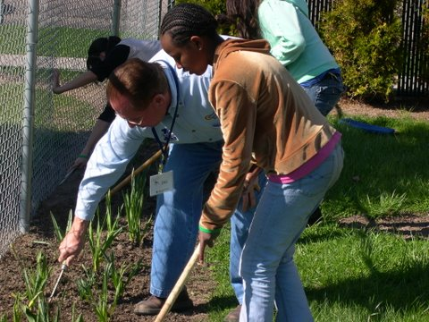
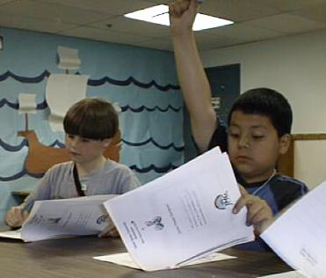
Key Components for Culturally Appropriate Instruction
Use multiple modes of teaching to accommodate different learning styles.
Have positive expectations of all students.
Encourage community involvement as well as parental involvement.

Slide 9
Learning about your Clientele, Their Families, and Communities
Strategies focusing on more direct interpersonal methods include:
Engage families in programming from conception to implementation.
Get involved in activities and events that are important in the community.
Get assistance and support from opinion leaders, gatekeepers and informal leaders.
Assemble a focus group of individuals from the target audience to gain insight into their learning styles.
Pilot test a lesson using various learning approaches, then assess which approach is most effective.

Slide 10
Culturally Relevant Educational Materials
Equal in importance to using a culturally appropriate teaching method, is using culturally appropriate teaching materials.
Even if it seems that your curriculum need not be changed, no matter what the audience, research has shown that due to different cultural norms, values, beliefs, practices and traditions within a given ethnic group, the way the principles are presented may need to vary in order to reach the audience.

Slide 11
Curricula that promotes “One –Size-Fits-All” may not be effective when working with diverse audiences

Slide 12
Culturally Relevant Educational Curricula
Before choosing any curriculum or educational resource for a specific group, ask the following questions:
Is the content accurate and research-based?
Is the material written at the appropriate reading-level?
Are the applications and activities appropriate for the needs of the audience?
Does the curriculum cover issues/topics on the subjects that are important to the audience?

Slide 13
Culturally Relevant Educational Materials
Does it provide interesting application exercises for applying the ideas?
Are the examples relevant to the life experiences of the audience? (Do visual aids reflect the audience’s ethnicity?)
Does the content reflect the norms, values, and preferences of the target audience and avoid negative stereotyping?
When related to the subject content, are the cultural observances acknowledged and/or celebrated?
Does the curriculum involve users as partners in applying the principles taught in the lessons to their lives?

Slide 14
Enhancing Instruction to Connect with Diverse Audiences
Certain teaching styles and learning aids that are appropriate for one group may not be appropriate for a group from a different cultural background.
It may be difficult given time constraints, responsibility for multiple programs, understaffing, etc., however small steps can and should be taken to build classrooms where all participants have the optimum chance of learning.

Slide 15
Let’s Explore Some of the Learning Styles of Four Ethnic Groups
Hispanic/Latino
Native American
Asian American
African American
Note: Cultural learning styles are intended as general guides--not absolutes for all members of an ethnic group

Slide 16
Hispanic/Latino Learning Styles
Large supportive extended family; the learning process benefits by involving the extended family often
Value cooperative group learning--not competitive learning
Most communicate fluently in native language (Spanish) within the family and ethnic community
If not bilingual, possible language barriers may arise without the assistance of a translator
Less independent and more modest
Children have unusual maturity/responsibility for their age
Youth initiate and maintain meaningful interaction and communication with adults (adults may also take the lead)
More affectionate and physically closer to others in class, conversation, asking questions, and all learning activities
Use intuitive reasoning (making inferences) naturally
Experience with giving advice and judgments in disputes
Eagerness to try out new ideas and work collaboratively
Value history, oral tradition, and visual/kinesthetic learning

Slide 17
Native American Learning Styles
Oral traditions give value to creating stories, poems, and recalling legends; good at storytelling
Value cooperation--not competition; work well and communicate effectively in groups
Learn holistically; beginning with an overview or "big picture," and moving to the particulars
Trial-and-error learning by private (not public) experiences
Developed visual/spatial abilities, highly visual learners
Value life experiences in traditional learning
Value design and create symbols to communicate, often exhibit visual art talent
Often exhibit performing arts talent
Intuitive ability valued and well developed
Seeks harmony in nature and life, are good mediators
Excellent memory, long attention span, deductive thinkers
High use of nonverbal communication
Accept responsibility and discipline of leadership

Slide 18
Asian American Learning Styles
High achievement motivation
Use of intuition in learning and problem solving preferred
High degree of self-discipline, self-motivation, self-control
High level of concentration and persistence on academics
Possible language barriers in some subgroups
Disagreeing with, arguing with, or challenging the teacher is not an option; this has to do with respect
Attitude toward discipline as guidance
Modest, minimal body contact preferred
Respects others, ability to listen and follow directions
Excellent problem-solving ability (female Asians have higher math scores than any other female ethnic group)
Indirect and nonverbal communication used, attitudes unfavorable to participate in discussion groups
Keen awareness of environment
Strong valuing of conformity may inhibit creative thinking

Slide 19
African American Learning Styles
Movement and kinesthetic abilities highly developed
Value imagination and humor
Ability to express feelings and emotions, both verbally and nonverbally; strong oral language tradition
Richness of imagery in informal language
Experience with independent action and self-sufficiency
Physical action orientation (learn by doing)
Learn quickly through hands-on experience, manipulative materials, and multiple stimuli
People oriented (focus on people rather than objects)
Resourcefulness, unique problem solving abilities
Tend to view things in their entirety--not in separate pieces
Preference for the oral mode of presentation in learning
Use of inferences, may approximate time/space/number
Alert, curious, good retention and use of ideas
Ability to navigate between two cultures, some subgroups have high assimilation to mainstream learning styles

Slide 20
References
Allison, B.N. (2003). Multicultural classrooms: Implications for family and consumer sciences teachers. Journal of Family and Consumer Sciences, 95(2), 38-43.
Banks, J.A., Cookson, P., Gay, G., & Whawley, W.D. (2001). Diversity within unity: Essential principles for teaching and learning in a multicultural society. Phi Delta Kappan, 83(3), 196-210.
Guion, L. A., Goddard, H.W., Broadwater, G., Chattaraj, S., & Sullivan-Lytle, S. (2003). Strengthening programs to reach diverse audiences. Gainesville, FL: Florida Cooperative Extension, University of Florida.
McCarthy, C. (1994). Multicultural discourses and curriculum reform: A critical perspective. Educational Theory, 44(1).
Shade, B. J. (1997). Culture, style and the educative process. Springfield, IL: Thomas Publishing.
Sleeter, C. E. (1992). Restructuring schools for multicultural education. Journal of Teacher Education, 43(2), 141–148.
Sparks, S. (2000, May). Classroom and curriculum accommodations for Native American students. Intervention In School And Clinic, 35(5), 259–263.
Villegas, A. M. & Lucas, T. (2002). Preparing culturally responsive teachers: rethinking the curriculum. Journal of Teacher Education, 53(1), 20-43

