Slide 1
Culturally Competent Extension Educators
Dallas L. Holmes EdD, USU Extension
Adapted from Lisa A. Guion and Kay Brown,
Florida State University Cooperative Extension, 2010.

Slide 2
Cultural Competence
Knowledge of
History
Culture
Traditions
Customs
Language
Dialect
Values
Religious or Spiritual Beliefs
Art
Music
Learning Styles
Practices of Individuals
Roles
Family Hierarchies
Expressions of politeness
Communication patterns

Slide 3
Cultural Competence
“Respecting and learning about culture promotes a focus on the positive characteristics and strengths of a community and the individuals that reside within it.”
Okun, Fried, & Okun, 1999

Slide 4
Cultural Competence
In order for Extension Educators to be culturally competent, they must first recognize their own biases and preconceptions.
It then becomes easier to disregard those biases and learn about others in a non-judgmental way.

Slide 5
Cultural Competency Communication
Every culture has its own communication style.
direct versus indirect
verbal versus nonverbal
high context versus low context
circular versus linear
formal versus informal
expressive versus stoic

Slide 6
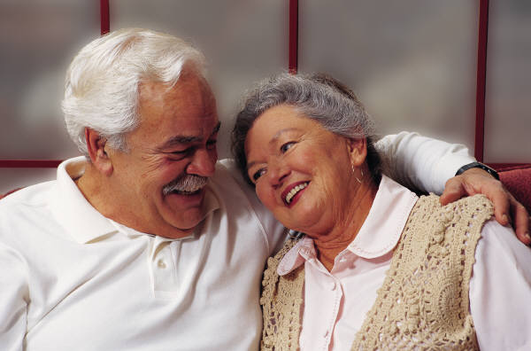
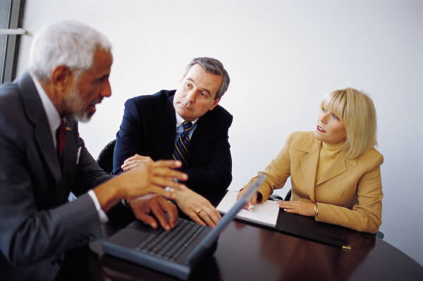
Cultural Competency Communication
How do Euro-Americans communicate?
Verbal/Non-verbal
Expressive/Stoic
Linear/Circular
High context/ Low context
Formal/Informal

Slide 7
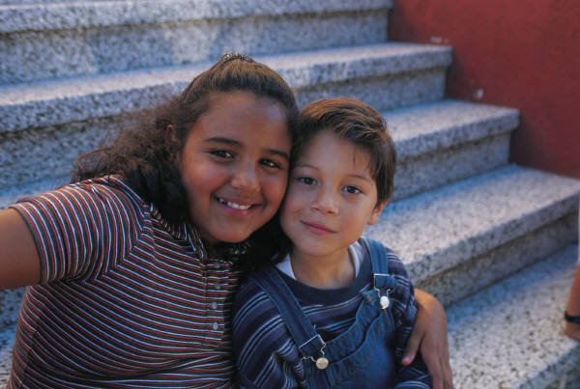
Cultural Competency Communication
What are characteristics of Latin Communication styles?
Verbal/Non-verbal
Expressive/Stoic
Linear/Circular
High context/Low context
Formal/Informal

Slide 8
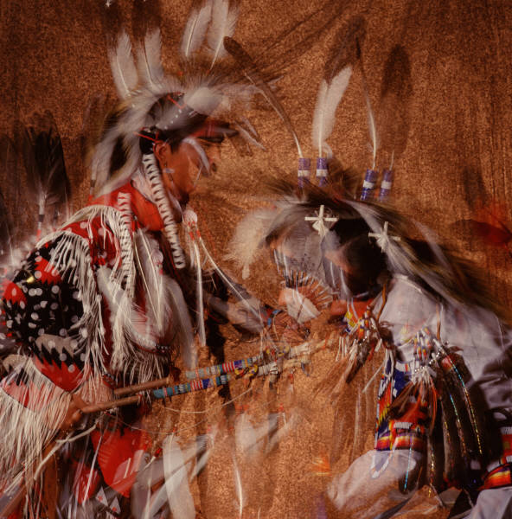
Cultural Competency Communication
What are characteristics of Native American Communication styles?
Verbal/Non-verbal
Expressive/Stoic
Linear/Circular
High context/Low context
Formal/Informal

Slide 9
Cultural Competency Communication
“Awareness of one’s own cultural communication style and awareness of other valid cultural communication styles reflect different perceptions, assumptions, norms, beliefs and values.” –Schauber & Castania

Slide 10
Cultural Competency Communication
Requires an understanding of:
Historical Power Differences (i.e. Slavery)
Present Day behaviors that result from the history of that group’s survival (i.e. Russians’ external coldness is a result of the Stalin era when they were under surveillance)
Ability to empathize cross-culturally (i.e. The European Union is a geographically small area with great diversity—they learn cultural empathy and tolerance quickly).

Slide 11
Cultural Competency Communication
Requirements, continued
Acceptance of multiple perspectives (i.e. Gandhi’s mediation between the British, Hindu and Muslim all vying for power in India)
Observation while reserving judgments.
Adaptation of one’s communication style to others (i.e. Native Americans and early European settlers interactions)

Slide 12
Cultural Competency Communication
There are many resources available to assist in developing culturally appropriate communication.
The best way is to actually DO it! Interact with culturally diverse people, their families, their religion, their language and their communities.

Slide 13
Resources
Strengthening Programs to Reach Diverse Audiences: http://fycs-diversity.ifas.ufl.edu
National Extension Diversity Center: http://www.ediversitycenter.net/
Teachers Corner EdChange Multicultural Pavilion: http://www.edchange.org/multicultural/teachers.html

Slide 14
References
Corey, M.S., & Corey, G. (2003). Becoming a helper. Pacific Grove, CA: Brooks/Cole.
Dresser, N. (1996). Multicultural manners: New rules of etiquette for a changing society. New York: Wiley.
Guion, L.A., Chattaraj, S.C. & Lytle, S.S. (2005). A Conceptual framework for connecting across cultures. Journal of Family and Consumer Sciences, 97(1), 76-82.
Okun, B., Fried, J. & Okun, M. (1999). Understanding Diversity: A learning-as-practice primer. Pacific Grove, CA: Brooks/Cole.

