Slide 1
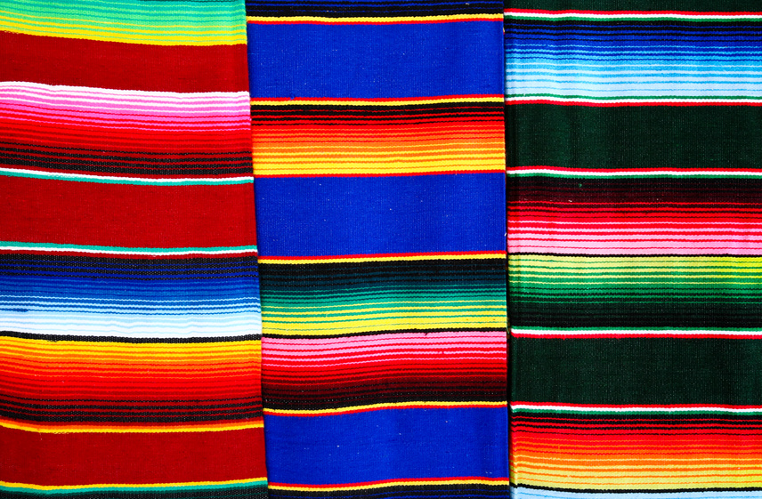
Cultural Awareness: Hispanics
“Buenos dias! Cómo te va?”
“Good day! How’s it going?”
“Muy bien, gracias!”
“Very well, thank you!”

Slide 2
When Considering Cultural Values of Hispanics
To work effectively with any ethnic group, extension educators need to be aware of values in their own culture, as well as sensitive to differences in other cultures. The cultural values highlighted in this presentation are generally representative of some of the cultural values attributed to Hispanic populations. The Hispanic cultural values enumerated may create an awareness that will assist extension program planners in making better decisions when designing, developing and marketing programs to Hispanic audiences.

Slide 3
Physical contact is important

Slide 4
Hispanic families are a very close, important social unit.

Slide 5
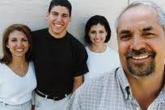
Family is a source of support and pride, but also the primary means of economic and social stability.

Slide 6
The family usually includes extended family

Slide 7
A firm handshake is common as a greeting and for leaving.

Slide 8
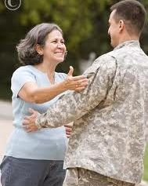
A hug and light kiss on a cheek are common among friends and family

Slide 9
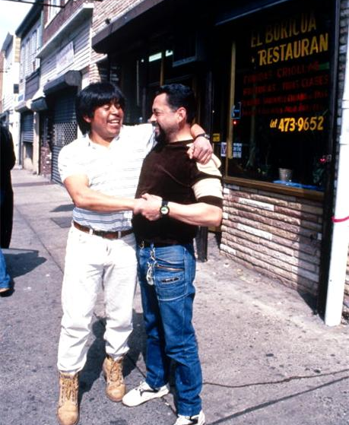
Physical distance when holding a conversation is relatively close.

Slide 10
Information is passed mostly by word of mouth

Slide 11
Values attention to present companions over punctuality in appointments

Slide 12
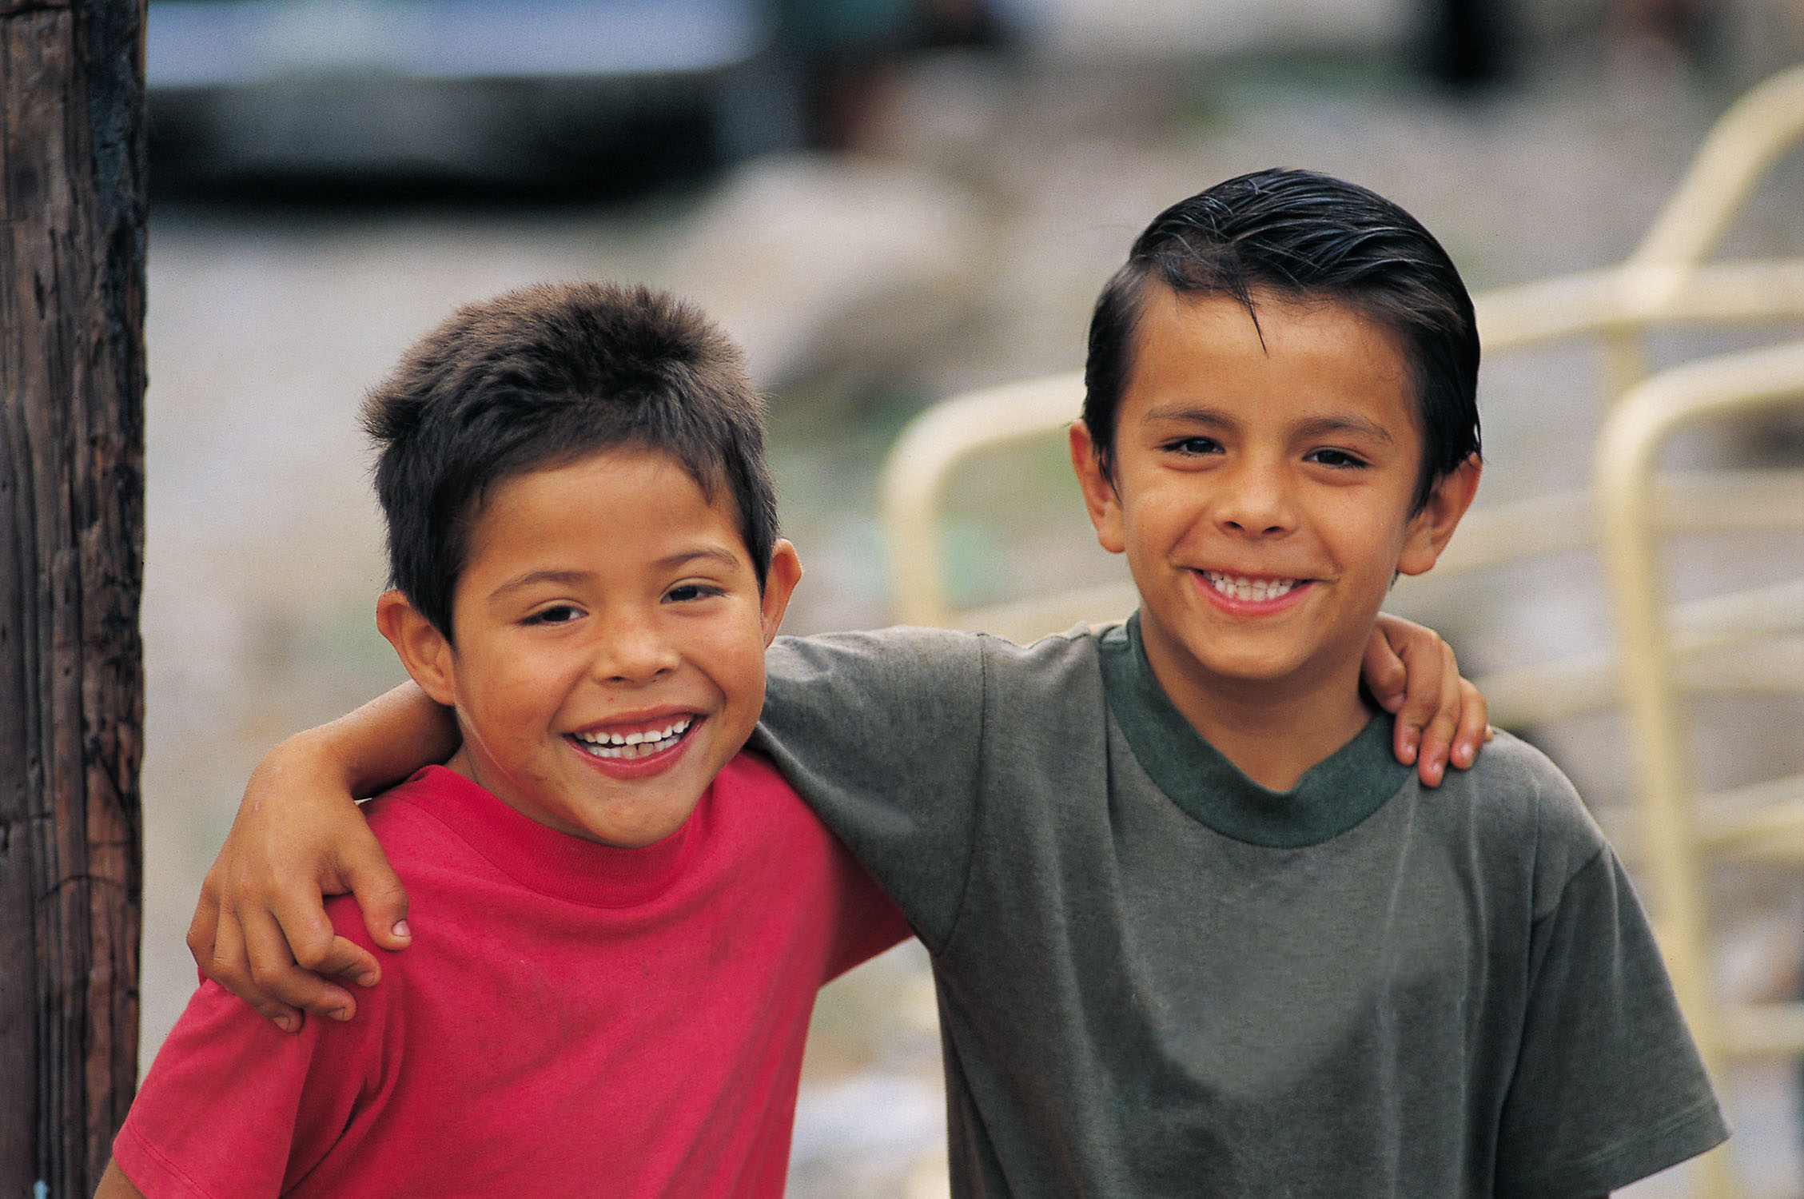
Personal space is close

Slide 13
Loyal to those they trust

Slide 14
Family is highest priority

Slide 15
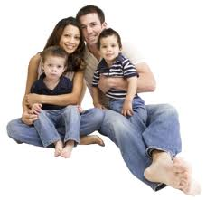
Children are part of overall society rather than the property of a set of parents

Slide 16
Patriarchal, male‐dominate in most cases

Slide 17
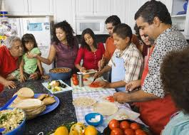
Emphasis on present tense

Slide 18
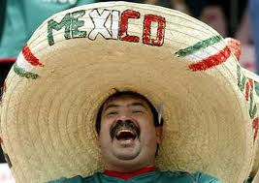
Tend to not make plans too far in the future

Slide 19
Time is usually flexible

Slide 20
Prefer to conform to the group than stand out

Slide 21
Trust is earned but respect should be given to everyone

Slide 22
Sense of formality

Slide 23
Predominantly Roman Catholic

Slide 24
Dallas L. Holmes EdD
Utah State University Extension
Diversity and Civil Rights Specialist
2011
Special Thanks to University of Idaho Extension, Understanding the Culture: Hispanics and Barbara Sawer, Ed.D.,Evaluating Latino Outreach Programs with Attention to Cultural Factors

