Slide 1

Culturally Diverse Advisory Boards and Volunteers
Dallas L. Holmes, EdD.
USU Extension
Adapted from an article by Lisa A. Guion and
Janet Harper Golden and David C. Diehl
Florida State University Cooperative Extension, 2005.

Slide 2
Culturally Diverse Advisory Boards and Volunteers
Inviting members of diverse communities to participate in the programming and planning of Extension activities is a good step toward building inter-community relationships.
People with different backgrounds bring strength to the quality of the Advisory Board.
Volunteers with different backgrounds make the programs more effective and relevant to a greater segment of the community.

Slide 3
Inviting Advisory Board Participation
To encourage diversity, Extension units should choose Advisory Board members that mirror the demographics of the county.
Advisory Board membership invitations and letters should be formal and provide detailed information on board activities, expectations and benefits.
Provide an orientation to new board members about Extensions’ current objectives and directions.
Document invitations, contacts and attempts to populate the Advisory Board with diverse members.

Slide 4
Culturally Diverse Advisory Boards and Volunteers
Cultural Guides
Culturally diverse volunteers and Advisory Board members are also effective as “Cultural Guides”
‘Cultural Guides’ can highlight traditions, belief systems, and other elements of a culture that may be unfamiliar to Extension educators

Slide 5
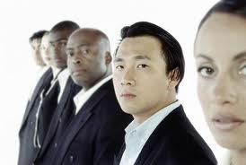
Culturally Diverse Advisory Boards and Volunteers
Cultural Guides
Cultural Guides can lead Extension educators to the “gatekeepers” of their community.
  Religious authorities
  Prominent business people
  Respected leaders

Slide 6
Culturally Diverse Advisory Boards and Volunteers
Cultural Guides
It is vital to approach a Cultural Guide from a position of equality and mutual assistance.
Avoid “tokenism”
  The selected Cultural Guide is the only individual of their community represented and should be regarded as the Extension’s steward for multiculturalism.

Slide 7
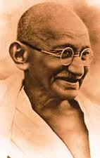
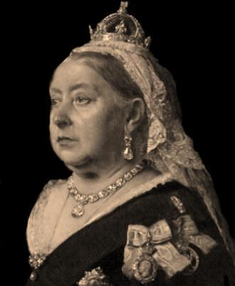
Culturally Diverse Advisory Boards and Volunteers
Cultural Guides
Individuals who are viewed by another community as formal leaders are not always regarded as such in the community they represent.
Find more than one Cultural Guide from each group that needs representation.
Mohandas Gandhi was not an official political leader.
Queen Victoria was considered the Queen of India.
Which did the people of India listen to?

Slide 8
Culturally Diverse Advisory Boards and Volunteers
Cultural Guides
Cultural Guides are helpful to educators in:
  Selecting activities and learning experiences that will be most effective and beneficial
  Designing marketing approaches
  Recruiting other volunteers from the community
  Planning how lessons are taught
    Maximizing learning style preferences

Slide 9

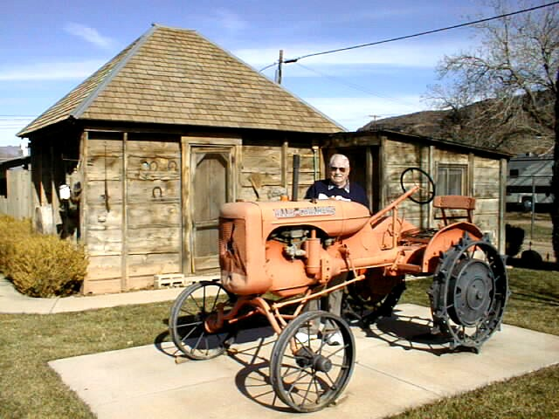
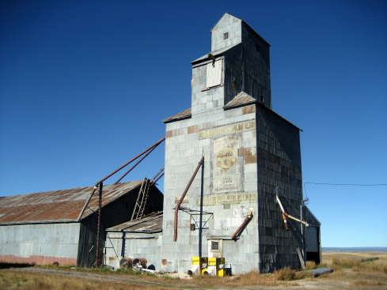
Culturally Diverse Advisory Boards and Volunteers
Our Advisory Boards and Volunteers should be representative of the communities that we serve.
Cultural Guides help to make our programs relevant to clientele.

Slide 10
An example of using cultural Guides effectively
Diabetes Education in the Latino Community
Conducted by Ann Henderson, Family and Consumer Science Extension Educator in Box Elder County

Slide 11
Diabetes Education in the Latino Community
“In order to meet the needs of the Latino population Father Schoeppe [The local Catholic Priest] invited six men and women from the parish to meet with us and help us plan the class. This group discussed the format of the class, meeting days, times, and locations, how to publicize the class, and whether measuring height, weight, waist and hip circumference, blood pressure and hemoglobin A1c would be accepted.”

Slide 12
Diabetes Education in the Latino Community
“Elsa, the secretary from the church, continued to work with us. The church provided the facilities for the class. Elsa personally contacted those who were interested in the class and prepared announcements for the church bulletin. She also helped translate a flyer that other committee members delivered [all over the city]. . . Elsa also attended each class and called participants to remind them about the classes and sometimes provided rides for participants. . . . One of the key factors that made this program successful was having Elsa work with us and guide us. She served as our “cultural guide.” She provided an essential link to the Latino population and helped us reach the population.”

Slide 13
References
Guion, L. A., Goddard, H. W., Broadwater, G., Chattaraj, S., & Sullivan-
Lytle, S. (2003). Strengthening programs to reach diverse audiences. Gainesville, FL: Florida Cooperative Extension, University of Florida.
Lynch, E., & Hanson, M. (1997). Developing cross-cultural competence (2nd ed.) Baltimore, MD: Paul H. Brookes.
Nash, K. (1999). Cultural competence: A guide for human agencies. Washington D.C: Child Welfare League of America Press.
Robinson, T.L. & Howard-Hamilton, M. F. (2000). The convergence of race, ethnicity, and gender: Multiple identities in counseling. Upper Saddle River, NJ: Prentice Hall

