Slide 1
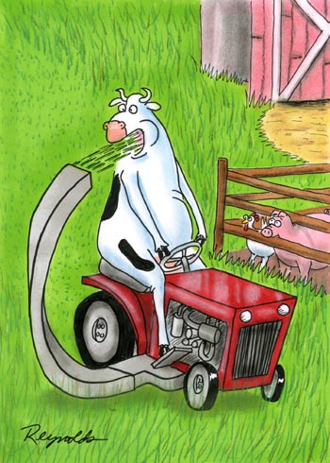
Notes:
We know cattle are selective grazers. They select diets that are higher in nutrients and lower in toxins than the average of the plants community where they are grazing

Slide 2
Behavior Depends on Consequences
Notes:
Intake and diet selection are behaviors. Many studies on behavior simply describe how animals behave as if behavior is set in stone, but any behaviorist can tell you that behavior depends on consequences.

Slide 3
Behavior
Consequences
Consequences
Consequences
Notes:
Positive consequences increases the likelihood of a behavior recurring and negative consequences decrease the likelihood of a behavior recurring. Though behaviors are easiest to change in young animals, behavior is flexible throughout life.

Slide 4
Behavior
Consequences
Notes:
Positive consequences increases the likelihood of a behavior recurring and negative consequences decrease the likelihood of a behavior recurring. Though behaviors are easiest to change in young animals, behavior is flexible throughout life.

Slide 5
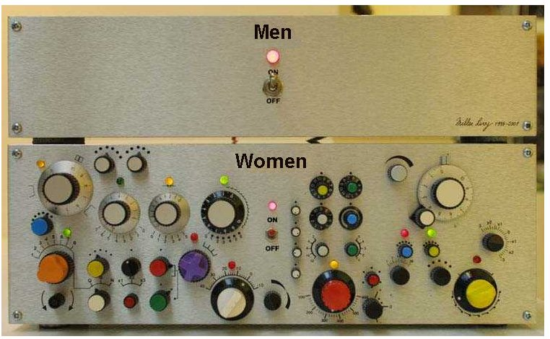
Notes:
I’d like to tell you that diet selection is like MEN but it’s more like WOMEN

Slide 6
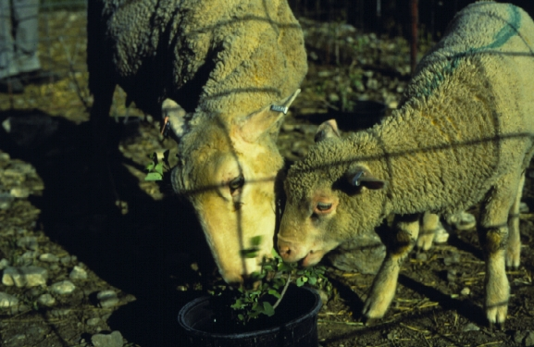
Mother Knows Best
Notes:
Mom has the greatest influence on an animal’s food and habitat preferences. Learning from mom is efficient. Mom’s a good role model because she has been successful enough at foraging to grow up and reproduce. Mom likely knows the plants in the area where her offspring will be foraging.

Slide 7
Lambs Eat What Mom Eats and Avoids What She Avoids
Number of bites/lamb
Notes:
In this study, ewes with lambs were either averted to serviceberry or mountain mahogany. Then ewes and lambs were allowed to eat with their mothers and given a choice of the two shrubs. Lambs ate what mom ate and avoided what she avoided.
The slide above is data from lambs whose mothers ate serviceberry but avoided mountain mahogany. Lambs whose mothers ate mountain mahogany but that avoided serviceberry did the reverse.
REF: Mirza, S.N. and F.D. Provenza. 1990. Preference of the mother affects selection and avoidance of foods by lambs differing in age. Appl. Anim. Behav. Sci. 28:255-263.

Slide 8
. . .even after weaning
% of bites by lambs
Days after weaning
Notes:
Even after weaning lambs continued to prefer what mom ate and avoid what she avoided.

Slide 9
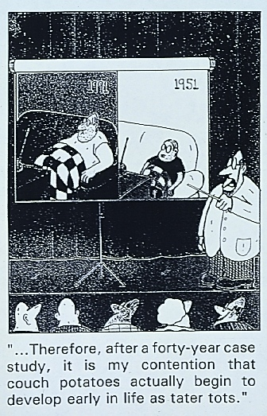
Experience Changes the Body
Neurology
Structure
Physiology
Notes:
Experience changes animals, not only their behavior but also the structure of their bodies and the way their bodies work.

Slide 10
Experience changes the body
Brain structure and function
Liver function
Nitrogen recycling
Rumen size
Rumen papilla size and number
Notes:
These are examples of how experience changes the the body.

Slide 11
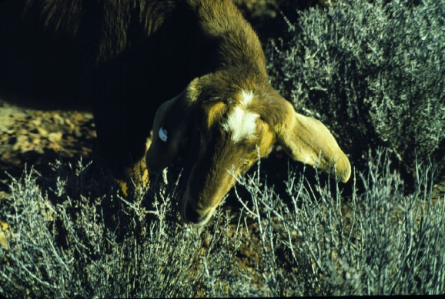
Foraging Skills
Notes:
I generally skip this slide and go straight to the video on foraging skills.
The rate at which goats and sheep are able to ingest grasses and shrubs increases with experience. In one study, bite rates nearly doubled as experience increased from no experience to 30 days of browsing the shrub blackbrush. Younger animals 6 months of age learned foraging skills more quickly than older animals 18 months of age. After 20 days, biting rate for animals exposed to blackbrush at 18 months of age had leveled off whereas biting rate for goats exposed at 6 months were still increasing even after 30 days.
REF: Ortega-Reyes L. and F.D. Provenza. 1993. Amount of experience and age affect the development of foraging skills of goats browsing blackbrush (Coleogyne ramosissima). Appl. Anim. Behav. Sci. 36:169-183.

Slide 12
Palatability: More than a Matter of Taste
Notes:
Read slide. Why do you like the foods you like?

Slide 13
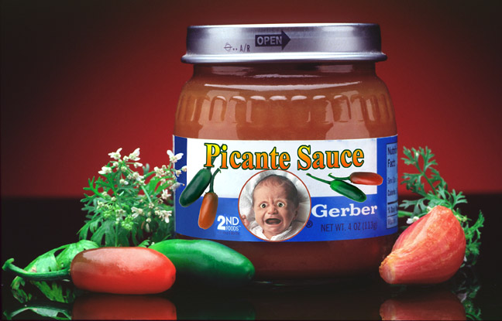
Notes:
If we only like foods that taste good, then why do we sometimes not like foods the first time we eat them? We may continue to eat these foods due to social pressures or lack of alternatives and learn to like them if the consequences of eating the foods are positive.
Coffee, beer, avocados are examples of foods that may not taste good to at first but taste good after eating the food several times.

Slide 14
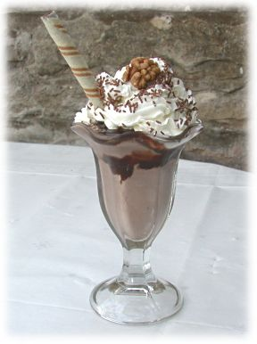
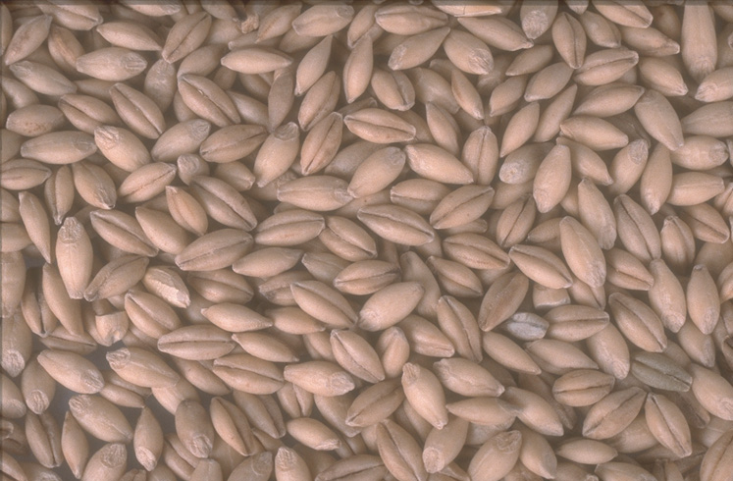
Nutrients Increase Palatability
Notes:
Palatability depends on feedback from nutrients and toxins. Nutrient increase palatability.

Slide 15
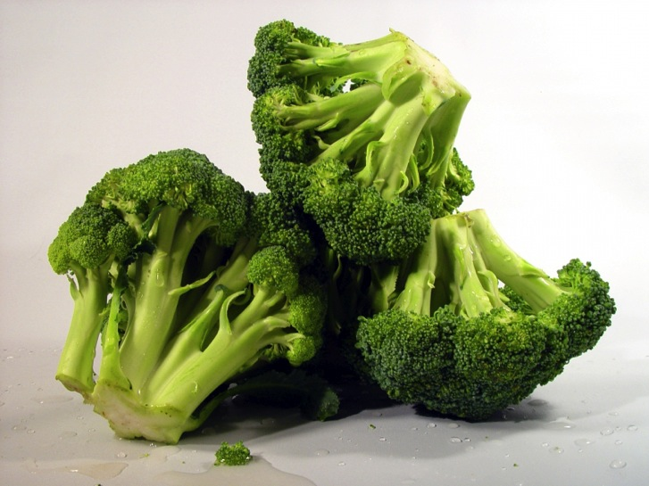
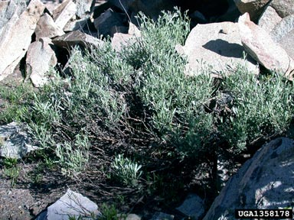
Toxins Decrease Palatability
Notes:
Toxins decrease palatability.

Slide 16
Plants with Toxins
Poisonous
Plants
Notes:
Plants with toxins aren’t necessarily poisonous plants. While virtually all plants contain toxins only a few cause morbidity or mortality losses and are termed poisonous.

Slide 17
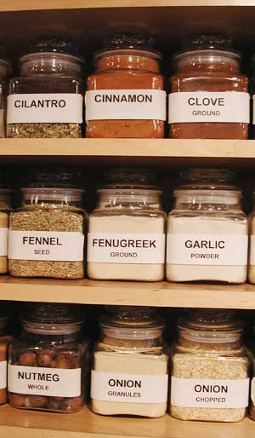
Flavors apart from feedback are neither palatable or unpalatable
Feedback tells the body whether a particular food flavor is useful or harmful.
What is the purpose of flavor?
Flavor allows animals to discriminate between foods.
Notes:
So what good is flavor? It enables us to tell foods apart. It also allows us to associate nutrients, which make us feel good and experiences, with a particular flavor. That’s why some foods make us feel all warm and fuzzy.

Slide 18
They can’t be that smart.
Changes in preferences for foods are automatic.
They don’t have to think about them.
At times, they are not rational.
Notes:
People often have a hard time believing animals especially livestock are smart enough to learn about foods. It isn’t a matter of intelligence because changes in palatability occur automatically. Animals don’t need to think about or remember the flavor-feedback event. The same is true for digestion. I often ask how many of you have to tell the pancreas to release a dose of insulin after eating a meal? Even when animals are deeply anesthetized, postingestive feedback still causes changes in the palatability of a food eaten just prior to anesthesia. When sheep eat a nutritious food and then receive a toxin dose during deep anesthesia, they become averse to the food because the negative feedback of the toxin still occurs even when the animals are deeply asleep.
You can chose what you put in your mouth but you can’t chose how you feel about that food.
This is the most important point in this section you need to make.
Read booklet: Ch. 3 pg 17
REF: Provenza, F.D. Provenza, F.D., J.J. Lynch and J.V. Nolan. 1994. Food aversion conditioned in anesthetized sheep. Physiology & Behavior 55:429-432.

Slide 19
Variety is the Spice of Life
Notes:
Variety is the spice of life.

Slide 20
Monotony – Same Flavor
Intake (g)
Notes:
In this study, two groups of steers were fed maple- or coconut-flavored straw all day for one day. Then for the next 5 days they were offered a choice of coconut or maple flavored straw for 1 hr/day. Steers that previously ate maple preferred coconut and vice versa.
Atwood, S.B., F.D. Provenza, R.D. Wiedmeier and R.E. Banner. 2000. Changes in preferences of gestating heifers fed untreated or ammoniated straw in different flavors. J. Anim. Sci. 79:3027-3033.

Slide 21
Preference for Nutrients
Preference
Meal
Energy
Protein
High Energy
High Protein
Notes:
After a meal high in energy animals prefer foods higher in protein. And after a meal excessive in protein they prefer foods higher in energy and lower in protein.

Slide 22
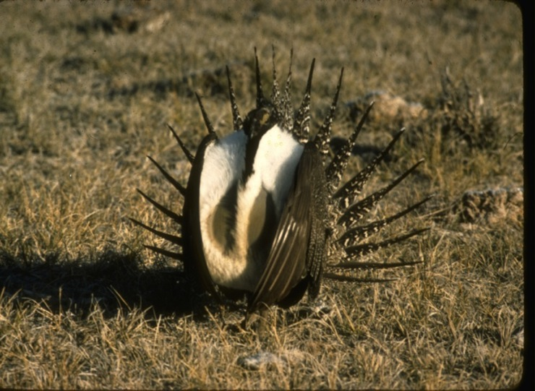
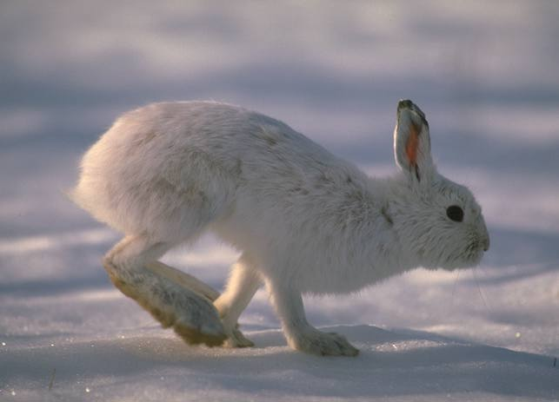
Most toxins limit intake, and cause animals to eat a variety of foods
Notes:
Most toxins cause animals to limit intake of a particular plant species and cause them to eat a variety of foods.

Slide 23
Toxins Limit Intake
Intake of oats, g
Notes:
Animals don’t refuse to eat plant with toxins. As long as the toxins causes nausea and most toxins do, animals can figure out how much of a toxin-containing food they can eat. Toxins set a limit on intake. In the experiment above, lambs fed oats coated with 0.75% LiCl eat about twice as much food as lambs receiving oats with 1.5% LiCl.
Launchbaugh, K.L., F.D. Provenza and E.A. Burritt. 1993. How herbivores track variable environments: Response to variability of phytotoxins. J. Chem. Ecol. 19:1047-1056.

Slide 24
Neophobia:
I never tried it I don’t like it
Notes:
Read slide

Slide 25
Animals Sample Novel Foods
Intake (g)
Day
Notes:
Most animals, including people, don’t like to eat new foods. They are neophobic with regards to foods. When animals encounter a new food, they sample the new food carefully and if their experience with the food is positive then they slowly increase consumption of that food. If the flavor of the food changes then intake declines but then increases again as long as consequences are positive.
Neophobia – fear of new things

Slide 26
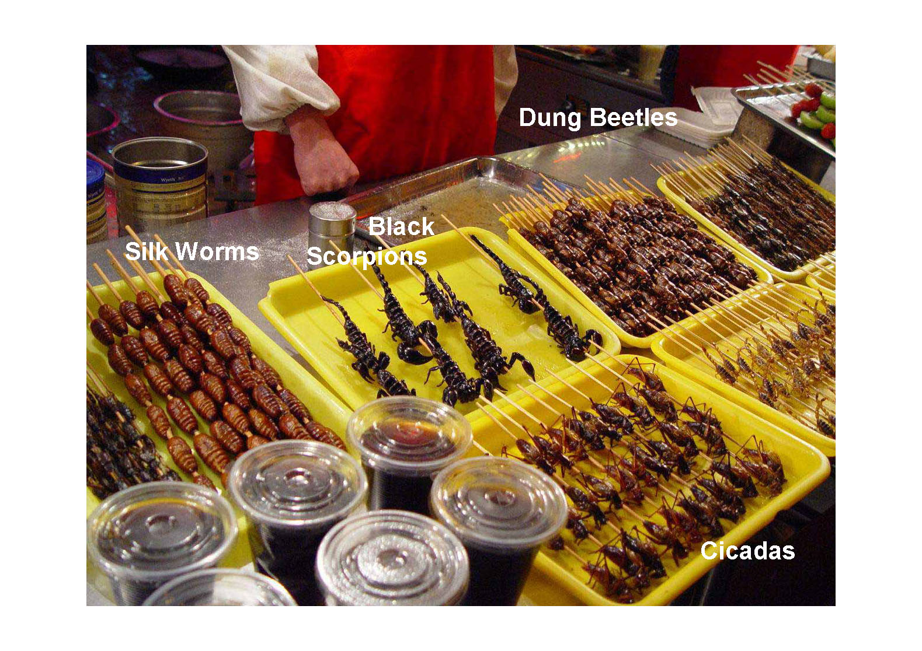
Beijing fast food
Notes:
The next few slides are from a pdf entitled Beijing Fast Food.

Slide 27
Beijing fast food

Slide 28
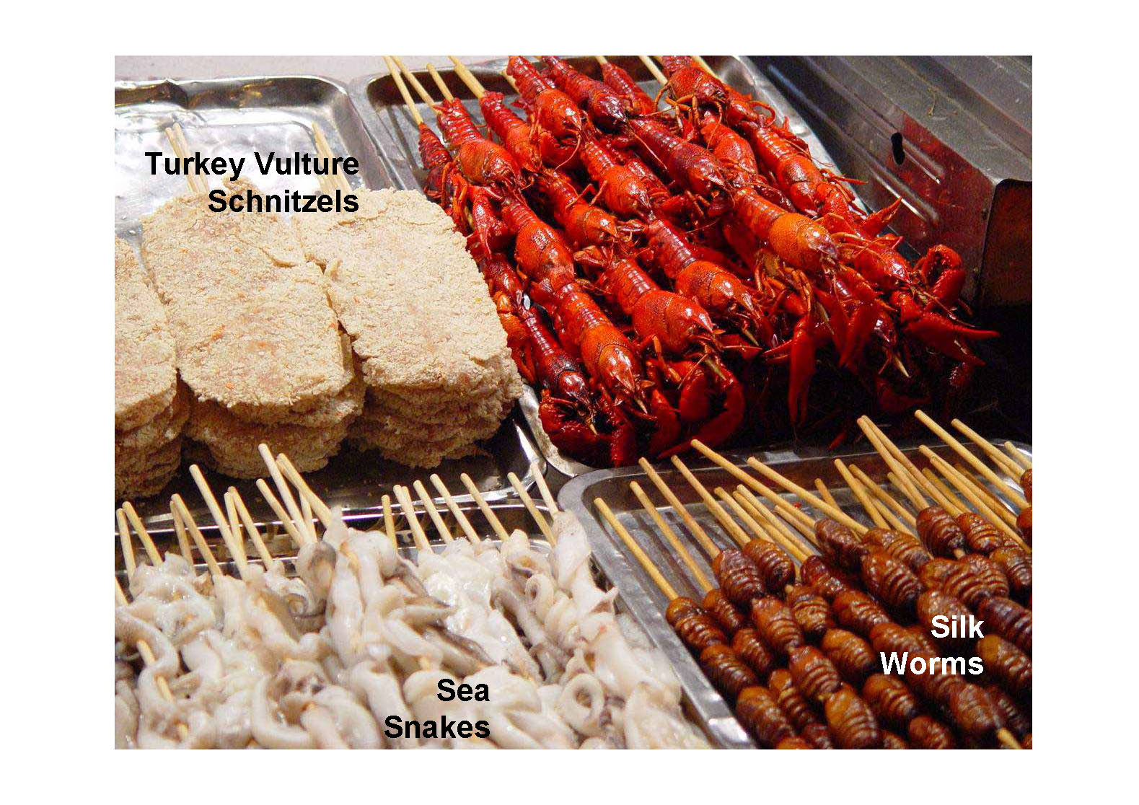
Beijing fast food

Slide 29
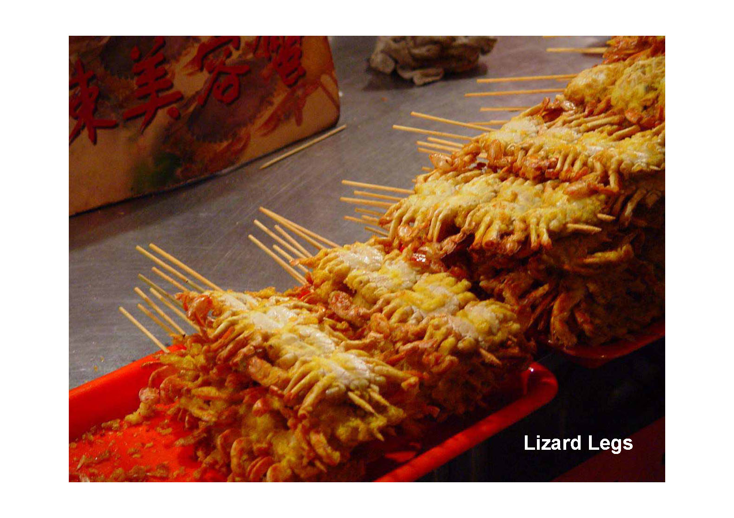
Beijing fast food

Slide 30
Beijing fast food

Slide 31
How does neophobia keep animals safe and help them learn about new foods?

Slide 32
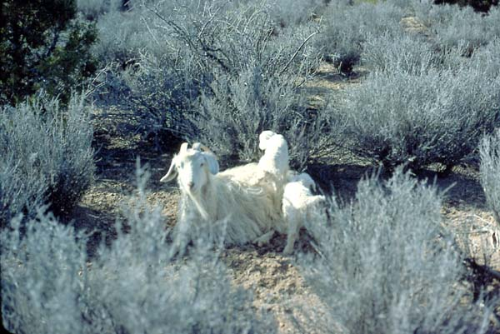
Notes:
At weaning, animals already have a repertoire of safe, familiar, nutritious foods they learned to eat by foraging with their mothers.

Slide 33
Familiar-Novel Dichotomy
Barley
Oats
Alfalfa
Corn
LiCl
Rye – Novel Food
Day
Notes:
When animals eat a meal of familiar foods and a novel food then experience illness, they reduce consumption of the novel food. These sheep were dosed with LiCl on day 1 of this experiment after eating a meal of 4 familiar foods and 1 novel food. Corn, barley, alfalfa and oats were familiar foods, rye was novel.
Note corn consumption also declined. When these lambs were first introduced to corn, we found regurgitated corn in their pen and believe they got sick on corn. When they got sick again they reduced corn consumption because it had made them ill in the past. A follow up study confirmed that this is likely what happened.

Slide 34
How cattle learn about new foods
Mom and Peers Don’t Eat
New Food
New Food
if familiar foods are inadequate
Nutrients and Toxins
Mom and Peers Eat
Feedback
Seek variety
negative
+ Toxins
Same flavor
posi tive
+ Nutrients
Unpalatable Familiar Foods
Palatable Familiar Foods
Notes:
This is a summary of behavior principles. Hopefully, it is self-explanatory.

Slide 35
How do cattle select their diets?
They prefer:
to forage with companions
familiar foods
foods high in nutrients and low in toxins
to eat a variety of foods
familiar foods that are rare in the environment

Slide 36
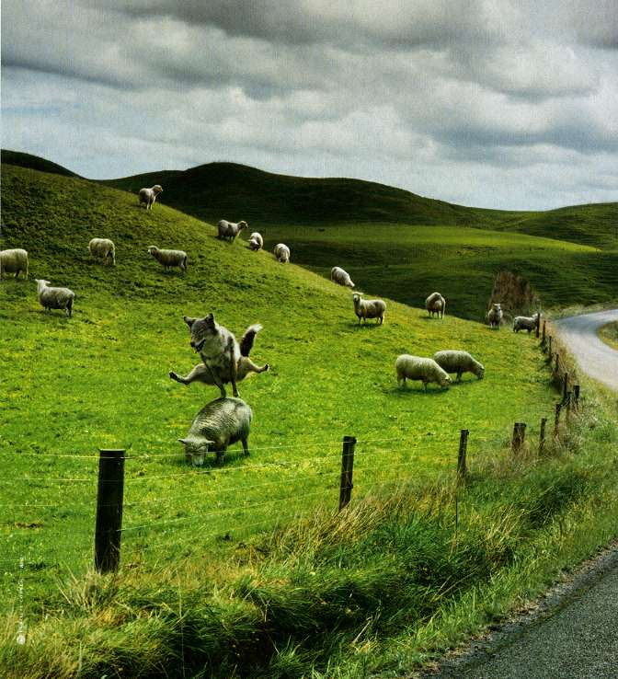
. . . but young dogs learn them quicker.
Notes:
Read slide. Remember experience early in life has the most profound effect on behavior.

Slide 37
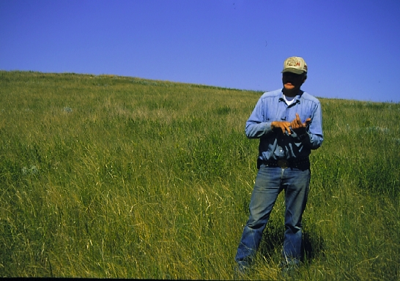
Biodiversity and
Boom-bust Grazing
Notes:
Ray Banister manages 7,200 acres of rangeland in eastern Montana. His management style has evolved over 40 years from reliance on rotational grazing that involved relatively short periods of grazing and rest to boom-bust management that consists of intensive periods of grazing followed by a 2-year period of rest. Ray’s boom-bust grazing management stresses systems - plants and cattle - with intensive grazing pressure, then allows them to recover. Ray believes that stress, and recovery from stress, strengthens systems.
Ray was able to retrain his cattle to eat all the plants on his rangeland thereby not giving unpalatable species a competitive advantage over palatable plants because unpalatable plants are never grazed.
Read about Ray Banister in booklet Ch 6 pg 47

Slide 38
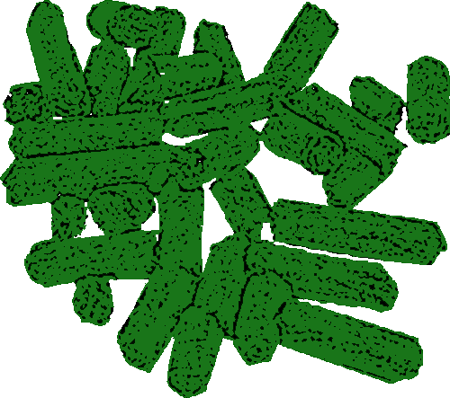
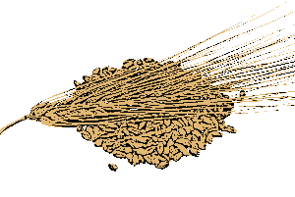
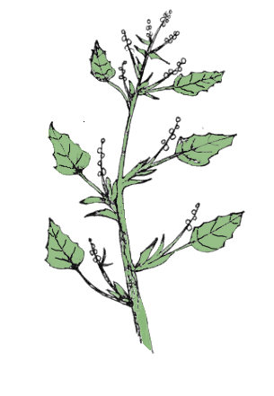
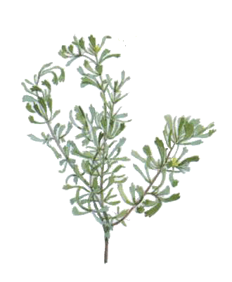
Inexperienced
Experienced
alfalfa pellets
alfalfa pellets
barley
Tannins
ex. bitterbrush
barley
Oxalates
Terpenes
ex. lambsquarter
ex. sagebrush
Notes:
A study was conducted at USU to determine if experience affected intake of plants that contained toxins. Three toxins were used in the study, foods contained either condensed tannin, terpenes or oxalate. One group of lambs were exposed to one toxic foods at a time until they had experience with all three foods. The other group of lams had no experience with the toxins. Animals were offered 5 foods daily. Sheep were further divided into four groups. Two groups (experience and no experience) were given free-access to the 3 toxin-containing diets plus alfalfa and an alfalfa-barley diet. The other two groups (experience and no experience) were fed 200 g each of alfalfa and an alfalfa-barley diet and free-access to the 3 toxin-containing diets.

Slide 39
Experience Affects Intake of Oxalates, Tannins and Terpenes
Intake g/d
Restricted
Ad libitum
Notes:
Experienced sheep ate more toxic food than inexperienced sheep whether food was restricted or offered free choice. Animals with no experience with toxic foods and with free access to all 5 foods, ate virtually no toxic food. While experienced animals with free choice still ate about 800 g/d of toxic food.
REF: Villalba, J.J., F.D. Provenza and GouDong. 2004. Experience influences diet mixing by herbivores: Implications for plant biochemical diversity. Oikos 107:100-109

Slide 40
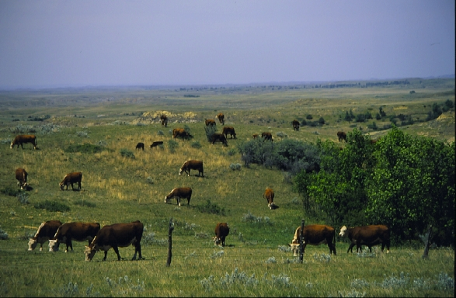
Ray’s cattle learned to “mix the best with the rest”
Rather than “eat the best and leave the rest.”
Notes:
Under boom-bust management, Ray’s cattle eat formerly unpalatable species such as snowberry and sagebrush as soon as they enter a new pasture. The cows evidently have learned how to mix their diets in ways that better enable them to eat both the palatable and the unpalatable species. Cattle likely lessen the aversive effects of toxins by eating palatable plants high in nutrients along with unpalatable species high in toxins. The higher the nutritional plane of the animal, the better able they are to detoxify toxic compounds found in all plants.

Slide 41
Learning to Eat Sagebrush

Slide 42
Terpenes limit intake of sagebrush
Daily Intake of Ration (g)
Daily Intake of Terpenes (g)
Terpene Concentration in Ration (%)
Notes:
Terpenes limit intake. In the study above, lambs could only eat about 27 g of terpenes/day. Lambs on the control diet (0%) and on the low (1.55%) terpene diets ate similar amounts of food each day and they ate much more than lambs on the medium (3.1%) and high (4.65%) terpene diets.
REF: Dziba, L.E. and F.D. Provenza. 2008. Dietary monoterpene concentrations influence feeding patterns of lambs. Appl. Anim. Beh. Sci. 109-49-57.

Slide 43
Supplemental nutrients - energy, protein - enhance intake of foods that contain toxins
Notes:
Read slide

Slide 44
Nutrient-Toxin Interactions
Intake of Sagebrush (g)
Notes:
Intake of sagebrush more than doubled for both goats and sheep when they are supplemented with nutrients (energy and protein).

Slide 45
Weight Changes (lbs)
Weight Changes of Cattle Eating Sagebrush During a Three Year Study
exp
inexp
exp
inexp
exp
inexp
inexp
18 to 19 days on sagebrush and supplement
Notes:
In the first year of the study, all cows were naïve to sagebrush and they lost about 2.1% of their body weight during the trial. In 2008, experience cows and heifers ate more sagebrush than inexperienced cows and heifers. In 2009, experienced heifers actually gained weight during the trial, while inexperienced heifers lost weight. Experience made a huge difference in sagebrush intake and performance on sagebrush by cattle. Cows used in the studies had a calf at their side. In 2008, bred heifers were used and they were calves in the 2007 trial. In 2009, heifers were first calf heifers and were calves in the 2007trial and bred heifers in the 2008 trial

Slide 46
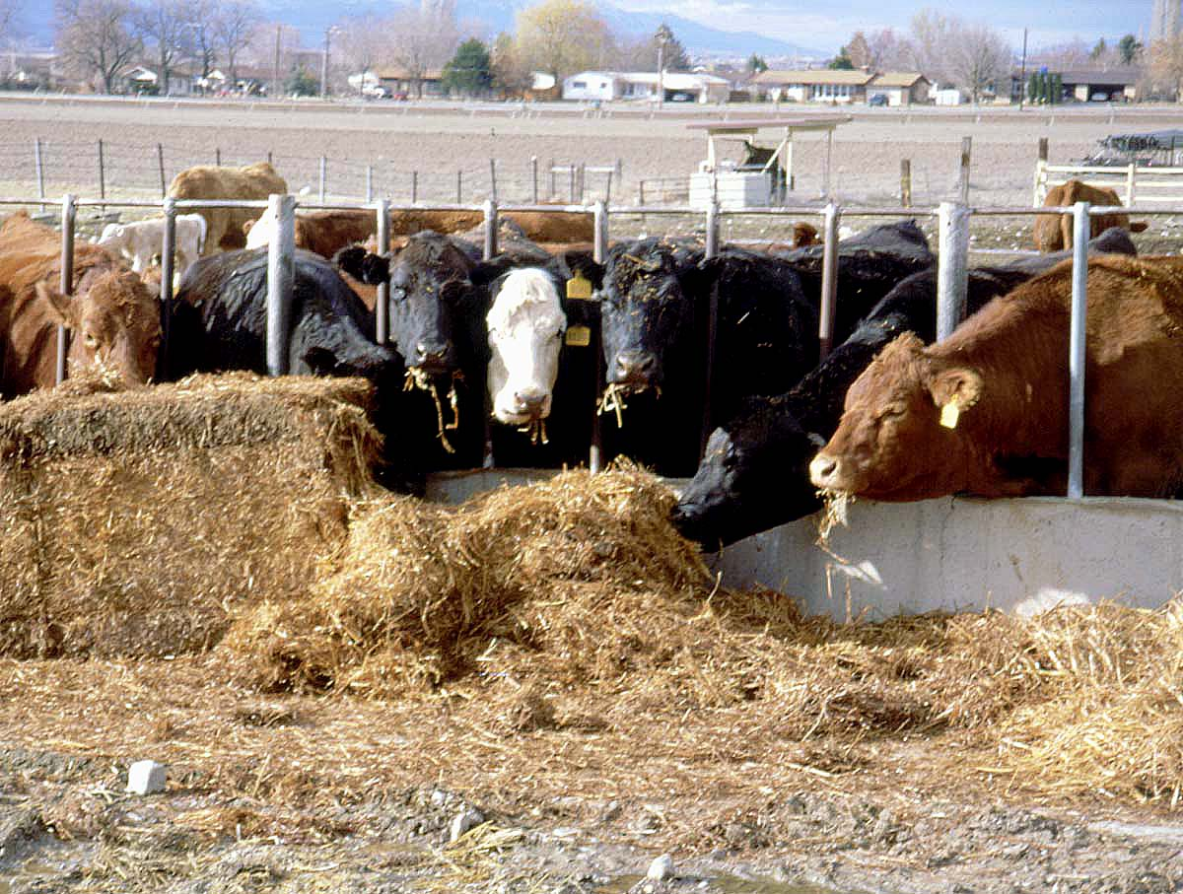
Same straw
Different performance
Notes:
To reduce the cost of ranch operation, researchers and producers are exploring ways to feed low-cost foods such as ammoniated straw to livestock during winter. During a 3-year trial, 32 cows - 5 to 8 years of age- were fed straw from December to May. Some cows performed poorly, while others maintained themselves on the diet. Why did cows perform so differently?

Slide 47
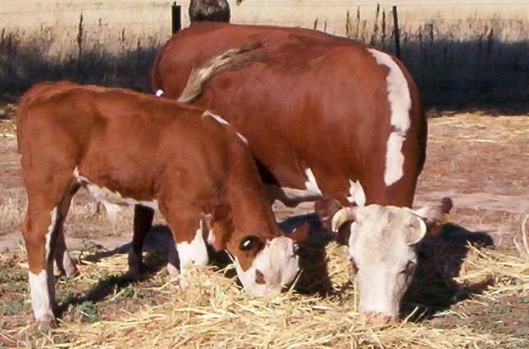
Different experience
Notes:
Researchers often don’t pay any attention to the dietary histories of their animals.
Researchers were baffled until they examined the dietary histories of the animals. Half of the cows were exposed to straw during their first 3 months of life, while the other half had never seen straw.
The story about this research project is more important than the data section because this was a study Randy Wiedmeier, the researcher, didn’t know he was doing. Fortunately for Randy, he’d had these animals from birth and a technician who remembered some of the animal’s dietary histories. When they check the records of the cattle half had been exposed to straw and half had not.
Read booklet: Ch. 2 pg 8
REF: Wiedmeier, R.D., F.D. Provenza and E.A. Burritt. 2002. Performance of mature beef cows wintered on low-quality forages is affected by short-term exposure to the forages as suckling heifer calves. J. Anim. Sci. 80:2340-2348.

Slide 48
Experience Influences Performance
Year 1 Year 2 Year 3
Body weight * * *
Body condition * * *
Milk production * * -
Post-partum interval * * -
Notes:
Even though they had not seen straw for 5 years, the experienced cows maintained higher body condition, produced more milk, lost less weight, and bred back sooner than cows with no exposure to straw throughout for 2 to 3 years of the study. Experience early in life has lifelong influences on animals that affects the efficiency and profitability of production systems.
Imagine if all of Randy’s cows had been exposed to straw as calves. His conclusion would have been straw is an adequate winter food. His conclusion could have been devastating for a producer.

Slide 49
“You gotta check this out, Stuart. Vinnie’s over on the couch putting the moves on Zelda Schwartz - but he’s talking to the wrong end”
Notes:
Sometimes researchers don’t know which end is up. If researchers conducting the straw study had used animals with experience, they would have concluded that feeding ammoniated straw was an adequate winter-feed. Then if a producer tried to use ammoniated straw, his cattle would have exhibited reductions in performance. If all of the cattle on the straw study had no experience with ammoniated straw, they would have concluded that ammoniated straw caused large decreases in performance possibly rejecting a viable winter-feed alternative for some operators.

Slide 50
Notes:
Sagebrush plot after fall grazing with sheep.

Slide 51
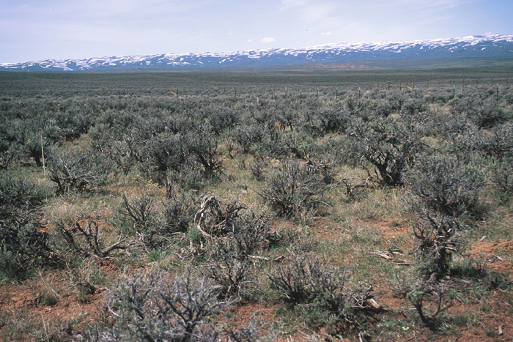
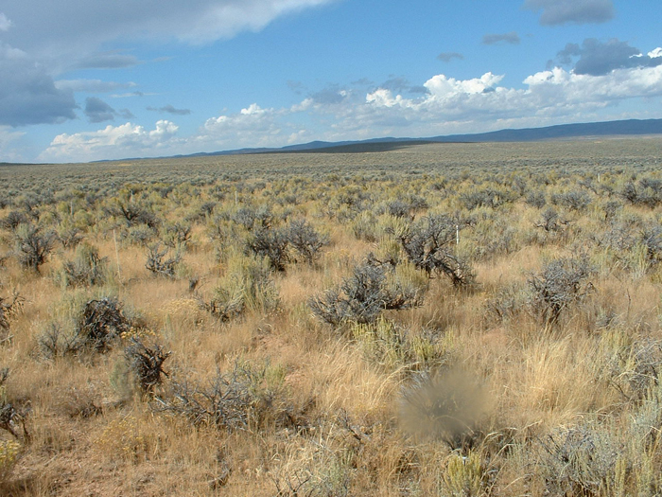
Spring 2004
Fall 2005
Notes:
These photos show recovery after the grazing treatment.

Slide 52
Training Cows to Eat Weeds

Slide 53
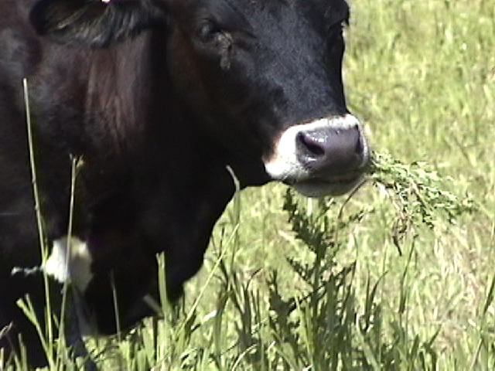
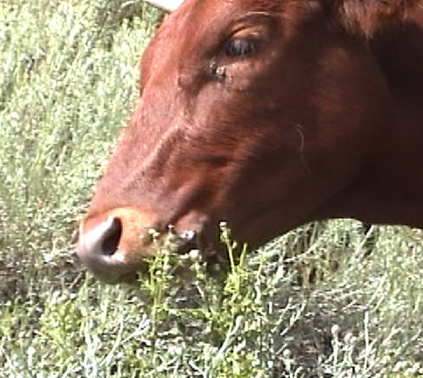
. . . by reducing novelty and
providing variety and positive feedback.
Notes:
Cattle were trained to eat leafy spurge, Canada thistle and spotted knapweed.

Slide 54
1. Know your weed
Nutrients
Toxins
Nutrient/Toxin Interactions

Slide 55
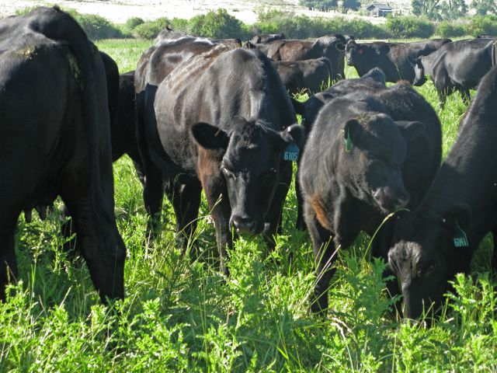
2. Work with the right animals
Young
Female
Healthy
Manageable
in Number and Temperament
Notes:
It’s important to work with the right animals. Young animals are more likely to try something new and females pass diet selection knowledge on to their young. Animals use additional nutrients when processing toxins, so it’s important that animals be healthy and that you never starve them into eating something. Finally choose a number that is manageable for you to train. You don’t have to train the whole herd because trained animals will train their herd mates. So choose a number that is manageable for you and your operation. And remember, it helps if they are accustomed to humans, or to coming to a horn a truck, or some other signal.

Slide 56
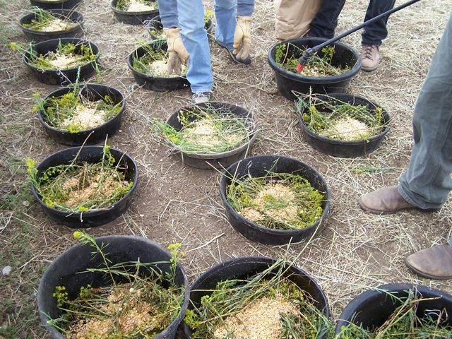
3. Build on how animals learn
Reduce fear of new things
Make the unfamiliar seem familiar
Notes:
To get cows used to trying new foods, I feed them a different, unfamiliar, but nutritious food, once in the morning and once in the afternoon, using the same tubs or troughs. I do this for four days, or until the animals’ response shows me that they know that even though the foods I give them may look a little strange, they are all still “food.” We also know that creatures generalize from one familiar odor or flavor to another, so I help them get used to new foods and to the weeds I feed them, by including a familiar flavor or odor. This can be a food they are familiar with, like rolled corn, or a spritz of watered down molasses (25% molasses to 75% water)

Slide 57
4. Test animals in trial pastures
Small
Provide a variety of forages
Notes:
Once animals are eating well from tubs or troughs (usually 3 days), put them in trial pastures. I use small pastures (a day to a day and a half of forage) because animals need to learn how to harvest the target weed on their own, so this gives them just enough pressure to encourage them to try and it also lets me observe animals to judge their progress. I never put animals in a solid stand of my target weed. They need plenty of variety, both in their trial pastures and in any pasture.

Slide 58
Cattle in Feedlot and on Pasture

Slide 59
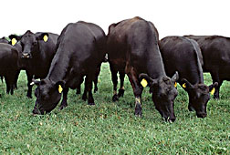
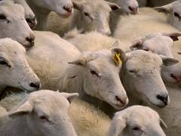
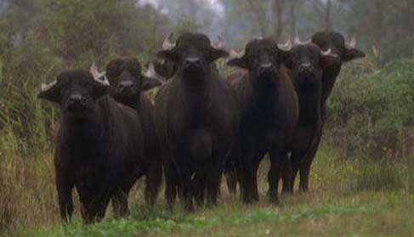
Sometimes they may all look alike . . .
. . . but
each one is a unique individual
Notes:
59
Often a group of animals all look the same to us but each animal is unique.

Slide 60
Mean
Number of Individuals
Ability to Cope with Toxin X
Requirement for Nutrient X
Notes:
Within a population most of the individual have similar needs for nutrients or abilities to cope with toxins but a few individuals have have a greater or lesser need for nutrients or resistance to toxins.
These differences among animals allow species to adapt to changing environments and can be use to produce animals to perform specific tasks for example eating unpalatable weeds.

Slide 61
Variation among Goats
Notes:
For example, most goats eat very little current season’s growth blackbrush (CSG) less than 200 g/d. CSG is high in tannins. But about 20% of goats will eat double that amount with no adverse effects.

Slide 62
Food Preferences
Intake (g/d)
Individual lamb
Notes:
Lambs uniform in age, sex, and breed vary in their preferences for foods. 24 lambs were offered the choice between barley and alfalfa pellets for several weeks. Some preferred foods high in energy. Others preferred foods with medium or even low concentrations of energy. Amounts of energy that condition preferences in some lambs cause aversions in others. Allowing animals to choose between alternative foods enables them to meet individual needs.
Scott, L.L., and F.D. Provenza. 1998. Variety of foods and flavors affects selection of foraging locations by sheep. Appl. Anim. Behav. Sci. 61:113-122.

Slide 63
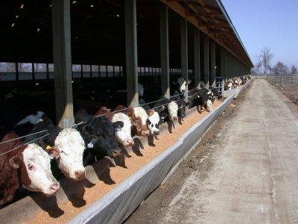
Total Mixed Ration versus Free Choice corn, barley, alfalfa, corn silage
Notes:
If animals are fed a nutritionally balanced total mixed ration or given a choice of the individual ingredients in the ration which group would perform the best?
or
What happens when cattle are given a choice of foods in the feedlot?
Atwood, S.B., F.D. Provenza, R.D. Wiedmeier and R.E. Banner. 2000. Influence of free-choice versus mixed-ration diets on food intake and performance of fattening cattle. J. Anim. Sci. 79:3034-3040

Slide 64
Mixed Ration vs Choice
Choice cost 19% less to feed than mixed.
Cattle were able to meet individual needs.
Notes:
No animal given a choice selected a diet similar to the total-mixed ration, and nor chose the same foods day after day. Yet each animal apparently selected a diet that met its needs.
1. Both groups consumed similar protein:energy ratios
2. Gain per unit food consumed was similar for both groups and they gained at the same rate.
3. Cost/lb gain was 19% less for the choice group than for the mixed-ration group because they ate less expensive foods but had the same.
These findings suggest that: (1) animals can meet their needs for energy and protein more efficiently when offered a choice among foods than when fed a mixed-ration, even if the ration is “nutritionally balanced”; (2) offering animals a choice of foods may reduce feeding costs; and (3) allowing individuals to choose their own diet may be less stressful for animals reducing illness and improving performance.

Slide 65
Finishing Your Cattle
Expose young animals with their mothers to foods they will eat in the feedlot or to a variety of foods.
Use across the fence weaning techniques.
Remove cows and leave calves.
Introduce animals to high concentrate foods slowly.
Let animals balance their own ration. Give animals choice of appropriate foods.
Notes:
This slide outlines how an individual producer can use some of the ideas presented in this workshop in his own operation.

Slide 66
Pasture Design
Mixtures versus Blocks
x o x o x o x o x o x o
o x o x o x o x o x o x
x o x o x o x o x o x o
o x o x o x o x o x o x
x o x o x o x o x o x o
o x o x o x o x o x o x
x x x o o o x x x o o o
x x x o o o x x x o o o
x x x o o o x x x o o o
x x x o o o x x x o o o
x x x o o o x x x o o o
x x x o o o x x x o o o
Notes:
How about on pasture? Studies indicate that offering animals mixtures of plants rather than monocultures improve intake and production. Do you think animals would do best if plants were interspersed or if they were planted in strips?

Slide 67
Increases in Production on Grass-Clover Pastures
Sheep
25% increase in daily dry matter intake (265 g/d)
Dairy Cattle
11% increase in milk production (2.4 kg/cow/d)
Notes:
The results outlined above indicate that animals perform best when pasture species are planted in strips or blocks rather than interspersed. This makes it easier for animals to select their diet.
The one problem with this idea is that grasses don’t benefit from nitrogen fixing by legumes.

Slide 68
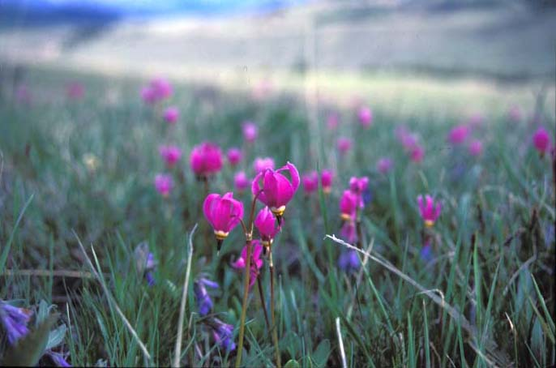
Diversity enables individuals to regulate intake of nutrients and toxins
Planting Pastures

Slide 69
Moving to New Locations

Slide 70
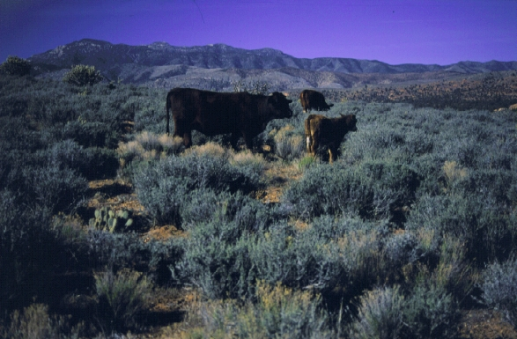
Moving to New Locations
Buy replacement animals from areas that are similar to where his cattle forage.
Notes:
Rod Leavitt runs his cattle on blackbrush dominated rangelands in southern Utah during the winter. Blackbrush is poor nutritionally and difficult to browse. Before buying cattle, Rod visits the place where the cattle were raised, and he only buys replacement animals from areas similar to the blackbrush range.

Slide 71
Poisonous Plants
Gila versus Apache Counties
Notes:
Mick Holder, a rancher in Arizona, writes:"Gila County is mercifully deficient in poisonous plants, but we have lupine and loco in small or moderate stands. In 30 years of ranching, I never had a problem with either. I leased rangeland in Apache County and moved a portion of my cattle to that location during a drought period and suffered severe losses to poisonous plants, while the sister cattle left here in Gila County on equally poor rangeland did not have one case of loco or lupine poisoning. Did they not recognize the plants because they had been relocated 100 miles east?"
Read booklet: Ch. 5 pg. 31

Slide 72
Animals Prefer Familiar - Toxic Plants - to Unfamiliar Plants in Unfamiliar Environments
Notes:
It may seem strange, but animals prefer familiar to unfamiliar foods, even if the familiar foods are toxic, and this response is especially pronounced in unfamiliar environments. Cattle in Gila county preferred familiar, toxic foods to unfamiliar foods. Holder summed it up: "The only plausible explanation I would make after reading your paper is that moving cattle to Apache County suspended their aversions to familiar plants - loco and lupine - due to the unfamiliar settings or the lack of diversity of browse found in the Pinyon-Juniper habitat.... painful lesson for us both."
There also is evidence that the same dose of a toxin has a much greater effect in an unfamiliar environment compared to a familiar one. The added stress heightens the toxin's action on the animal, likely by diminishing the effectiveness of detoxification processes, much as chronic stress suppresses immune responses. Thus, cattle may have ingested amounts of toxic plants that were sub-lethal in the familiar environment but lethal in the unfamiliar environment.

Slide 73
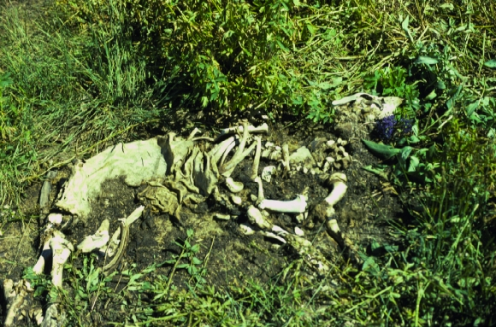
Ease the transition
with familiar foods
Notes:
Providing animals with foods they will encounter in the new area prior to moving them or providing them with familiar, nutritious foods while they are adapting to an unfamiliar environment can mean the difference between life and death.

Slide 74
Changing Habitat Preferences

Slide 75
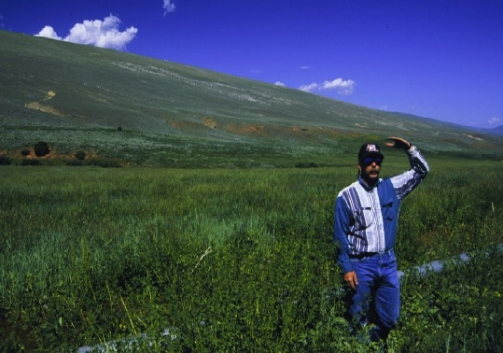
Notes:
This is Bob Budd he manages the Nature Conservancy’s Red Canyon Ranch. He has shown that cattle can be trained to increase use on uplands and reduce use on riparian areas thus protecting sensitive areas without fencing.

Slide 76
1994
2001
Notes:
Riparian areas recovered when cattle were no longer allowed to lounge in the bottoms. Bob used a combination of riding and rotational grazing. He doesn’t graze the same pasture at the same time of year. Prior to his management, I believe small groups of cattle were allowed to graze season long. After management change the land not only looked better but they had much more forage.

Slide 77
1995
1998
Notes:
Another example

Slide 78
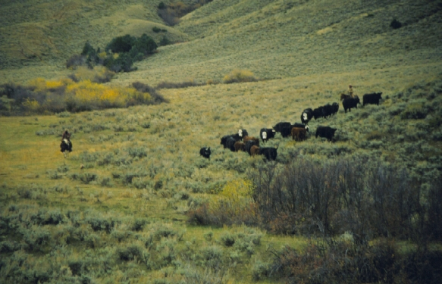
Notes:
Riding is a means for people to retrain cows and to train calves to prefer upland to riparian habitats. Riders using low stress livestock handling techniques, move animals from sensitive or overused area to new area that provide fresh nutritious forage.
Likewise, culling cows that overuse riparian areas, and keeping heifer calves whose mothers use uplands, will result in cattle herds that prefer upland to riparian areas.
Providing alternative shade and water sources away from riparian areas improves efforts to change cattle behavior.

Slide 79
Strategic supplementation improves use of forage and landscapes

Slide 80
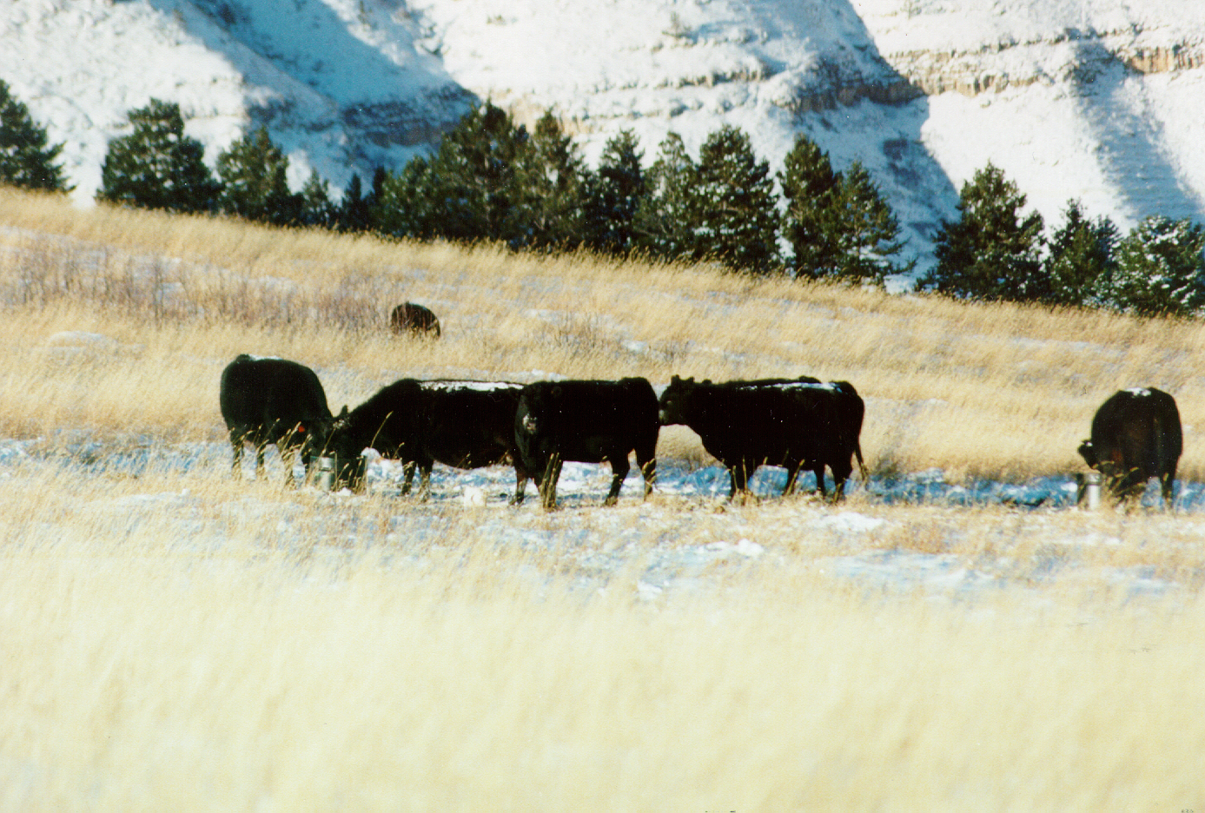
Low moisture blocks (LMB) contain 2 – 4 % moisture.
LMB are available in 125 - 250 lb containers.
LMB (250 lb) only need to be replaced about once every 2 weeks when fed 1 barrel per 25 cows.

Slide 81
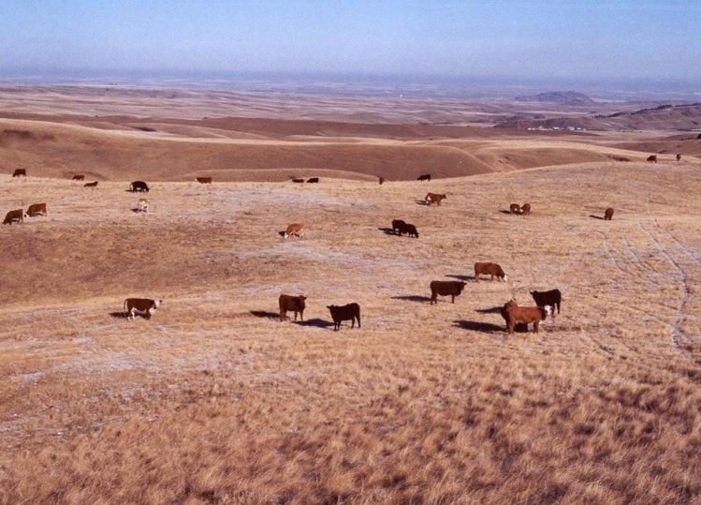
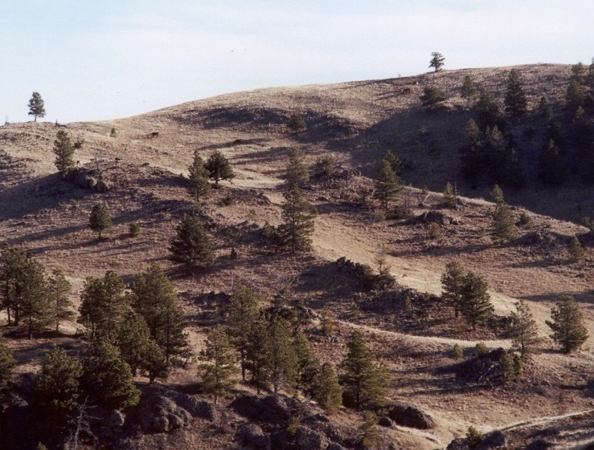
Low moisture block (LMB) effectively increased and focused grazing in moderate terrain.
LMB attracted cows to graze difficult terrain that typically was not used.

Slide 82
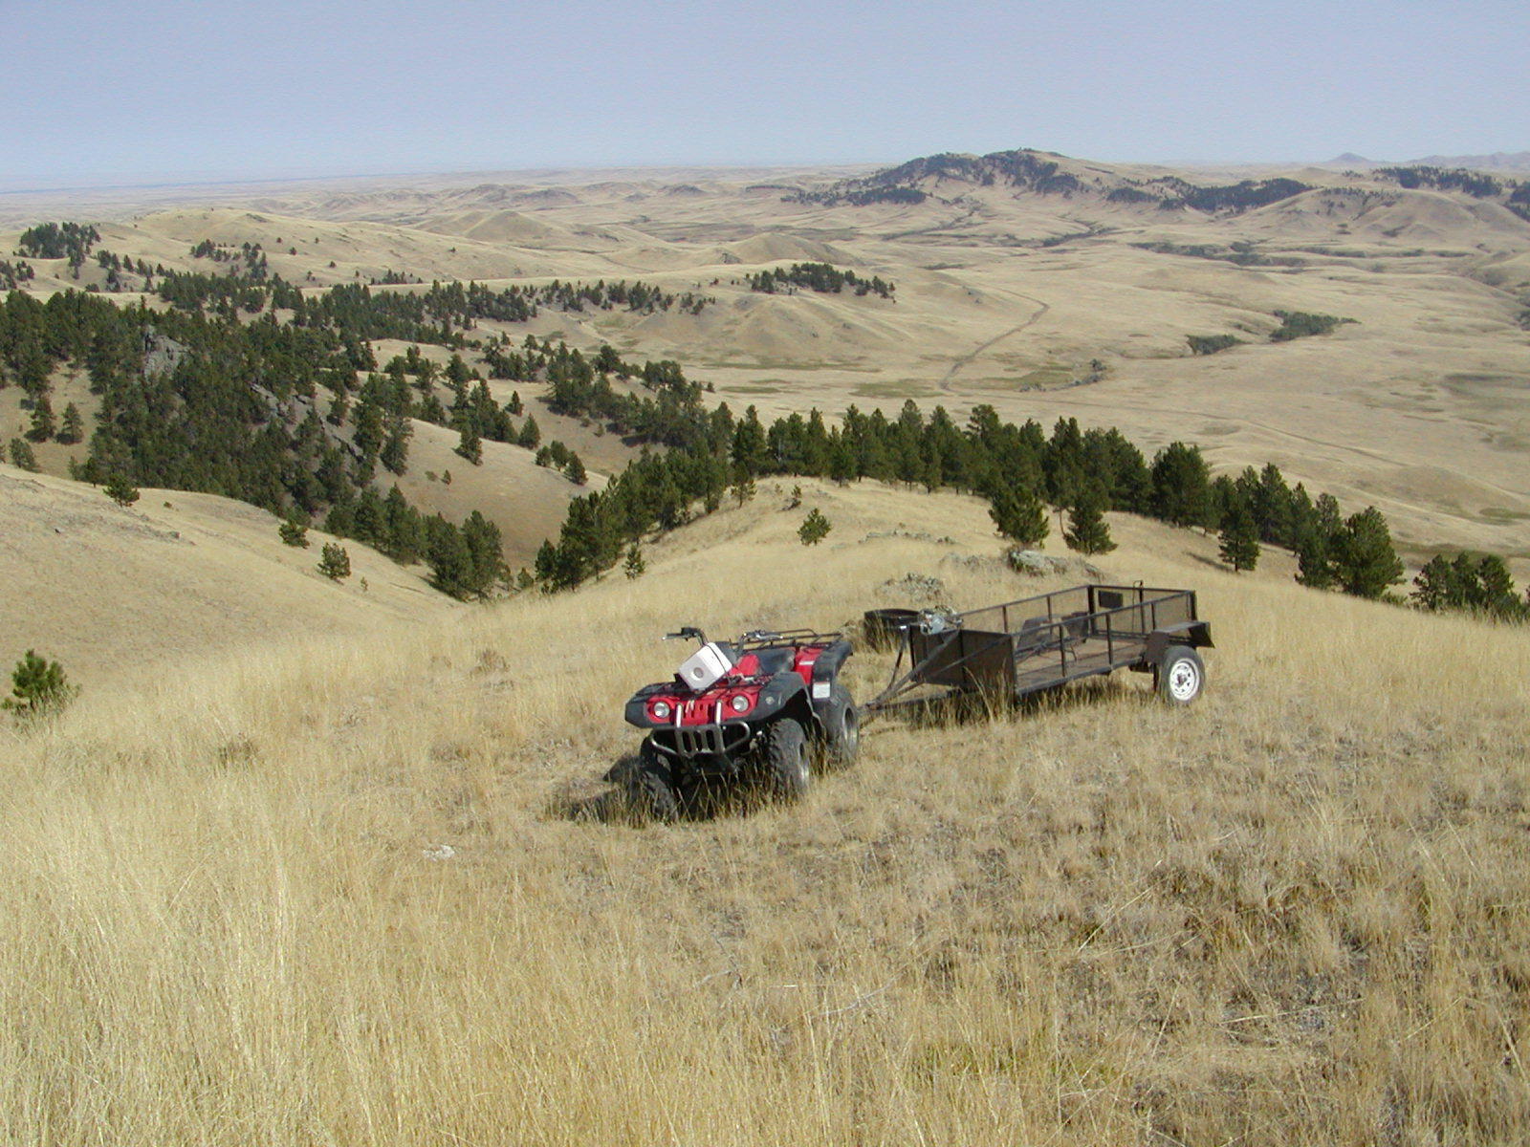
Low-moisture block can be placed with an ATV and trailer in steep, rocky terrain

Slide 83
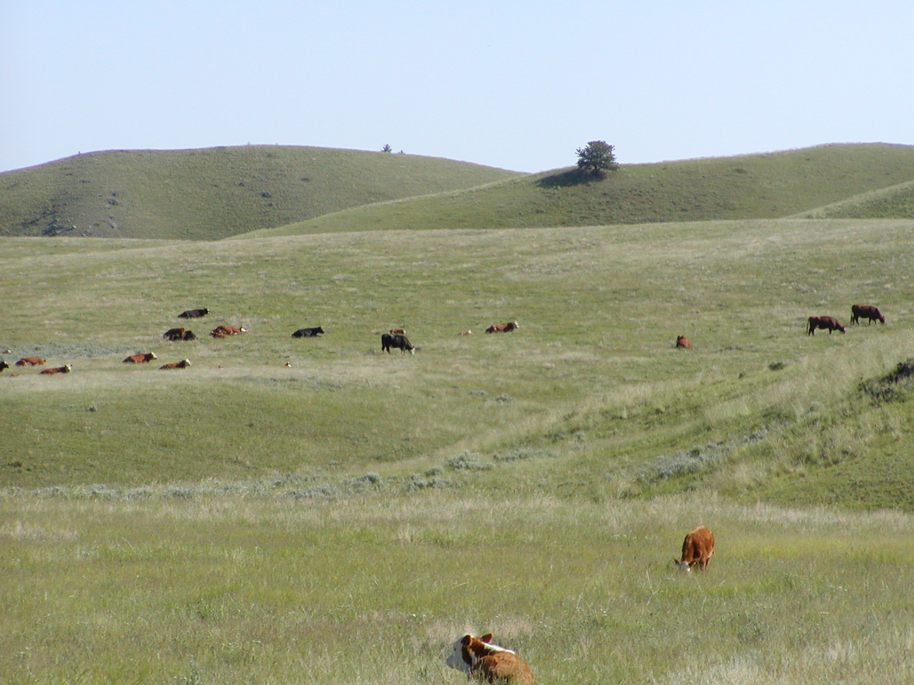
Training is critical for supplement to be an effective tool to improve grazing distribution.
Animals must also know where supplement is located.

Slide 84
Learning to Use Medicines

Slide 85
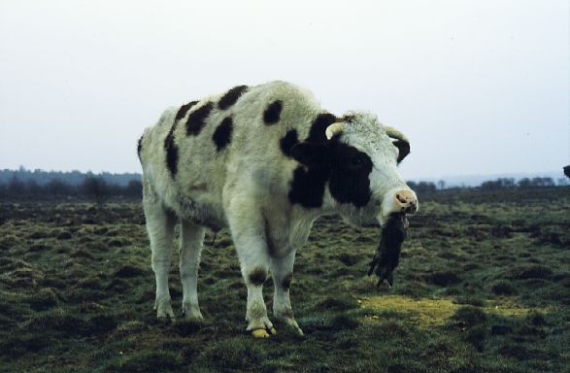
Animals eat to correct deficiency, not to prevent deficiency
Notes:
Animals are most likely to eat new foods if they are nutrient deprived. This poor specimen of a Holstein steer is eating a dead rabbit. This steer grazed a pasture grown on phosphorus-deficient soils. When scientists offered these steers dead rabbits, the steers developed a preference for rabbit while steers on phosphorus adequate soils refused to eat rabbits. Animals deficient in nutrients seek out new foods. Animals form preferences for foods, no matter how odd, if the food corrects the imbalance.

Slide 86
Oxalate Toxicosis
Illness
Grain Acidosis
Tannin
Toxicosis
Medicines
Bentonite
Polyethylene
Glycol
Dicalcium
Phosphate
Notes:
We conducted a study where seep were made familiar with three diets: 1) high grain, 2) high in tannin and 3) high in oxalates and three medicines 1) bentonite, 2) PEG and 3) dicalcium phosphate. One group was fed the medicines and diets at different times of the day. The other group received the proper medicine right after eating the diet that caused the illness. Bentonite helps animals deal with grain acidosis, PEG for tannin and dical for oxalate.
Animals were then put in one of the above physiological states and then offered a choice of three medicines. Did they select the correct medicine?

Slide 87
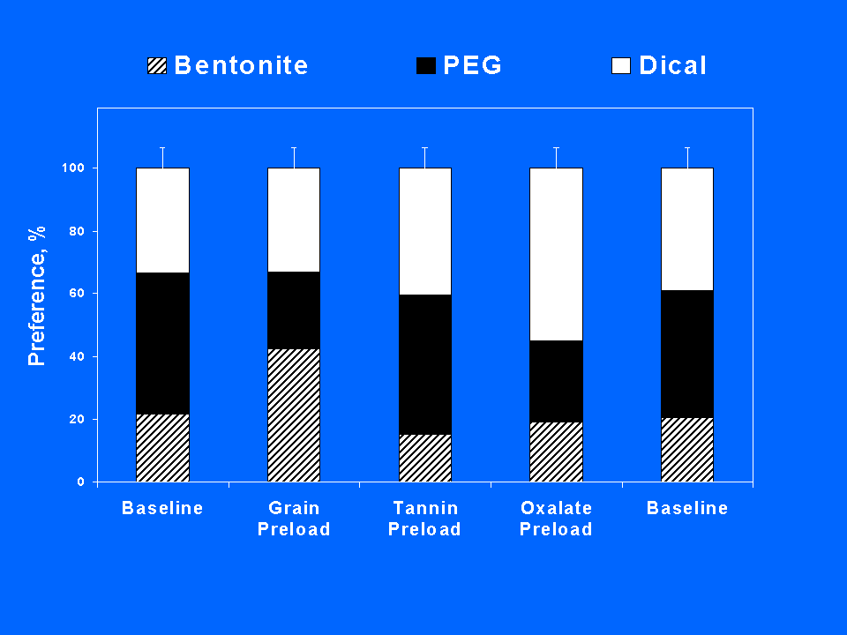
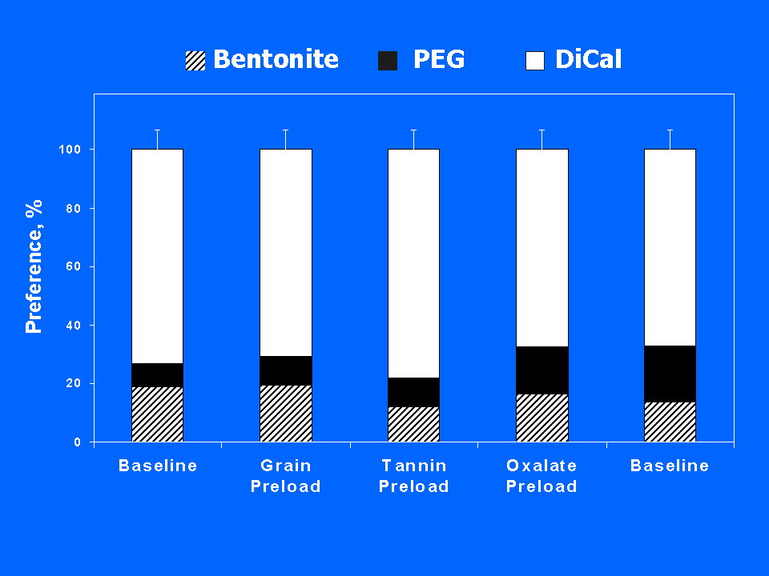
Sheep learn to take their medicine
Treatment- Medicines paired with illness
Control – Medicines not paired with illness
correct
correct
correct
correct
Notes:
Of course they did. Control animals ate the same proportion of medicines regardless of the diet they were eating. The treatment group ate more of the correct medicine depending on their physiological state.
REF: Villalba, J.J., F. D. Provenza and R. Shaw. 2006. Sheep self-medicate when challenged with illness-inducing foods. Anim. Behav.: in press.

Slide 88
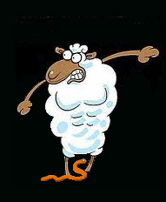
Medicines
Sheep learn to prefer foods that alleviate bloat.
Sheep with internal parasites eat more foods that contain tannins than sheep without parasites.
Sheep infected with parasites avoid grazing tall patches of grass and prefer short grass.

Slide 89
The question isn’t:
Do animals learn?
They learn everyday.
The question is:
Do we as managers want to be
part of the process?
Notes:
Read slide?

Slide 90
extension.usu.edu/behave
Department of Wildland Resources
email: beth.burritt@usu.edu
Notes:
BEHAVE stands for Behavioral Education for Animal, Vegetation and Ecosystem management.

