Slide 1
Financing: Federal/Private Loan & Grant Programs

Slide 2
Resources Available
Western Ag Credit
Utah Department of Agriculture and Food
Agriculture Marketing Service (AMS)
Rural Development (RD)
Farm Service Agency (FSA)
Natural Resources Conservation Service (NRCS)

Slide 3
Western Ag Credit
As an agricultural lender, Western AgCredit can lend money for any ag-related purchase
Common loan programs
Operating Loans
Equipment Loans
Livestock Loans
Agriculture Real Estate Loans
Special programs
Ag Start Program
Farm Fresh Marketing Grant
Young, Beginning and Small Program

Slide 4
Western Ag Credit
Ag Start Program https://www.westernagcredit.com/products_and_services/agstart
The purpose of AgStart is to assist small farming and ranching operations in the early stages of development who market, or plan to market, their agricultural products directly to consumers or through local/regional food systems through low interest loans. This includes but is not limited to organic farming, local food farming and small farming operations.
Up to $25,000 per applicant

Slide 5
Western Ag Credit
Farm Fresh Marketing Grant https://www.westernagcredit.com/products_and_services/farm_fresh_advertising_grants
Helps farmer’s markets publicize their markets and donates reusable shopping bags

Slide 6
Western Ag Credit
Young, Beginning and Small Program
https://www.westernagcredit.com/products_and_services/young_beginning_small
The special financing programs we offer help young (under 35), beginning (less than 10 years of experience) and small (operators that generate less than $250,000 in annual gross sales of agriculture products) borrowers obtain the agricultural financing necessary for success in their operations.

Slide 7
Utah Department of Agriculture & Food
Agricultural Resource Development Loans (ARDL)
Specialty Crop Block Grant Program
Utah’s Own Program
Ag Land Preservation
Agriculture Certificate of Environmental Stewardship (ACES)
Utah Grazing Improvement Program (UGIP)
http://ag.utah.gov/

Slide 8
Agricultural Marketing Service
Farmers’ Market Promotion Program (FMPP)
Local Food Promotion Program (LFPP)
Federal State Marketing Improvement Program (FSMIP)
http://www.ams.usda.gov/

Slide 9
Agricultural Marketing Service
Farmers’ Market Promotion Program
Projects that develop new market opportunities for farm and ranch operations serving local markets by developing, improving, expanding, and providing outreach, training, and technical assistance.
Projects that assist in the development, improvement, and expansion of…
Farmers markets, roadside stands, community-supported agriculture programs, agritourism and food activities
Other direct producer-to-consumer market opportunities
Per grant awards
$15,000 - $100,000
24 month grant period

Slide 10
Agricultural Marketing Service
Local Food Promotion Program
Projects supporting the development and expansion of local and regional food business enterprises. Projects for entities that process, distribute, aggregate, or store locally or regionally produced food products.
Planning grants
Activities can include, but are not limited to:
Market research, feasibility studies, business planning
Per grant awards
$5,000 - $25,000, 25% match required
12 month grant period
Implementation grants
Activities can include, but are not limited to:
Training & technical assistance, outreach & marketing, non-construction infrastructure improvements, working capital
Per grant awards
$25,000 - $100,000
24 month grant period

Slide 11
Rural Development
Value Added Producer Grants
Rural Business Development Grants
Rural Microentrepreneur Assistance Program
Rural Energy for America Program Renewable Energy Systems & Energy Efficiency Improvement Loans & Grants
Many others at http://www.rd.usda.gov/

Slide 12
Rural Development
Value Added Producer Grants
http://www.rd.usda.gov/programs-services/value-added-producer-grants
The VAPG program helps agricultural producers enter into value-added activities related to the processing and/or marketing of bio-based, value-added products. Generating new products, creating and expanding marketing opportunities, and increasing producer income are the goals of this program. You may receive priority if you are a beginning farmer or rancher, a socially-disadvantaged farmer or rancher, a small or medium-sized farm or ranch structured as a family farm, a farmer or rancher cooperative, or are proposing a mid-tier value chain. Grants are awarded through a national competition.
Maximum grant amounts
$75,000 for planning grants; $250,000 for working capital grants
Matching funds requirements
50% of total project costs, in-kind or cash

Slide 13
Rural Development
Rural Business Development Grants http://www.rd.usda.gov/programs-services/rural-business-development-grants
RBDG is a competitive grant designed to support targeted technical assistance, training and other activities leading to the development or expansion of small and emerging private businesses in rural areas that have fewer than 50 employees and less than $1 million in gross revenues. Programmatic activities are separated into enterprise or opportunity type grant activities.
Generally, grants range from $10,000 up to $500,000. There is no cost sharing requirement.

Slide 14
Farm Service Agency
http://www.fsa.usda.gov/
Microloan Program
Minority and Women Farmers and Ranchers Loans
Beginning Farmer and Rancher Loans
Conservation Loan Program
Direct Farm Ownership Loans
Direct Operating Loan Program

Slide 15
Farm Service Agency
Microloan Program
http://www.fsa.usda.gov/programs-and-services/farm-loan-programs/microloans/index
The focus of Microloans is on the financing needs of small, beginning farmer, niche and non-traditional farm operations, such as truck farms, farms participating in direct marketing and sales such as farmers’ markets, CSA’s (Community Supported Agriculture), restaurants and grocery stores, or those using hydroponic, aquaponic, organic and vertical growing methods.
Portion of funds targeted to small and beginning farmers/ranchers, and minority and women farmers/ranchers.

Slide 16
Natural Resources Conservation Service
NRCS provides technical and financial assistance to private landowners/ag producers.
NRCS's natural resources conservation programs help people reduce soil erosion, enhance water supplies, improve water quality, increase wildlife habitat, and reduce damages caused by floods and other natural disasters. Public benefits include enhanced natural resources that help sustain agricultural productivity and environmental quality while supporting continued economic development, recreation, and scenic beauty.
http://www.nrcs.usda.gov
Notes:
A brief overview of history of NRCS and our current purpose.

Slide 17
Natural Resources Conservation Service
Conservation Plan Development
Environmental Quality Incentives Program (EQIP)
General (Irr. Cropland, Dry Cropland, Range, Pasture, Forestry, Riparian, AFO/CAFO)
Initiatives (High Tunnels, Sage Grouse, Salinity, Wildlife, Drought, Energy, Organics)
Agricultural Management Assistance Program (AMA)
Conservation Stewardship Program (CSP)
Agricultural Conservation Easement Program (ACEP)
Agricultural Land Easement (ALE)
Agricultural Land Easement Grasslands (ALE-GSS)
Wetland Reserve Easement (WRE)

Slide 18
Natural Resources Conservation Service Conservation Plan Components
Plants
Condition: Invasive Weeds, Wildfire, T&E Species
Animals
Wildlife: Habitat, Food, Cover, Shelter Domestic: Water, Forage Quality, Grazing, Manure Management
Adequate Energy Supply
Fuel, Alternative, Power
Human Interaction
Economics, Sustainability, Cultural Resources, Traditions
Sustainable and Productive Soils
Quality: Erosion, Nutrients, Contaminants
Clean and Abundant Water
Quality: Nutrients, Pathogens, Petroleums, Salinity
Quantity: Irrigation, Drought, Water Flow
Air
Quality: Odor, Particulate Matter, Reduced Visibility

Slide 19
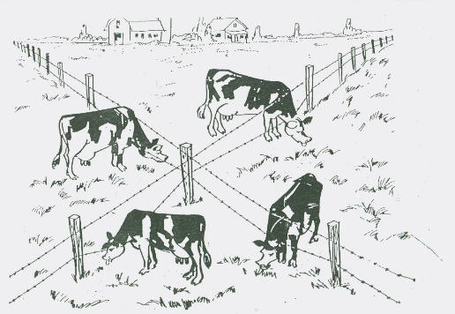
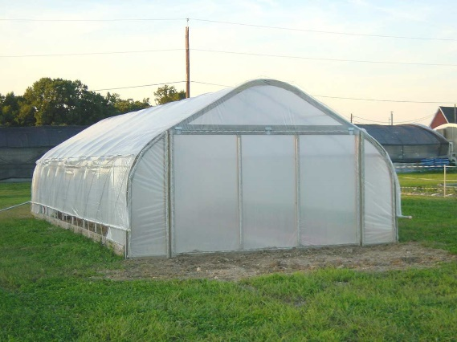
Natural Resources Conservation Service
Environmental Quality Incentives Program
Project examples
Composting facility
Cover crops
Fencing
Irrigation systems, pipeline, pumping, sprinklers
Pasture and hay planting
Residue management
Season high tunnel systems
Watering facilities
Crop rotation
Nutrient management
Prescribed grazing

Slide 20
Natural Resources Conservation Service
High Tunnel Initiative
NRCS provides financial assistance for high tunnels up to a maximum of five percent of one acre, or a total of 2,178 square feet. Landowners can purchase and install larger high tunnels, but NRCS will only pay for the first 2,178 square feet. Plants must be planted in the ground or in permanent raised beds, not containerized.
Since water runoff from high tunnels can cause erosion, pooling and other environmental concerns, additional conservation practices may be installed as a condition for the installation of a high tunnel.
These might include runoff management, filter strips, drain structures for water control, critical area planting

Slide 21
Thank you!

