Slide 1
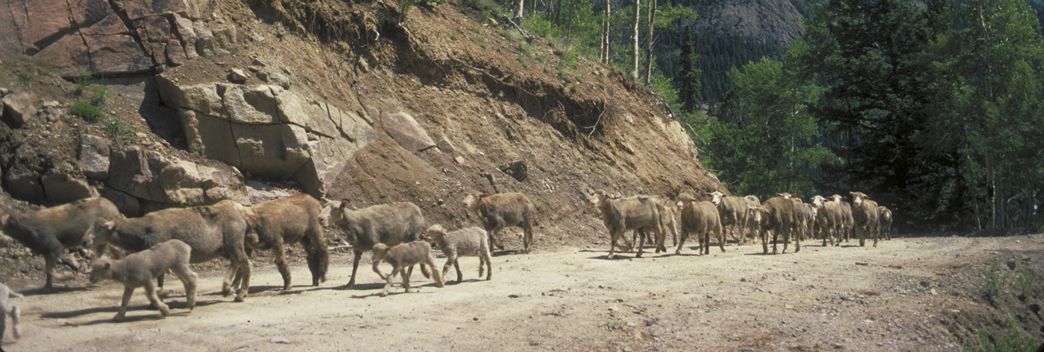
Insuring Success for Utah Agriculture
Livestock Insurance: Overview of LRP-Lamb
Source: http://nationalatlas.gov
Content edited from a previous version of these materials available at RightRisk.org by:
John P. Hewlett, Agricultural & Applied Economics University of Wyoming
Voice annotation contributed by:
John P. Hewlett, Agricultural & Applied Economics University of Wyoming

Slide 2
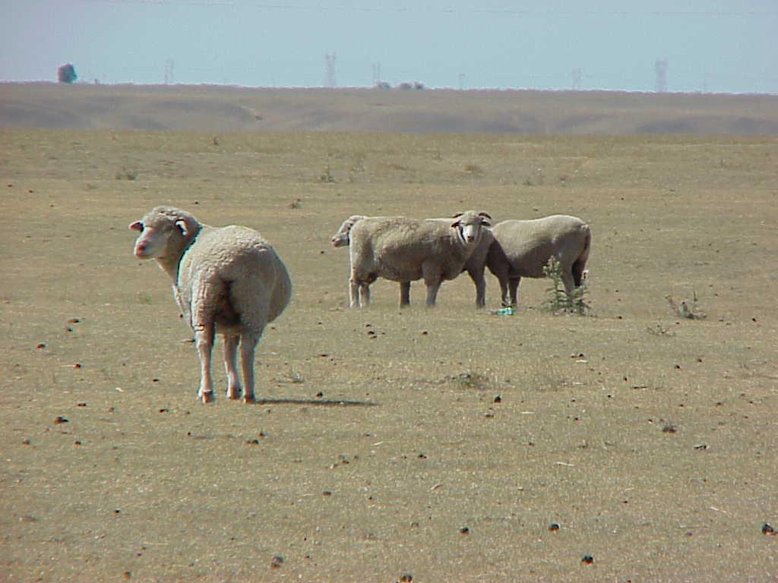
Livestock Insurance: Overview
Livestock Risk Protection (LRP) feeder cattle and fed cattle
Livestock Risk Protection (LRP) for swine
Livestock Risk Protection (LRP) for slaughter lambs
The insurable types and weights of feeder cattle under livestock insurance
Insurance against price changes
Indemnity calculations
Notes:
Speaker Notes:
There are several types of insurance that handle production and revenue risks for most crops grown in Utah. Now let’s look at a price insurance product available for livestock producers. Feeder cattle, fed cattle, swine and slaughter lambs can all be covered by insurance policies in Utah. In this presentation, we’re going to take a look at highlights of the livestock risk protection (LRP) insurance, primarily as it relates to slaughter lambs.

Slide 3
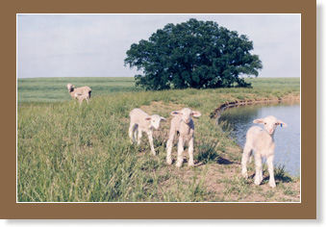
Livestock Insurance: LRP for Lambs Geographic Coverage
The program is available in all counties of Utah and in all counties in 27 other states
LRP for lamb:
Offers single-peril price protection for lamb producers
May reduce downside price risk for producers, but it does not eliminate other risks
Does not cover sickness or death of lambs
Does not insure against possible rising feed costs. Producers remain subject to basis price risk.
Notes:
Speaker Notes:
LRP-Lamb is available in all Utah counties and in 27 other states. Livestock Risk Protection for lambs offers a single-peril price protection for lamb producers. The insurance for slaughter lambs may reduce the downside price risk for lamb producers, but it does not eliminate other risks. For instance, it does not cover sickness or death of the lambs or insure against possible rising feed costs. Producers remain subject to the “basis price risk” which is the difference between a producer’s actual cash market sale price and the AMS price series against which LRP-Lamb is settled.

Slide 4
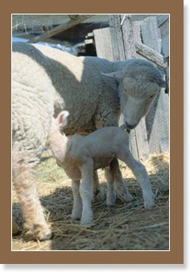
Livestock Insurance: LRP for Lambs Basics
Product Offered: Protection for producer against decline in slaughter lamb prices below the established coverage price.
Insurance Period: Offered for 13, 20, 26, and 39 week periods.
The producer will choose time closest to the time slaughter lambs will be marketed.
Application: An application is required to purchase insurance coverage.
Establishes producer eligibility
The producer must also file a form indicating beneficial interest
Specific Coverage Endorsement: A producer must file a Specific Coverage Endorsement for each group of lambs to be insured. Several endorsements may be filed under one application as long as beneficial interests are the same.
Notes:
Speaker Notes:
Let’s look at some of the basics of Livestock Risk Protection insurance for slaughter lambs. LRP-Lamb insurance protects the producer against a decline in prices below the established coverage price. The insurance is offered at 13, 20, 26, and 39-week periods. You, as the producer will choose a time closest to the period when the lambs will be marketed.
In order to buy the insurance, an application must be submitted in order to purchase insurance coverage. It establishes the producer’s eligibility. You must also file a form indicating beneficial interest with the application and also file a specific “coverage endorsement” for each group of slaughter lambs that is to be insured. Several endorsements may be filed under one application as long as the beneficial interests are the same.

Slide 5
Livestock Insurance: LRP for Lambs Basics (cont.)
Target Weights: LRP-Lamb target weights refer to the anticipated per head weights of slaughter lamb expressed on a hundredweight basis at the end of the insurance period.
Endorsement Limits: A limit of 2,000 head of slaughter lambs may be insured under any one Specific Coverage Endorsement.
Annual Policy Limits: The maximum number of head of slaughter lambs that may be covered during a crop year is 28,000 head. The “crop” year is July 1 through June 30.
Notes:
Speaker Notes:
Slaughter lambs are insurable under LRP-Lamb insurance. Producers select as a target weight what they anticipate lambs will weigh at the end of the insurance period. The annual policy limits the number of head of slaughter lambs that may be covered during a “crop” year to 28,000 head. In addition, a limit of 2,000 head of slaughter lambs may be insured under any one Specific Coverage Endorsement

Slide 6
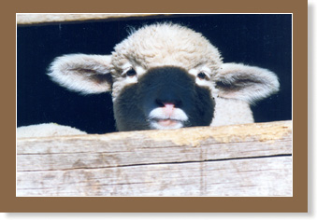
Livestock Insurance: LRP for Lambs Coverage Prices and Levels
Coverage Prices
Prices that may be insured by the producer
Prices change weekly and are obtained from the RMA website.
Coverage Levels
Based on the chosen coverage price
Range from 80 to 95%
Notes:
Speaker Notes:
Coverage prices are the prices that may be insured by the producer. The prices for slaughter lambs change weekly and may be obtained from the RMA website.
Coverage levels are based on the chosen coverage price and range from 80 to 95% of the expected end value.

Slide 7
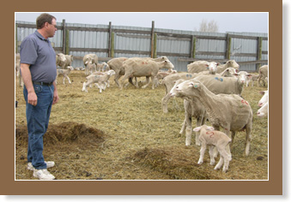
Livestock Insurance: LRP for Lambs Actual and Expected End Values for Lambs
Expected End Value: This is the expected price at the end of an insurance period for slaughter lambs published weekly on the RMA website.
Actual End Value: The actual ending value for lambs at the end of the endorsement is the price of slaughter lambs is reported in the National Weekly Sheep Review. The reference price will be labeled as Formula Prices established for previously slaughtered lambs (live basis).
Subsidy Level: RMA provides a 13% subsidy on LRP-Lamb
Notes:
Speaker Notes:
The expected end value is the expected price at the end of an insurance period. The price is published weekly by AMS. The actual end value is the Formula Price established for previously slaughtered lambs (live basis). This price is reported in the National Weekly Sheep Review. The subsidy level for LRP-Lamb insurance is 13%.

Slide 8
Livestock Insurance: LRP for Lambs Example
Contract Data | Value | Calculation
Number of Lambs | 1,000 | Producer
Expected Weight | 135 lb. | Producer
Current Date | July 8 | Producer
Marketing Date | October 5 | Producer
Insurance Period | 13 weeks | Producer*
Expected Ending Value | $107.00 /cwt | RMA
Coverage Level | 95.00% | Producer*
Coverage Price | $101.65 /cwt
* Producer’s choices are limited.
Notes:
Speaker Notes:
In this example, Rodney, the producer has 1,000 head of lambs with an expected end weight of 135 pounds. The current date is July 8 and Rodney expects to market the lambs on October 5 or in approximately 13 weeks. The expected end value, as found on the RMA website, is $107.00 per hundredweight. The coverage level selected is 95.000% giving a coverage price of $101.65 per hundredweight.

Slide 9
Livestock Insurance: LRP for Lambs Example (cont.)
Contract Data | Value | Calculation
Insured Value | $137.228 | 1,000 hd x 1.35 cwt/hd x $101.650/cwt
Premium Rate | 0.01997 | RMA
Total Premium | $2,740 | $137,228 x 0.01997
Subsidy Rate | 13% | RMA
Subsidy Amount | $356 | $2,740 x 0.13
Producer Premium | $2,384 | $2,740 - $356
Suppose Rodney actually sells 1,000 135 pound lambs on October 5. The reported actual ending value is $98.00/cwt.
Will Rodney receive an indemnity?
Notes:
Speaker Notes:
Rodney knows the insured value of the lambs is the number of head times the expected end weight, times the coverage price for a total insured value of $137,228. The premium as specified on the RMA website is just under 2%. Multiplying the premium rate times the insured value gives a total premium of $2,740. The subsidy rate is 13% on all the contracts. Multiplying the subsidy rate times the total premium gives a subsidy amount of $356. Subtracting this subsidy from the total premium reduces the premium to $2,384 that Rodney will pay. On a “per head” basis, this premium would be $2.38 per head. Therefore, for a premium of $2.38 per head, he can protect himself from any downward price movement below $101.65 per hundredweight. Will he receive an indemnity?

Slide 10
Livestock Insurance: LRP for Lambs Example (cont.)
Indemnity: =
[1,000 head of lambs x 1.35 hundredweight per lamb x ($101.650 – 98.000)] x 1.0 =
$4,928
Notes:
Speaker Notes:
Yes, Rodney will receive an indemnity. The 1,000 head of lambs at 135 pounds or 1.35 hundredweight multiplied by the difference between the coverage price of $101.650 per hundredweight and the actual end value of $98.00 gives the indemnity due to Rodney of $4,928. Keep in mind that Rodney paid a premium of $2,384 for this coverage, so his net position after receiving an indemnity is $2,544.

Slide 11
Livestock Insurance: LRP for Lambs Example II
Contract Data | Value | Calculation
Number of Lambs | 2,000 | Producer
Expected Weight | 135 lb. | Producer
Current Date | June 21 | Producer
Marketing Date | September 15 | Producer
Insurance Period | 13 weeks | Producer*
Expected Ending Value | $126.30 /cwt | RMA
Coverage Level | 80.00% | Producer*
Coverage Price | $101.040 /cwt
* Producer’s choices are limited.
Notes:
Speaker Notes:
In this second example, Jim, a larger sheep producer has 2,000 head of lambs with an expected end weight of 135 pounds. The current date is June 21st and Jim expects to market the lambs on September 15 or in approximately 13 weeks. The expected end value, as found on the RMA website, is $126.30 per hundredweight. The coverage level selected is 80.000% giving a coverage price of $101.040.

Slide 12
Livestock Insurance: LRP for Lambs Example II (cont.)
Contract Data | Value | Calculation
Insured Value | $272,808 | 2,000 hd x 1.35 cwt/hd x $101.040/cwt
Premium Rate | 0.000800 | RMA
Total Premium | $218 | $272,808 x 0.000800
Subsidy Rate | 13% | RMA
Subsidy Amount | $28 | $218 x 0.13
Producer Premium | $190 | $218 - $28
Suppose Jim actually sells 2,000 135 pound lambs on September 15. The reported actual ending value is $98.00/cwt.
Will Jim receive an indemnity?
Notes:
Speaker Notes:
Jim is aware that the insured value of the lambs is the number of head times the expected end weight, times the coverage price for a total insured value of $272,808. The premium as specified on the RMA website is $0.081 per hundredweight. Multiplying the premium rate times the insured value gives a total premium of $218. The subsidy rate is 13% on all the contracts. Multiplying the subsidy rate times the total premium gives a subsidy amount of $28. Subtracting this subsidy from the total premium reduces the premium to $190 that Jim will pay. On a “per head” basis, this premium would be $0.10 per head. Therefore, for a premium of $0.10 per head, he can protect himself from any downward price movement below $101.04 per hundredweight. Will he receive an indemnity?

Slide 13
Livestock Insurance: LRP for Lambs Example II (cont.)
Indemnity: =
[2,000 head of lambs x 1.35 hundredweight per lamb x ($101.040 – 98.000)] x 1.0 =
$8,208
Notes:
Speaker Notes:
Yes, Jim will receive an indemnity payment. The 2,000 head of lambs at 135 pounds or 1.35 hundredweight multiplied by the difference between the coverage price of $101.040 per hundredweight and the actual end value of $98.00 gives the indemnity due to Jim of $8,208. Keep in mind that Jim paid a premium of $190 for this coverage, so his net position after receiving an indemnity is $8,018.

Slide 14
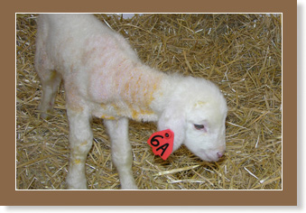
Livestock Insurance: LRP for Lambs Summary
Let’s summarize what you have learned. In this lesson, you’ve learned about:
Livestock Risk Protection (LRP) for Lamb
Insures against price changes
Indemnities received when prices decline
Notes:
Speaker Notes:
In summary, you’ve seen how slaughter lamb producers can use LRP-Lamb to insure against national-level declines in lamb prices. Producers will be indemnified when the coverage prices they select are greater than the actual ending values. Final prices as determined by referencing the Formula Prices established for previously Slaughtered Lambs (live basis) compiled by the USDA Agricultural Marketing Service (AMS). As with other LRP products, the indemnity does not depend on the price at which the individual producer sold his or her lambs.

