Slide 1
Coupon Craze
Presented by:
Darlene Christensen and Teresa Hunsaker

Slide 2
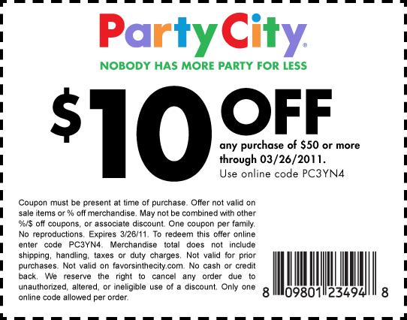
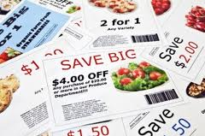
Objective
Teach consumers how to effectively use coupons, online/mobile coupons, and coupon codes to save money.
Notes:
It is likely you have seen extreme couponing on TV. The shows are somewhat fascinating and the savings unreal. But couponing was not me
ant to be a job. It was not meant to cause stress. It was not meant to buy 243 BBQ Sauces just because they are free or $0.03 each.
Cash that you would have spent originally can now be saved. Are you ready for couponing; not obsessive couponing but smart, casual, routine coupon clipping and savings.

Slide 3
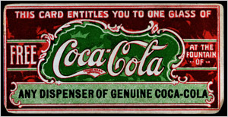
How Far Back Do Coupons Go?
1887 1913
Notes:
Coca Cola was among the first to offer free goods. In 1887 Coca Cola started offering slips for complimentary Coke and provided the vendors with free syrup to compensate. By 1913 nearly 8,500,000 people had enjoyed a free beverage. Asa Chandler, marketing guru and Coca Cola mogul, took the French word "couper" (to cut) and officially calls what he offers “a coupon.”
Reference: Promotion Marketing Association (PMA) Educational Foundation, Inc
Photo Source: http://www.ilovecouponmonth.com/resources/history-of-coupons.htm

Slide 4
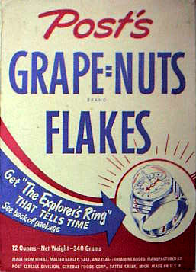
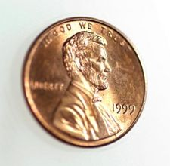
1st Grocery Coupon…
1895
Notes:
The next year, another successful businessman, C.W. Post, began to promote his new health cereal.
He offered a one cent coupon, good towards the purchase of his new product called Grape Nuts.
Reference: Promotion Marketing Association (PMA) Educational Foundation, Inc
Photo Source –
Grape Nuts box: http://blogs.static.mentalfloss.com/blogs/archives/20822.html
Penny: www.clipart.com

Slide 5
Additional Coupons Continue
1957
Nielson Clearing House was developed
Notes:
The Nielson Coupon Clearing House was created in 1957 to sort, count and tabulate coupons to determine how much money was owed to each retailer.
Photo Source: http://artskooldamage.blogspot.com/2009/11/5-cents-8-cents-10-cents-off.html

Slide 6
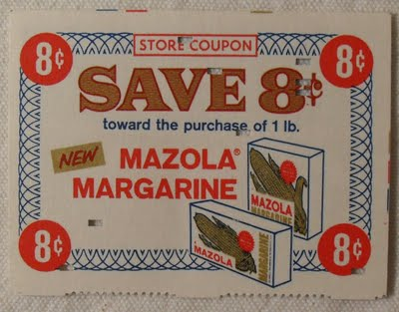
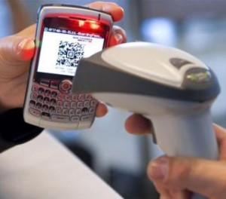
Evolution of Coupons Continues…

Slide 7
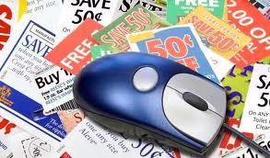
Online Coupon Use
55.7 million people
Notes:
A study from 2012 shows that more than 55.7 million American consumers are using on-line coupons – which represents 25% of the US population.
Source: http://www.couponsinc.com/corporate/OurCompany/PressReleases/2012.aspx?udt_619_param_detail=312
Photo Source: clickheresave.com

Slide 8
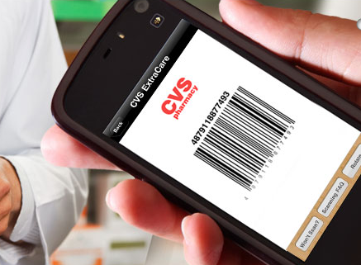
Smart Phone Use In Store
40%
Notes:
Source: A 2012 survey
http://www.couponcabin.com/blog/2012/05/21/40-of-smartphone-users-have-redeemed-coupons-couponcabin-launches-new-mobile-app/

Slide 9
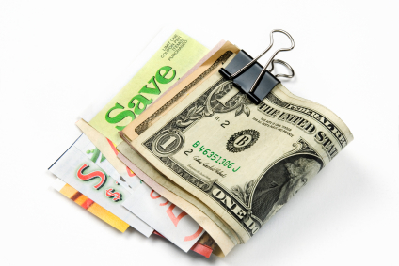
Stats for 2016
Notes:
Source: http://www.ilovecouponmonth.com/statistics/
Information from:
Valassis Annual Topline U.S. Consumer Packaged Goods Coupon Facts Report for 2011
NCH Marketing Services, Inc.
RedPlum eMarketer Nielsen Company
Fortune3.com
Inmar
Internet Retailer
NCH Marketing
Coupon Info Now
Photo Source: freecoupons.com

Slide 10
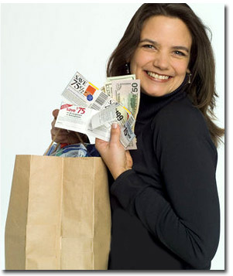
Who Uses Coupons by Age
Age 18-24 – 65% Age 25-34 – 71% Age 35-44 – 77% Age 45-54 – 80% Age 55-64 – 81% Age 65+ 80%
Notes:
Thanks partly to on-line coupons, coupons are now cool. Source: National Coupon Council

Slide 11
Who Uses Income by Income?
Under $25,000 74%
$25-50,000 – 80%
$50-75,000 – 77%
$75,000 – 76%

Slide 12
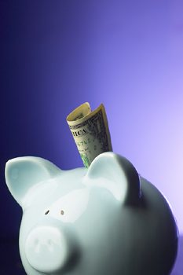
Coupon Savings Used For…
Paying debt
Long-term savings
Emergency fund
Only7% splurge!!
Notes:
Source: 2015 Vlasis Report

Slide 13
When online couponing…
What are your goals?
How much time are you willing to spend?
Is it worth it?
Where in your spending do you hope to save the most money?

Slide 14
When online couponing…
Can you be organized/focus?
Do you have a way of tracking the savings?
Do you have a specific purpose for the savings?

Slide 16
Think About
Are you buying just because you have a coupon?
Will you use cash or credit?
Notes:
Just because you have a coupon, does not mean you should buy the item. And just because it is a good deal, does not mean you should but the item. Using a coupon on something you do not want or will not use is a waste of money no matter how cheap.
Use coupons to purchase items that you already buy and use in your normal routine or for a substitute brand if it will fulfill the same need/taste/desire. Source: Couponfinder.com
Consumers and companies are using both paper and digital coupons. Newspaper coupons are still the most redeemed- with 76% of coupons being from newspaper.
Statistics Source: 2012 - NCH Marketing Resource Center Photo Source: Savingwithshellie.com

Slide 17
Educator Tips for Teaching
Organization tips brought into the discussion
Homework assignments
Step Down Principle

Slide 18
Educator Tips for Teaching
Allow time for discussion and comments
Give them ideas for goals
Step by step handout…pick an app
Notes:
Instructor Note: One of the challenges of maximizing the use of apps and coupons/codes is acquainting oneself with each app as it works to your advantage, style, and time restraints. Point out to the students that each app has its own set of nuances and downside. The key is to combine a few different apps and websites, try them, and always be on the look out for others without getting to overwhelmed with the process. Demonstrating one app briefly to point out key parts to the process of maximizing coupon use does not need to take long in class.

Slide 19
Virus Protection

Slide 20
Websites…coupons and promo codes
RetailMeNot.com
Offers.com
CouponCabin.com
SmartSource.com
Coupons.com
Groupon.com
Savings.com
Krazycouponlady.com
Moneysavingmom.com
Passionforsaving.com
Checkout51.com
Valpak.com
Couponsurfer.com
Befrugal.com
Honey.com
Notes:
Coupon and promo code websites come in many different forms for use and application. Some websites are a third party website that serve as a type of dispensary for coupons. Some websites serve as a notification of coupons and discounts available, but are not necessarily linked to the coupon. Each have their place and it is up to the consumer to find the strengths of the site for the purposes needed.

Slide 21
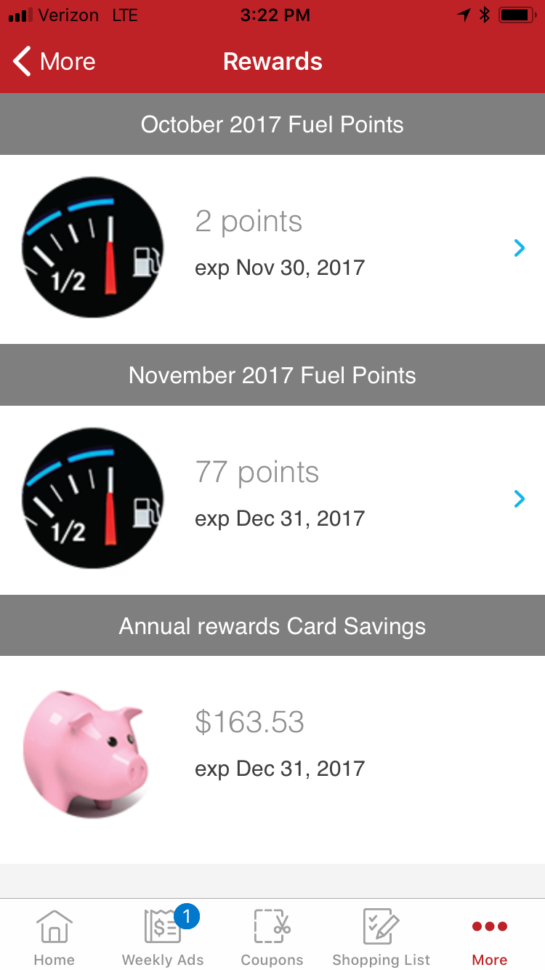
Apps
There IS an app for that…
Travel/lodging
Food/restaurants
Store loyalty
Coupon
Free Wifi locations
Cash back
Ibotta
Ebates
Apps:
Flipp
Checkout51
SavingStar
Shopkick
TheCouponsApp
Notes:
Saving Star: allows you to select the eCoupons you like and link them to your store loyalty cards. Use your linked loyalty card at checkout. Your money is automatically added to your SavingStar account. They’ll e-mail you when your savings post.
Shop Kick: shopping rewards program that’s more rewarding. No plastic cards, no confusing rules, no extra steps. Walk into your favorite stores like Target, Macy’s, Best Buy, Crate&Barrel, Old Navy, Toys”R”Us, Exxon and Mobil convenience stores, and more—and you automatically rack up points called “kicks”, which are redeemable for gift cards. No applications to fill out, and no purchase required. Just walk in with your smartphone and instantly earn kicks.
Photo courtesy of Teresa Hunsaker Smiths app on personal iphone.

Slide 22
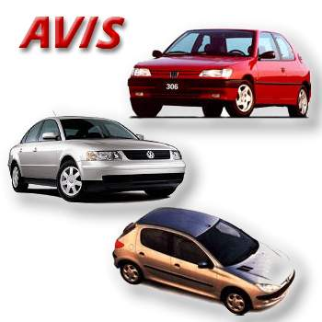
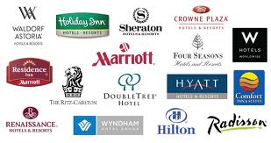
Travel
Value points
Coupon codes
Discount travel websites
Notes:
Photos courtesy of the internet at google images.

Slide 23
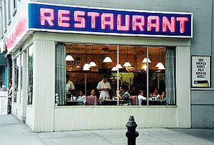
Eating Out
Papa Johns
McDonalds
Panera Bread
Chili's
TGI Fridays
Wendy’s
Taco Bell
Applebee’s
Panda Express
Einstein Bagels
Chick-fil-a
Olive Garden
Jimmy Johns
Sonic
Chipotle
Subway

Slide 24
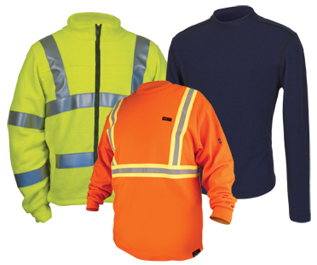
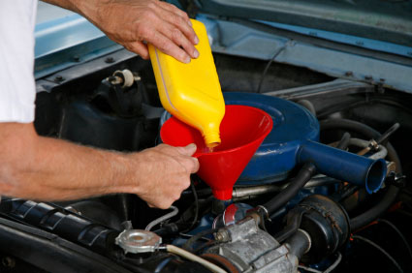
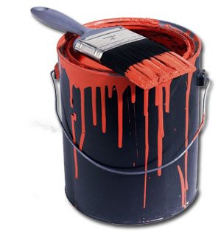
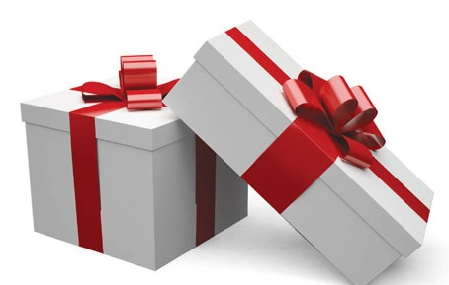
Other Categories for Savings
This is when coupon codes are really helpful

Slide 25
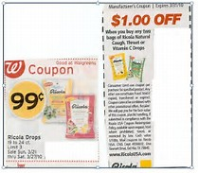
Coupon Stacking
Not the same as double couponing.
The way we layer coupons, rebates, sales and promotions to maximize our savings.
Stacking could mean using a store coupon with a manufacturer coupon on one item.
Or, it could mean submitting a rebate on a rollback price.
Notes:
Instructor Note: You may want to include samples of Manufacturer coupons and store or retailer coupons in the discussion here. Store or retailer coupons are basically a sale in their store that is issued in coupon form. They are funded by the store only with no reference to a manufacturer reimbursement. Target, Walgreens, and CVS pharmacy are particularly common for this and are printed in their weekly ads and have the option of loading them as a digital coupon directly onto your rewards cards. Some you may have to log into your store rewards account and select the coupon you want to use.
Once class participants can identify the coupons, they are ready to stack. Please note there are some coupon restrictions to stacking and will be stated as such on the coupon. So the consumer must read the fine print. Kohls, Michaels, JC Penny’s, Rite Aid, Dollar General are additional stores friendly to stacking coupons.
Source: YahooFinance.com; Krazy Coupon Lady; PennyPinchingMom.com

Slide 26
Stacking Continued…
In the offline world, “stacking” commonly means “using one store coupon with one manufacturer coupon together for greater savings” (often used in addition to “sale” items).
In the online world…essentially means you can use more than one coupon or coupon code per order.
The mechanics of stacking coupon codes online is simple. When you go to your online cart to check out, there will be a blank box with a prompt that states something like "enter coupon/promo/discount code here."
Notes:
Information and photo courtesy of Krazy Coupon Lady

Slide 27
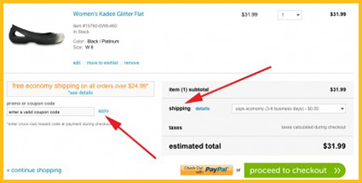
Stacking Promo Codes
For stackable online codes, in most cases (except where specifically instructed otherwise) you will enter each code one at a time, pressing "enter" after each to adjust your total balance to reflect all coupon codes.
You can double-check your work by looking at your online invoice before you pay—you should see all coupon codes reflected above your final amount owed. If one of your codes is for free shipping, then also check the "shipping" line to be sure the amount is zero
Notes:
Information and photo courtesy of Krazy Coupon Lady

Slide 28
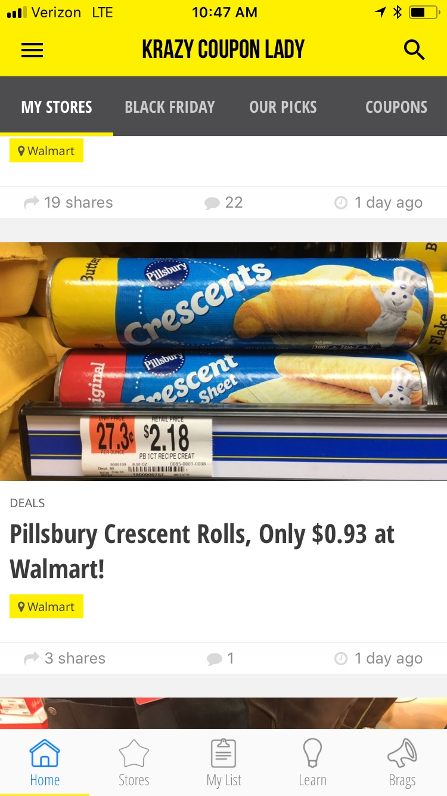
Krazy Coupon Lady
Here’s an example:
Buy 1 Pillsbury Crescent Rolls (or Grands) at @$2.18, regular price.
Use one $.50/1 printable or online coupon. Price is now $1.68
Submit one $.75 rebate via Ibotta rebate app
Final Price, $.93
Notes:
Source:

Slide 29
Another Local Example
Tillamook Ice Cream…
Stack a store coupon and a manufacturer coupon to score Tillamook ice cream for just $1.99
Regularly, this ice cream sells for $5.99+ per carton.
Notes:
I was able to find a Tillamook coupon for $1 off, then using my store/retailer coupon for $1 off, I was able to get my favorite ice cream for only $1.99.
Instructor Note: Finding something from your local stores and coupons would be good to use in teaching the concepts here.
Photo courtesy of Teresa Hunsaker from newspaper ad.

Slide 30
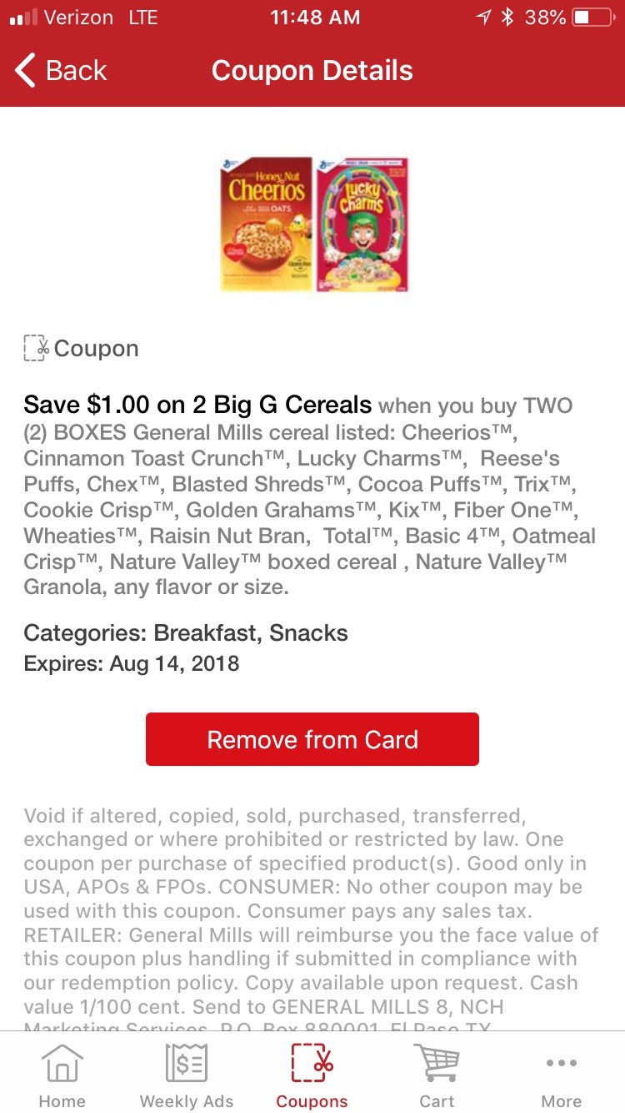
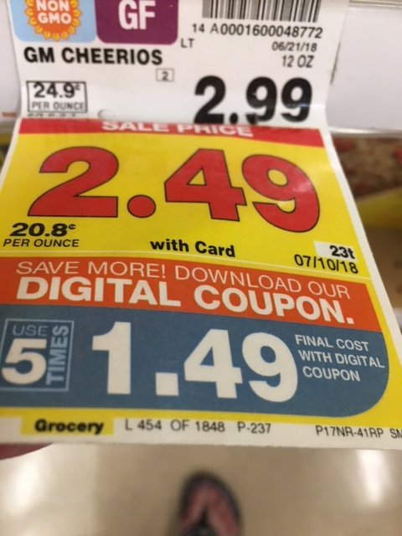
Recent Savings
Regularly…$2.99
In-store digital ad…$1.49 (Friday/Sat. only).
Bought 8 at $.99 each because they allowed ‘stacking’.
I had 4 coupons…two printed manufacturers and the others on two different phones…used my husband’s.
Notes:
Photo courtesy of Teresa Hunsaker Smiths app and Smiths store shelf label.

Slide 31
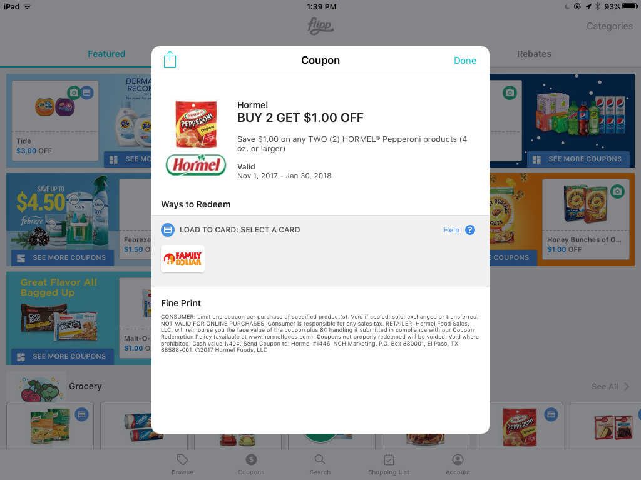
Grocery App Demo
Flipp
Notes:
Some apps allow you to load manufacturer coupons on to a store reward card. The Flipp app is one of those where there are a number of selected stores that the coupon can be attached to a store rewards card. This means you have to be set up with those stores rewards programs.
There have been times when some apps programs do not interface with some store rewards programs. When you consider the number of stores and the number of apps and the number of coupons, you can see that there might be times when there is a problem. Always check to see if the coupon was applied.
Photo courtesy of Teresa Hunsaker Flipp app on personal iphone.

Slide 32
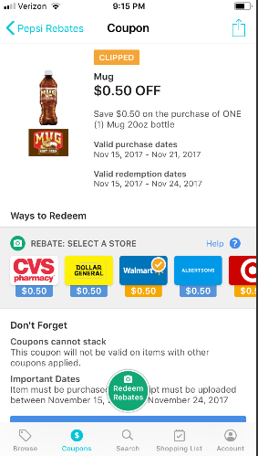
Flipp App
Notes:
Photo courtesy of Teresa Hunsaker Flipp app on personal iphone.

Slide 33
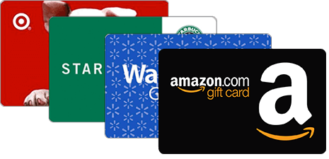
Consider Cash Back—Rebates
eBates…Earn cash back at over 2500 stores by check or PayPal, and helps you find deals/coupons. You must use your email to sign up for Ebates, then simply shop at your favorite store through the Ebates site or app.
Ebates operates on a referral program…companies pay them to direct online shoppers to their sites. Then Ebates shares those commissions with you. Then Ebates will mail you a check.
They also pay you a bonus for every time you refer someone who signs up!
Ibotta…Scan your receipt into their app after shopping. You will then get cash back for items you already purchased!
Swagbucks…lets you earn FREE gift cards for taking surveys, watching videos, shopping online and more!
TopCashback…online purchases…get access to thousands of cash back deals and coupon codes w/no minimum payout threshold; plus bonuses
Mr. Rebates
Notes:
Photo courtesy of the internet google images.

Slide 34
Common Mistakes Made
Being unrealistic in money saving expectations
Using too many apps/websites
Not taking advantage of a good sale without a coupon
Not spending enough time at it…familiarized yourself with apps, getting organized, and narrowing your scope
Forgetting to compare store brand item costs with name brand item even with a coupon
Not reading the coupon carefully…size, variety, stacking option, etc.
Not having a plan for the saving…tracking
Not utilizing ‘cash back’ options
Notes:
It is easy to get discouraged when expanding your use of online coupons and coupon codes. Avoiding these common mistakes will help make the process of expanding and maximizing websites and apps to save money a more rewarding experience.

Slide 35
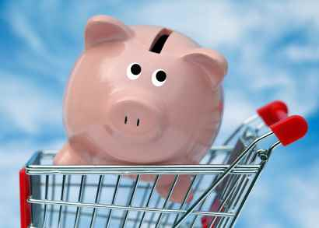
Impacts
$ saved
Savings were used for:
Pay down debt
Down payment on a house
Family vacation
Cash only for Christmas
Numbers taught
Sense of accomplishment
Example/teaching children
Giving back/Generous
Notes:
Helping save for family’s needs and priorities is a big accomplishment. Being able to be financially responsible and use shifty budgeting strategies is always a win/win.
Children and teenagers may become more frugal with their money. They also will understand the value of money.
Items found, that are relatively inexpensive or even free are bought and then donated to a family in need, or a food pantry, or a local agency.

Slide 36
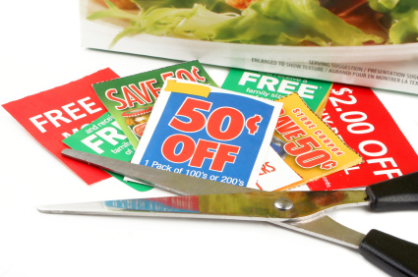
Questions?
Teresa.hunsaker@usu.edu

