Slide 1
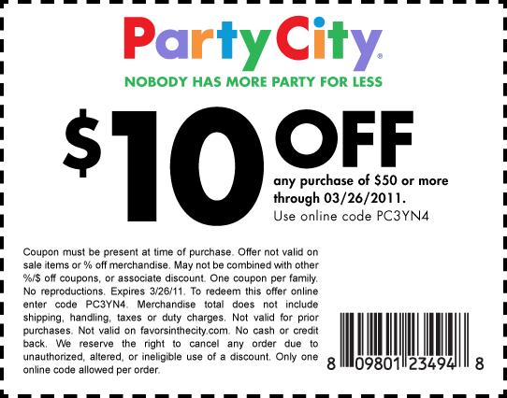
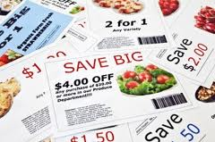
CUT IT OUT! COUPON CRAZE
Notes:
What level of couponer are you?

Slide 2
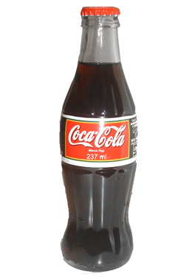
How far back do coupons go?
1894
Notes:
A clever entrepreneur, Asa Candler, a druggist, was the first to come up with coupons. He had purchased the formula for Coca-Cola and gave out individual handwritten coupons for a free glass of this new fountain beverage.

Slide 3
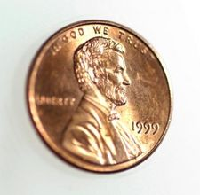
1st grocery coupon
1895
Notes:
The next year, another successful businessman, C.W. Post, began to promote his new health cereal. He offered a one cent coupon, good towards the purchase of his new product Grape Nuts.

Slide 4
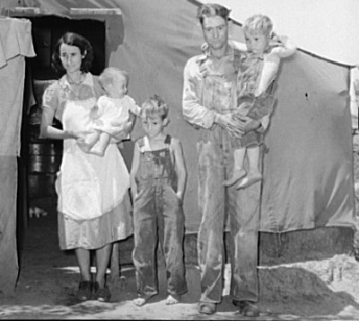
1930s
Notes:
1930’s- widely used because of the depression

Slide 5
1957
Nielson Clearing House was developed
Notes:
1957- the Nelson Clearing House was developed to assist with coupon redemption. Grocery stores were not getting reimbursed.

Slide 6
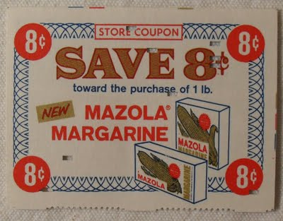
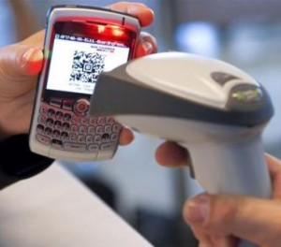
Coupons Today… They’ve come a long way baby!

Slide 7
76% Newspaper
59% E:mails & Coupon alerts
33%
Internet search

Slide 8
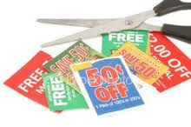
89% use coupons
$3 Billion saved each year
Notes:
Source: Promotion Marketing Association Coupon Council

Slide 9
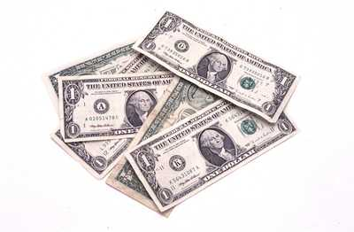
$70 Billion coupons offered
Only 4.5 Billion are redeemed
Only 6%
are redeemed
Notes:
70 billion of coupon saving offered by manufacturers each year, only $4.5 billion are redeemed by consumers. That's barely 6%

Slide 10
Coupon savings
Paying debt
Long-term savings
Emergency fund
Only
7% splurge

Slide 11
96%
Would still use coupons if they won the lottery
Notes:
According to a survey by RedPlum of more than 23,000 shoppers 96 percent said they would still use coupons even if they won a big lottery. People have become more and more focused on being value-minded since the onset of the recession.

Slide 12
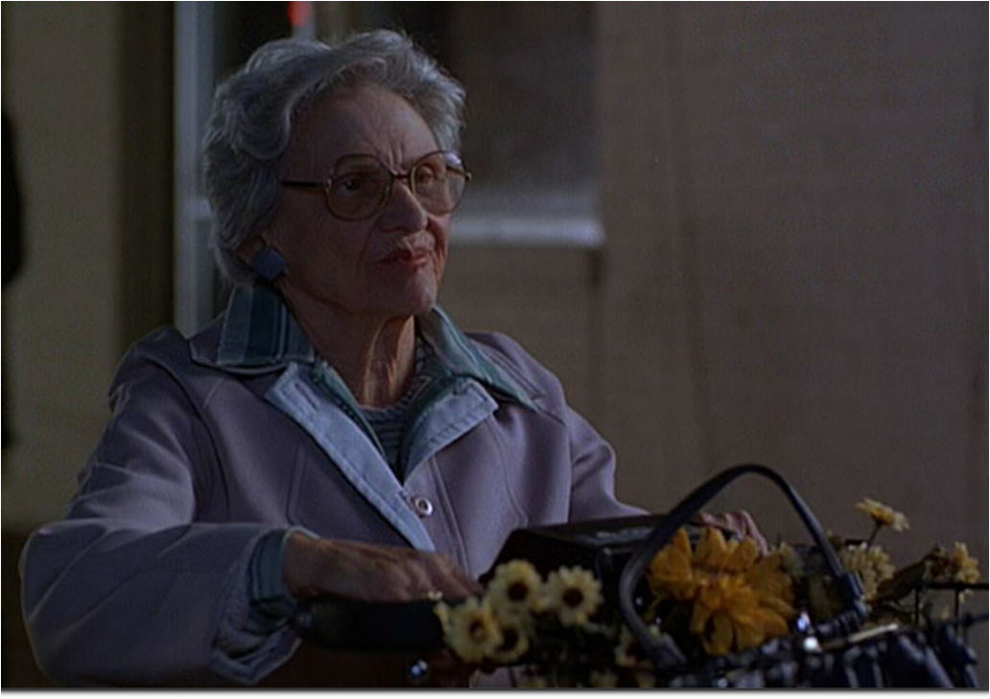
Who uses coupons?

Slide 13
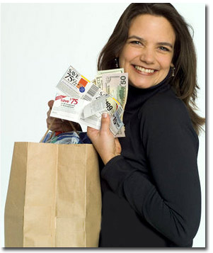
AGES: Age 18-24 – 65% Age 25-34 – 71% Age 35-44 – 77% Age 45-54 – 80% Age 55-64 – 81% Age 65+ - 80%
Notes:
Thanks partly to on-line coupons, coupons are now cool. Source: National Coupon Council

Slide 14
INCOME:
Under $25,000 74%
$25-50,000 – 80%
$50-75,000 – 77%
$75,000 – 76%

Slide 15
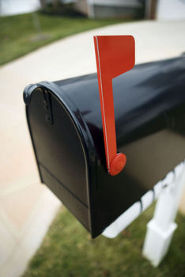
Where Do You Find Coupons?
Sunday
Newspaper
In the Mailbox
Notes:
Sunday Newspaper or in your mailbox
If you already get the Sunday newspaper great- if not, think about if it is worth the cost to do so.
Grocery Guru
Also- as you have probably noticed, you get some free ads in the mail

Slide 16
Tuesday Tooele Transcript
Notes:
P& G BrandSaver
Smart Source
Red Plum
The Parade magazine – often has buy one, get one free
Three major coupon inserts available through newspaper and/or mail:
Tooele
Transcript- Smart Source runs in Tuesday papers

Slide 17
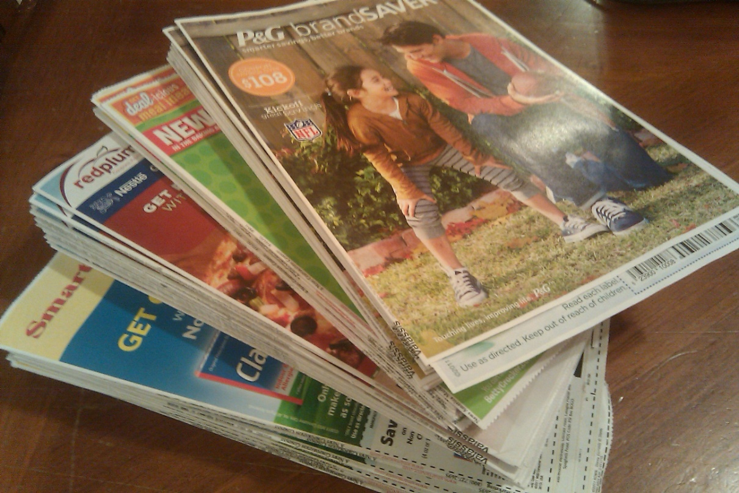
Preview Sunday Inserts
New Products –
may not be what you need
Photo credit: savvyalbertsonslady.com

Slide 18
Tribune & Deseret News have same coupons 4 newspapers a week
Photo credit: utahdealdiva.com

Slide 19
Magazines
Notes:
Magazines - coupons

Slide 20
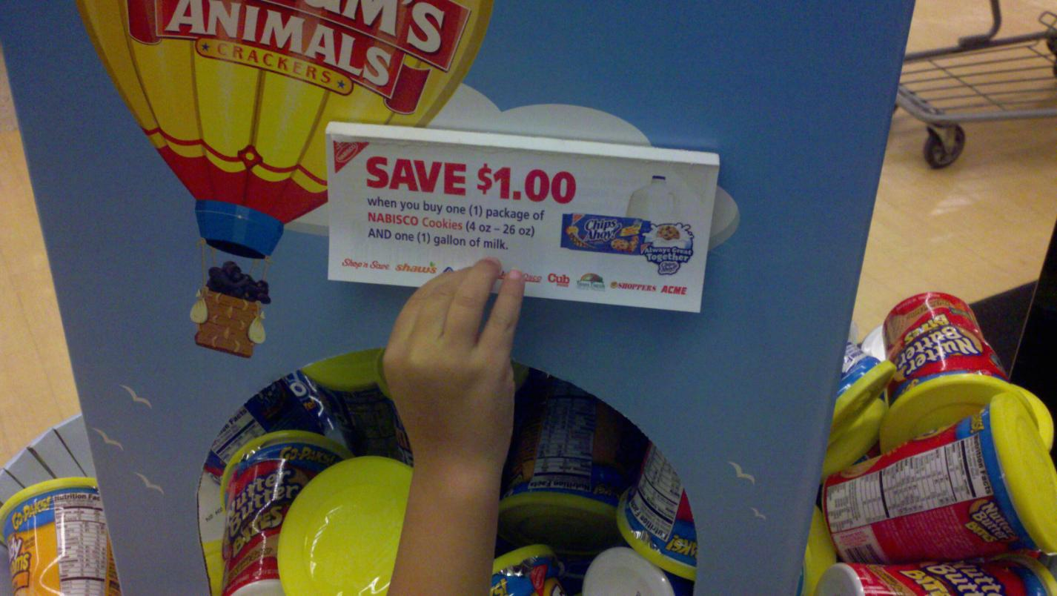
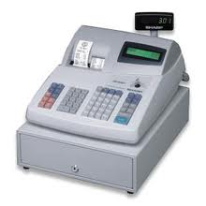
Tear sheets
Printed with cash register receipt
(Catalinas)
Notes:
Printed with cash register receipt – also known as catalina coupons – you can use these on your next purchase
In most cases Catalinas cannot be combined with other manufacturer’s coupons, unless they are specifically categorized as store coupons
Grocery Store (Shelf Display unit)

Slide 21
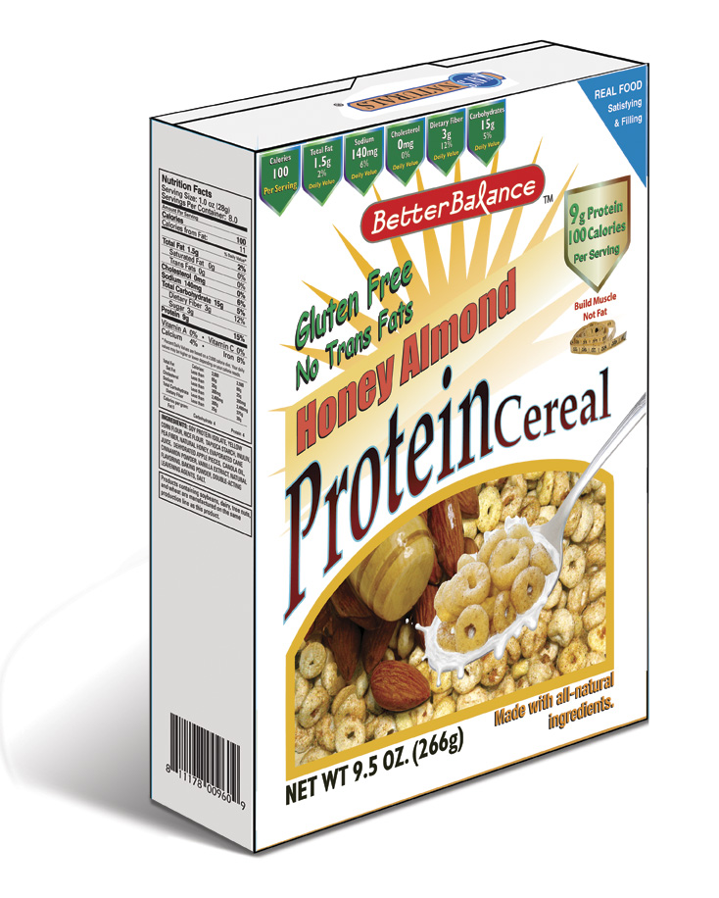
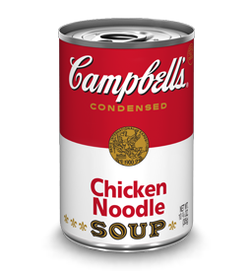
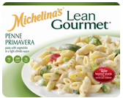
Product Packages
Manufacturers
websites
Notes:
Manufacturers web sites
Product Packages

Slide 22
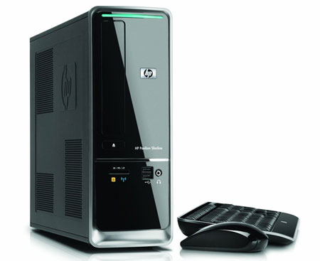
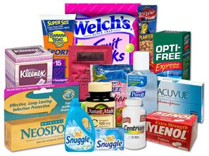
With Free Samples
On the internet
Notes:
Internet
Samples

Slide 23
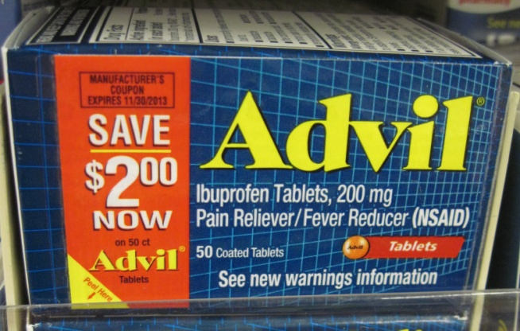
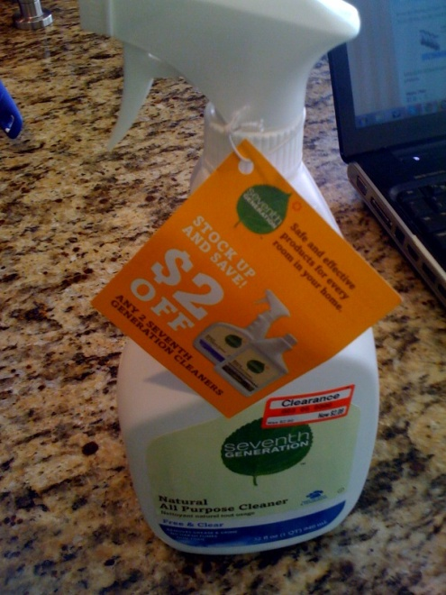
Peelie
Blinkie
Hangtag

Slide 24
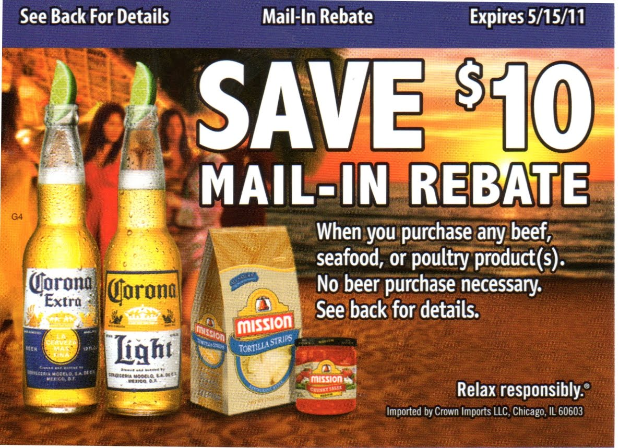
Beer Rebates
http://www.youtube.com/watch?v=NZM1Z4ig-l8

Slide 25
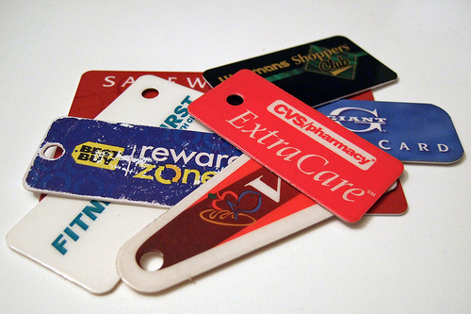
Store Loyalty Card
Scan to get discounts & customized catalinas

Slide 26
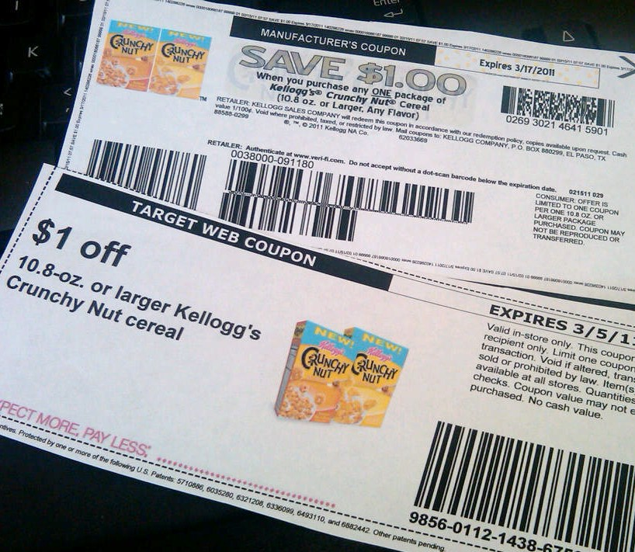
Stacking Coupons
Manufacturers
+
Store

Slide 27
Stacking Savings
Found $5 Catalina on ground near trash (used to buy paper towels- FREE)
In store ad- $20 Prevacid (normally $23.97)
$10 Register Savings for $20 spent on certain products- Prevacid included
Normally would pay $23.97 for prevacid
Savings- $13.97

Slide 28
Bring coupon policy
Problems? Ask for a manager

Slide 29
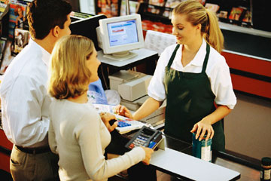
Dealing with Cashiers & other Shoppers
Plan some extra time

Slide 30
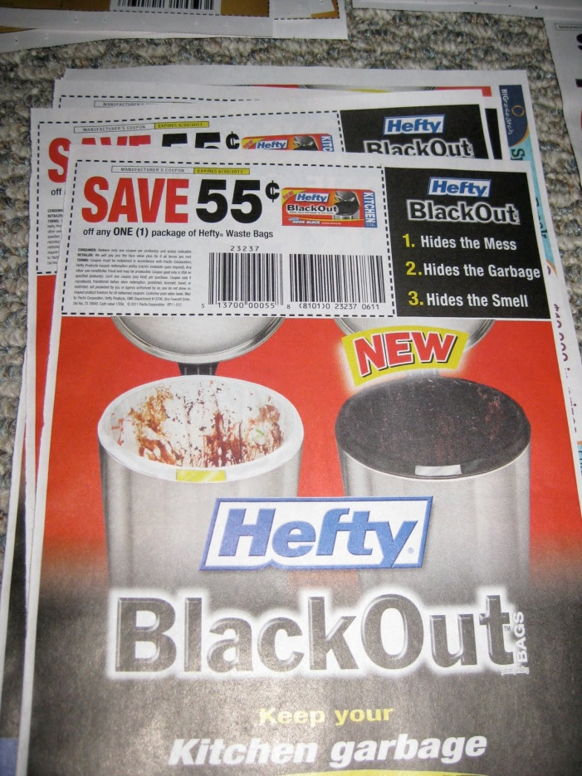
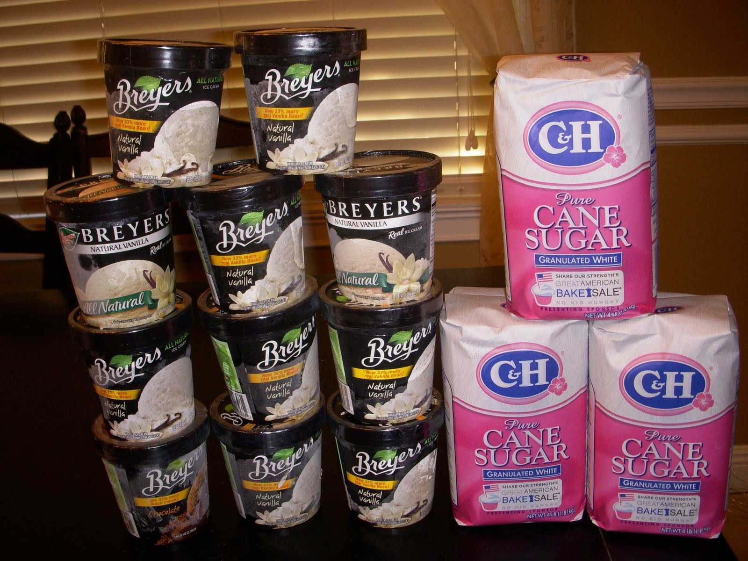
Multiple Transactions
Check store policy

Slide 31
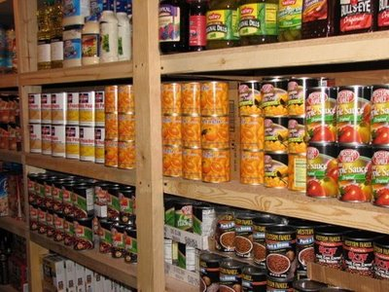
Good way to build up food storage OR donate
Notes:
Food storage

Slide 32
DOUBLE-AD TUESDAYS
Shopping list with coupons to
Print or send to Smartphone

Slide 33
Weekly on-line coupons
30 day deals
Printable on-line coupons
Competitors Price Match

Slide 34
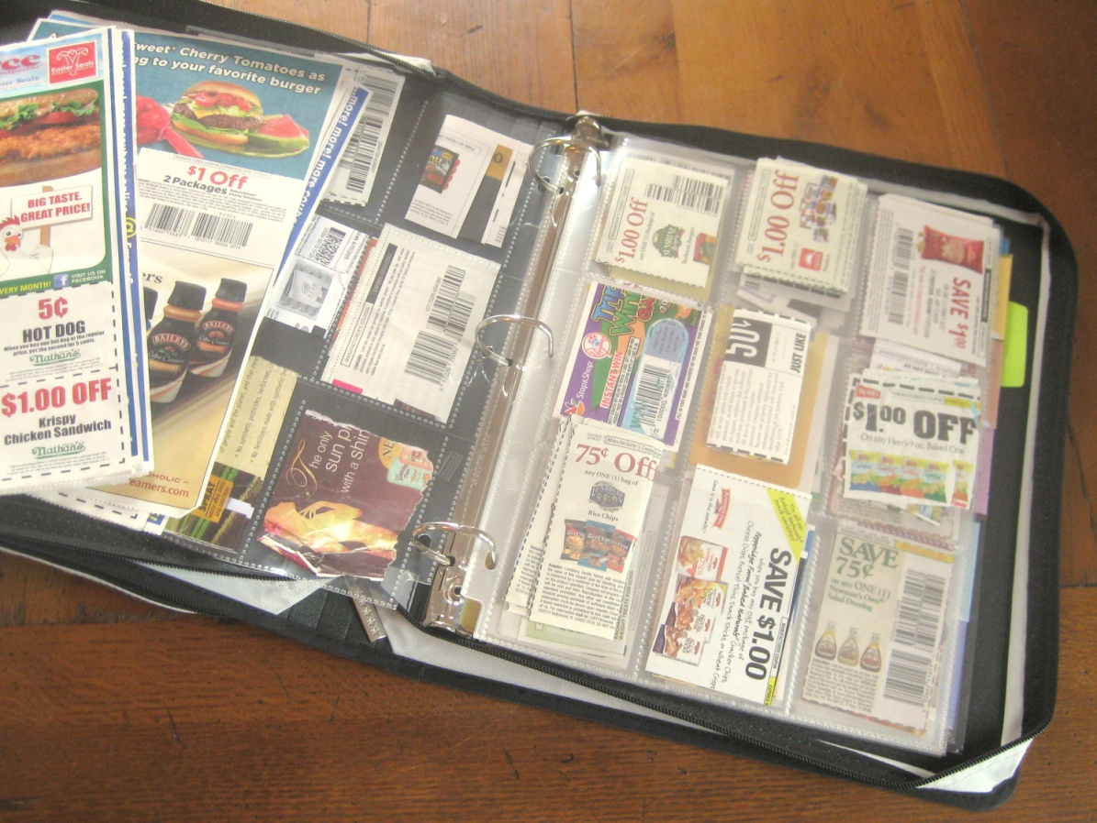
Get organized
What works for you?
Notes:
NEED TO REWORD – SOURCE:
There are lots of ways to organize coupons; the key is to find the approach that works best for you. Three options to consider:
Clipping out all coupons
Clipping out just the coupons that you intend to use
Leaving the coupon inserts intact, and clipping coupons on an "as-needed" basis
Whichever approach you choose, there are several things that you can do to ensure that your coupons remain neat and accessible:
Develop a filing system. Many couponers organize their coupons by grocery category--dairy, frozen foods, deli, etc. – but it's not the only way to go. Find a filing system that works for you--by aisle, by expiration, etc. – and put it into action.
Find a container to hold your coupons. Use a shoebox, a storage container, a coupon binder, a coupon wallet or a recipe box – it doesn't matter what you choose – but it's important to have a landing spot for all of those coupons.
File coupons the same day you get them. Okay, so you may not always have time to file your coupons right away, but try to file them as soon as you can. This will prevent them from getting lost, and save you the hassle of having to sort through a big mess of coupons all at once.
Purge regularly. Expired coupons won't save you money, so don't let them hog space in your coupon file. Set a schedule for purging expired coupons, and stick to it.
www.frugalliving.aboutcom.

Slide 35
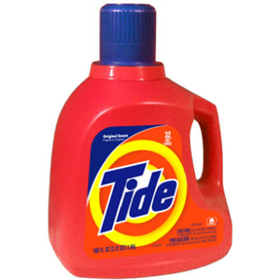
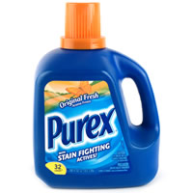
Be open to trying other Brands

Slide 36
Don’t buy items you wouldn’t ordinarily buy

Slide 37
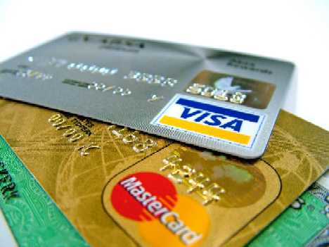
Are you really saving?
Photo credit: loancredit.org

Slide 38
Other areas to save
Travel

Slide 39
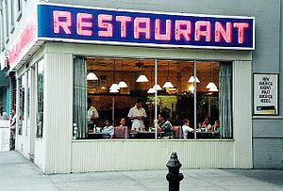
Eating out

Slide 40
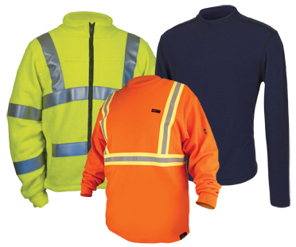
Clothing & Gifts

Slide 41
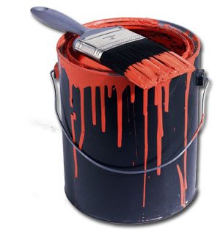
Household & Automobile

Slide 42
And much, much more

Slide 43
Starting a Coupon Club
Meet 1st Thursday every month
Feb 2 – 6:30 – 7:30 p.m.
Getting organized
(bring your binders, folders, etc.)
New to couponing?
Just bring you!
Want to share?
Leave the kids home please

Slide 44
What tips do you have?

Slide 45
Want to learn more? Free tutorials, videos & study guides
http://www.cuckooforcoupondeals.com
http://coupondivas.com/videos.html
http://www.couponmom.com/tutorials-416
www.Youtube.com

Slide 46
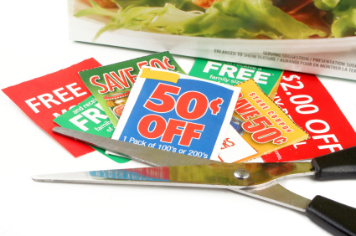
Questions?

